Slide 1

Capstone Project
Loan Default Prediction
Presented By –
1. Dhananjay Mishra
2. Mumal Tanwar
3. Neha Nirwan
Batch Number – DSP03 (Jaipur)

Slide 2
Index
Business Problem
Data Processing
Data Visualization
About Dataset
Machine Learning

Slide 3
Business Problem
LOAN APPLICATION
LOAN APPLICATION REJECTED
LOAN APPLICATION ACCEPTED
This is the region where we need to work.
DEFAULTER
NON-DEFAULTER

Slide 4
About The Dataset
The dataset contains more than 8 lakhs of records and 73 different variables
72 independent variable and 1 dependent variable names default_ind which is having 2 different values 0 and 1
0 -> Non - Defaulter
1 -> Defaulter

Slide 5
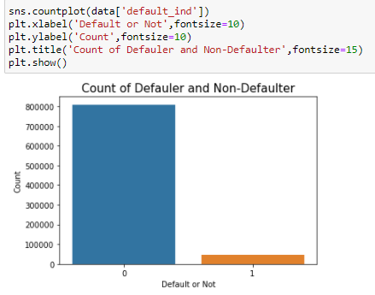
Data Visualisation
Defaulters or Not

Slide 6
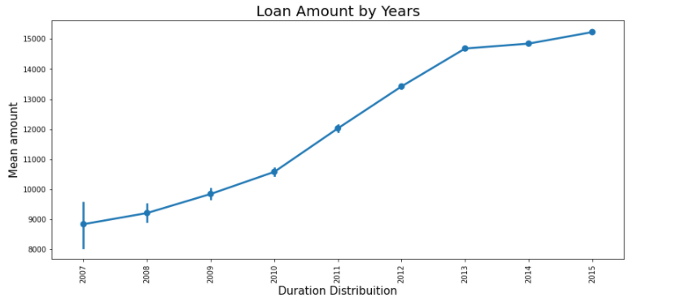
Loan amount given over each year

Slide 7
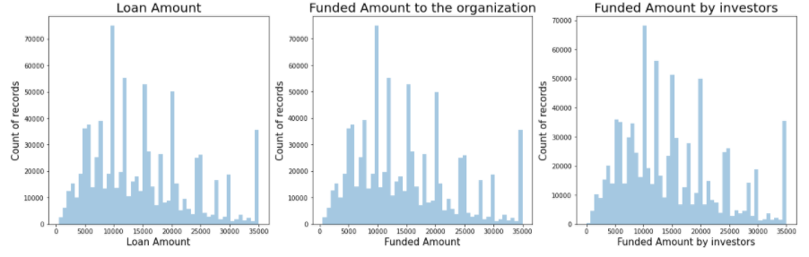
Distribution of Loan amount, funded amount and funded amount by investors

Slide 8
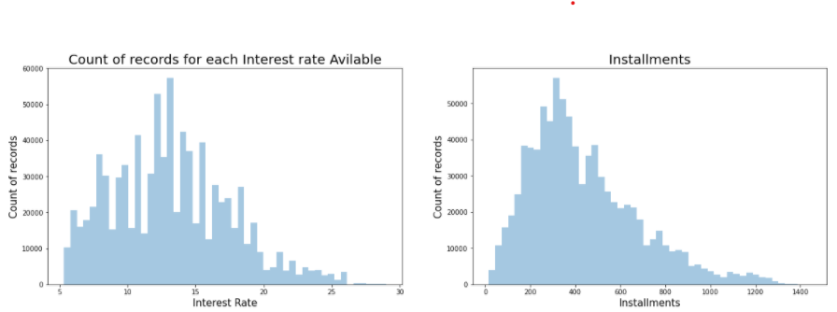
Distribution of interest rate and the instalment

Slide 9
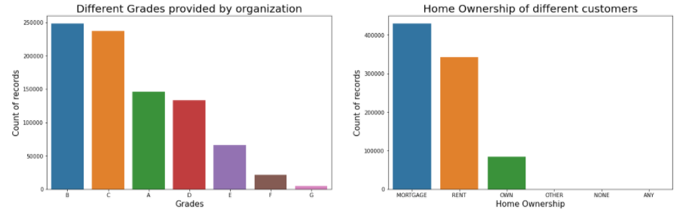
Count to the grades provided by organization
Count to the home ownership of each record

Slide 10
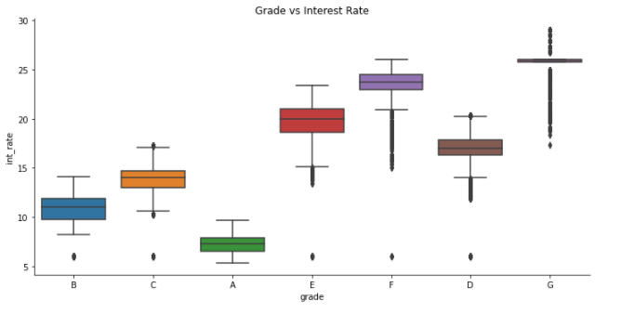
Interest rate on basis of grade

Slide 11
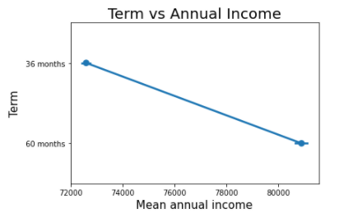
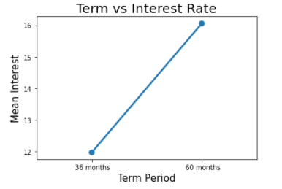
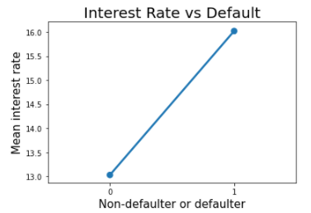
Term period vs annual income
Term period vs interest rate
Interest rate on the basis of default or non-default status

Slide 12
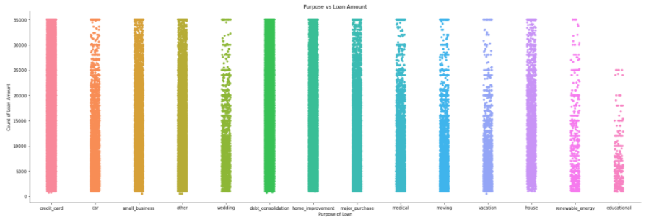
Purpose of Loan and loan amount

Slide 13
Data Processing
Handling Null Values
Cleaning date type variables
Removing unnecessary variables
Label encoding

Slide 14
Handling Null Values
Check for the null values
No null values present
Null values present
Less than 50% null values
More than 50% null values
Replace using different method
Delete the variable

Slide 15
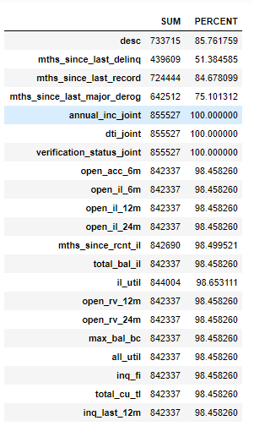
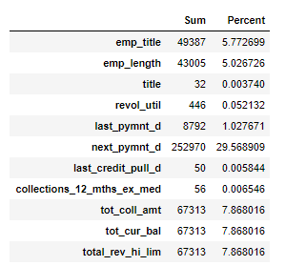
There are two scenarios
Where null values are more then 50%
Where null values are less than 50%

Slide 16

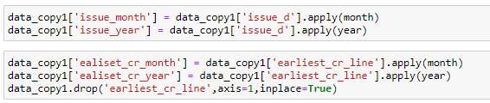
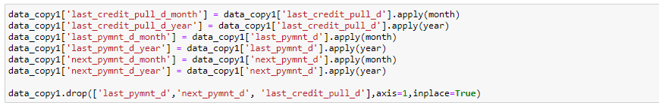
Cleaning Date Type Variables

Slide 17
Removing Variables

Slide 18
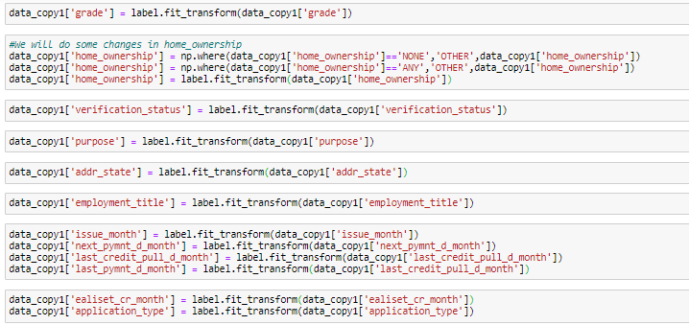
LABEL ENCODING

Slide 19
Machine Learning
Logistic Regression
Decision Tree
Random Forest
KNN
SVM
XG Boost

Slide 20
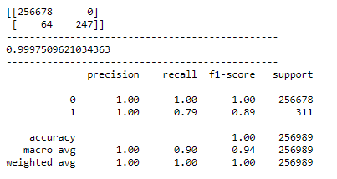
Logistic Regression

Slide 21
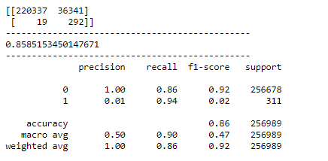
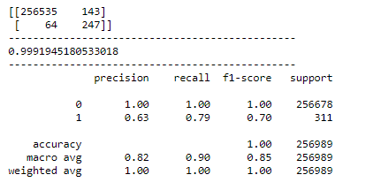
Decision Tree
BEFORE TUNNING
AFTER TUNNING

Slide 22
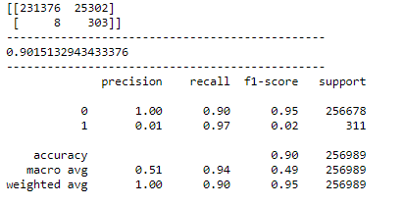
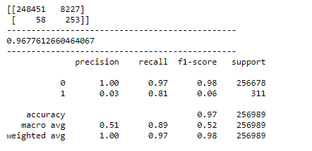
Random Forest
Before Tuning
After Tuning

Slide 23
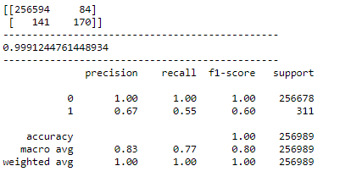
KNN

Slide 24
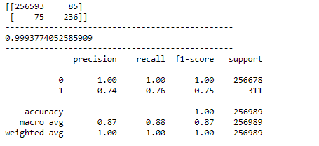
SVM

Slide 25
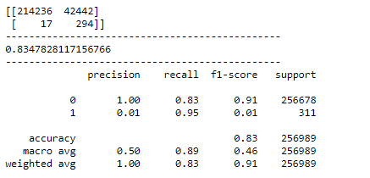
XG Boost

Slide 26
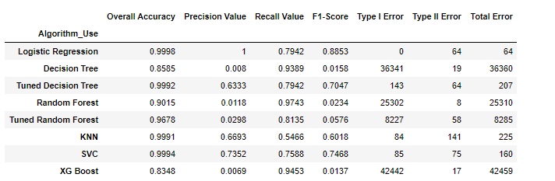
Comparison Table

Slide 27
Conclusion
There is not one variable which will decide whether the customer will be defaulter or not
Loan amount is varying very much over these years
Interest Rate, Term period, Annual income are very much related
Grade and interest rate are very much correlated

Slide 28


