Slide 1
JavaScript Juggernauts
Day 9
July 29th, 2016

Slide 2

This will soon be you…
JavaScript Juggernauts.

Slide 3
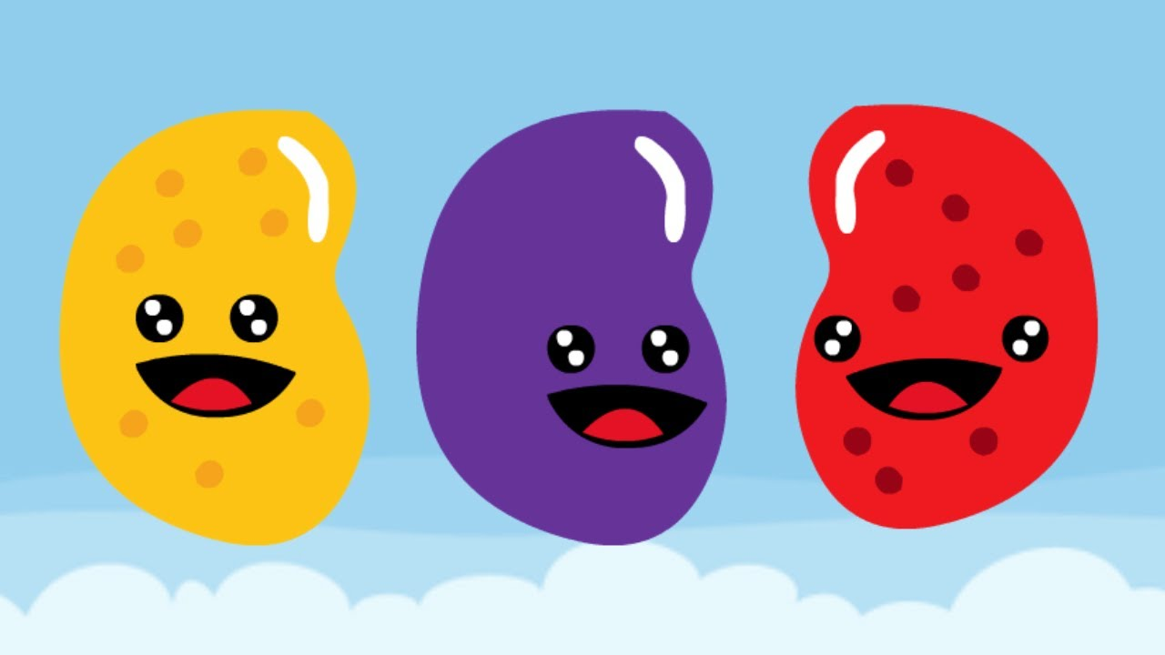
But right now…
Maybe feeling like
JavaScript Jellybeans.

Slide 4
Transformation to Come
HANG IN THERE!

Slide 5
Today’s Class

Slide 6
Objectives
In today’s class we’ll be covering:
JavaScript Functions
JavaScript Objects
Building Simple JavaScript Applications

Slide 7
Functions

Slide 8
> YOUR TURN!!
Activity: 25-LoopTV | Suggested Time: 10 min
Code Dissection: Array Building
Open loop-tv-unsolved.html in your browser.
Then, with a partner, fill in the missing comments for each line of code by opening the file in Sublime.
Make sure both of you can fully explain what each line means.
Be prepared to share with the class.

Slide 9
Demo Time
Instructor: Demo
(SuperHeroLogging_NoFunctions.html | 26-SuperHeroLogging)

Slide 10
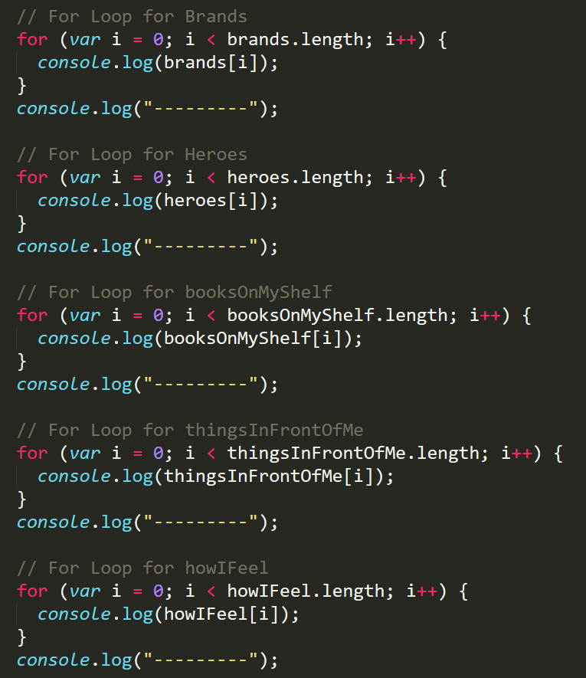
Mondo Repetitive…
Who wants to maintain this??
Hint: No one.

Slide 11
Demo Time
Instructor: Demo
(SuperHeroLogging_WithFunctions.html | 26-SuperHeroLogging)

Slide 12
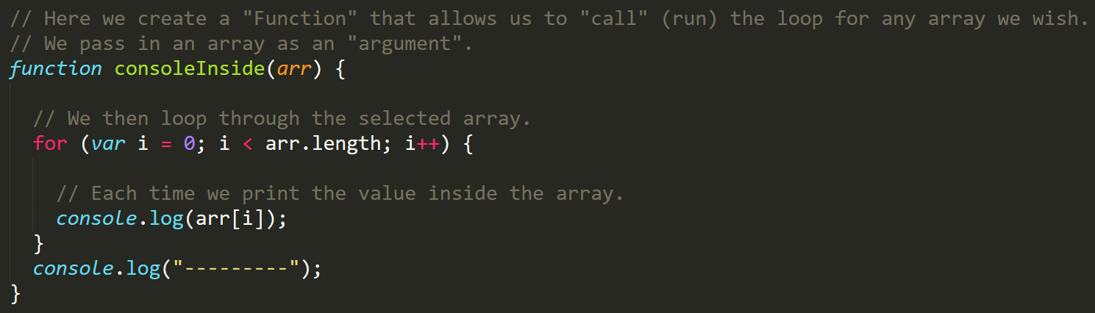
Much Better with Functions!
Squeaky Clean Code.
Minimal repetition

Slide 13
> YOUR TURN!!
Activity: 27-MyFirstFunctions | Suggested Time: 20 min
Code Creation: Function Building
Working in pairs and using class activity 27–fill in the missing functions and function calls.
Note: Try to finish all four functions if you can, but don’t be distressed if you only get 1 or 2. The important thing is that you get at least one function fully done.
HINT: Look back to the previous example if you need help.

Slide 14
Objects

Slide 15
Demo Time
Instructor: Demo
(GoodArray.html | 28-GoodArray)

Slide 16
Demo Time
Instructor: Demo
(JoanOfArcArrays.html | 29-JoanOfArcArrays)

Slide 17
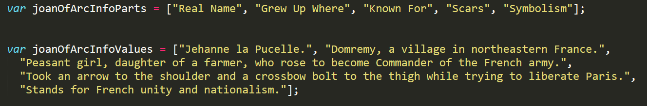
Associated Data ==/== Arrays
Relating two separate arrays is not fun.

Slide 18
Demo Time
Instructor: Demo
(gandalf-the-grey-objects.html | 30-GandalfTheGreyObjects)

Slide 19
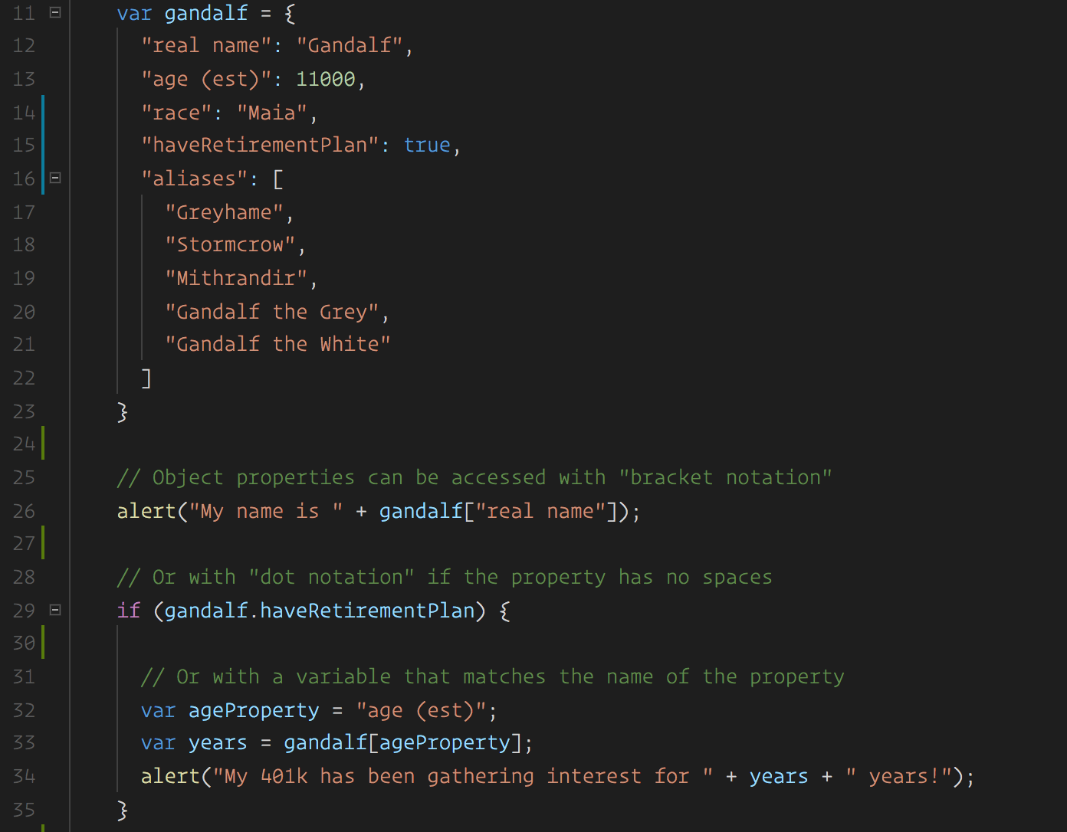
Gandalf – The Object
Gandalf’s “properties” and “values” are associated in object form, making it easy to recall specific data.

Slide 20
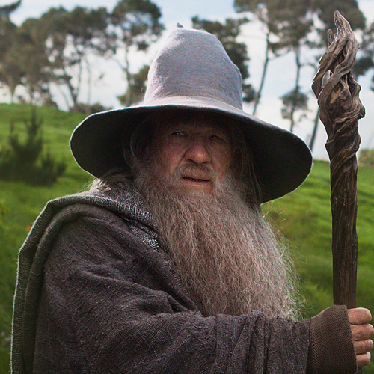
Objects Visualized
var gandalf
=
{
“real name”
:
“Gandalf”
,
“age (est)”
:
11000
,
“race”
:
“Maia”
}
This is Gandalf. According to code… Gandalf is an Object.

Slide 21
Objects Visualized
var gandalf
=
{
“real name”
:
“Gandalf”
,
“age (est)”
:
11000
,
“race”
:
“Maia”
}
These are Gandalf’s properties (like descriptors).

Slide 22
Objects Visualized
var gandalf
=
{
“real name”
:
“Gandalf”
,
“age (est)”
:
11000
,
“race”
:
“Maia”
}
These are the “values” of Gandalf’s properties.

Slide 23
Objects Visualized
var gandalf
=
{
“real name”
:
“Gandalf”
,
“age (est)”
:
11000
,
“race”
:
“Maia”
}
Thus: gandalf[“race”] = “Maia

Slide 24
Demo Time
Instructor: Repeat Demo
(gandalf-the-grey-objects.html | 30-GandalfTheGreyObjects)

Slide 25
> YOUR TURN!!
Activity: 31-MyFirstObject | Suggested Time: 15 min
Code Dissection / Creation: Basic Objects
With a partner, spend the next few moments studying the code for activity 31.
Then, write code below each comment to log the relevant information about the provided car object.
Bonus: If you finish early, create a brand new object of your own. Slack out a snippet of the code to the class when you are done. Be Creative!

Slide 26
Demo Time
Instructor: Demo in Browser
(carGame_Solved.html | 32-CarGame)

Slide 27
> YOUR TURN!!
Activity: 32-CarGame | Suggested Time: 20-30 min
Code Creation: Run that Car!
Using the code from the previous activity as a starting point, create a complete application such that:
Users can enter keyboard input (letters).
Each of the car's methods are assigned to a key.
When the user presses a key it calls the appropriate function.
These letters also trigger a global function called reWriteStats() that logs the car’s make, model, color, mileage, and isWorking status to the console.
HINT: You will need to use the document.onkeyup() function to collect input from the user's keyboard.

Slide 28
Scope & Stuff
Everyone Do: Scope & Callbacks

Slide 29
> YOUR TURN!!
Activity: 34 - Question Game | Suggested Time: 45 min
Extra Activity: Trivia Game
With whatever class time remains, complete the following activity in pairs.
Starting from a blank HTML file:
Create an object with 10 questions. The object should be structured like this: q1: [“QUESTION”, “ANSWER”] q2: [“QUESTION”, “ANSWER”]
Then create code that will ask the user questions, one by one. The user must answer by hitting t (for true) or f (for false).
Check the user’s answer against the correct answer, and provide them with an alert telling them if they are right or wrong.
Bonus: Keep track of the user’s score.
Hint: Don’t worry about having DRY code to start with. Just focus on getting working code first.

Slide 30
Questions

