Slide 1
React, Gently
Unit 19, Day 2
12/05/2017

Slide 2
Roadmap for Learning
Paradigm / Concept | Specific Technology using the Paradigm | Technology-Specific Concepts
CSS grid system | Bootstrap (12-column grid) | .container .row .col
Component-based UI | React.js | JSX render() states and props react router

Slide 3
Welcome to ReactJS!!!

Slide 4
Resources To Use:
Facebook React Official Documentation https://facebook.github.io/react/
Code School React Tutorial https://www.codeschool.com/courses/powering-up-with-react
EggHead.io
Build With React Tutorial http://buildwithreact.com/tutorial
Just YouTube things…
Just read everything..

Slide 5

So… What is React?
React is an open-source Javascript Library developed by Facebook specifically for the task of developing User Interfaces.
It was developed for the purpose of building large apps with data that rapidly changes over time.
It relies on a component-based architecture. Each element of the UI is treated as sub-components of larger components.

Slide 6
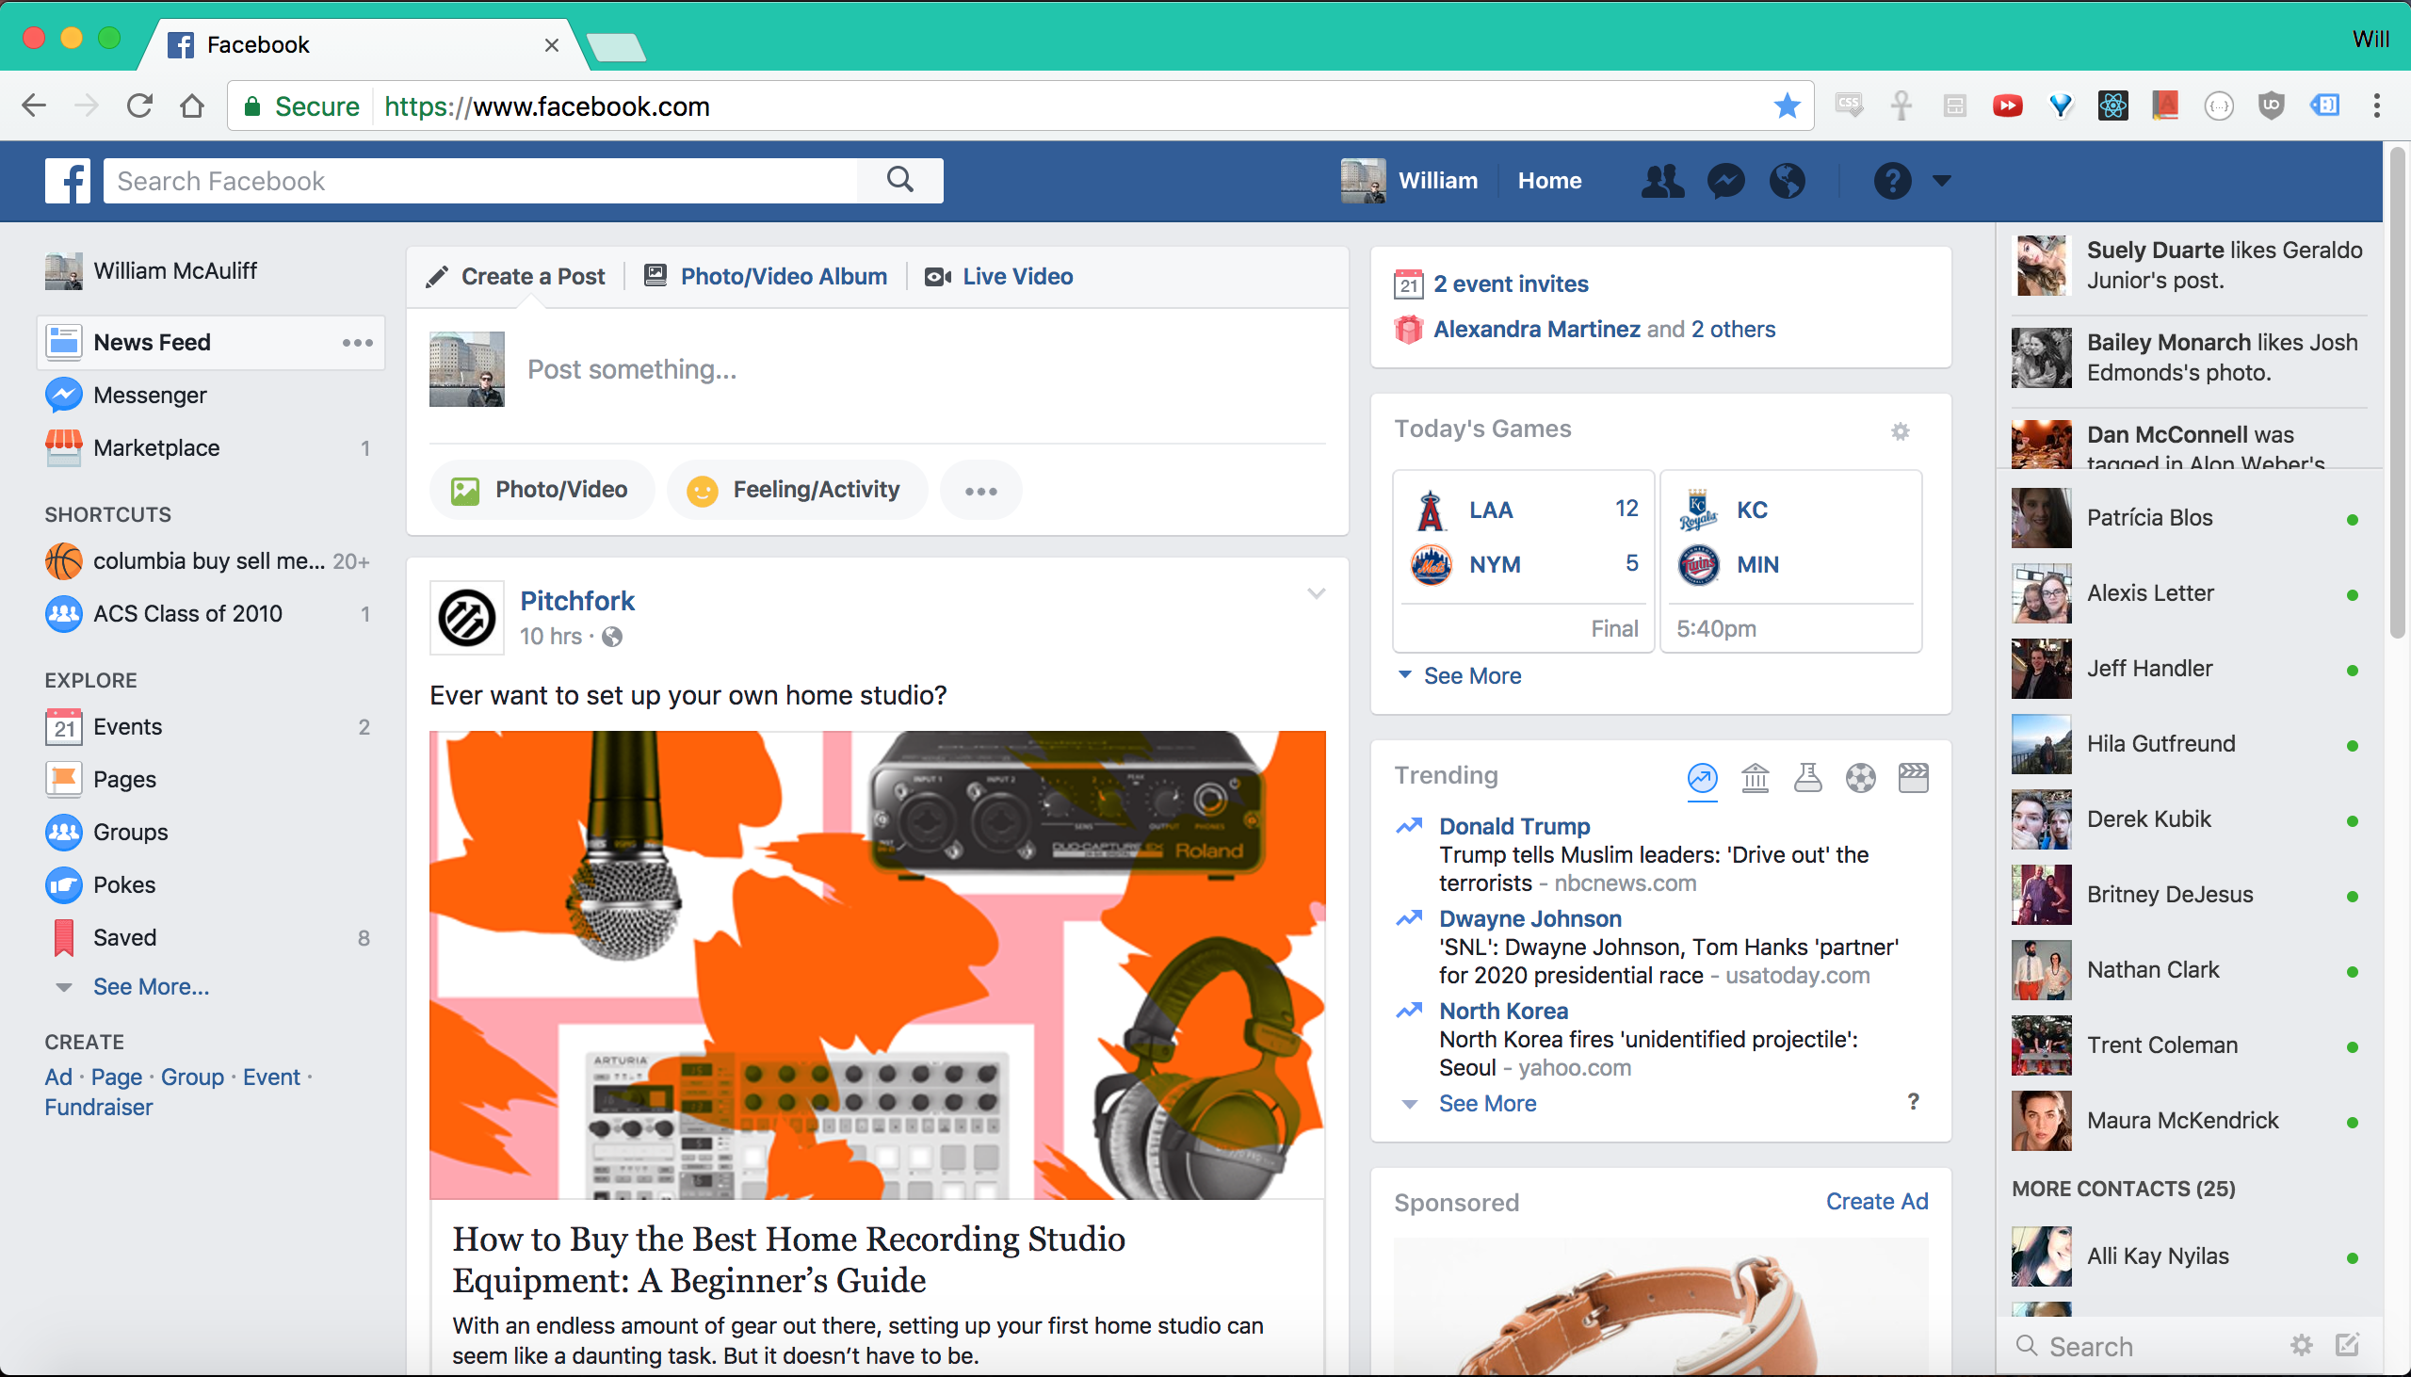
Facebook’s UI Complexities
Facebook’s website buzzes with interactive options, live-updating data, and tightly interacting elements. This poses a challenge to simple DOM manipulation strategies.

Slide 7
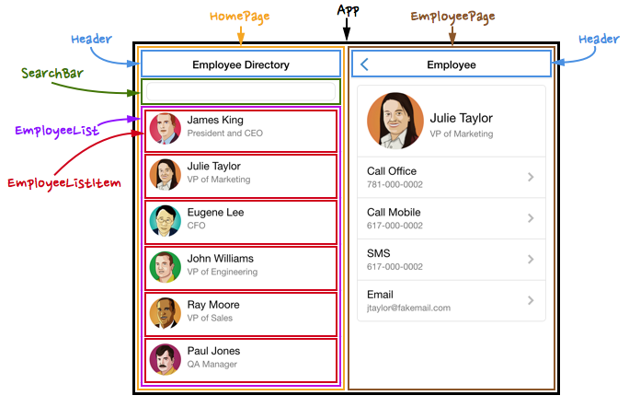
The Concept of Components
Using React, UI elements are broken down into re-usable sub-components.
Each sub-component behaves in a way that it is fully contained

Slide 8
Power of Components!
Why separate the elements of a UI into Components?
Components allow us to logically decompose a UI into different parts.
Components can easily be re-used in various points in the application without needing to be re-coded.
Components can be more easily tested. (i.e. having one re-usable component means only one UI element needs to be tested).
For complex applications each of these can be critical in finding bugs and saving time.

Slide 9
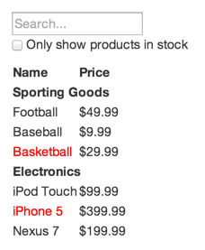
From Mockup to Components

Slide 10
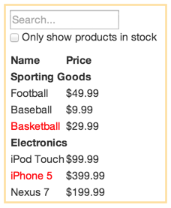
From Mockup to Components

Slide 11
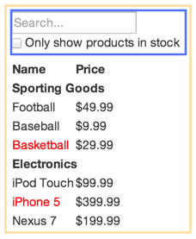
From Mockup to Components

Slide 12
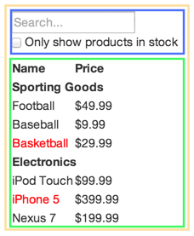
From Mockup to Components

Slide 13
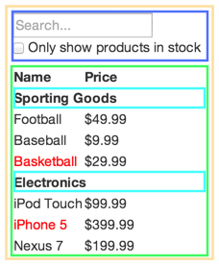
From Mockup to Components

Slide 14
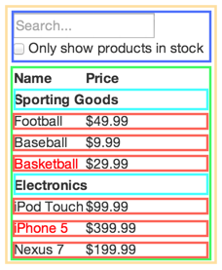
From Mockup to Components

Slide 15
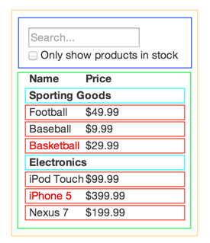
From Mockup to Components

Slide 16
Data Shifting Applications

Slide 17
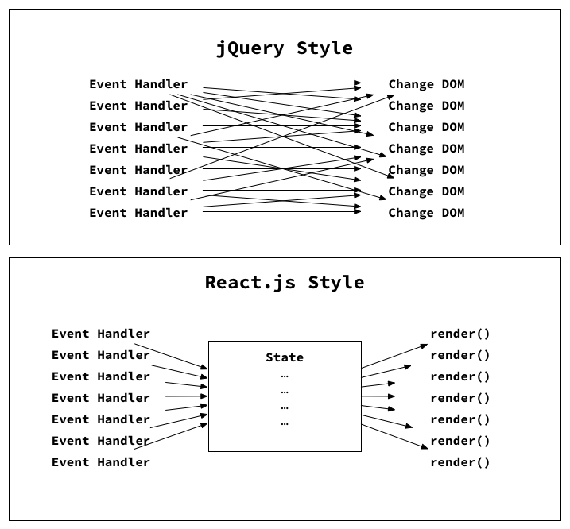
Why Can’t I jQuery Everything?
Jquery
In jQuery, our application’s state and UI are updated independently of each other. Without an organization structure, code quickly become a series of erratic DOM manipulations.
React
In contrast, when working with React, we never update the DOM ourselves. Instead, whenever some part of our application’s state changes, React efficiently updates the DOM for us to reflect this. Our application’s UI is a pure function of its state.
Notes:
file:///Users/willmcauliff/Desktop/Bootcamp/FullStack-Lesson-Plans/01-Class-Content/06-ajax/02-Homework/Solutions/hw.html

Slide 18
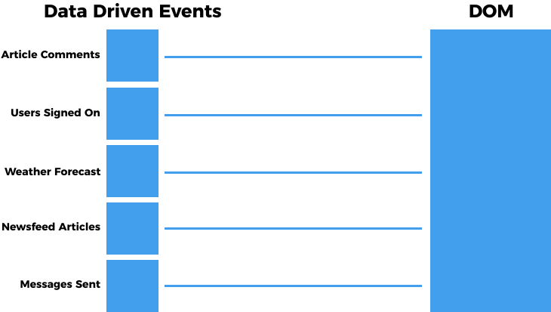
Rapid Data Changes: Option #1 –jQuery
JavaScript is Fast.
But whenever we update the DOM, the browser needs to recalculate the CSS, update the layout, and repaint the web page...
This can be a slow process in comparison.

Slide 19
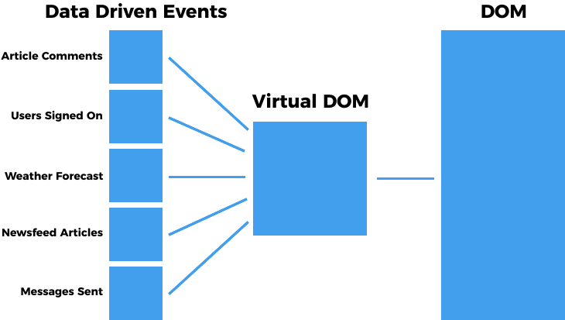
Rapid Data Changes: Option #1 –jQuery
React’s Virtual DOM serves as an intermediary and avoids unnecessary trips to the DOM

Slide 20
Build Tools

Slide 21

Babel
Babel is a JavaScript transpiler. It allows us to transform next generation JavaScript code (ES6, ES7, ES8) into ES5 JavaScript code that most browsers will understand.

Slide 22

Webpack
webpack allows us to us to modularize our front end code, then packages all of those modules into a bundle to be loaded by the browser.
webpack also allows us to apply various transformations on our assets through the use of plugins, such as Babel.

Slide 23
Digging into Docs

Slide 24
Documentation Immersion
1. Install yarn and create-react-app
2. Collaborate on research questions.

