Slide 1
CompSci – Data Structures
Day 69
January 13th, 2017

Slide 2
Outline
Project Check-In
Computer Science Context
Big O Notation
Data Structures
Arrays
Stacks / Queues
Linked Lists
Dictionaries
Hash Tables
Sets
Binary Trees and Binary Search Trees
Graphs

Slide 3
Project Check-In

Slide 4
Computer Science Context

Slide 5

Welcome To…
“Computer Science Fundamentals”

Slide 6
Remember…
Computer Science “Fundamentals”
Isn’t about “easy” computer science stuff.
Rather, it’s about the “fundamental” concepts that underlie all of the work we’ve been doing to date.
The biggest takeaway is to understand that there are different tools to increase computational efficiency.

Slide 7
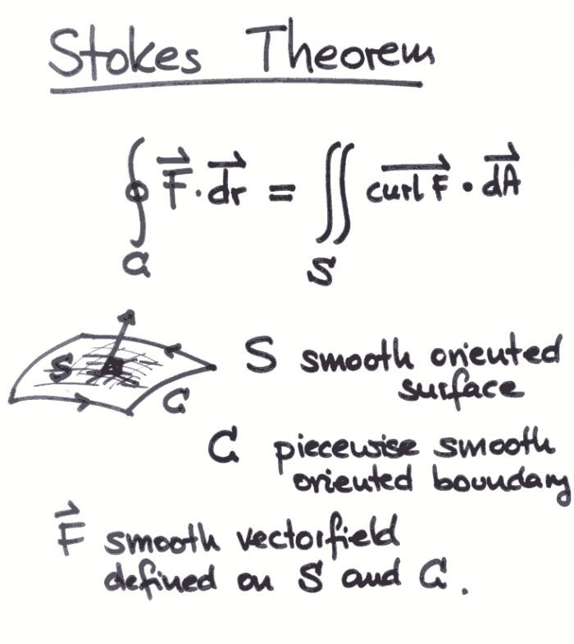
“Fundamentals”
Remember this stuff?
Yeah. Me neither.

Slide 8
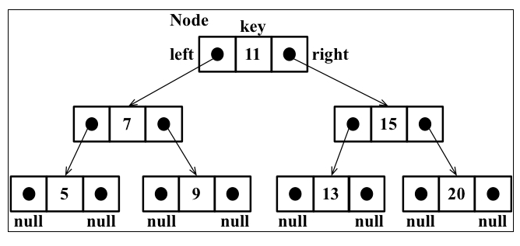
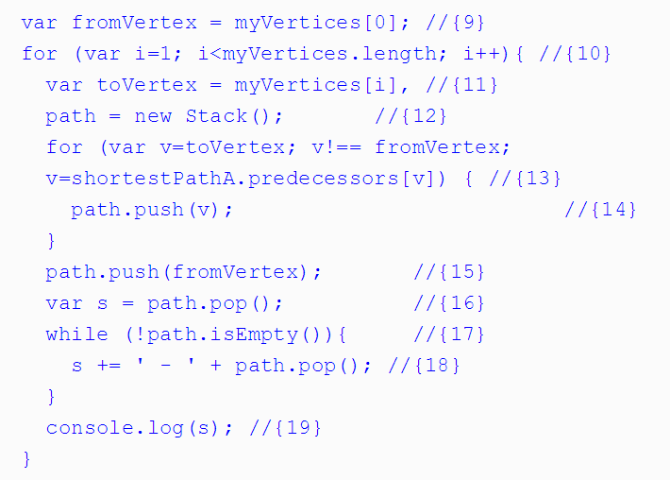
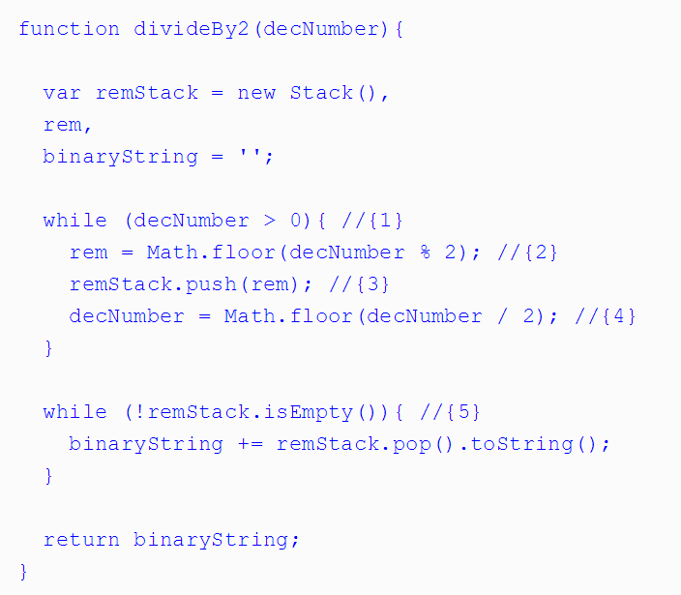
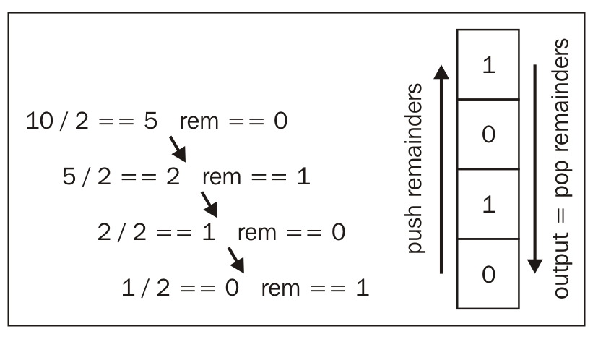
It gets hairy… and scary.

Slide 9
Why Cover This?
These concepts sometimes appear in coding interviews
When inheriting large code-bases you may be tasked to “optimize” code efficiency.
The computational challenges here forces you to deepen your understanding.

Slide 10
Bottom Line
My goal is to give you the terminology and the concepts.
Enough insight that you can understand the context of interview questions that come your way.
And… to encourage those of you into math to take a second look.

Slide 11
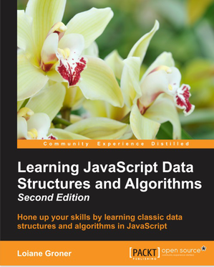
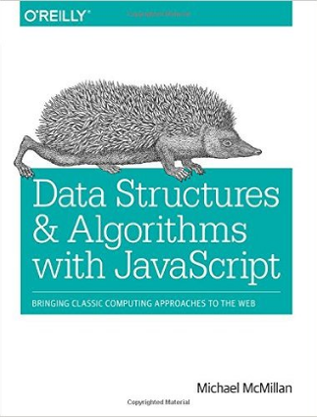
Going Deep
For those that dare dive deeper.

Slide 12
Efficiency

Slide 13
What does “efficient” mean?
We talk a lot about “efficiency”.

Slide 14
What does “efficient” mean?
But…

Slide 15
What does “efficient” mean?
What, exactly, does “efficient” mean?

Slide 16
Fewer Steps = Faster Code
Number of steps ~ Efficiency

Slide 17
Fewer Steps = Faster Code
More steps = Less Efficient
Fewer Steps = More Efficient

Slide 18
What’s a “step”?
A step is an instruction to the computer.
All computations boil down to a handful of “basic steps”.
Arithmetic (+, *, etc.)
Assignment (var x = 42;)
Boolean tests (x === 42)
Reading from memory
Writing from memory

Slide 19
What’s a “step”?
Each of these counts as a step.

Slide 20
What’s a “step”?
Fewer Steps = Faster Code

Slide 21
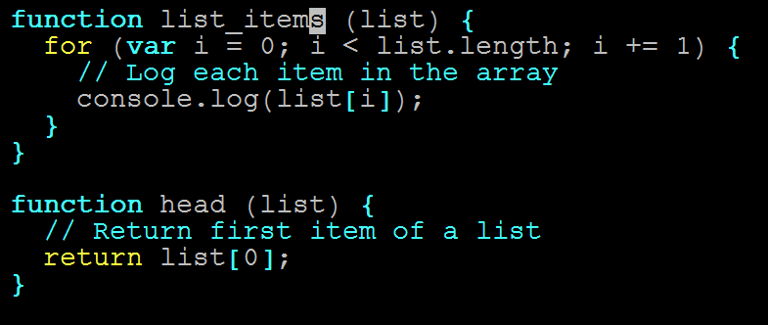
Pop Quiz (!)
Which function is more efficient?
(Which has fewer instructions?)

Slide 22
Count Instructions
Count the instructions!

Slide 23
Count Instructions
head = 1 instruction

Slide 24
Count Instructions
list_items = n instructions
…
(n = list.length)

Slide 25
The Verdict
head is more efficient.

Slide 26
The Verdict
But list_names isn’t bad…

Slide 27
Time Complexity

Slide 28
Quantifying Efficiency
head always executes one instruction…

Slide 29
Quantifying Efficiency
…No matter how long our array is

Slide 30
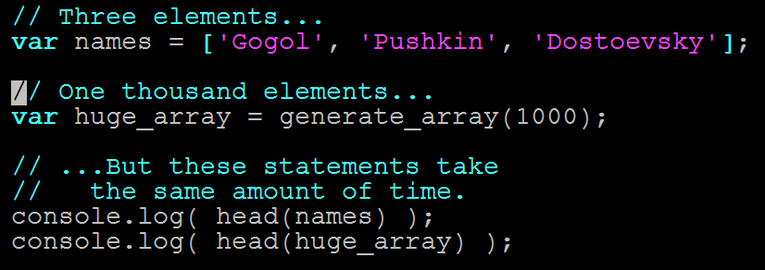
Quantifying Efficiency
head takes same amount of time on any input

Slide 31
Quantifying Efficiency
list_items needs n instructions

Slide 32
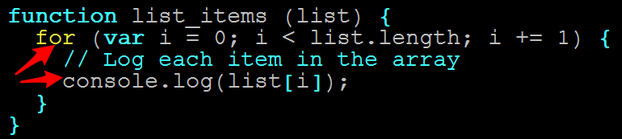
Quantifying Efficiency
One console.log per item

Slide 33
Quantifying Efficiency
console.log is fast…

Slide 34
Quantifying Efficiency
…but not free.

Slide 35
Quantifying Efficiency
Longer arrays = more time

Slide 36
Quantifying Efficiency
Double array length = Double time
Triple array length = Triple time

Slide 37
Quantifying Efficiency
In other words…

Slide 38
Quantifying Efficiency
The running time of head and list_items scale differently.

Slide 39
Quantifying Efficiency
The running time of head and list_items scale differently.

Slide 40
Quantifying Efficiency
Time complexity = Rate at which algorithm slows as input grows

Slide 41
Quantifying Efficiency
head is always one instruction

Slide 42
Quantifying Efficiency
Running time does not slow for larger inputs

Slide 43
Quantifying Efficiency
In other words…

Slide 44
Quantifying Efficiency
The running time of head is constant.

Slide 45
Quantifying Efficiency
list_items takes n instructions

Slide 46
Quantifying Efficiency
Running time depends on array

Slide 47
Quantifying Efficiency
Double array length, double time
Etc…

Slide 48
Quantifying Efficiency
Running time increase linearly with array length.

Slide 49
Big O Notation

Slide 50
Big O
Big O notation lets us describe how running time scales when we increase the input size (n)
Denoted with a big O, and the “growth factor” in parentheses
Examples:
head ~ O(1)
Grows like “1”—i.e., running time never grows
list_items ~ O(n)
Grows like “n”—i.e., gets bigger as n gets bigger

Slide 51
Big O
There are other Big O “classes”

Slide 52
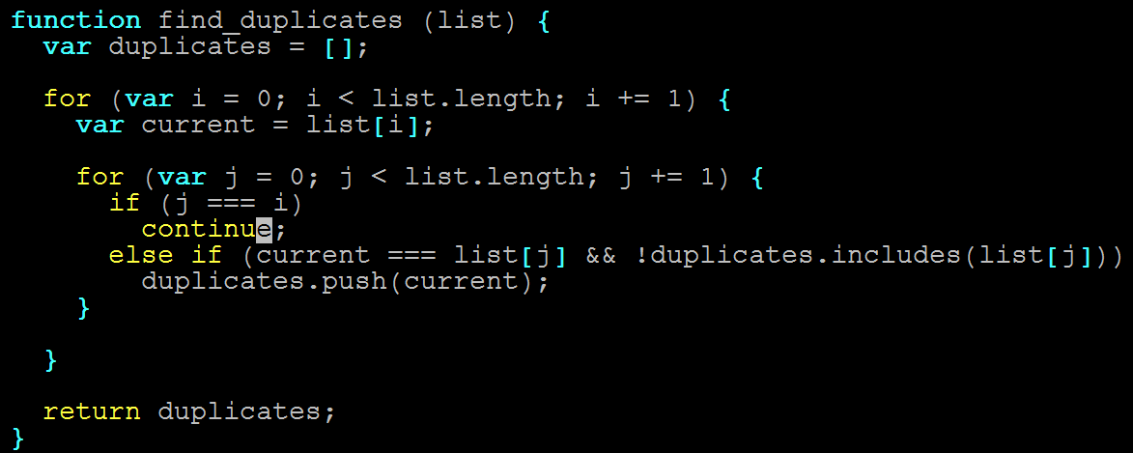
Big O
n steps for each of the n items in list (!)

Slide 53
Big O
2x length = 4x time
3x length = 9x time
nxn length = n² time

Slide 54
Big O
Running time grows as square of input

Slide 55
Big O
find_duplicates ~ O(n²)
“Quadratic time complexity”

Slide 56
Big O
MAJOR INSIGHT

Slide 57
Big O
2 nested for loops ~ O(n²)

Slide 58
Big O
NOT COINCIDENCE!

Slide 59
Big O
3 nested for loops ~ O(n³)
Etc.

Slide 60
Big O
One more…

Slide 61
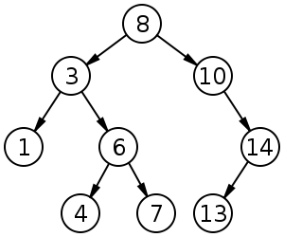
Big O
How fast is binary search?

Slide 62
Big O
Is it…
O(1)
O(n)
O(n²⁾
Something else?...

Slide 63
Big O
Something else.
Why?

Slide 64
Exercise
Binary search this array by hand, for 3, then 9.
Count the steps.

Slide 65
Big O
3 steps.

Slide 66
Big O
Add the digits 11-20. Repeat.

Slide 67
Big O
4 steps (!)

Slide 68
Big O
Much faster than linear.

Slide 69
Big O
(input size)² ~ 2x running time
(input size)³ ~ 3x running time
Etc.

Slide 70
Big O
This is called O(lg n).

Slide 71
Big O
lg n = how many times do I divide n by two to get to 1?

Slide 72
Logarithm Example
What is lg 8?

Slide 73
Logarithm Example
8 / 2 = 4 (1)
4 / 2 = 2 (2)
2 / 2 = 1 (3)

Slide 74
Logarithm Example
lg 8 = 3
But if this is confusing…

Slide 75
Logarithm Example
Don’t worry about it.

Slide 76
Big O Review
head ~ O(1)
Grows like “1”—i.e., 2x input size -> 1x running time
list_items ~ O(n)
Grows like “n”—i.e., 2x input size -> 2x running time
find_duplicates ~ O(n²)
Grows like “n^{2”}—i.e., 2x input size -> 4x running time
binary_search ~ O(lg n)
Grows like “lg n”—i.e, (input size)² -> 2x running time

Slide 77
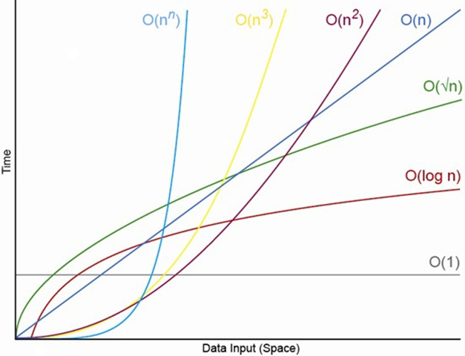
Big O Comparisons

Slide 78
Data Structures

Slide 79
Data Structures? (Tricky Question)
What is a data structure?
(And what is an example?)

Slide 80
Data Structures? (Tricky Question)
Before we answer that…

Slide 81



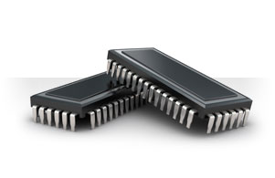
Code = Data. Data is Saved.
Code we write…
Gets saved in memory…

Slide 82
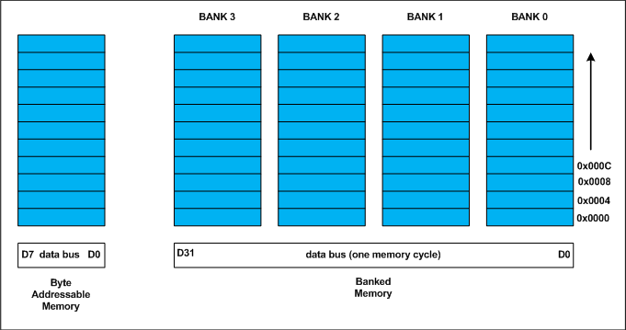
Different Ways to Save…
Memory can be visualized as slots. Data is then allotted into these slots.

Slide 83
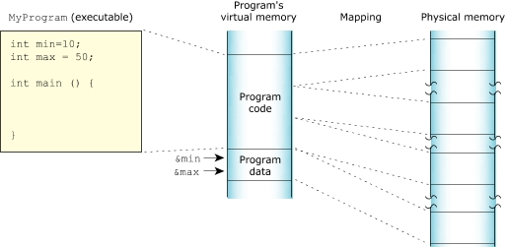
Memory on My Mind
Our code as a whole takes some of these slots of memory.
Our variable data itself also takes slots of memory.

Slide 84
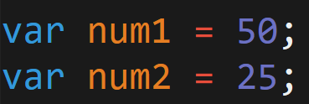
Saving to Memory…
Code
Memory
50
25
Each time we declare or instantiate a variable, we are saving that data to memory.

Slide 85

Retrieving from Memory…
Code
Memory
50
25
When we reference these variables in our code, we are retrieving the data from memory.

Slide 86
Growing Data = Growing Problem
As applications grow and we begin to incorporate larger quantities of information with inter-relationships…
These simple operations of saving, retrieving, etc.
Become a lot more intensive (both time-wise and CPU processing wise).
Don’t let the simplicity fool you!

Slide 87


Building Devices
Fitbit Surge
You have 1 MB. Use it wisely
Devices inherently have limited memory because of space requirements – making efficiency decisions critical

Slide 88
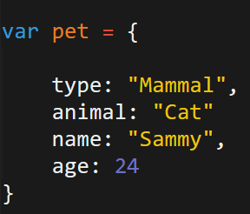
Retrieving from Memory…
Code
Memory
pet
Mammal
type
Cat
animal
Sammy
name
24
age
Even simple objects, require memory to keep track of numerous relationships in memory.

Slide 89
Data Structures?
What is a data structure?
A way of storing data so that it can be used efficiently by the computer or browser.

Slide 90
Data Structures?
What is a data structure?
They are built upon simpler primitive data types (like variables)

Slide 91
Data Structures?
What is a data structure?
They are non-opinionated, in the sense, that they are just responsible for holding the data.

Slide 92
Data Structures?
Example Data Structure:
Arrays

Slide 93
Arrays

Slide 94
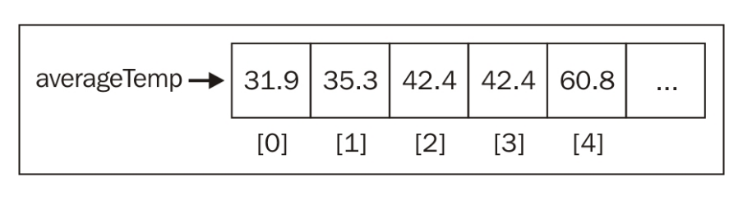
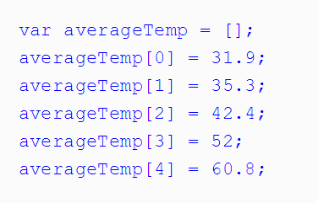
Arrays!
Arrays are the simplest data structure.
Javascript includes it natively.
In most languages, arrays do not allow mixing of types.
In most languages, arrays are not extendable. (They are fixed sizes)

Slide 95
Arrays in Javascript
In most languages (non-Javascript), arrays are immutable – meaning that upon declaration, the length of the array is fixed.
With Javascript, we can easily add elements using the .push method().
Question for You .push adds elements to which side of the array?

Slide 96
Arrays in Javascript
In most languages (non-Javascript), arrays are immutable – meaning that upon declaration, the length of the array is fixed.
With Javascript, we can easily add elements using the .push method().
Question for You .push adds elements to which side of the array?

Slide 97
Arrays in Javascript
2nd Question for You How can we add an element to the beginning of the array?
If you finish early, implement it yourself.
(i.e. Don’t use the in-built method).

Slide 98

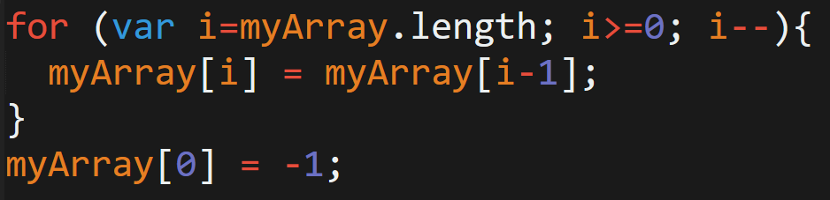
Arrays in Javascript
Unshift Method
What’s really happening…

Slide 99
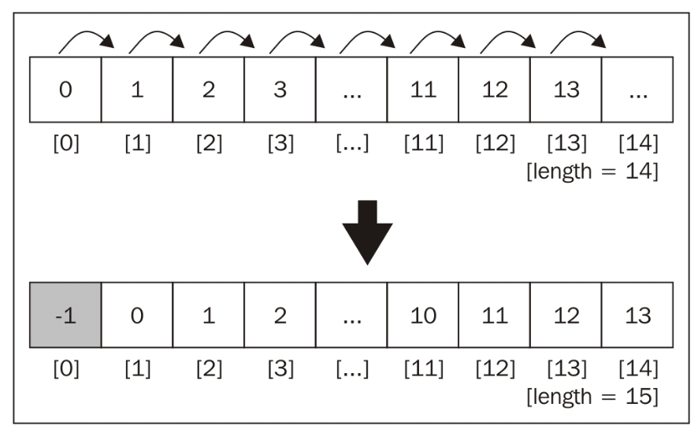
Arrays in Javascript
An inefficiency emerges!

Slide 100
Arrays in Javascript
An inefficiency emerges!
We’ll come back to this.

Slide 101
Stacks / Queues

Slide 102
Data Structures = Abstractions
Going forward, treat each of the following data structures as concepts.
These are paradigmatic ways of organizing data that are commonly seen in code.

Slide 103
Stacks
Stacks are another common data structure.
They are similar to arrays in that they are a sequenced order of numbers.
The difference is they only allow access to the top element.
These data structures obey “LIFO” (Last-in-first-out). This means that new elements are placed at the top and removed from the top.
Stacks are an abstraction for how data can be arranged.
20
14
12
1

Slide 104

Stacks
Stacks are another common data structure.
They are similar to arrays in that they are a sequenced order of numbers.
The difference is they only allow access to the top element.
These data structures obey “LIFO” (Last-in-first-out). This means that new elements are placed at the top and removed from the top.
Stacks are an abstraction for how data can be arranged.

Slide 105
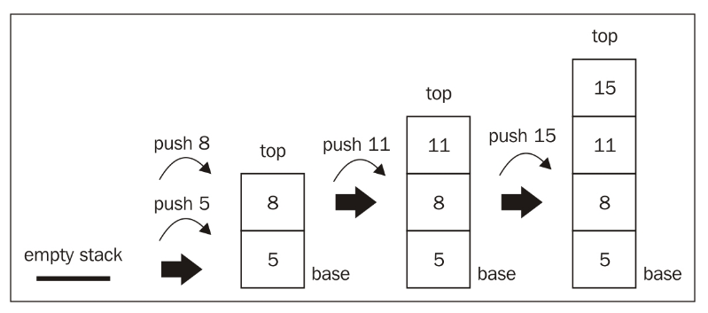
Stacks
Last in First Out:
Items added to the top. Removed from the top

Slide 106
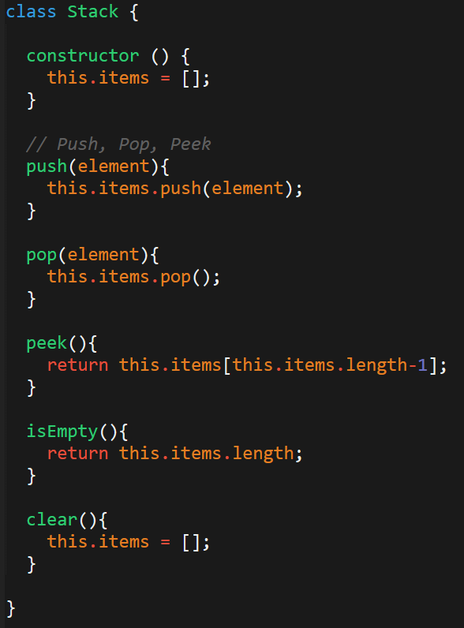
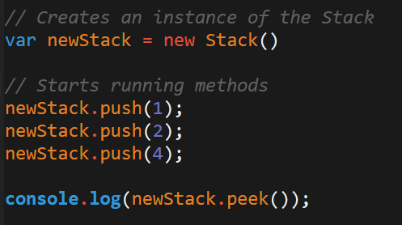
Stacks – In Code
“Stacks” aren’t supported natively in Javascript.
To utilize this structure, one needs to create the class themselves.
Once you’ve created a class you can create and utilize these structures in your code.

Slide 107
Queue
Queues are another common data structure.
They are similar to arrays in that they are a sequenced order of numbers.
The difference is they only allow access to the first element.
These data structures obey “FIFO” (First-in-first-out). This means that new elements are placed at the “back” but that the “first” element is removed from the front.
Queue are an abstraction for how data can be arranged.
20
14
12
1

Slide 108

Queue
Queues are best remembered as similar to a movie queue. The first one in line is the first one to enter (or exit).

Slide 109
Queue – In Code
“Queues” aren’t supported natively in Javascript.
Again, this means we need to create our own for use.
Queues provide two common methods: enqueue and dequeue.

Slide 110
Linked Lists

Slide 111
Arrays in Javascript
An inefficiency emerges!
We’ll come back to this.

Slide 112
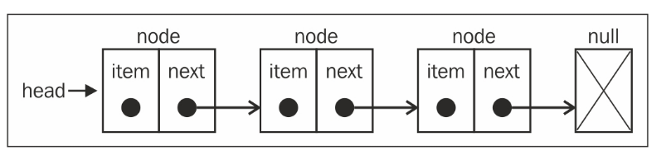
Linked List
Linked Lists are data structures in which each element of the list is sequentially joined to the next element.
The major difference is that the list elements are not stored contiguously in memory (i.e. they fall in different memory slots).
These linked lists keep track of the position of elements using pointers which explicitly point to the “connected item”.
Each element (called nodes) track both the item and the “next item’s” position.

Slide 113

Linked List
Linked Lists are like trains.
Each car of the train not only knows its own position – but it also knows the position of the train in front of it.

Slide 114
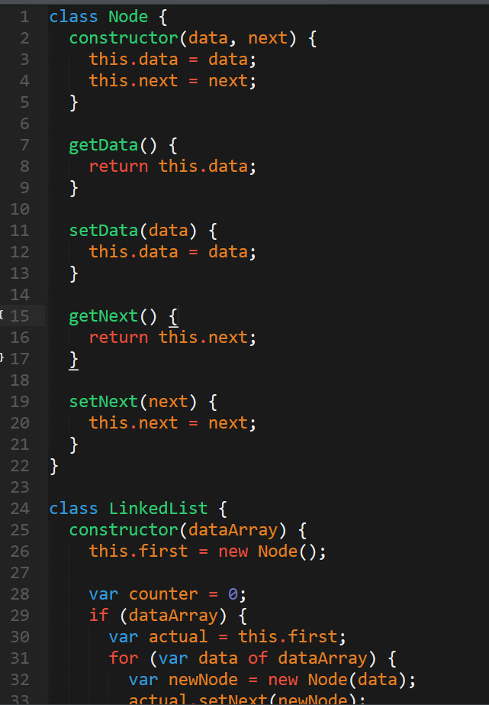
Linked List – In Code
JS does not include Linked Lists natively
But when you need one…
Plenty of implementations are available online.
http://codepen.io/gben/pen/ZGLava

Slide 115
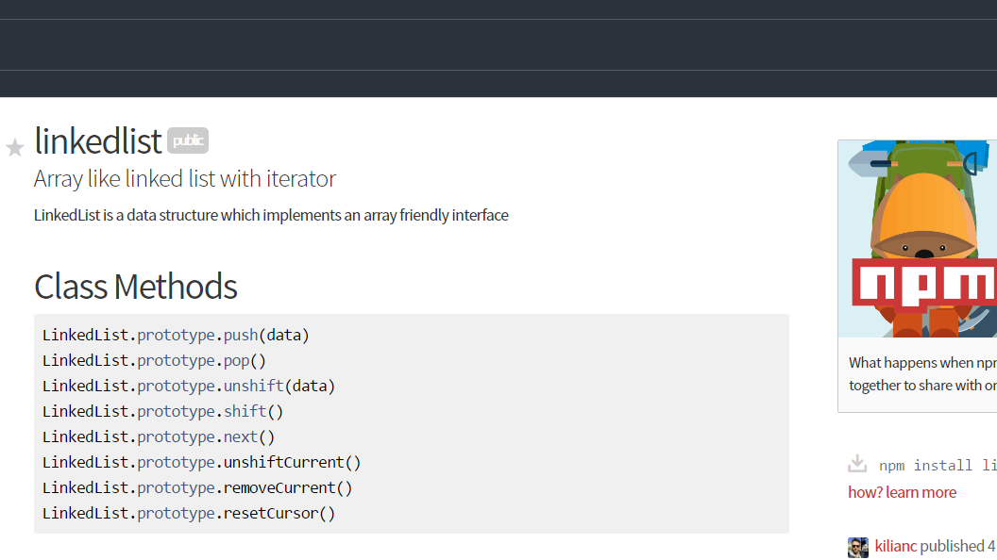
For the Lazy… (Myself included)

Slide 116
Pulse Check…

Slide 117
You Be the Teacher
To the person, next to you, explain each of the following concepts:
What is a data structure?
What does FIFO and LIFO stand for and mean?
What is a Stack?
What is a Queue?
What is a Linked List?
How are they each different from arrays?
What is one disadvantage of an array?
Most important question: Why are we doing all this again?

Slide 118
Dictionaries (Maps)

Slide 119
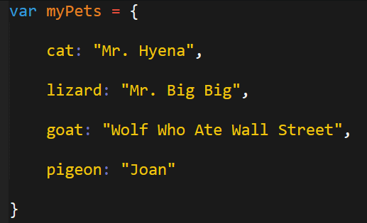
Dictionaries (Maps) **** (Actually Useful) ****
Dictionaries are an incredibly important data structure..
In fact, they address a common situation you’ve faced in this class.
How would you print all the pet names?

Slide 120
Dictionaries (Maps) **** (Actually Useful) ****
Dictionaries are an incredibly important data structure..
In fact, they address a common situation you’ve faced in this class.
How would you print all the pet names?
Arrays don’t solve the problem either….

Slide 121
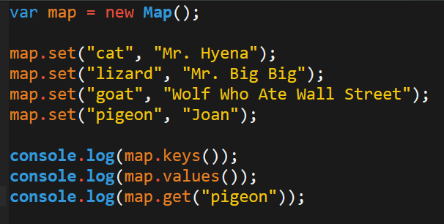
Dictionaries (Maps) **** (Actually Useful) ****
The solution is to use a dictionary (map).
In a way, dictionaries serve as a hybrid between objects and arrays.
They can be iterated over like arrays.
They have key, value pairs like objects.
Aaaand, it’s included in the latest version of Javascript (ES6).
BIG DEAL!

Slide 122
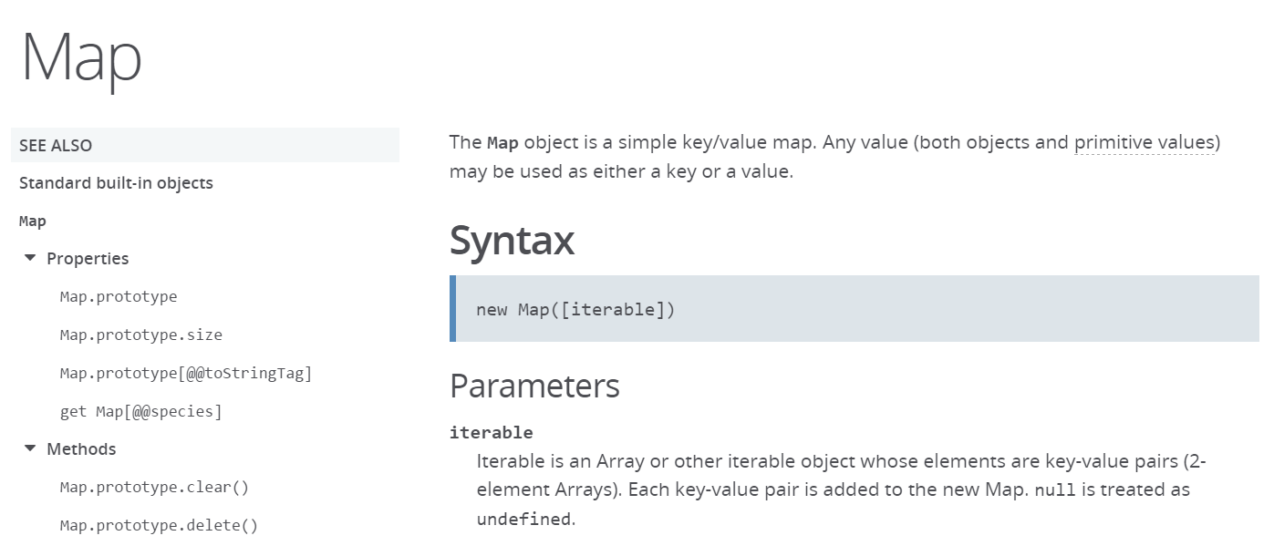
Dictionaries (Maps) **** (Actually Useful) ****
Learn more about Dictionaries (Maps) in JS:
https://developer.mozilla.org/en-US/docs/Web/JavaScript/Reference/Global_Objects/Map

Slide 123
Trees

Slide 124
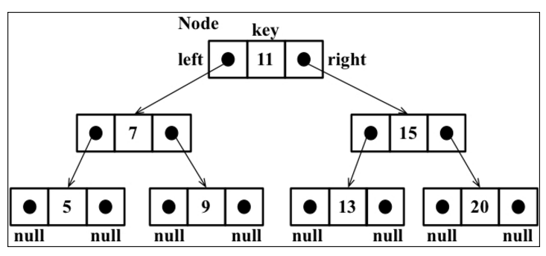
Trees
Trees are a favorite data structure for computer scientists
Trees are a non-sequential data structure made of parent-child relationships.
The top node of a tree is the root.
Trees have internal nodes and external nodes
Each node has ancestors and descendants
Kind of like a linkedlist

Slide 125
Binary Trees
Binary Trees / Binary Search Trees (BST) are particularly useful
In a Binary Tree, nodes have two children at most. One on left and on right.
In a Binary Search Tree:
Left-hand side is lesser number; right-hand side is the larger
Paradigm makes it easy to insert, search, and delete from tree

Slide 126
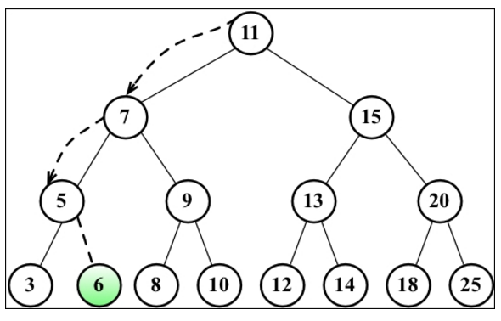
Binary Trees
Binary search trees are extremely efficient for searching.

Slide 127
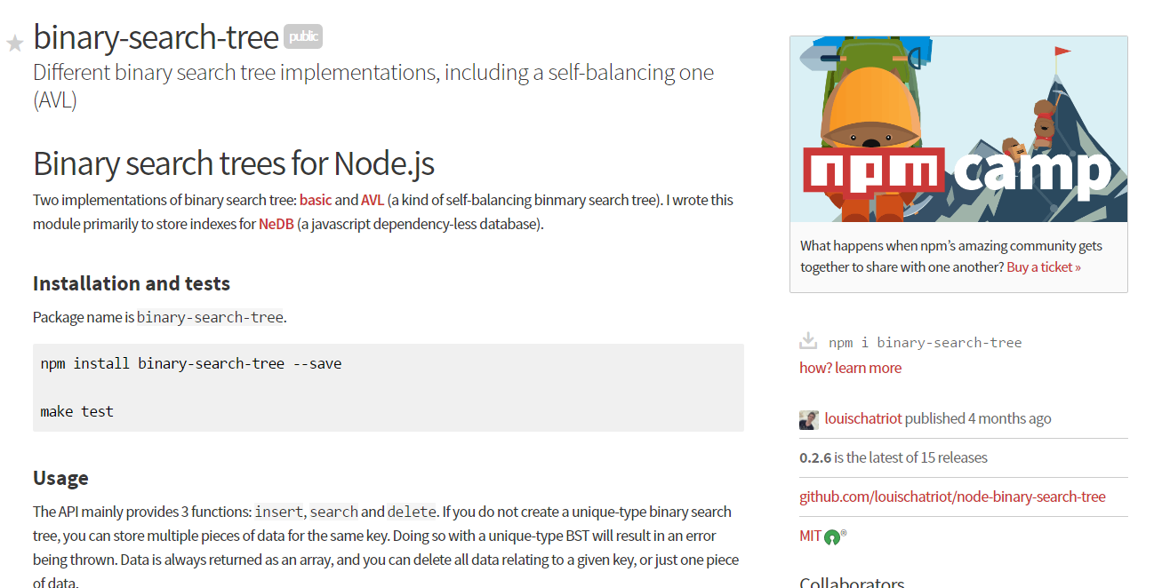
Binary Search Trees
https://www.npmjs.com/package/binary-search-tree

Slide 128
Let’s Build this!
Take a few moments to build a binary search tree with those around you. As a suggestion, implement the following tree.
Then run a search for any number in the tree.

Slide 129
Graphs

Slide 130
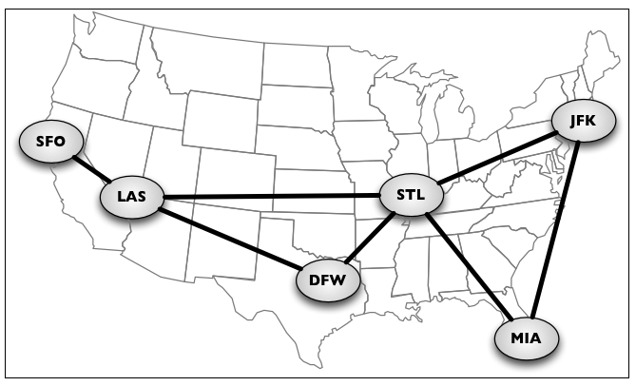
Graphs
Graphs are extremely powerful and increasingly common structures.
Graphs are abstract models of a network structure. They are a set of nodes (or vertices) connected by edges.
They are the essence of social networks and geographic maps.
The math gets ridiculously scary with this stuff…

Slide 131
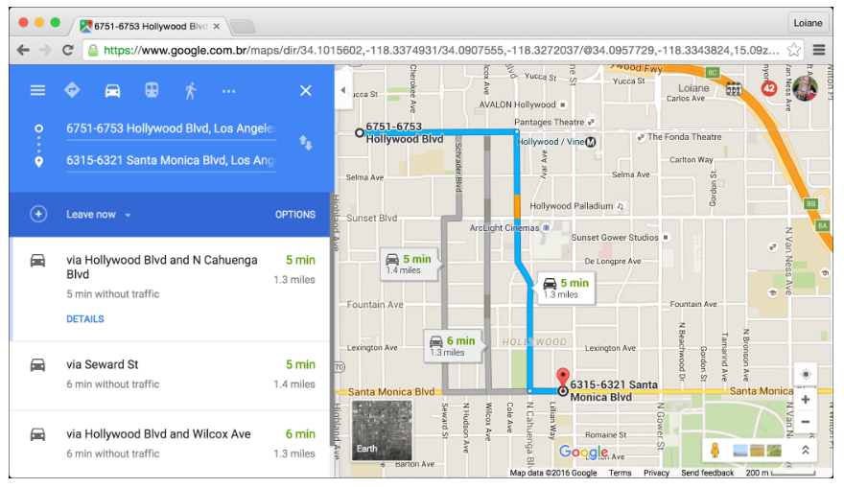
Graphs
But through graphs and “shortest-path” algorithms we can build map applications like the ones found on Google Maps

Slide 132
Back to Projects!

Slide 133
Questions

