Slide 1
Final Projects
The End is Near…
December 16th, 2017

Slide 2
This is your brain
The Browser
Dev Tools
Server Side
HTML
CSS
JavaScript
jQuery
Bootstrap
SEO
Vue
Heroku
Git
GitHub
Forge
Templating Engines
Sessions
Writing tests
Node
Express
Creating APIs
MVC
User Authentication
ORM (Sequelize)
Laravel
Databases
Firebase
MySQL
MongoDB
API Interaction
APIs (Consuming)
JSON
AJAX
Real Time Cloud Database via Firebase
Algorithms
Benchmarking
CS Fundamentals
Cutting Edge Development
React

Slide 3
Nudge Forward
Didn’t quite make your target?
Let’s chat.

Slide 4
What’s Left
Final Projects
Remaining Topics
PHP/Laravel
Computer Science Algorithms (half class topics)
Lightning Talks & Job Workshops:
By Request - half class topics, last two class days before final project presentations
Presentation Day!!!!

Slide 5
What’s Left - Schedule
December
19 - PHP
January
04* - PHP
06, 09, 11* - Laravel
13, 16, 18* - Computer Science Fundamentals (half day)
20, 23 - Lightning talks & Job Workshops (half day on request)
25 - Presentation Day - Opportunity to excel!
* indicates deliverable review

Slide 6
Big News!
No homework from now till the end!
(With a small caveat)

Slide 7


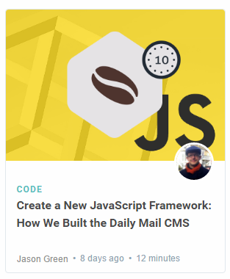
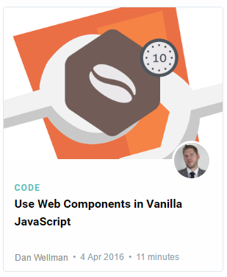
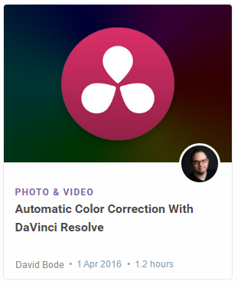
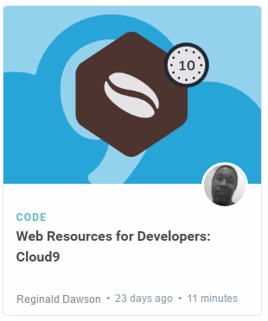
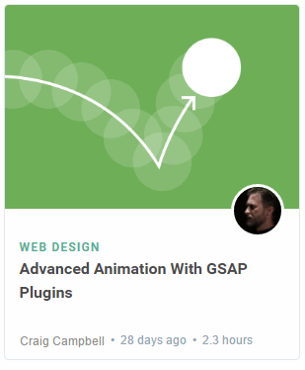
Lightning Talks!
Disclaimer: Not actual topics for Lightning Talks. Just possibilities

Slide 8

Never Stop Learning!
The key to being marketable and relevance is to constantly be learning.
The field is always changing and there is never a point where you can call it quits.
Stick with it! It’s a craft that you continue to hone with time.

Slide 9
Final Projects

Slide 10
Your Challenge
You have plenty of time to work on this.
-- IF YOU START TODAY
You have ALL the skills you need.
You have a team of skilled developers.
You have experts willing to help.
No excuses. Time to prove yourself.

Slide 11
Expectations

Slide 12
Expectations
We expect whatever you build to have utility
We expect you to have market or real-world research that evidences your idea has REAL value to people.
We expect you to have done research on other web / mobile applications in your domain. Why is your app different?
We expect you to put serious time and thought into this.
We expect you to report problems you are facing along the way.
We expect you to utilize some form of project management system.
We expect you to dig deep into documentation and external resources to learn what you need.

Slide 13
Requirements

Slide 14
Coding Requirements (recommendations...?)
Must use ReactJS, Angular or PHP/Laravel in some way (even if minimal)
Must use a Node and Express Web Server - or - Apache for PHP
Must be backed by a MySQL or MongoDB Database with a Sequelize or Mongoose ORM (Laravel has a built in library called Eloquent that you would use), or Firebase
Must have both GET and POST routes for retrieving and adding new data
Must be deployed using Heroku (with Data), Digital Ocean, Forge.Laravel or AWS
Must utilize at least two libraries, packages, or technologies that we haven’t discussed
Must allow for or involve the authentication of users in some way
Must have a polished frontend / UI
Must have folder structure that meets MVC Paradigm
Must meet good quality coding standards (indentation, scoping, naming)
And for crying out loud, use the Readme to add pertinent information about the application :)

Slide 15
But Honestly…
Do what you want within limits. Talk to us first. Get our input.
If you have an idea and want to run with it, we’re not going to stop you.
Final Project should be groups of 2 people.
1 and 3 are allowed but again, talk to us first.
No excuses. Time to prove yourself.

Slide 16
Deliverables

Slide 17
Project Updates
Instead of homework, you will be required to submit 4 Project Deliverables.
These will be due each Wednesday starting in January until Presentation Day. We will discuss your deliverable submissions with you individually during class on the 4th (deliverable 1), 11th (deliverable 2) and 18th (deliverable 3).
Deliverable #1 (January 3, 2018) – Plan, Design, and Research
YES - This is BEFORE our first class of the new year. Realistically this should be done by the 20th of December.
Deliverable #2 (January 10, 2018) – Ready MVP (Working App!), Mini-Presentation. Provide screencast or link to screencast of your application working at the very basic level. Highlight (verbally) where you need to focus and what is already running smoothly.
Deliverable #3 (January 17, 2018) – Project Polish, Functionality Push, Final Plan
Final Presentation (January 25th, 2018) – Presentation Time!

Slide 18
Deliverable #1

Slide 19
Deliverable #1 - Due January 3rd by 11:00pm
By January 3rd, 2018 you must submit a detailed plan of action for your project.
In this plan, you will include:
An overview of the intended application and WHY you feel it’s valuable.
A set of DETAILED screen-by-screen design layouts with annotations describing all UI/UX components and all data relevant to the screen.
A breakdown of roles by group member.
A schedule for completion of various tasks.
A screenshot of your Jira, Trello, or Project Management Board that shows breakdown of tasks – assigned to group members with a schedule.

Slide 20
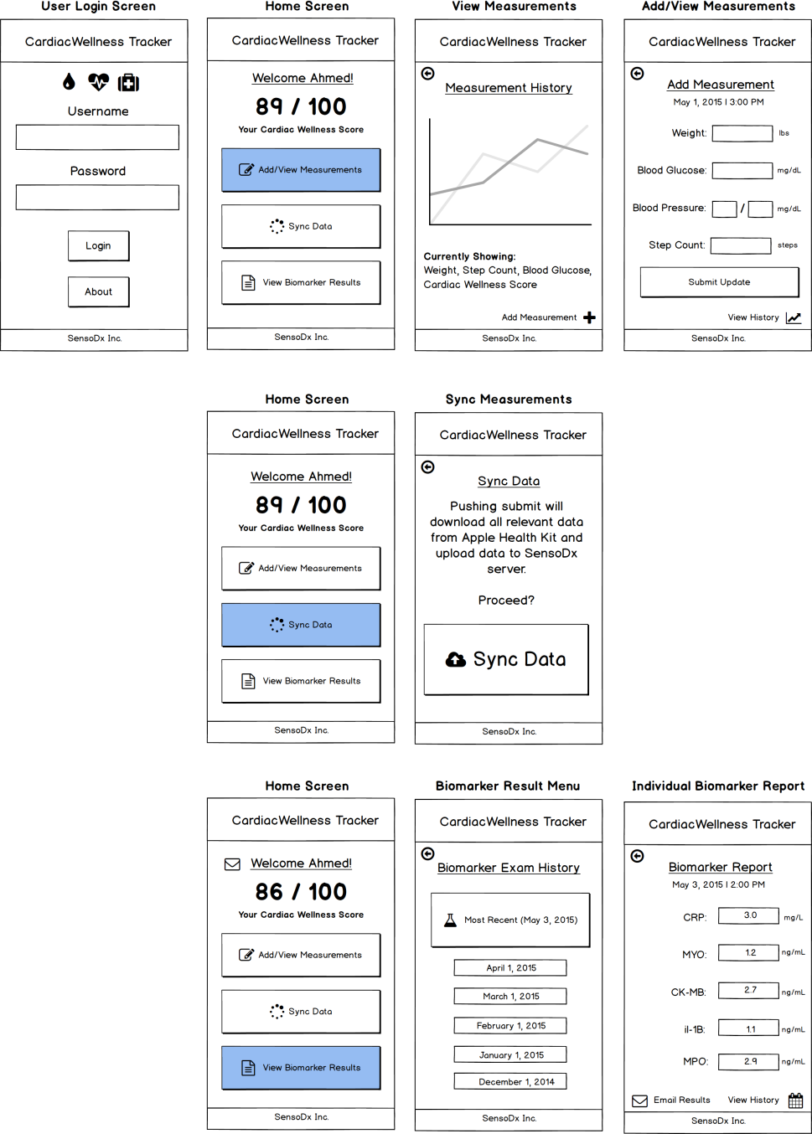
Example UI/UX Flow
Screen Map
This is intended to show you the order in which users would see screens. The three branches correlates with the three button options from the main menu.

Slide 21
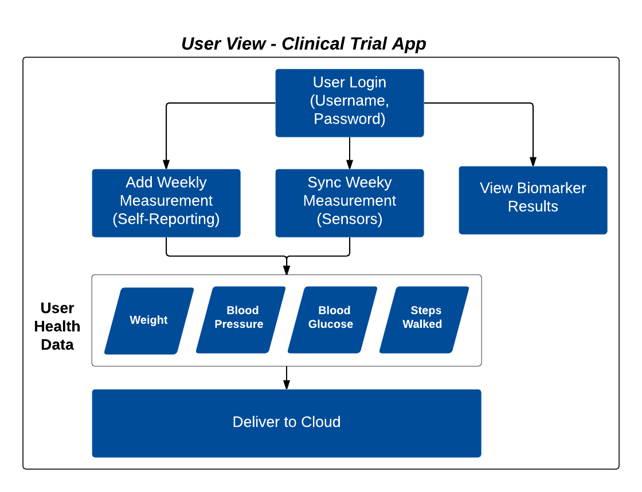
Example Data Flow

Slide 22
Questions

