Slide 1
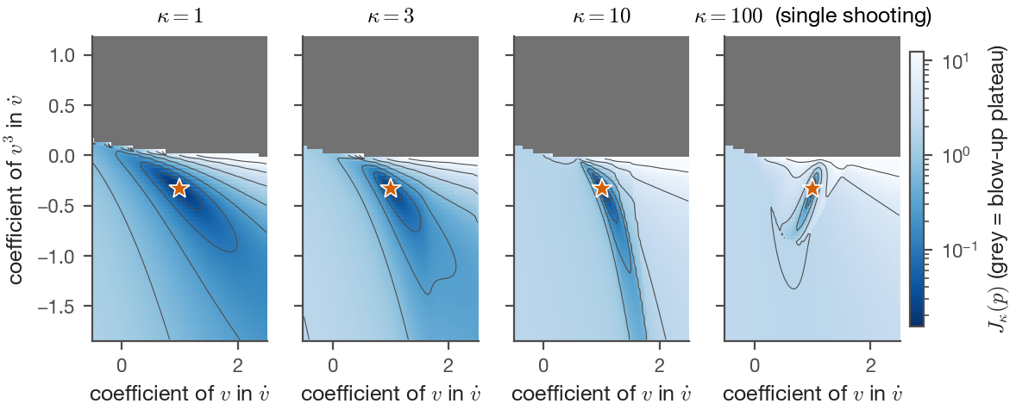
Discovering sparse dynamics with multiple shooting and guess propagation
Cost landscape vs window size: smooth for short windows, rugged for single shooting
From noisy trajectory samples to the few governing terms — by solving a sequence of easier problems and carrying the answer forward.
Manu Jayadharan, Alasdair Hastewell, Niall Mangan
Figures and numbers: report R002 (11 September 2026), FitzHugh–Nagumo, Lotka–Volterra and Lorenz test systems

Slide 2
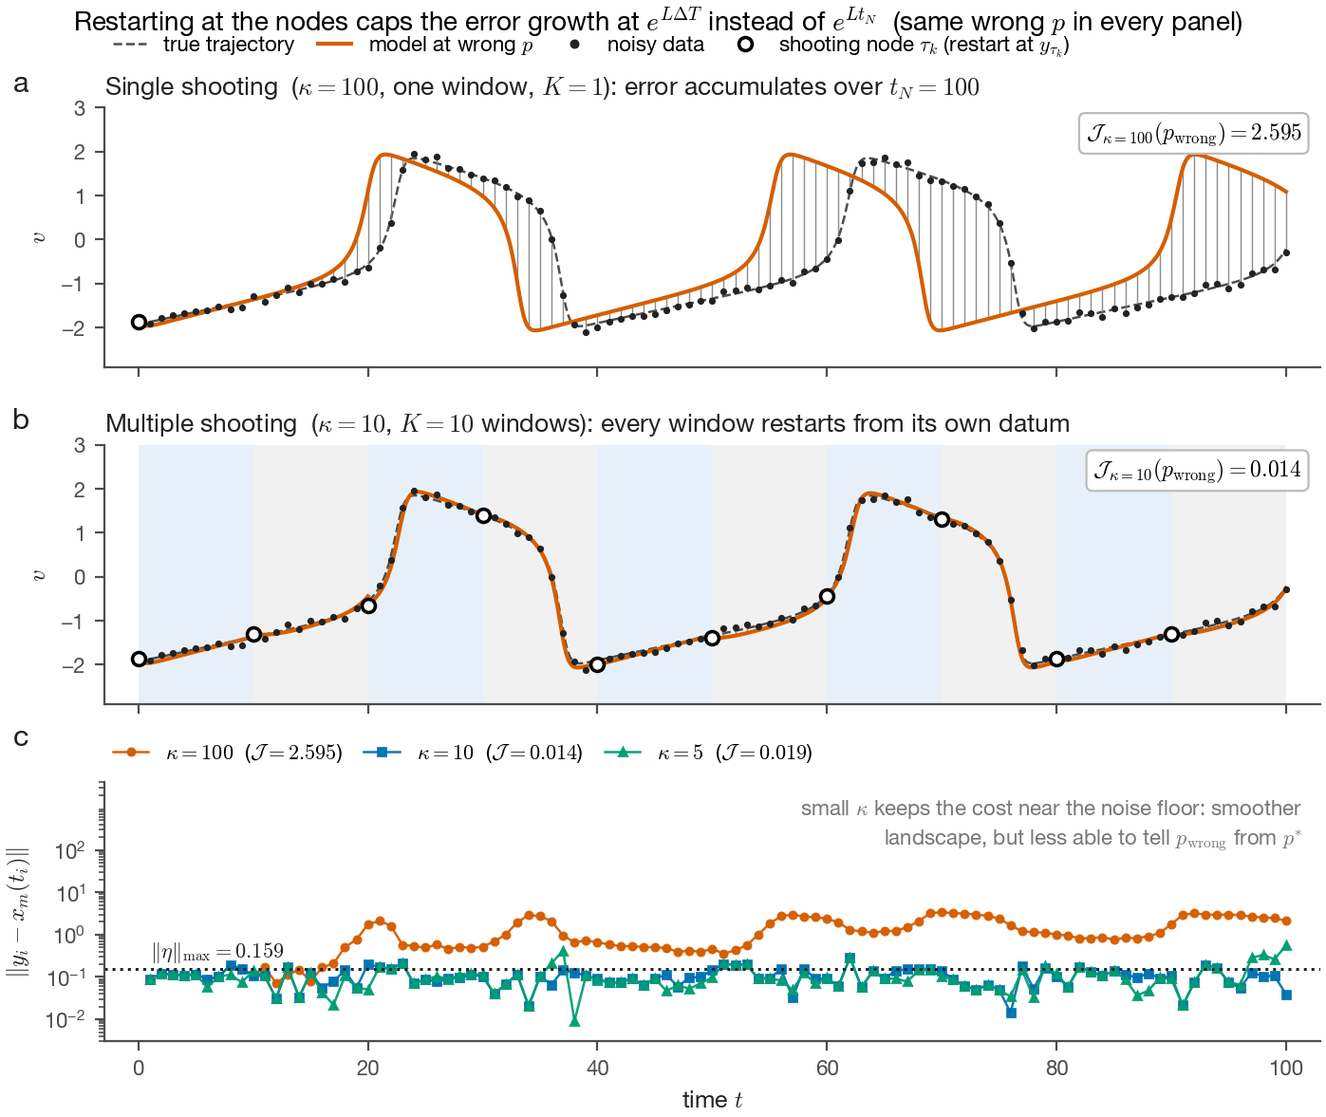
Noisy samples in, a sparse equation out
Model discovery: choose which library terms are non-zero and estimate them by matching simulated trajectories to the data
▸ Data. N = 101 noisy samples of v(t), w(t) (FitzHugh–Nagumo), spacing Δt = 1, 5 % noise per component.
▸ Ansatz. ẋᵢ = Σⱼ pᵢⱼ Θⱼ(x) over all monomials up to degree 3: 20 unknown coefficients, 7 truly non-zero.
▸ Single shooting. Integrate from y₀ over the whole record and fit p. Errors in p and y₀ are amplified along the orbit: the cost is rugged, has a blow-up plateau, and a small wrong p costs 260× the true one.
▸ Consequence. From a random start, the optimiser never finds the model (control arm: error stays at the seed, 1.65).
Same wrong p: single shooting (top) vs restarting every 10 samples (middle); residuals (bottom)
2

Slide 3
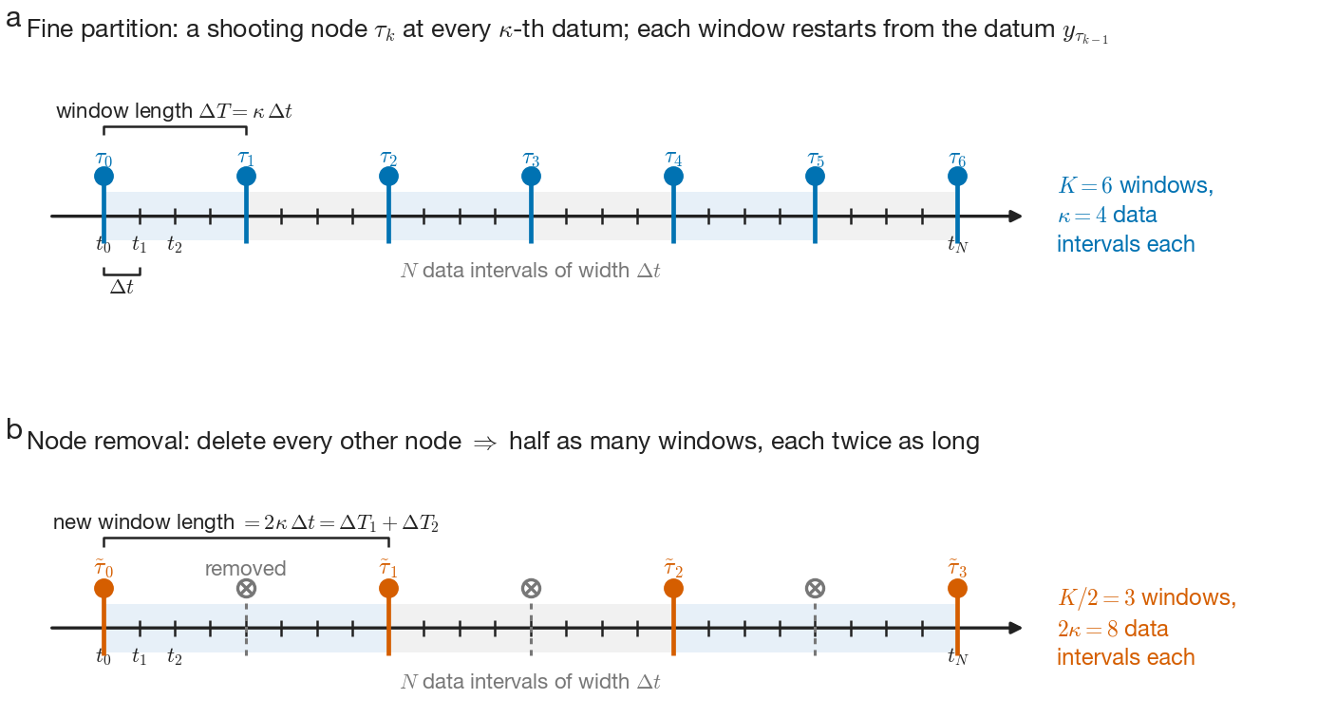
Multiple shooting, and the gap we fill
Partition [t₀, t_N] into K windows; each window is integrated from the datum at its left node, with no continuity constraint
Cost with K windows (κ data intervals each)
J_K(p) = Σₖ Σ_{tᵢ ∈ [τₖ₋₁, τₖ]} ‖ φ(tᵢ − τₖ₋₁; p, y_{τₖ₋₁}) − yᵢ ‖²
K = 1 is single shooting; κ = 1 (a node at every datum) is nearly convex.
▸ Known. Textbook multiple shooting makes the node states extra variables and enforces continuity — many more unknowns, constrained optimisation.
▸ Gap. Nobody exploits the smooth-to-rugged family J₁, J₂, …, J_N directly: solve the easy problem first, then remove nodes gradually while carrying the minimiser forward.
▸ Needed. A bound on how much the cost — and its minimiser — moves when nodes are removed, so the sweep stays inside the right basin.
Fine partition (top) and the coarser one after deleting every other node (bottom): the elementary step of the sweep
Node removal changes the cost only on the windows next to the removed nodes — by an amount that grows with the number of nodes removed and with the extra span ΔT₂ the surviving segment must cover (Proposition 1, next slides).
3

Slide 4
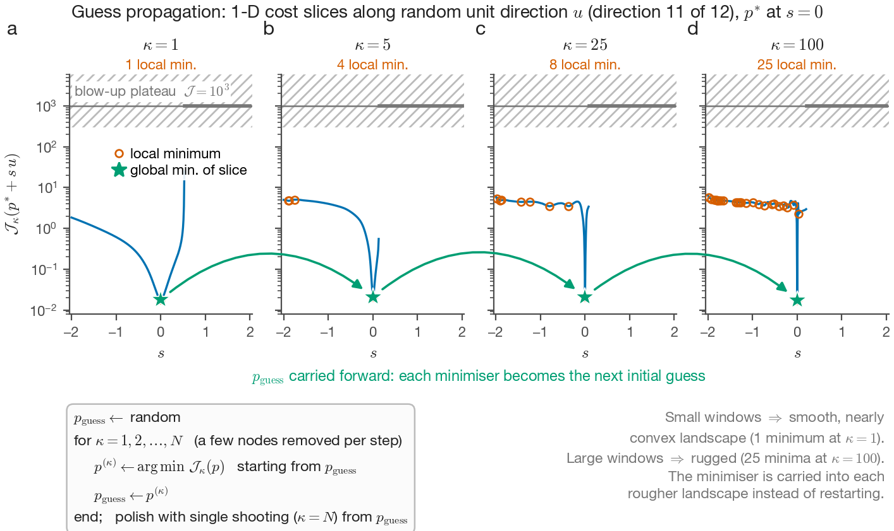
Our method: guess propagation across window sizes
Solve the smooth problem first, then carry each minimiser into the next, more rugged landscape
Algorithm
→ p_guess ← random start
→ for κ = 1, 2, 3, … , N−1 (few nodes removed per step): p^(κ) ← argmin J_κ(p) from p_guess; p_guess ← p^(κ)
→ polish with single shooting (κ = N−1) from p_guess
→ sparsity: smooth-ℓ1 penalty γ Σ|pⱼ| inside every J_κ
Why it works: the number of local minima along a random line grows from 1.3 (κ = 1) to 7.9 (κ = 100), but consecutive landscapes are close, so the carried guess stays in the right basin.
4

Slide 5
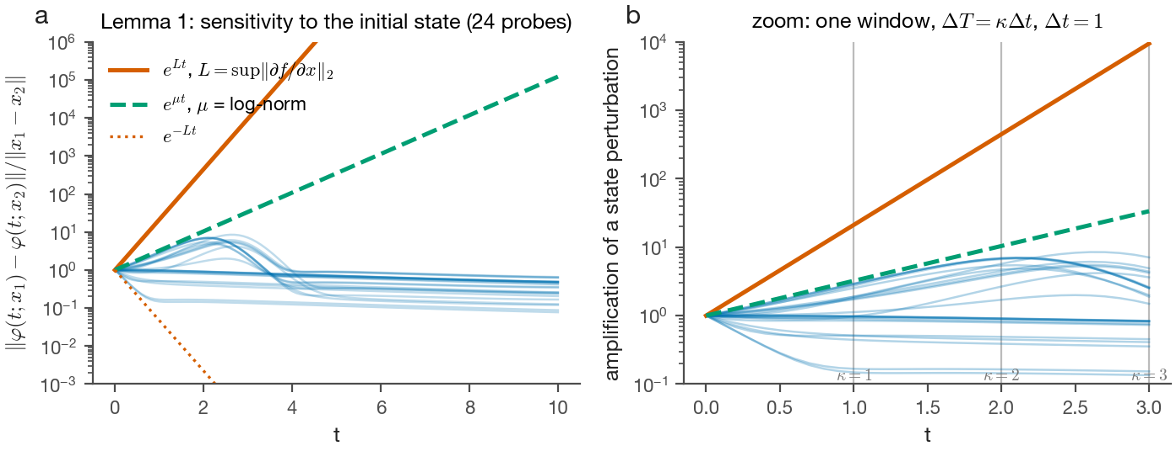
Theoretical results — and how tight they are
Lipschitz constant L of the vector field, noise η, window length ΔT; strong convexity with modulus μ near the minimiser
Lemma 1 (flow sensitivity).
e^{−Lt} ‖x₁−x₂‖ ≤ ‖φ(t;x₁) − φ(t;x₂)‖ ≤ e^{Lt} ‖x₁−x₂‖
so the noise at a node is amplified by at most e^{LΔT} within a window instead of e^{L t_N} over the record.
Parameter error.
‖p* − p^(K)‖ ≤ √( (2/μ) [ N ‖η‖²_max (1 + e^{LΔT})² − J_K(p^(K)) ] )
Proposition 1 (node removal).
|Ĵ_K(p) − J_K(p)| ≤ 2 |I_R| C_max ( e^{L(ΔT₁+ΔT₂)} ‖η‖_max + e^{LΔT₁} [ (L̃/L)(e^{LΔT₂} − 1) ‖p − p*‖ + ‖η‖_max ] )
Design rule: remove few nodes at a time, keep ΔT₂ small, prefer low-noise nodes.
Lemma 1 checked on FHN: 24 perturbed orbits (blue) stay below e^{Lt} (vermilion); the bound holds but is loose
≤ 8×
10¹³
measured amplification of a state perturbation on the FHN orbit
what e^{Lt} with L = 3.05 allows at t = 10: the bounds order the arms, not the sizes
5

Slide 6
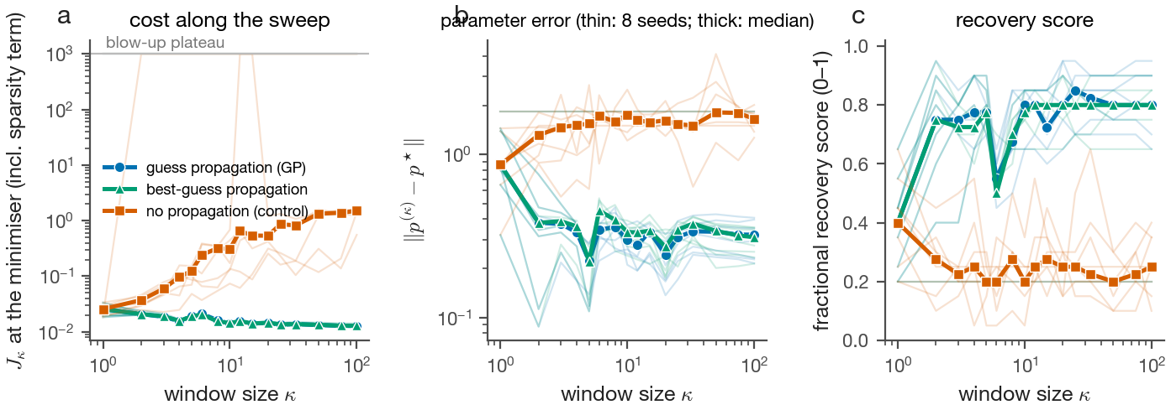
Numerical results: FitzHugh–Nagumo, 8 starts
Same optimiser (Nelder–Mead, 2500 iterations per stage), same seeds, same 16-stage schedule, with and without propagation
0.32 vs 1.65
final ‖p − p*‖, propagation vs control (seed medians; start ≈ 1.6)
7 of 8
seeds where propagation is strictly better at every κ ≥ 2 (the 8th starts on the blow-up plateau)
Cost, parameter error and recovery score along the sweep; thin lines = seeds, thick = median. Blue: guess propagation; vermilion: restart from the seed every stage
-1.14
Also: the parameter error is smallest at κ = 5 (0.22) and drifts to 0.32 at single shooting while the cost keeps falling — the sparsity term and noise bias the final polish, so stop on validation error, not on cost.
paired difference at κ = 100, 95 % bootstrap CI [-1.43, -0.77]
6

Slide 7
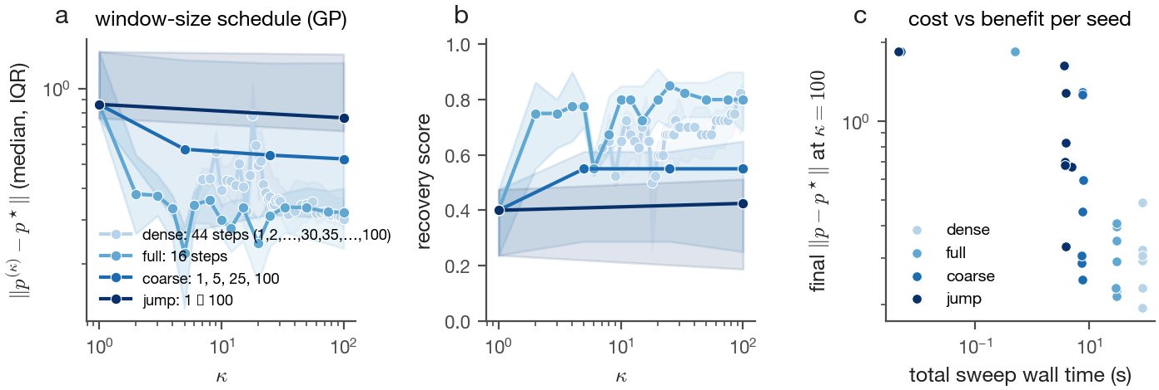
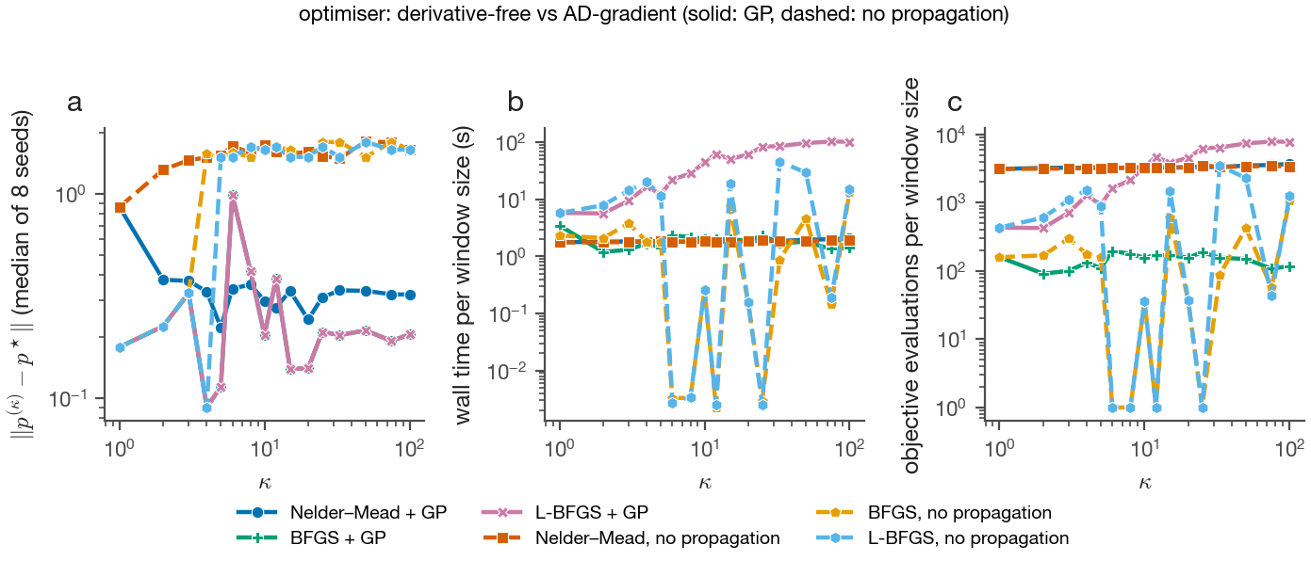
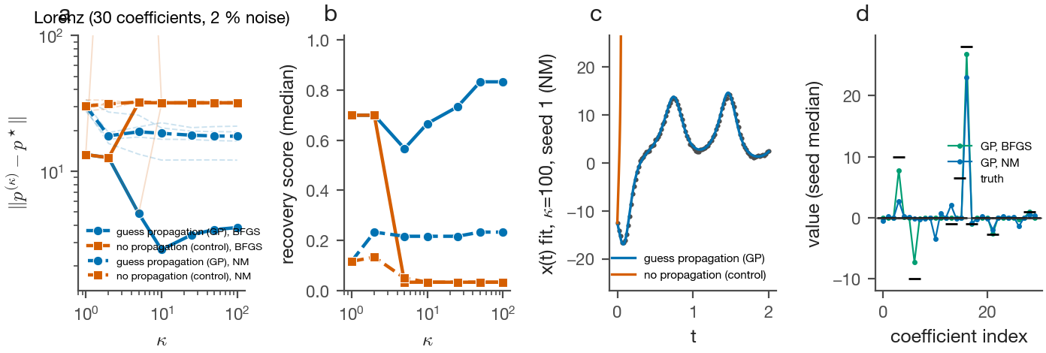
What matters, and does it generalise?
Every variation re-run with the same seeds; numbers are seed medians at the end of the sweep
0.30 vs 0.76
0.21 / 0.95
0.83
error with a dense schedule (44 steps) vs a 1→100 jump: remove few nodes per step
error / recovery score for BFGS with the exact AD gradient + propagation; gradients die on the flat plateau without it
recovery score on Lorenz (30 coefficients, chaotic) with BFGS + propagation; the control blows up in 4 of 4 seeds
▸ Robust to noise up to 10 % (error 0.22–0.36); fails at 20 %. The control fails even at zero noise — the difficulty is the landscape, not the noise.
▸ Lotka–Volterra: error 0.29, score 0.83 with propagation; 5 of 6 control seeds blow up. A graded blow-up penalty rescues starts that begin on the plateau.
7

Slide 8
Takeaways and what comes next
▸ Guess propagation works. Sweeping the window size and carrying the minimiser turns an unsolvable single-shooting fit into a reliable one (7 of 8 starts; paired CI excludes zero).
▸ Three design rules. Remove few nodes per step; use a graded blow-up penalty; use a gradient method (BFGS through the integrator) once the sweep has started.
▸ Theory is qualitative. The Lipschitz bounds order the arms correctly but are loose by orders of magnitude on an attracting orbit; strong convexity is not verified at Nelder–Mead's iterates.
▸ Code audit. Six defects found and fixed (dropped w-residual, truncated Jacobian, wrong gradient, mixed monomial order, ignored data argument, disabled propagation) — every published number re-derived.
Next
→ Node removal chosen by node noise (the Note in Prop. 1), not by a fixed stride
→ Tighter bounds via the logarithmic norm (μ = 1.17 vs L = 3.05 for FHN)
→ Validation-based stopping of the sweep instead of running to single shooting
→ Real data: unknown noise, partial observations
Report R002: 37 figures, 6 animations, 18/18 gates — reports/2026-09-11-R002-multishooting-figure-atlas/

