Slide 1





ChatGPT
Prompt Engineering
Jayant Kumar Mulmoodi
Educator
Soloprenuer

Slide 2

Jayant Kumar Mulmoodi
Jayant Kumar Mulmoodi has more than 17 years of experience in Consulting, Product Development, Research and Academics
Clientele include MNCs, Worked at Google INC, California*
Worked on various technologies including SDLC, Cloud Technologies, Machine Learning , Deep Learning, Analytics Big Data, MDM, ETL,ELT, Data warehousing, Testing.
Conducted more than 1000 sessions in offline and online mode.
Education – Bachelor in Mechanical Engineering (MVSR, O.U) ,
Masters in CS from BITS Pilani
* Vendor position

Slide 3



What is AI – Artificial Intelligence
Human beings intelligence
Machine/Software intelligence
Notes:
We know Human beings have inteliigence –
If this intelligence is of a machine or a computer program then we can call it artificial intelligence.
Machine/Software Intelligence mimics the human beings intelligence
Human beings have inteliigence –
Artificial Inteligence of software program or machines and not that of the human intelligence.
--- Artificial Intelligence (AI) is a branch of computer science focused on creating systems that can perform tasks requiring human-like cognitive abilities. It involves developing algorithms and models that enable machines to learn from data, make decisions, and solve problems. AI encompasses various techniques, such as machine learning, natural language processing, and robotics, aiming to mimic human intelligence. It has applications in diverse fields, from automation and healthcare to gaming and finance, with the goal of enhancing efficiency, accuracy, and adaptability in tasks that typically demand human intelligence

Slide 4
Artificial Intelligence
Artificial Intelligence
A disciple that mimics Human Behaviour
Machine Learning
Sub-field of AI. Software programs/Algorithms use data to enable decision making
Deep Learning
Sub-field of ML that use Artificial neural networks either to generate data or used in decision making

Slide 5







What is Generative-AI
Computer/Server
Generate new output
Input

Slide 6
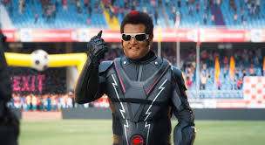
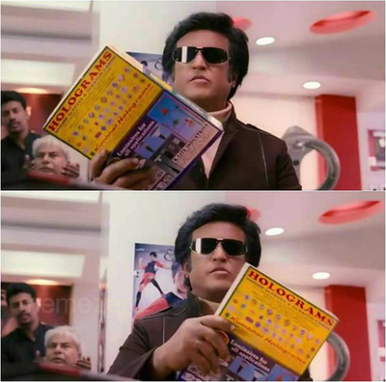
Recall this ?
Robo Chitti reads multiple books ,
learns the books
memorizes the books.
Hello World I am Robot, Speed 1 terahertz, memory 1 zeta byte.

Slide 7






What does Generative AI do ?
Story
Poem
Generate Code
Generate
Summarize Text
Conversation
Input
Generate
create music
New Song
Input
Input
Generate
Digital avatars
Long-form to short-form video
Machine Learning/Deep Learning Algorithm
Content Marketing Teams
polishing video
Create Movies
Notes:
Video Generator -- https://zapier.com/blog/best-ai-video-generator/
Audio Generator -- https://beebom.com/meta-audiocraft-ai-audio-tool-introduced/
Audio Generator --- https://www.assemblyai.com/blog/recent-developments-in-generative-ai-for-audio/
https://www.assemblyai.com/blog/recent-developments-in-generative-ai-for-audio/

Slide 8

ChatGPT
Story
Input
Generate
Poem
Generate Code
Summarize Text
Conversation
New Song

Slide 9



What is ChatGPT
ChatGPT
Large Language Model
Notes:
ChatGPT is Conversation LLM - Large Language Model

Slide 10
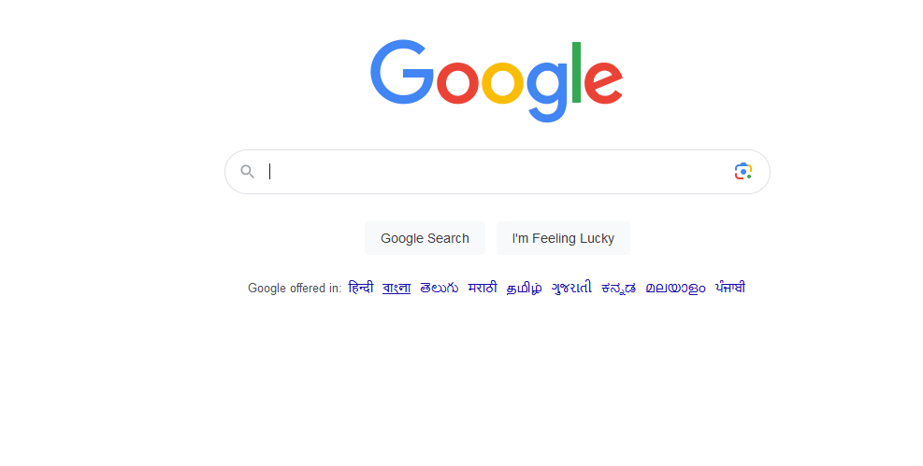
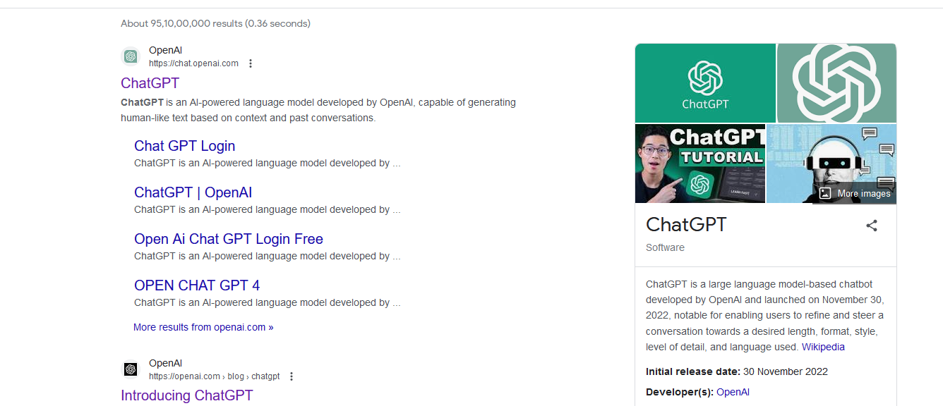
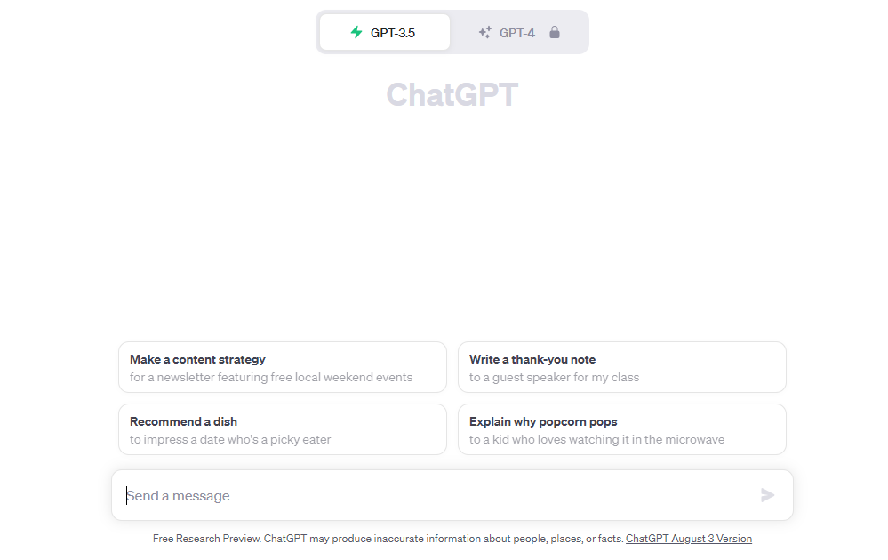
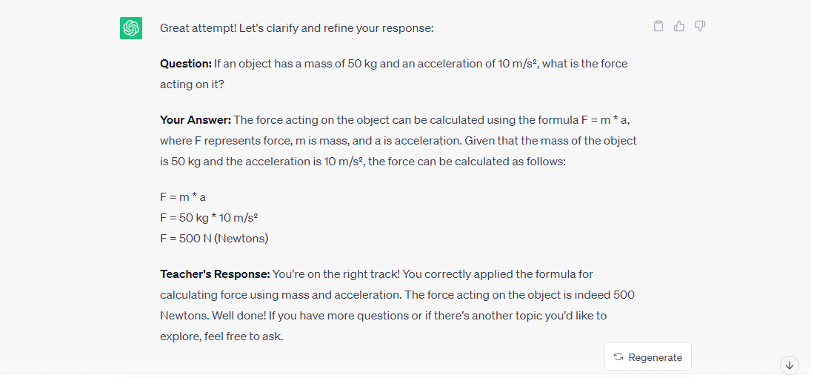
Google vs ChatGPT
Search for text in text bar
Converse in Chat format

Slide 11



Setup ChatGPT and Getting Started
Navigate to http://chat.openai.com
Make an account in chat.openai.com
Login with account in chat.openai.com

Slide 12
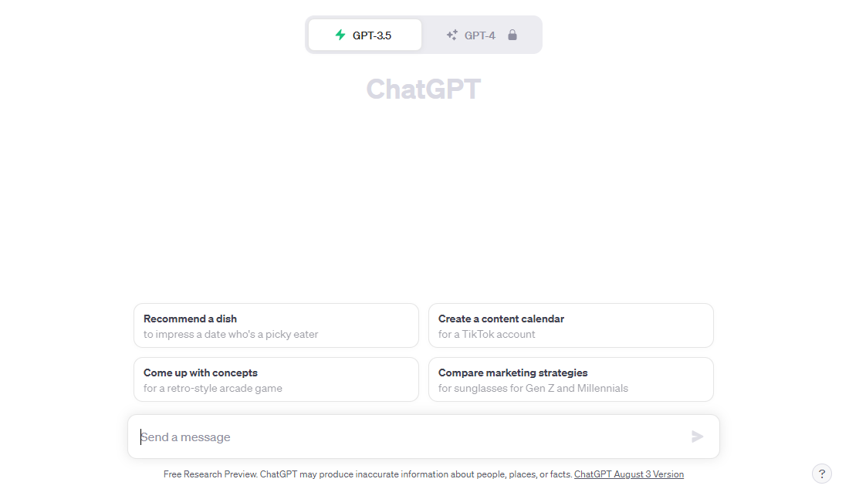
Prompt

Slide 13

What is a Prompt
A set of instructions provided to ChatGPT (LLM) in order to
generate an output
A Prompt sets the context for conversation in order to retrieve
the desired output content and the output form

Slide 14
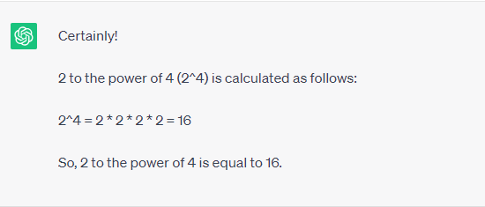
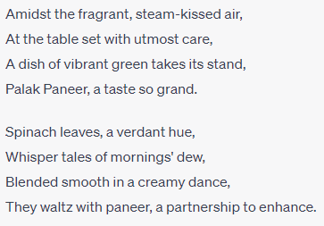
Prompt Examples
Calculate the 2 to the power of 4
Or Calculate the sum of sin 30 and cos 30
Can you write a short poem on describing the situation while eating palak paneer
Problem Solving
Writing Poem

Slide 15
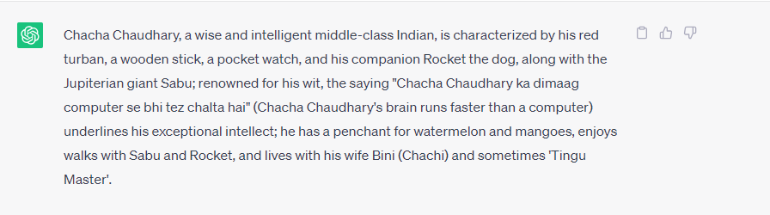
Prompt Examples
Text Summarization
Chacha Chaudhary is a middle class Indian, frail but an extremely intelligent elder. The word chacha means uncle in Hindi, while Chaudhary is a term used for landlords. A common saying about him is that "Chacha Chaudhary ka dimaag computer se bhi tez chalta hai" (Chacha Chaudhary's brain runs faster than a computer), which is a testament to his unparalleled wisdom and wits.
Chacha Chaudhary's attire includes his red turban, a wooden stick, a waistcoat with a double inside pocket, and a pocket watch. His household consists of his wife Bini (Chachi), a faithful street dog called Rocket and a giant alien from jupiter named Sabu. Sometimes, a tiny man called 'Tingu Master' is also shown to live with them. Chacha Chaudhary enjoys eating watermelon with relish but mangoes are his weakness, and takes off for a walk with Sabu and Rocket, whenever Chachi nags him. When he takes off his turban, it is shown that he is completely bal

Slide 16
Prompt Engineering
Asking ChatGPT the best possible questions to get more accurate and a reasonable answer.
Better Questions that are asked then the better answers are written.

Slide 17
Prompt Engineering Example
Prompt 1 : Write a tweet about movieAI
Prompt 2 : Write a tweet about movieAI ? MovieAI writes about Akshay Kumar
Prompt 3 : Write a tweet about movieAI as Akshay Kumar is a Father of two kids in the movie Palampa :MovieAI narrates how Akshay Kumar makes ends meet to raise the kids
Replace Akshay Kumar with he
Prompt 4 : Write a tweet about movieAI as he is a Father of two kids in the movie :MovieAI narrates how he makes ends meet to raise the kids

