Slide 1
K Nearest Neighbors

Slide 2
KNN
KNN can be used for both regression and classification. We shall use KNN only for classification in this case

Slide 3
KNN
K Nearest Neighbors is one of the simplest machine learning algorithms.
It simply assigns a label to new data based on the distance between the old data and new data.

Slide 4
KNN
Imagine a height and weight data set
HEIGHT
WEIGHT

Slide 5
KNN
We historically know the sex of the chicks:
MALE
FEMALE
HEIGHT
WEIGHT

Slide 6
KNN
How would we assign sex to a new point?
MALE
FEMALE
HEIGHT
WEIGHT

Slide 7
KNN
We intuitively “know” this is likely female.
MALE
FEMALE
HEIGHT
WEIGHT

Slide 8
KNN
Intuition comes from distance to points!
MALE
FEMALE
HEIGHT
WEIGHT

Slide 9
KNN
What about a less obvious point?
MALE
FEMALE
HEIGHT
WEIGHT

Slide 10
KNN
How many points to we consider?
MALE
FEMALE
HEIGHT
WEIGHT

Slide 11
KNN
Let’s imagine a situation like this:
MALE
FEMALE
HEIGHT
WEIGHT

Slide 12
KNN
K=1
MALE
FEMALE
HEIGHT
WEIGHT

Slide 13
KNN
K=1
MALE
FEMALE
HEIGHT
WEIGHT

Slide 14
KNN
K=2
MALE
FEMALE
HEIGHT
WEIGHT

Slide 15
KNN
K=3
MALE
FEMALE
HEIGHT
WEIGHT

Slide 16
KNN
K=4 leads to a tie!
MALE
FEMALE
HEIGHT
WEIGHT

Slide 17
KNN
Tie considerations and options:
Always choose an odd K.
In case of tie,simply reduce K by 1 until tie is broken.
Randomly break tie.
Choose nearest class point.

Slide 18
KNN
What does Scikit-Learn do in case of tie?
Warning: Regarding the Nearest Neighbors algorithms, if it is found that two neighbors, neighbor k+1 and k, have identical distances but different labels, the results will depend on the ordering of the training data.

Slide 19
KNN
What does Scikit-Learn do in case of tie?
In the case of ties, the answer will be the class that happens to appear first in the set of neighbors.
Results are ordered by distance, so it chooses the class of the closest point.

Slide 20
KNN
K=4 leads to a tie!
MALE
FEMALE
HEIGHT
WEIGHT

Slide 21
KNN
Choose closest K
MALE
FEMALE
HEIGHT
WEIGHT

Slide 22
KNN
Choose closest K
MALE
FEMALE
HEIGHT
WEIGHT

Slide 23
KNN
K=5 causes a switch from previous K values.
MALE
FEMALE
HEIGHT
WEIGHT

Slide 24
KNN
How to choose best K value?
MALE
FEMALE
HEIGHT
WEIGHT

Slide 25
KNN
We want a K value that minimizes error:
Error = 1 - Accuracy
Two methods:
Elbow method.
Cross validate a grid search of multiple K values and choose K that results in lowest error or highest accuracy.

Slide 26
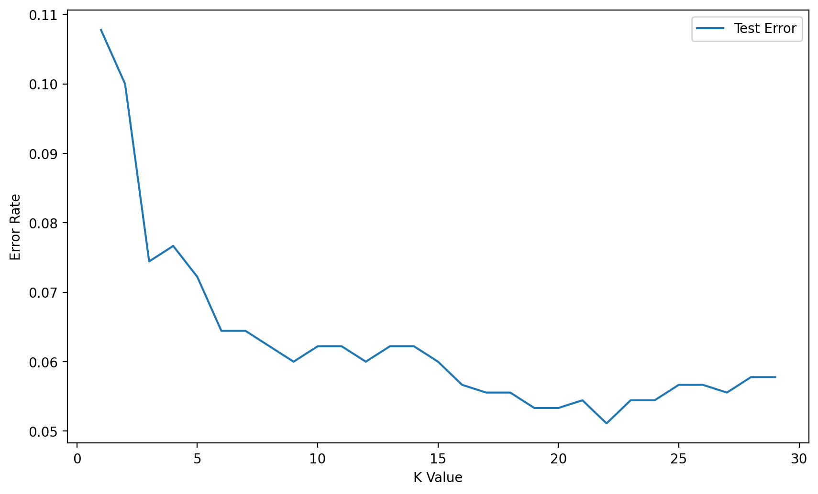
KNN
Elbow method:

Slide 27
KNN
Elbow method:

Slide 28
KNN
Elbow method:

Slide 29
KNN
Cross validation only takes into account the K value with the lowest error rate across multiple folds.
This could result in a more complex model (higher value of K).
Consider the context of the problem to decide if larger K values are an issue.

Slide 30
KNN
KNN Algorithm
Choose K value.
Sort feature vectors (N dimensional space) by distance metric.
Choose class based on K nearest feature vectors.

Slide 31
KNN
KNN Considerations:
Distance Metric
Many ways to measure distance:
Minkowski
Euclidean
Manhattan
Chebyshev

Slide 32
KNN
KNN Considerations:
Scaling for Distance
Features could have vastly different value ranges!
Feature 2
Feature 1

Slide 33
KNN
KNN Considerations:
Scaling for Distance
Features could have vastly different value ranges!
Feature 2
Feature 1

Slide 34
KNN
KNN Considerations:
Scaling for Distance
Features could have vastly different value ranges!
Feature 2
Feature 1

Slide 35
KNN
KNN Considerations:
Scaling is necessary for KNN.
Scaled Feature 2
Scaled Feature 1

Slide 36
KNN
While the KNN Algorithm is relatively simple, keep in mind the following considerations:
Choosing the optimal K value.
Scaling features.

