Slide 1
HttpConnectionThread 1
On crée au tant des threads que des connexions http au serveur
Socket
-IP Address
ServerListenerThread
ServerSocket
Port
IP Address
…
1 -- N
HttpConnectionThread N
Socket
-Ip Address

Slide 2
Http request
HTML (request with no parameter)
NanoHTTPD
JSON (with parameter request=upload)
MyHttpServer
Browser
Response 1 : Html liste des fichiers sous la racine du serveur
Response 2 : Json la liste des fichiers au format Json sous le répertoire upload

Slide 3
extends
MyHttpServer
NanoHTTPD

Slide 4
1
Connect (server IP +port)
Download file (file url)
NanoHTTPD
HttpUrlConnection
2
MyHttpServer
HttpFileDownloader

Slide 5
MyHttpServer 1
MyHttpServer 2
1
Request = upload (+ file url)
NanoHTTPD
NanoHTTPD
Instanciation du uploader
Transfer progress ( + file name)
2
Download Data ( + file url)
3
HttpUrlConnection
HttpFileUploader
Mécanisme de téléversement d’un fichier

Slide 6
Package MyApplication
-MainActivity
Package DB
Package Http
Package UI
DatabaseHelper
Connexion
FileTransfer
NanoHTTPD
MyHttpServer
HttpFileDownloader
HttpFileUploader
HttpUrlOpener
Filetransfer
- FiletransferFragment
- FiletransferViewModel

Slide 7
Package MyApplication
-MainActivity
Package DB
Package UI
DatabaseHelper
Connexion
FileTransfer
Administration
- AdministrationFragment
- AdministrationViewModel

Slide 8
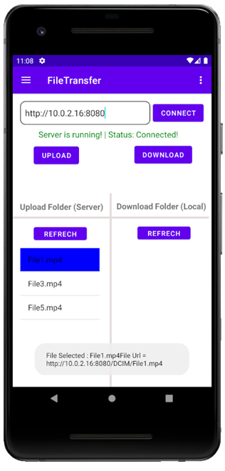
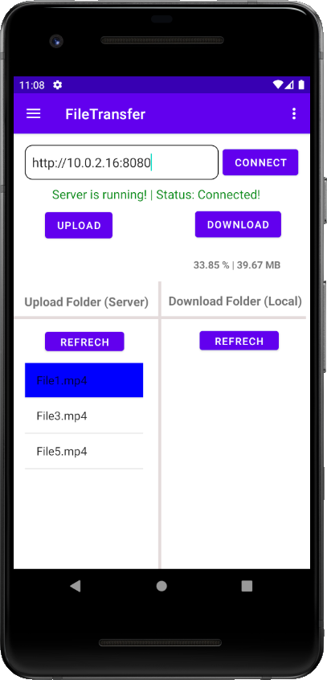
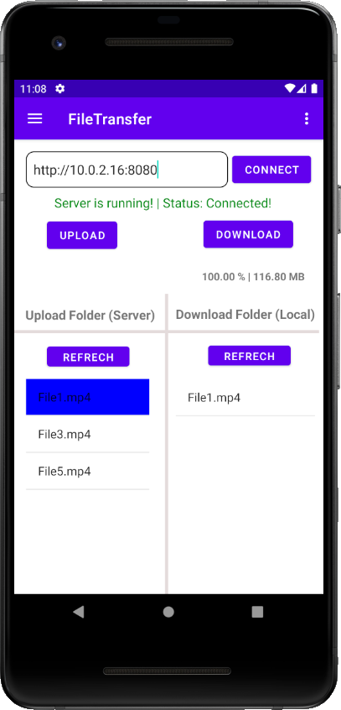

Slide 9
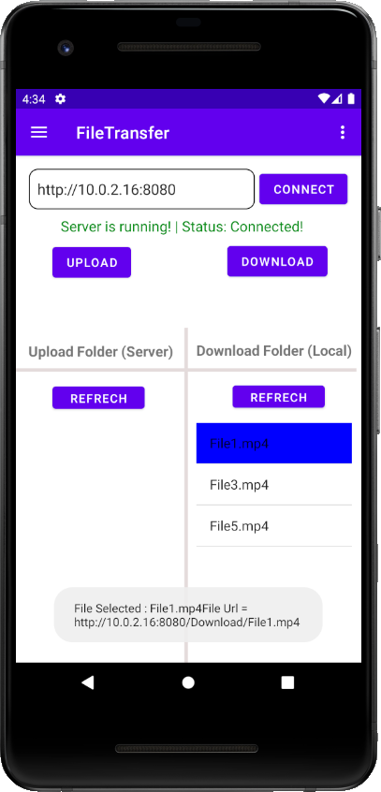
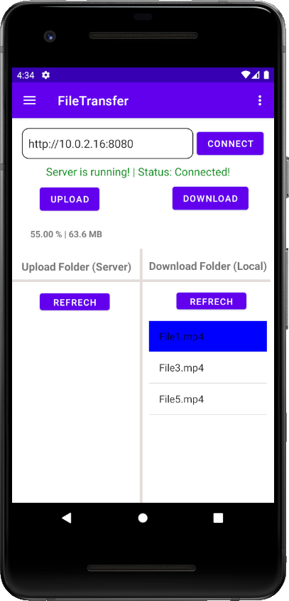
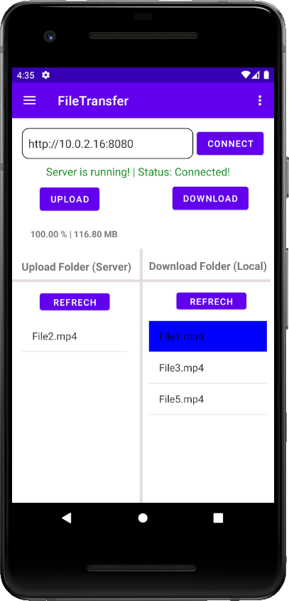

Slide 10
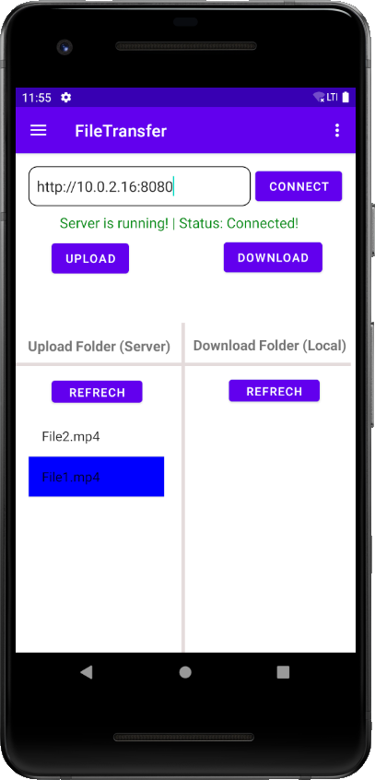

Slide 11
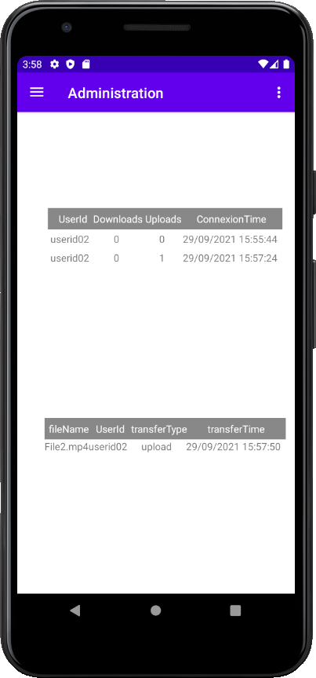
"Connexions" TableView
"Files Transfers" TableView

Slide 12
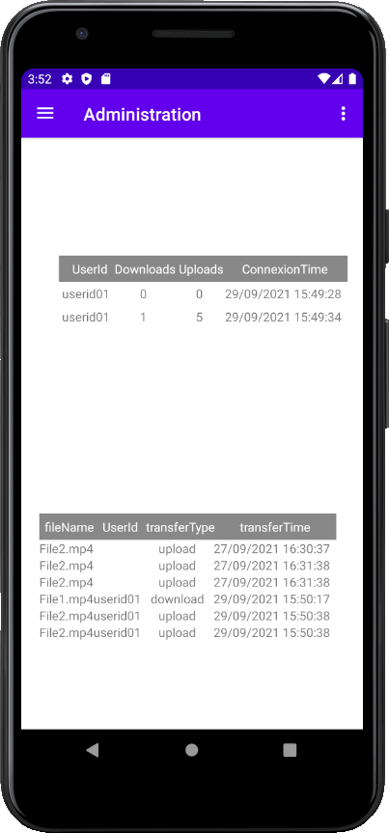

Slide 13
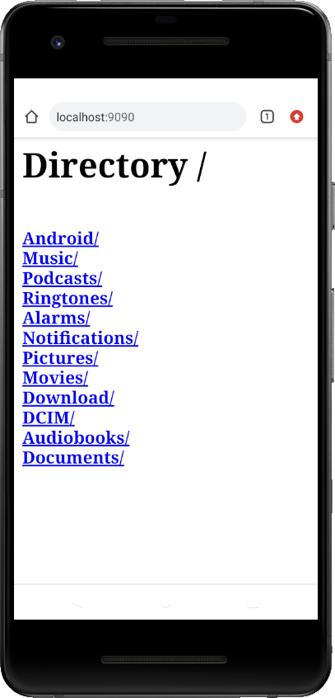

Slide 14
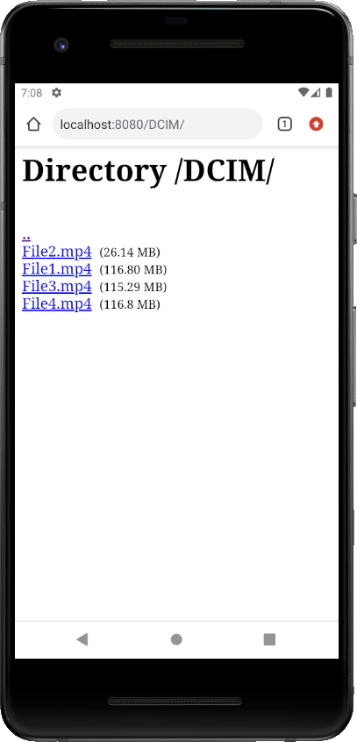
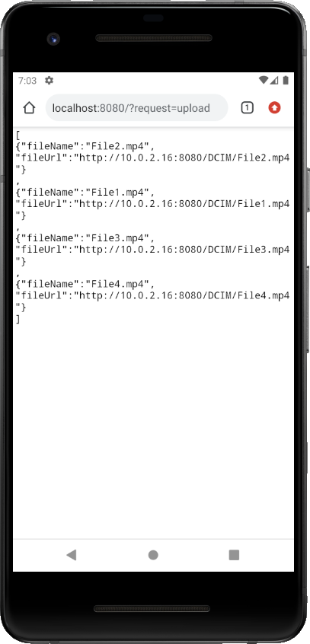
Format HTML
Format JSON

