Slide 1
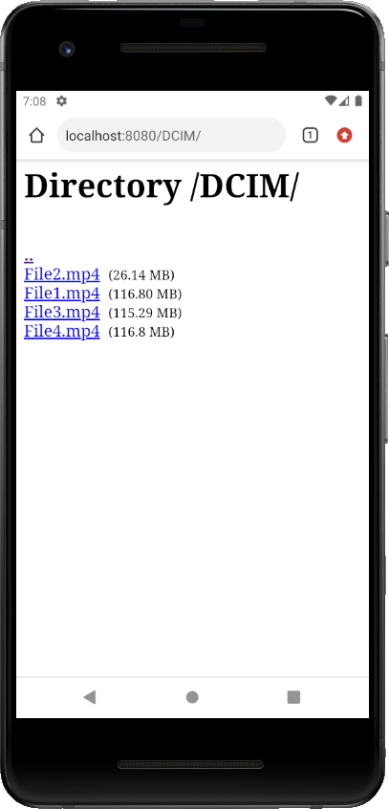
1
File_url
HttpUrlConnection
3
HttpFileDownloader
File bytes
Output/file
2
Android Apllication
OS/Browser Downloader

Slide 2
3
File_url
4
File bytes
Progression + filename
update
2
7
« File Transfer » Fragment
1
6
http request 1
http request 2
HttpUrlConnection
5
HttpFileUploader
HttpUrlConnection
http://server_ip:port/?request=upload
&fileUrl=[adresse_du_fichier_sur_le_seveur]
Output:File
http://server_ip:port/?request=upload&
progress=[progression]&fileName=[fileName]

Slide 3
File Transfer Fragment
Java.io
2
Folder Path
1
Button Refrech sous Download Folder Local
Liste des fichiers
File
3
ListView sous Download Folder Local

Slide 4
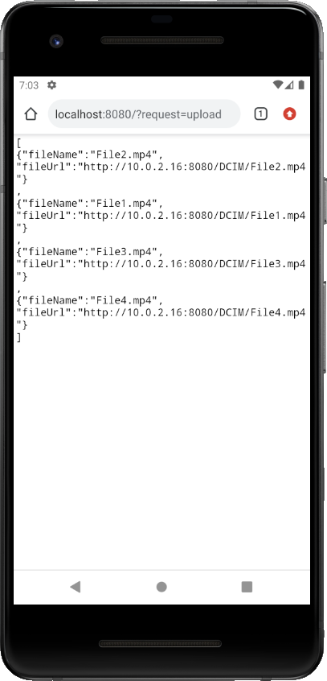
File Transfer Fragment
2
Server address + request = upload
1
Refrech Upload Folder
Listes des fichiers en format Json
sous le répertoire Upload Folder distant
3
4
ListView sous répertoire
Upload folder distant

