Slide 1

Crypto-psy
An attempt to use deep learning to predict crypto-currency value.
team = [Ahmed, Dewesh, Matt, Karthik, Kihoon ];

Slide 2

Can this make us rich?
We have used a deep neural network to predict the price of a Bitcoin but we aren’t millionaires yet…Here is what we did

Slide 3


Tech stack
Python-Pandas
Python-Matplotlib
Keras (neural-network library)
TensorFlow (Dataflow library)
scikit-learn (machine learning library)

Slide 4
USING LSTM wait.. what?
LSTM: Long Short Term Memory: is an artificial recurrent neural network (RNN) architecture particularly suitable for time series problems.
Simply put, LSTM networks have some internal contextual state cells that act as long-term or short-term memory cells. The output of the LSTM network is modulated by the state of these cells. This is a very important property when we need the prediction of the neural network to depend on the historical context of inputs, rather than only on the very last input.

Slide 5
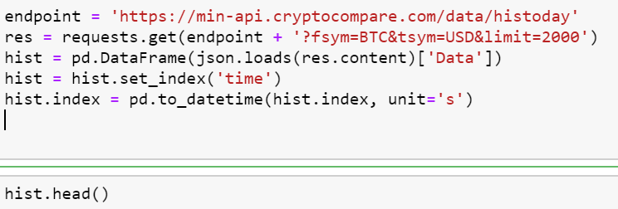
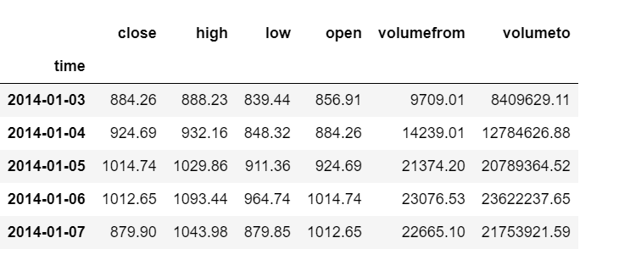
The approach
1-Finding the data: Using a single API call we fetched historic data for Bitcoin prices

Slide 6
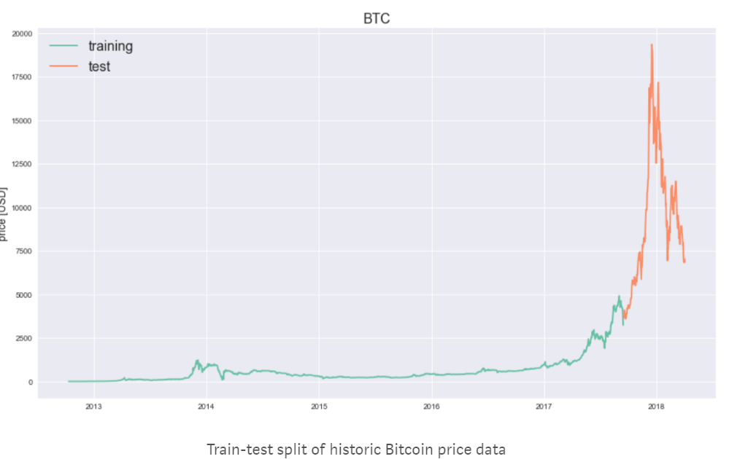
2-Train-Test Split: We split the data into a training and a test sets.The last 10% of the data is the test set.
We are focused on the closing price so here is a plot of this column

Slide 7
3-Normalizing the data
the data was split into windows of 7 days and within each window we normalized the data to zero base, i.e. the first entry of each window is 0 and all other values represent the change with respect to the first value. Hence, we are predicting price changes, rather than absolute price.

Slide 8
The Neural Network:
a single LSTM layer consisting of 20 neurons, a dropout factor of 0.25, and a Dense layer with a single linear activation function. In addition, We used Mean Absolute Error (MAE) as loss function and the Adam optimizer trained the network for 50 epochs with a batch size of 4

Slide 9
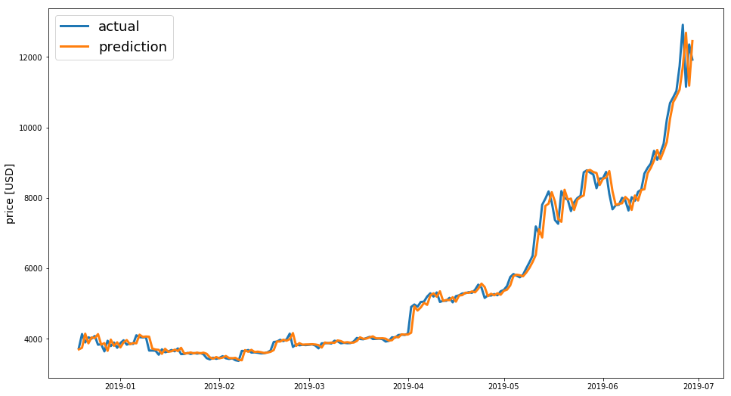
The result
Using the trained model to predict the Bitcoin price Then graphed the prediction against actual value:

Slide 10
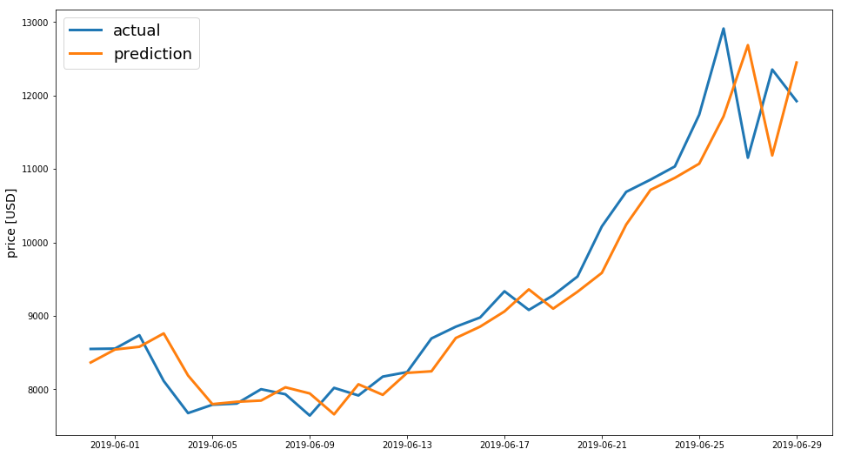
Lets zoom in the last 30 days to take a closer look:
“The prediction seems to be a shifted version of the actual price, To be specific it is shifted by a day”

Slide 11
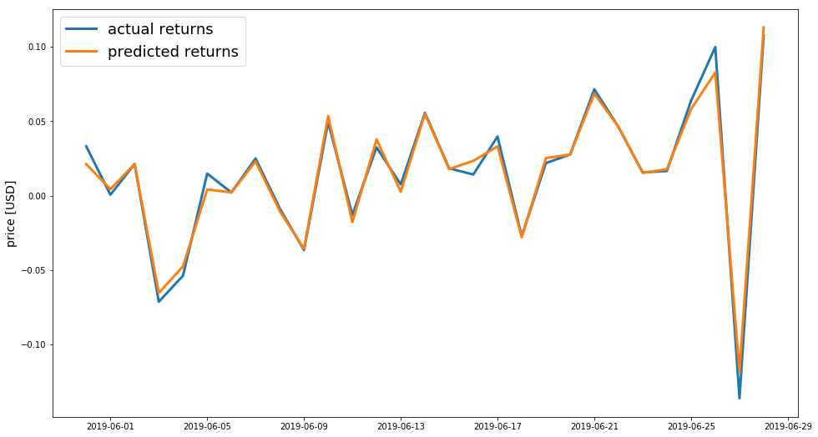
If we shift the prediction by a day the observation becomes more clear

Slide 12
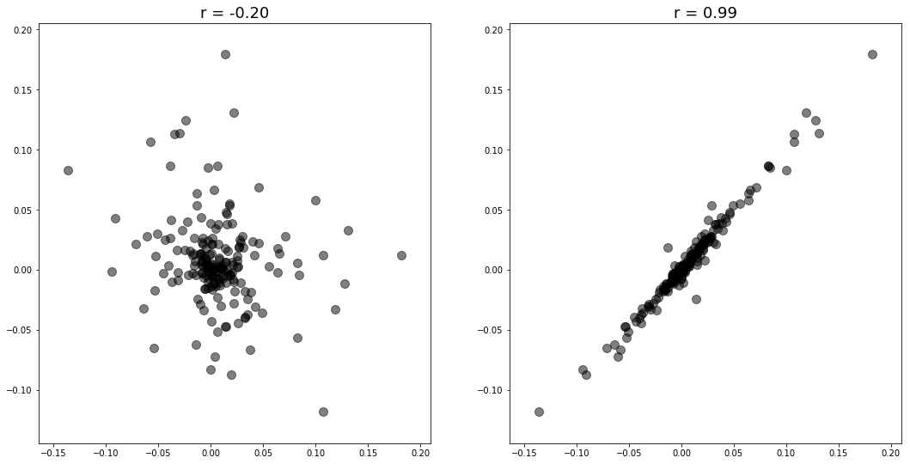
Lets compare the correlation of the original prediction vs a 1-day shifted prediction :

Slide 13
Conclusion
LSTM was able to learn but it ended up using a strategy which predicts a value very close to the previous day which is successful in minimizing the mean absolute error.
However, no matter how accurate the predictions are in terms of the loss error — in practice, the results of single-point prediction models based on historic price data alone, as the one showcased here, remain hard to accomplish and are not particularly useful for trading.
“past performance is not an indicator for future outcomes”

Slide 14
Next Steps
Incorporate Tabpy to integrate python functionalities with tableau.
Create interactive dash boards to present the findings in tableau.
Predict prices for at least one more day accurately.
Requires additional data to train the model.
Need to incorporate more algorithms

Slide 15
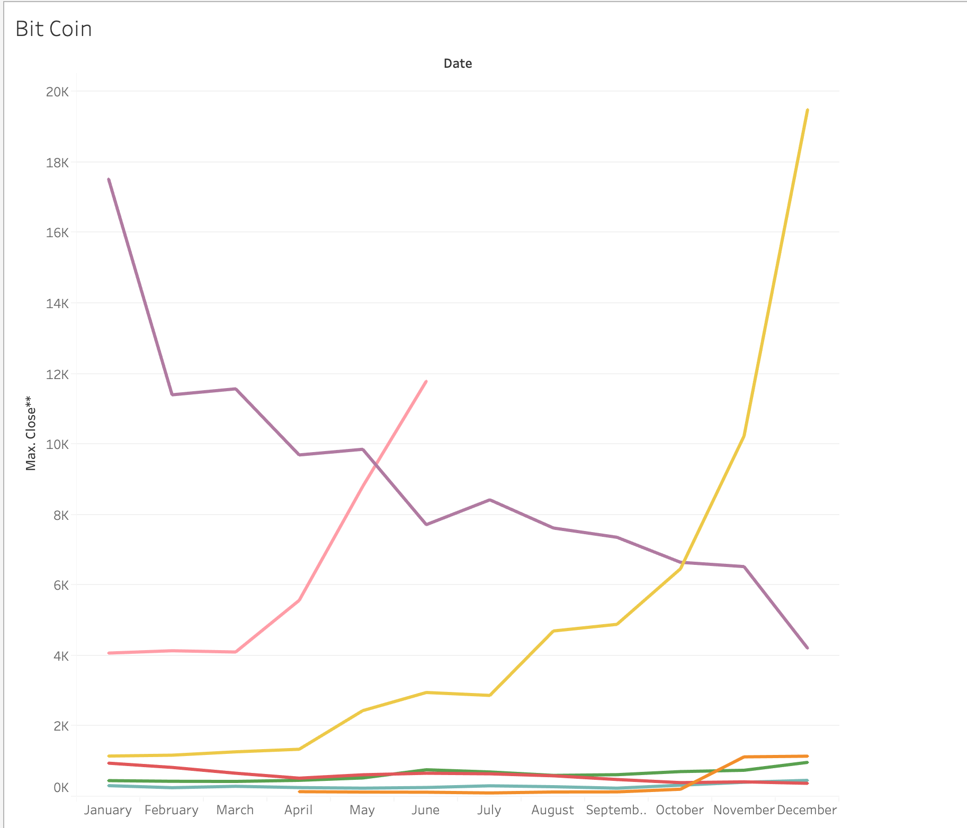
Appendix - 1 : Tableau Year on Year Monthly Performance

Slide 16
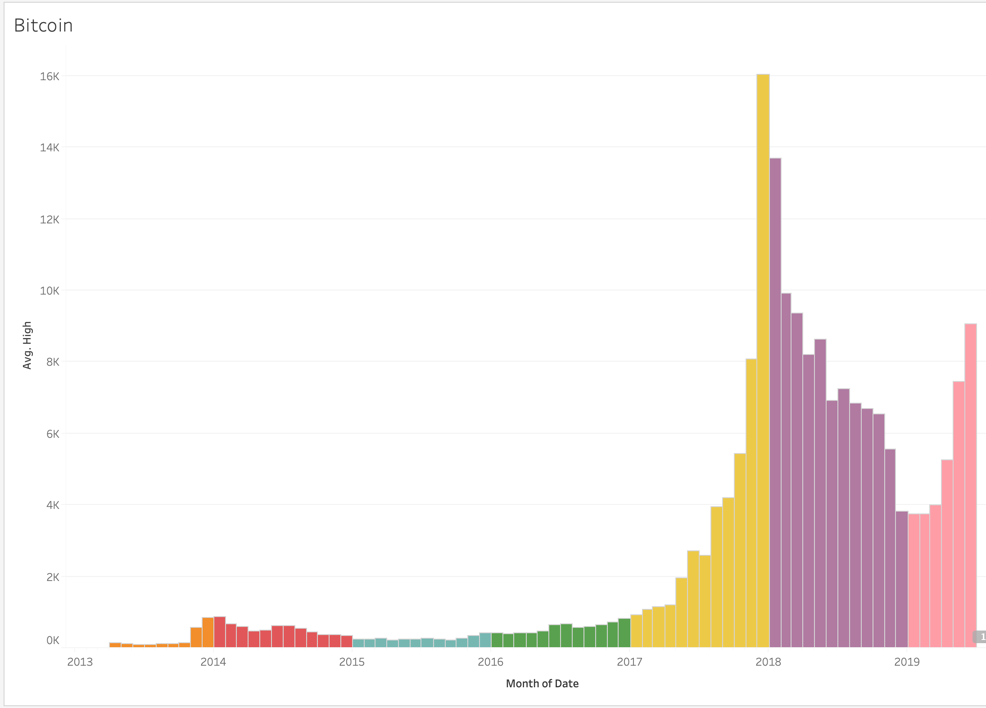
APPENDIX - 2: Price variations over the years

