Slide 1
My Journal to Python
name: mark jay p. pecjo
Sid: 4110e228
Teacher: mydeargreatteacher

Slide 2
Agenda
PYTHON
INPUT AND OUTPUT: INPUT () AND PRINT ()
DATA TYPES: NUMERISC, STRINGS, LIST , DICT
OPERATORS ON DATA TYPE:
CONTROLS : IF- | IF –ELSEIF |-F-ELSE
LOOP: FOR | WHILE | RANGE() | BREAK | CONTINUE
FUNCTION:
PARAMETERS (ARGUMETNS)
RECURSIVE FUNCTION
LAMBDA FUNCTION

Slide 3
pYThoN
What can Python do?
Python can be used on a server to create web applications.
Python can be used alongside software to create workflows.
Python can connect to database systems. It can also read and modify files.
Python can be used to handle big data and perform complex mathematics.
Python can be used for rapid prototyping, or for production-ready software development.

Slide 4
pYThoN
Why Python?
Python works on different platforms (Windows, Mac, Linux,
Raspberry Pi, etc.).
Python has a simple syntax similar to the English language.
Python has syntax that allows developers to write programs with fewer lines than some other programming languages.
Python runs on an interpreter system, meaning that code can be executed as soon as it is written. This means that prototyping can be very quick.
Python can be treated in a procedural way, an object-oriented way or a functional way.

Slide 5
pYThoN
GOOD TO KNOW
The most recent major version of Python is Python 3, which we shall be using in this tutorial. However, Python 2, although not being updated with anything other than security updates, is still quite popular.
In this tutorial Python will be written in a text editor. It is possible to write Python in an Integrated Development Environment, such as Thonny, Pycharm, Net beans or Eclipse which are particularly useful when managing larger collections of Python files.

Slide 6
pYThoN
Python Syntax compared to other programming languages
Python was designed for readability, and has some similarities to the English language with influence from mathematics.
Python uses new lines to complete a command, as opposed to other programming languages which often use semicolons or parentheses.
Python relies on indentation, using whitespace, to define scope; such as the scope of loops, functions and classes. Other programming languages often use curly-brackets for this purpose.

Slide 7
pYThoN syntax

Slide 8
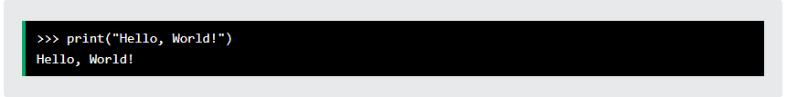
pYThoN syntax
pYThoN - execute python syntax
As we learned in the previous page, Python syntax can be executed by writing directly in the Command Line:

Slide 9

pYThoN syntax
pYThoN - execute python syntax
Or by creating a python file on the server, using the .py file extension, and running it in the Command Line:

Slide 10
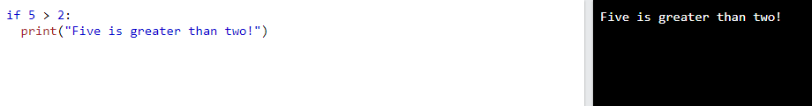
pYThoN syntax
pYThoN - identation
Indentation refers to the spaces at the beginning of a code line.
Where in other programming languages the indentation in code is for readability only, the indentation in Python is very important.
Python uses indentation to indicate a block of code.

Slide 11
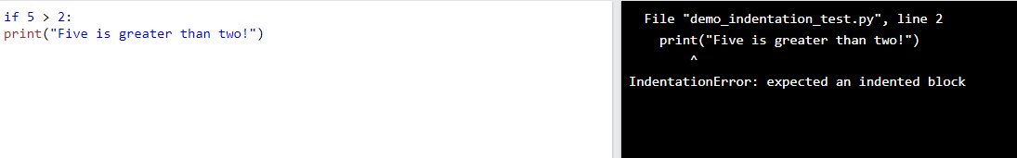
pYThoN syntax
pYThoN - identation
Python will give you an error if you skip the indentation:
Syntax Error:

Slide 12
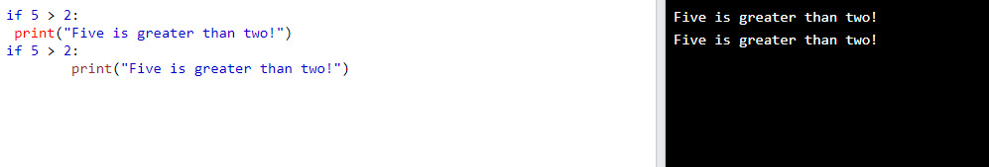
pYThoN syntax
pYThoN - identation
The number of spaces is up to you as a programmer, the most common use is four, but it has to be at least one.

Slide 13
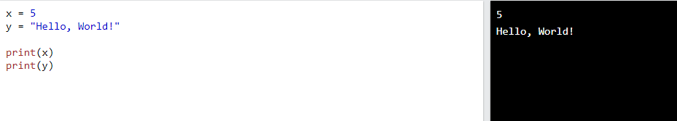
pYThoN syntax
pYThoN - variables
In Python, variables are created when you assign a value to it:
Variables in Python:
Python has no command for declaring a variable.
You will learn more about variables in the Python Variables chapter.

Slide 14
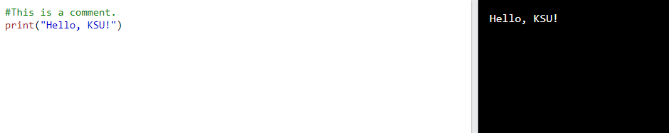
pYThoN syntax
pYThoN - Comments
Python has commenting capability for the purpose of in-code documentation.
Comments start with a #, and Python will render the rest of the line as a comment:

Slide 15
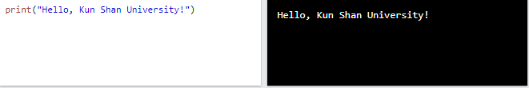
pYThoN
Example:

Slide 16
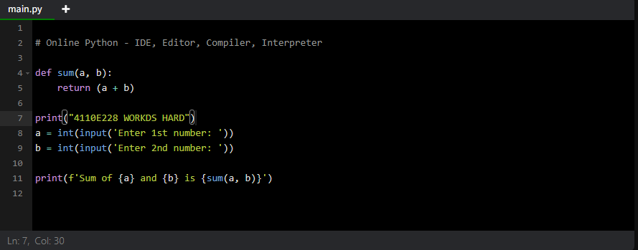
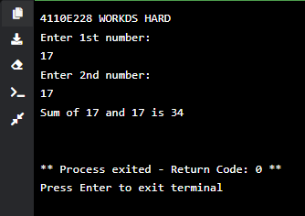
pYThoN
PYTHON ONLINE INTERPRETER 1

Slide 17
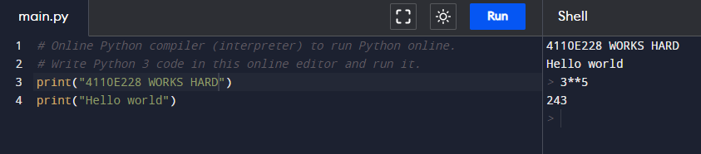
pYThoN
PYTHON ONLINE INTERPRETER 2
INTERACTIVE

Slide 18
pYThoN dictionaries

Slide 19
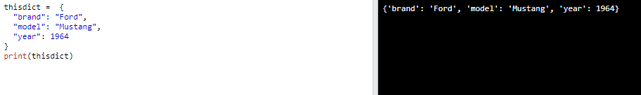
pYThoN dictionaries
Python - Dictionary
Dictionaries are used to store data values in key:value pairs.
A dictionary is a collection which is ordered*, changeable and do not allow duplicates.
As of Python version 3.7, dictionaries are ordered. In Python 3.6 and earlier, dictionaries are unordered.
Dictionaries are written with curly brackets, and have keys and values:
Create and print a dictionary:

Slide 20
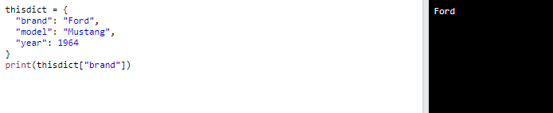
pYThoN dictionaries
Python - Dictionary items
Dictionary items are ordered, changeable, and does not allow duplicates.
Dictionary items are presented in key:value pairs, and can be referred to by using the key name.
Print the "brand" value of the dictionary:

Slide 21
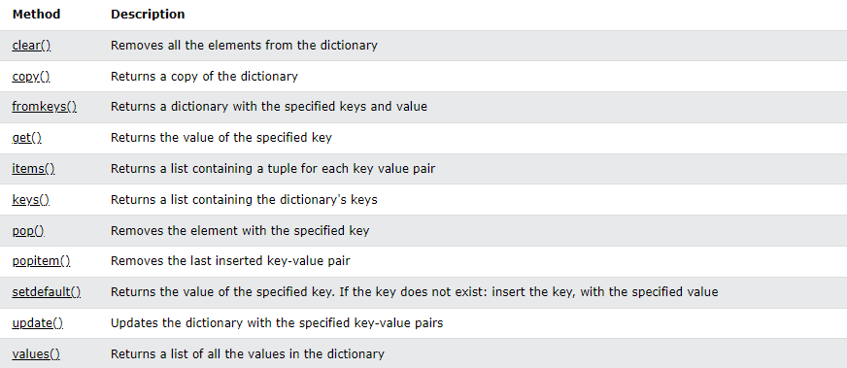
pYThoN dictionaries
Python - Dictionary methods
Python has a set of built-in methods that you can use on dictionaries.

Slide 22
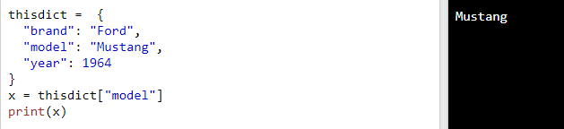
pYThoN access dictionary items
Python – accessing items
You can access the items of a dictionary by referring to its key name, inside square brackets:

Slide 23
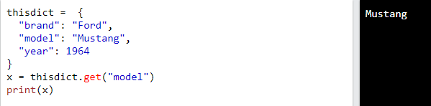
pYThoN access dictionary items
Python – accessing items
There is also a method called get () that will give you the same result:

Slide 24
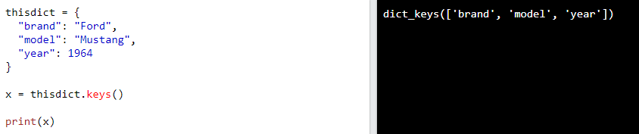
pYThoN access dictionary items
Python – get keys
The keys () method will return a list of all the keys in the dictionary.

Slide 25
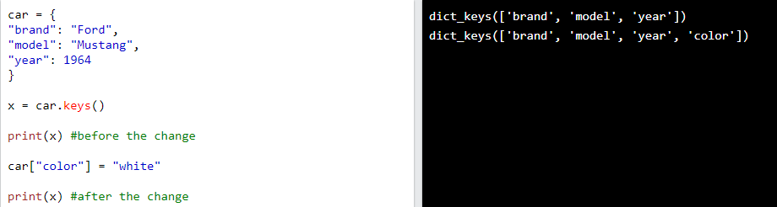
pYThoN access dictionary items
Python – get keys
The list of the keys is a view of the dictionary, meaning that any changes done to the dictionary will be reflected in the keys list.

Slide 26
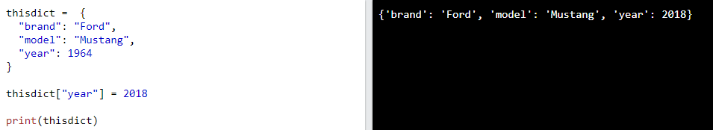
pYThoN change dictionary items
Python – change values
You can change the value of a specific item by referring to its key name:
The pop() method removes the item with the specified key name:

Slide 27
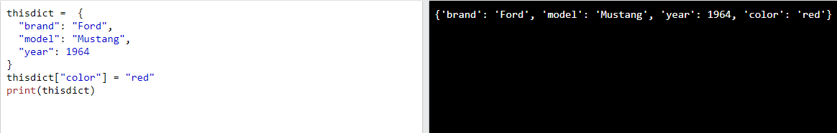
pYThoN add dictionary items
Python – adding items
Adding an item to the dictionary is done by using a new index key and assigning a value to it:

Slide 28
pYThoN add dictionary items
Python – adding items
Adding an item to the dictionary is done by using a new index key and assigning a value to it:

Slide 29
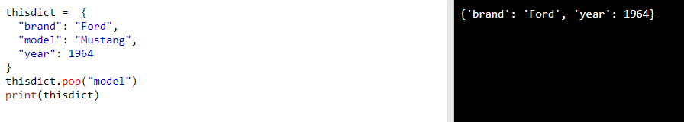
pYThoN remove dictionary items
Python – removing items
There are several methods to remove items from a dictionary:
The pop() method removes the item with the specified key name:

Slide 30
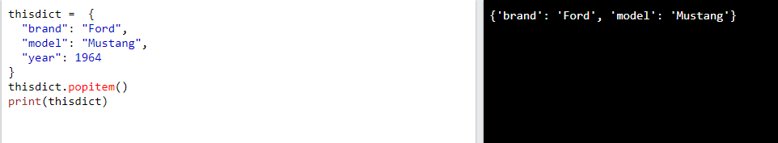
pYThoN remove dictionary items
Python – removing items
There are several methods to remove items from a dictionary:
The popitem() method removes the last inserted item (in versions before 3.7, a random item is removed instead):

Slide 31
pYThoN remove dictionary items
Python – removing items
There are several methods to remove items from a dictionary:
The del keyword removes the item with the specified key name:

Slide 32
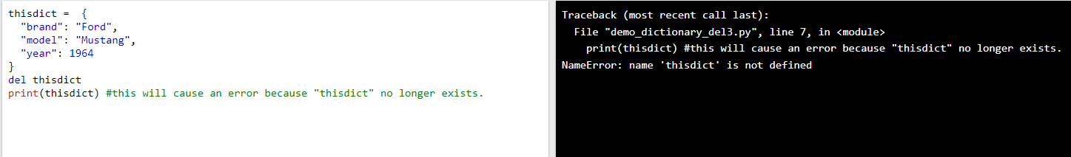
pYThoN remove dictionary items
Python – removing items
There are several methods to remove items from a dictionary:
The del keyword can also delete the dictionary completely:

Slide 33
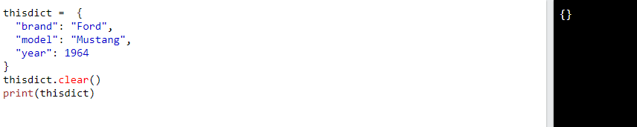
pYThoN remove dictionary items
Python – removing items
There are several methods to remove items from a dictionary:
The clear() method empties the dictionary:

Slide 34
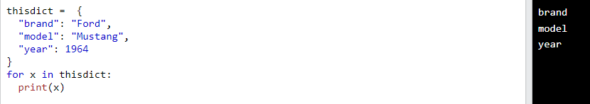
pYThoN loop dictionaries
Python – loop through a dicionary
You can loop through a dictionary by using a for loop. When looping through a dictionary, the return value are the keys of the dictionary, but there are methods to return the values as well.
Print all key names in the dictionary, one by one:

Slide 35
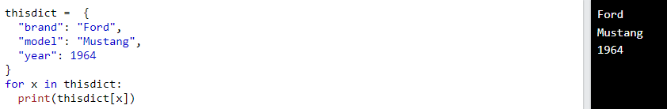
pYThoN loop dictionaries
Python – loop through a dicionary
You can loop through a dictionary by using a for loop. When looping through a dictionary, the return value are the keys of the dictionary, but there are methods to return the values as well.
Print all values in the dictionary, one by one:

Slide 36
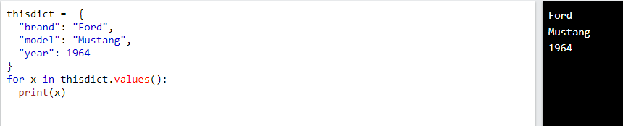
pYThoN loop dictionaries
Python – loop through a dicionary
You can loop through a dictionary by using a for loop. When looping through a dictionary, the return value are the keys of the dictionary, but there are methods to return the values as well.
You can also use the values() method to return values of a dictionary:

Slide 37
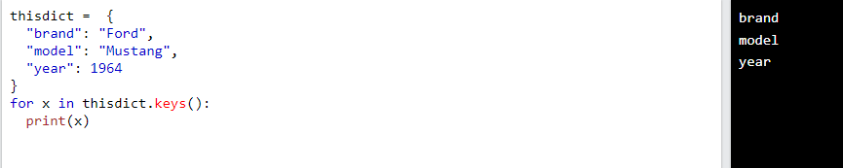
pYThoN loop dictionaries
Python – loop through a dicionary
You can loop through a dictionary by using a for loop. When looping through a dictionary, the return value are the keys of the dictionary, but there are methods to return the values as well.
You can use the keys() method to return the keys of a dictionary:

Slide 38
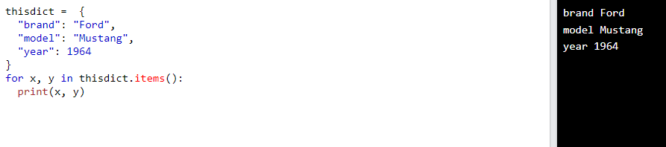
pYThoN loop dictionaries
Python – loop through a dicionary
You can loop through a dictionary by using a for loop. When looping through a dictionary, the return value are the keys of the dictionary, but there are methods to return the values as well.
Loop through both keys and values, by using the items() method:

Slide 39
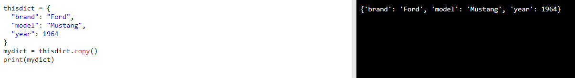
pYThoN copy dictionaries
Python – copy a dictionary
You cannot copy a dictionary simply by typing dict2 = dict1, because, dict2 will only be a reference to dict1, and changes made in dict1 will automatically also be made in dict2.
There are ways to make a copy, one way is to use the built-in Dictionary method copy()
Make a copy of a dictionary with the copy() method:

Slide 40
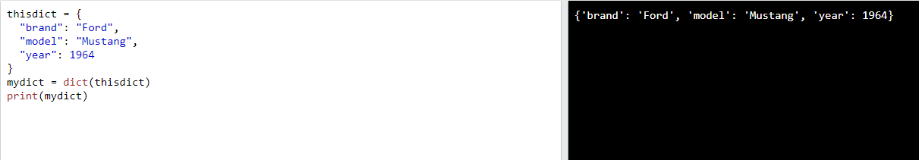
pYThoN copy dictionaries
Python – copy a dictionary
You cannot copy a dictionary simply by typing dict2 = dict1, because, dict2 will only be a reference to dict1, and changes made in dict1 will automatically also be made in dict2.
Another way to make a copy is to use the built-in function dict ()
Make a copy of a dictionary with the dict() function:

Slide 41
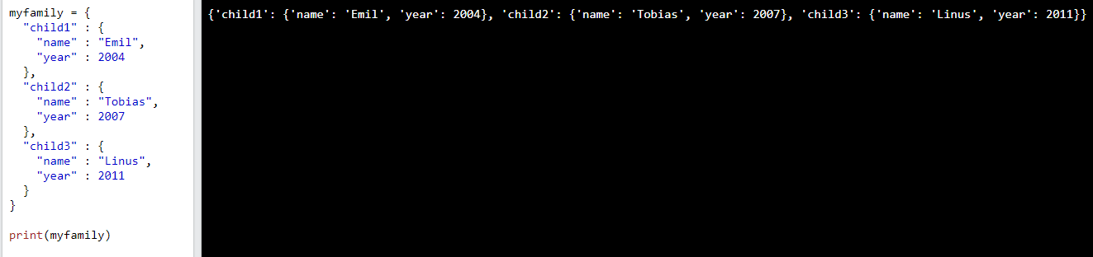
pYThoN nested dictionaries
Python – nested dictionaries
A dictionary can contain dictionaries, this is called nested dictionaries.
Another way to make a copy is to use the built-in function dict ()
Create a dictionary that contain three dictionaries:

Slide 42
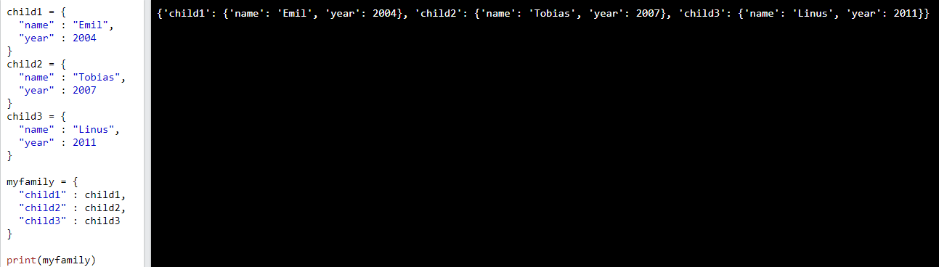
pYThoN nested dictionaries
Python – nested dictionaries
A dictionary can contain dictionaries, this is called nested dictionaries.
Or, if you want to add three dictionaries into a new dictionary:
Create three dictionaries, then create one dictionary that will contain the other three dictionaries:

Slide 43
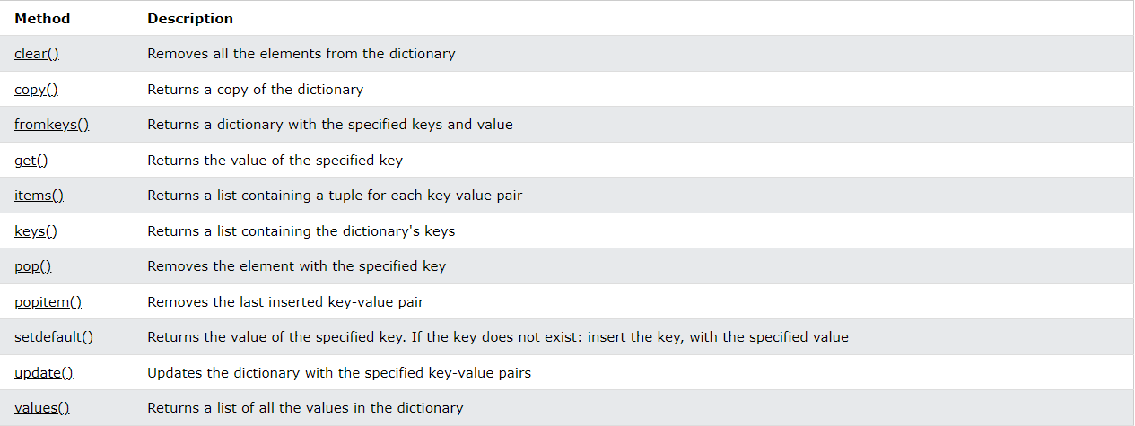
pYThoN dictionary methods
Python – dictionary methods
Python has a set of built-in methods that you can use on dictionaries.

Slide 44
pYThoN
PYTHON COMMENTS
Comments can be used to explain Python code.
Comments can be used to make the code more readable.
Comments can be used to prevent execution when testing code.

Slide 45
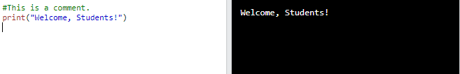
pYThoN comments
CREATING A COMMENTS
Comments starts with a #, and Python will ignore them:

Slide 46
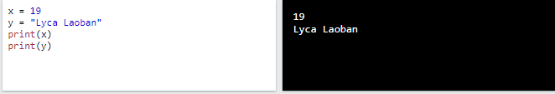
Python variables
Creating Variables
Python has no command for declaring a variable.
A variable is created the moment you first assign a value to it.

Slide 47
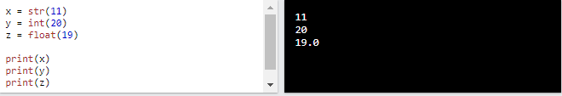
Python variables
casting
If you want to specify the data type of a variable, this can be done with casting.

Slide 48
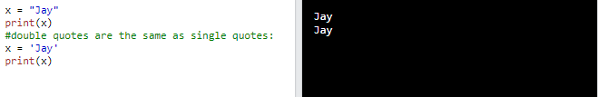
Python variables
Single or double quotes
String variables can be declared either by using single or double quotes:

Slide 49
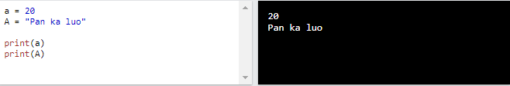
Python variables
Case-sensitive
Variable names are case-sensitive.

Slide 50
Python
Python numbers
There are three numeric types in Python:
int
float
complex

Slide 51
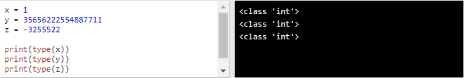
Python numbers
Python numbers: int
Variables of numeric types are created when you assign a value to them:

Slide 52
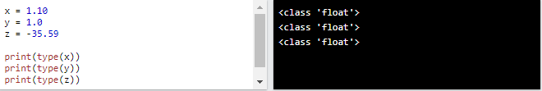
Python numbers
Python numbers: float
Float, or "floating point number" is a number, positive or negative, containing one or more decimals.

Slide 53
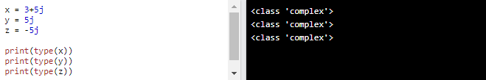
Python numbers
Python numbers: complex
Complex numbers are written with a "j" as the imaginary part:

Slide 54
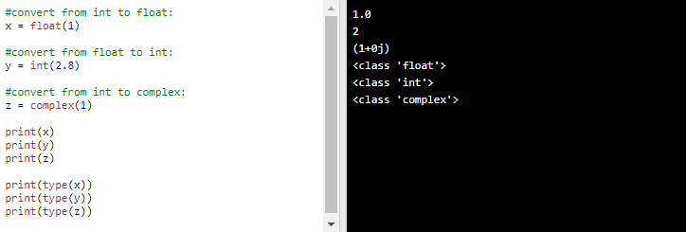
Python numbers
Type conversion
You can convert from one type to another with the int(), float(), and complex() methods:
Note: You cannot convert complex numbers into another number type.

Slide 55
Python numbers
Type conversion
You can convert from one type to another with the int(), float(), and complex() methods:
Note: You cannot convert complex numbers into another number type.

Slide 56
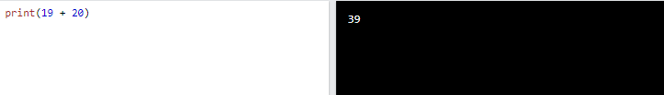
Python
Python operators
Operators are used to perform operations on variables and values.
In the example below, we use the + operator to add together two values:

Slide 57
Python
Python operators
Python divides the operators in the following groups:
Arithmetic operators
Assignment operators
Comparison operators
Logical operators
Identity operators
Membership operators
Bitwise operators

Slide 58
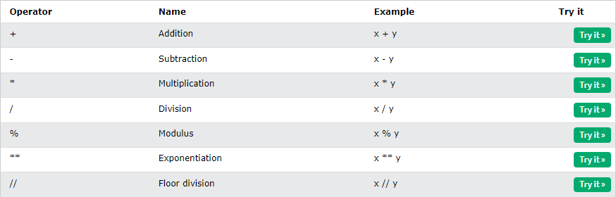
Python operators
Python arithmetic operators
Arithmetic operators are used with numeric values to perform common mathematical operations:

Slide 59
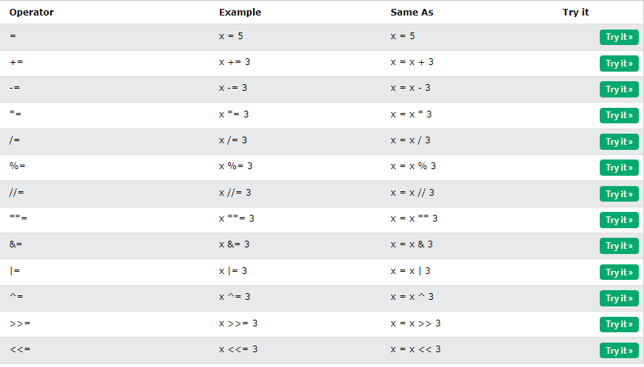
Python operators
Python assignment operators
Assignment operators are used to assign values to variables:

Slide 60
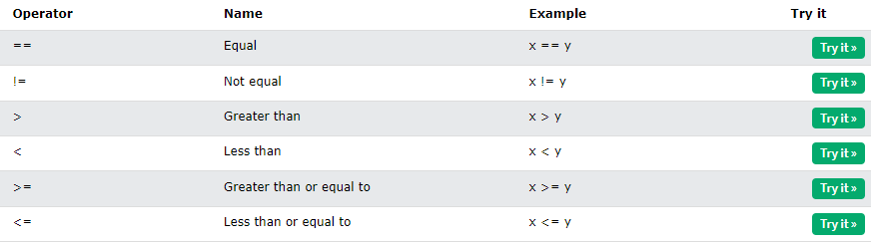
Python operators
Python comparison operators
Comparison operators are used to compare two values:

Slide 61
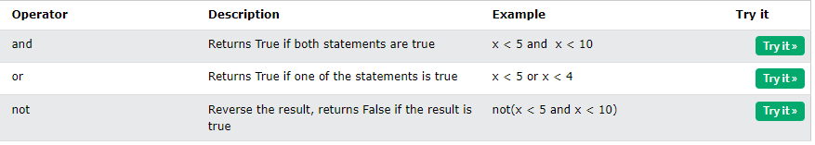
Python operators
Python logical operators
Logical operators are used to combine conditional statements:

Slide 62
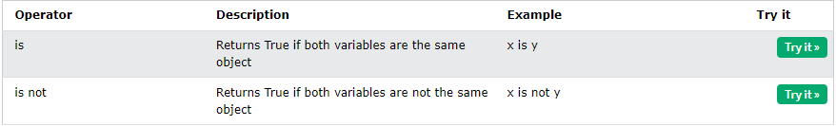
Python operators
Python identity operators
Identity operators are used to compare the objects, not if they are equal, but if they are actually the same object, with the same memory location:

Slide 63
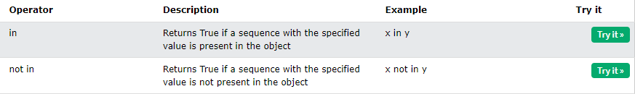
Python operators
Python membership operators
Membership operators are used to test if a sequence is presented in an object:

Slide 64
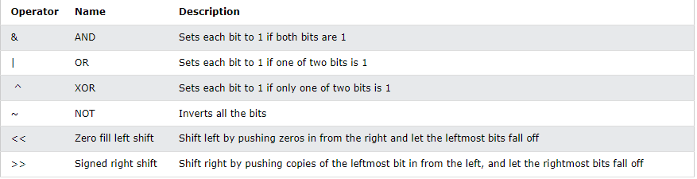
Python operators
Python bitwise operators
Bitwise operators are used to compare (binary) numbers:

Slide 65
Input and output

Slide 66

Input and output
Question:
Data Type

Slide 67

Input and output
Way: 1

Slide 68

Input and output
Way: 2

Slide 69

Input and output
Way: 3

Slide 70

Input and output
Answer: 1

Slide 71

Input and output
Answer: 2

Slide 72

Input and output
Answer: 3

Slide 73
Python data types

Slide 74

Python data types
Text Type: str

Slide 75

Python data types
Numeric Types: int

Slide 76

Python data types
Numeric Types: float

Slide 77

Python data types
Numeric Types: complex

Slide 78

Python data types
Sequence Types: list

Slide 79

Python data types
Sequence Types: tuple

Slide 80

Python data types
Sequence Types: range

Slide 81

Python data types
Mapping Types: dict

Slide 82

Python data types
Set Types: set

Slide 83

Python data types
Set Types: frozenset

Slide 84

Python data types
Boolean Types: bool

Slide 85

Python data types
Binary Types: bytes

Slide 86

Python data types
Binary Types: bytearray

Slide 87

Python data types
Binary Types: memoryview

Slide 88

Python data types
None Type: NoneType

Slide 89
Python booleans

Slide 90

Python booleans
PYTHON – BOOLEAN VALUES
In programming you often need to know if an expression is True or False.
You can evaluate any expression in Python, and get one of two answers, True or False.
When you compare two values, the expression is evaluated and Python returns the Boolean answer:

Slide 91

Python booleans
PYTHON – BOOLEAN VALUES
When you run a condition in an if statement, Python returns True or False:
Print a message based on whether the condition is True or False:

Slide 92

Python booleans
PYTHON – Evaluate Values and Variables
The bool() function allows you to evaluate any value, and give you True or False in return,
Evaluate a string and a number:

Slide 93

Python booleans
PYTHON – Evaluate Values and Variables
The bool() function allows you to evaluate any value, and give you True or False in return,
Evaluate two variables:

Slide 94
Python operators

Slide 95

Python operatoes
PYTHON – Operators
Operators are used to perform operations on variables and values.
In the example below, we use the + operator to add together two values:

Slide 96
Python operatoes
PYTHON – Operators
Python divides the operators in the following groups:
Arithmetic operators
Assignment operators
Comparison operators
Logical operators
Identity operators
Membership operators
Bitwise operators

Slide 97

Python operatoes
PYTHON – Arithmetic Operators
Arithmetic operators are used with numeric values to perform common mathematical operations:

Slide 98

Python operatoes
PYTHON – Assignment Operators
Assignment operators are used to assign values to variables:

Slide 99

Python operatoes
PYTHON – Comparison Operators
Comparison operators are used to compare two values:

Slide 100

Python operatoes
PYTHON – Logical Operators
Logical operators are used to combine conditional statements:

Slide 101

Python operatoes
PYTHON – Identity Operators
Identity operators are used to compare the objects, not if they are equal, but if they are actually the same object, with the same memory location:

Slide 102

Python operatoes
PYTHON – Membership Operators
Membership operators are used to test if a sequence is presented in an object:

Slide 103

Python operatoes
PYTHON – Bitwise Operators
Bitwise operators are used to compare (binary) numbers:

Slide 104
Python IF .. ELSE

Slide 105
Python if .. else
Python Conditions and If statements
Python supports the usual logical conditions from mathematics:
Equals: a == b
Not Equals: a != b
Less than: a < b
Less than or equal to: a <= b
Greater than: a > b
Greater than or equal to: a >= b

Slide 106

Python if .. else
Python - IF
These conditions can be used in several ways, most commonly in "if statements" and loops.
An "if statement" is written by using the if keyword.
In this example we use two variables, a and b, which are used as part of the if statement to test whether b is greater than a. As a is 33, and b is 200, we know that 200 is greater than 33, and so we print to screen that "b is greater than a".

Slide 107

Python if .. else
Indentation
Python relies on indentation (whitespace at the beginning of a line) to define scope in the code. Other programming languages often use curly-brackets for this purpose.
If statement, without indentation (will raise an error):

Slide 108

Python if .. else
Python - ELIF
The elif keyword is pythons way of saying "if the previous conditions were not true, then try this condition".
In this example a is equal to b, so the first condition is not true, but the elif condition is true, so we print to screen that "a and b are equal".

Slide 109

Python if .. else
Python - ELSE
The else keyword catches anything which isn't caught by the preceding conditions.
In this example a is greater than b, so the first condition is not true, also the elif condition is not true, so we go to the else condition and print to screen that "a is greater than b".

Slide 110

Python if .. else
Python - ELSE
You can also have an else without the elif:

Slide 111

Python if .. else
Python – SHORT HAND IF
If you have only one statement to execute, you can put it on the same line as the if statement.
One line if statement:

Slide 112

Python if .. else
Python – SHORT HAND IF .. ELSE
If you have only one statement to execute, one for if, and one for else, you can put it all on the same line:
One line if statement:

Slide 113

Python if .. else
Python – This technique is known as Ternary Operators, or Conditional Expressions.
You can also have multiple else statements on the same line:
One line if else statement, with 3 conditions:

Slide 114

Python if .. else
Test if a is greater than b, AND if c is greater than a:
Python – AND
The and keyword is a logical operator, and is used to combine conditional statements:
One line if else statement, with 3 conditions:

Slide 115

Python if .. else
Test if a is greater than b, AND if c is greater than a:
Python – OR
The or keyword is a logical operator, and is used to combine conditional statements:
Test if a is greater than b, OR if a is greater than c:

Slide 116

Python if .. else
Test if a is greater than b, AND if c is greater than a:
Python – NESTED IF
You can have if statements inside if statements, this is called nested if statements.

Slide 117

Python if .. else
Test if a is greater than b, AND if c is greater than a:
Python – THE PASS STATEMENT
if statements cannot be empty, but if you for some reason have an if statement with no content, put in the pass statement to avoid getting an error.

Slide 118
Python WHILE LOOPS

Slide 119
Python WHILE LOOPS
Test if a is greater than b, AND if c is greater than a:
Python – LOOPS
Python has two primitive loop commands:
for loops
while loops

Slide 120

Python WHILE LOOPS
Test if a is greater than b, AND if c is greater than a:
Python – THE WHILE LOOP
With the while loop we can execute a set of statements as long as a condition is true.
Print i as long as i is less than 6:

Slide 121

Python WHILE LOOPS
Test if a is greater than b, AND if c is greater than a:
Python – THE BREAK STATEMENT
With the break statement we can stop the loop even if the while condition is true:

Slide 122

Python WHILE LOOPS
Test if a is greater than b, AND if c is greater than a:
Python – THE CONTINUE STATEMENT
With the continue statement we can stop the current iteration, and continue with the next:
Continue to the next iteration if i is 3:

Slide 123

Python WHILE LOOPS
Test if a is greater than b, AND if c is greater than a:
Python – THE ELSE STATEMENT
With the else statement we can run a block of code once when the condition no longer is true:
Print a message once the condition is false:

Slide 124
Python FOR LOOPS

Slide 125

Python FOR LOOPS
Test if a is greater than b, AND if c is greater than a:
Python – FOR LOOPS
A for loop is used for iterating over a sequence (that is either a list, a tuple, a dictionary, a set, or a string).
This is less like the for keyword in other programming languages, and works more like an iterator method as found in other object-orientated programming languages.
With the for loop we can execute a set of statements, once for each item in a list, tuple, set etc.
Print each fruit in a fruit list:

Slide 126

Python FOR LOOPS
Test if a is greater than b, AND if c is greater than a:
Python – LOOPING THROUGH A STRING
Even strings are iterable objects, they contain a sequence of characters:
Loop through the letters in the word “Taiwan":

Slide 127


Python FOR LOOPS
Test if a is greater than b, AND if c is greater than a:
Python – THE BREAK STATEMENT
With the break statement we can stop the loop before it has looped through all the items:
Exit the loop when x is "banana":
Exit the loop when x is "banana", but this time the break comes before the print:

Slide 128

Python FOR LOOPS
Test if a is greater than b, AND if c is greater than a:
Python – THE RANGE () FUNCTION
To loop through a set of code a specified number of times, we can use the range() function,
The range() function returns a sequence of numbers, starting from 0 by default, and increments by 1 (by default), and ends at a specified number.
Using the range() function:

Slide 129

Python FOR LOOPS
Test if a is greater than b, AND if c is greater than a:
Python – THE RANGE () FUNCTION
The range() function defaults to 0 as a starting value, however it is possible to specify the starting value by adding a parameter: range(2, 6), which means values from 2 to 6 (but not including 6):
Using the start parameter:
Note that range(6) is not the values of 0 to 6, but the values 0 to 5.

Slide 130

Python FOR LOOPS
Test if a is greater than b, AND if c is greater than a:
Python – THE RANGE () FUNCTION
The range() function defaults to increment the sequence by 1, however it is possible to specify the increment value by adding a third parameter: range(2, 30, 3):
Increment the sequence with 3 (default is 1):

Slide 131

Python FOR LOOPS
Test if a is greater than b, AND if c is greater than a:
Python – ELSE IN FOR LOOP
The else keyword in a for loop specifies a block of code to be executed when the loop is finished:
Print all numbers from 0 to 5, and print a message when the loop has ended:

Slide 132

Python FOR LOOPS
Test if a is greater than b, AND if c is greater than a:
Python – ELSE IN FOR LOOP
Note: The else block will NOT be executed if the loop is stopped by a break statement.
Break the loop when x is 3, and see what happens with the else block:

Slide 133

Python FOR LOOPS
Test if a is greater than b, AND if c is greater than a:
Python – THE PASS STATEMENT
for loops cannot be empty, but if you for some reason have a for loop with no content, put in the pass statement to avoid getting an error.

Slide 134
Python FUNCTION

Slide 135
Python FUNCTION
Python FUNCTION
A function is a block of code which only runs when it is called.
You can pass data, known as parameters, into a function.
A function can return data as a result.

Slide 136

Python FUNCTION
CREATING A FUNCTION
In Python a function is defined using the def keyword:

Slide 137

Python FUNCTION
CALLING A FUNCTION
To call a function, use the function name followed by parenthesis:

Slide 138

Python FUNCTION
ARGUMENTS
Information can be passed into functions as arguments.
Arguments are specified after the function name, inside the parentheses. You can add as many arguments as you want, just separate them with a comma.
The following example has a function with one argument (fname). When the function is called, we pass along a first name, which is used inside the function to print the full name:
Arguments are often shortened to args in Python documentations.

Slide 139
Python FUNCTION
PARAMETERS OR ARGUMENTS?
The terms parameter and argument can be used for the same thing: information that are passed into a function.
From a function's perspective:
A parameter is the variable listed inside the parentheses in the function definition.
An argument is the value that is sent to the function when it is called.

Slide 140
Python FUNCTION
PARAMETERS OR ARGUMENTS?
The terms parameter and argument can be used for the same thing: information that are passed into a function.
From a function's perspective:
A parameter is the variable listed inside the parentheses in the function definition.
An argument is the value that is sent to the function when it is called.

Slide 141
Python FUNCTION
Python - recursion
Python also accepts function recursion, which means a defined function can call itself.
Recursion is a common mathematical and programming concept. It means that a function calls itself. This has the benefit of meaning that you can loop through data to reach a result.
The developer should be very careful with recursion as it can be quite easy to slip into writing a function which never terminates, or one that uses excess amounts of memory or processor power. However, when written correctly recursion can be a very efficient and mathematically-elegant approach to programming.
In this example, tri_recursion() is a function that we have defined to call itself ("recurse"). We use the k variable as the data, which decrements (-1) every time we recurse. The recursion ends when the condition is not greater than 0 (i.e. when it is 0).

Slide 142
Python FUNCTION
Python - recursion
Python also accepts function recursion, which means a defined function can call itself.
Recursion is a common mathematical and programming concept. It means that a function calls itself. This has the benefit of meaning that you can loop through data to reach a result.
The developer should be very careful with recursion as it can be quite easy to slip into writing a function which never terminates, or one that uses excess amounts of memory or processor power. However, when written correctly recursion can be a very efficient and mathematically-elegant approach to programming.
In this example, tri_recursion() is a function that we have defined to call itself ("recurse"). We use the k variable as the data, which decrements (-1) every time we recurse. The recursion ends when the condition is not greater than 0 (i.e. when it is 0).
To a new developer it can take some time to work out how exactly this works, best way to find out is by testing and modifying it.

Slide 143

Python FUNCTION
Python - recursion
Recursion Example:

Slide 144


Python FUNCTION
Python - lambda
A lambda function is a small anonymous function.
A lambda function can take any number of arguments, but can only have one expression.
Syntax
The expression is executed and the result is returned:
Add 10 to argument a, and return the result:
Lambda functions can take any number of arguments:
Multiply argument a with argument b and return the result:
lambda arguments : expression
Summarize argument a, b, and c and return the result:

Slide 145


Python FUNCTION
Python - lambda
Why Use Lambda Functions?
The power of lambda is better shown when you use them as an anonymous function inside another function.
Say you have a function definition that takes one argument, and that argument will be multiplied with an unknown number:
Use that function definition to make a function that always doubles the number you send in:

Slide 146


Python FUNCTION
Python - lambda
Or, use the same function definition to make a function that always triples the number you send in:
Or, use the same function definition to make both functions, in the same program:
Use lambda functions when an anonymous function is required for a short period of time.

