Slide 1
My Journal to Python
name: mark jay p. pecjo
Sid: 4110e228
Teacher: mydeargreatteacher

Slide 2
Agenda
PYTHON
INPUT AND OUTPUT: INPUT () AND PRINT ()
DATA TYPES: NUMERISC, STRINGS, LIST , DICT
OPERATORS ON DATA TYPE:
CONTROLS : IF- | IF –ELSEIF |-F-ELSE
LOOP: FOR | WHILE | RANGE() | BREAK | CONTINUE
FUNCTION:
PARAMETERS (ARGUMETNS)
RECURSIVE FUNCTION
LAMBDA FUNCTION

Slide 3
pYThoN
What can Python do?
Python can be used on a server to create web applications.
Python can be used alongside software to create workflows.
Python can connect to database systems. It can also read and modify files.
Python can be used to handle big data and perform complex mathematics.
Python can be used for rapid prototyping, or for production-ready software development.

Slide 4
pYThoN
Why Python?
Python works on different platforms (Windows, Mac, Linux,
Raspberry Pi, etc.).
Python has a simple syntax similar to the English language.
Python has syntax that allows developers to write programs with fewer lines than some other programming languages.
Python runs on an interpreter system, meaning that code can be executed as soon as it is written. This means that prototyping can be very quick.
Python can be treated in a procedural way, an object-oriented way or a functional way.

Slide 5
pYThoN
GOOD TO KNOW
The most recent major version of Python is Python 3, which we shall be using in this tutorial. However, Python 2, although not being updated with anything other than security updates, is still quite popular.
In this tutorial Python will be written in a text editor. It is possible to write Python in an Integrated Development Environment, such as Thonny, Pycharm, Net beans or Eclipse which are particularly useful when managing larger collections of Python files.

Slide 6
pYThoN
Python Syntax compared to other programming languages
Python was designed for readability, and has some similarities to the English language with influence from mathematics.
Python uses new lines to complete a command, as opposed to other programming languages which often use semicolons or parentheses.
Python relies on indentation, using whitespace, to define scope; such as the scope of loops, functions and classes. Other programming languages often use curly-brackets for this purpose.

Slide 7
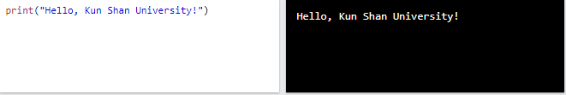
pYThoN
Example:

Slide 8
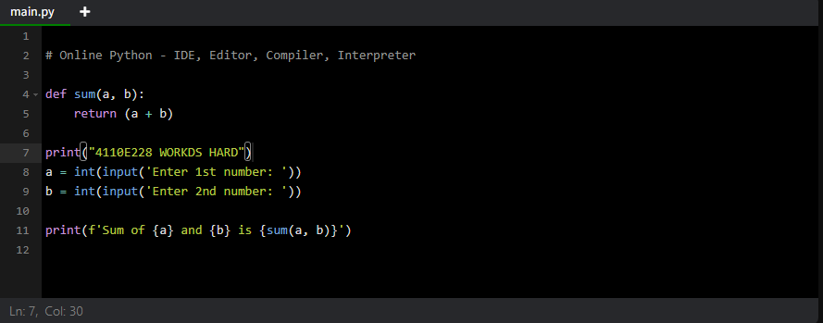
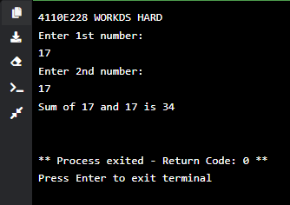
pYThoN
PYTHON ONLINE INTERPRETER 1

Slide 9
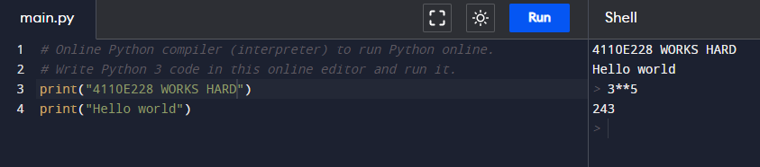
pYThoN
PYTHON ONLINE INTERPRETER 2
INTERACTIVE

Slide 10
pYThoN dictionaries

Slide 11
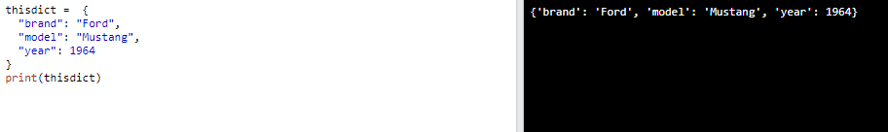
pYThoN dictionaries
Python - Dictionary
Dictionaries are used to store data values in key:value pairs.
A dictionary is a collection which is ordered*, changeable and do not allow duplicates.
As of Python version 3.7, dictionaries are ordered. In Python 3.6 and earlier, dictionaries are unordered.
Dictionaries are written with curly brackets, and have keys and values:
Create and print a dictionary:

Slide 12
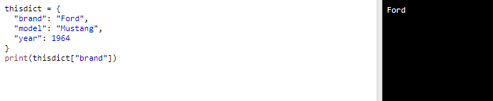
pYThoN dictionaries
Python - Dictionary items
Dictionary items are ordered, changeable, and does not allow duplicates.
Dictionary items are presented in key:value pairs, and can be referred to by using the key name.
Print the "brand" value of the dictionary:

Slide 13
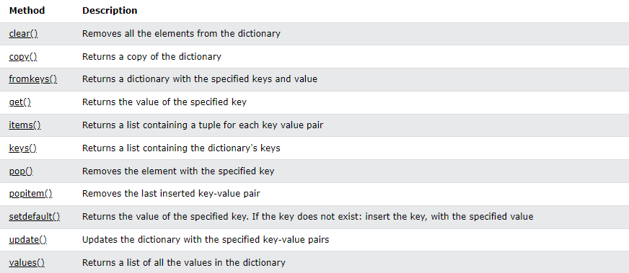
pYThoN dictionaries
Python - Dictionary methods
Python has a set of built-in methods that you can use on dictionaries.

Slide 14
pYThoN
PYTHON COMMENTS
Comments can be used to explain Python code.
Comments can be used to make the code more readable.
Comments can be used to prevent execution when testing code.

Slide 15
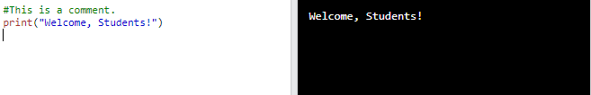
pYThoN comments
CREATING A COMMENTS
Comments starts with a #, and Python will ignore them:

Slide 16
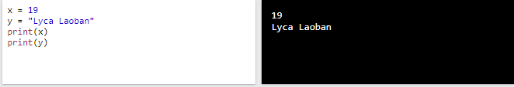
Python variables
Creating Variables
Python has no command for declaring a variable.
A variable is created the moment you first assign a value to it.

Slide 17
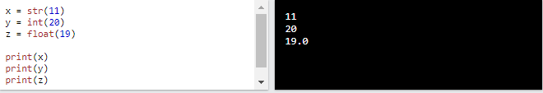
Python variables
casting
If you want to specify the data type of a variable, this can be done with casting.

Slide 18
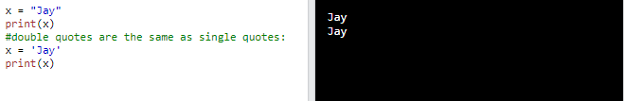
Python variables
Single or double quotes
String variables can be declared either by using single or double quotes:

Slide 19
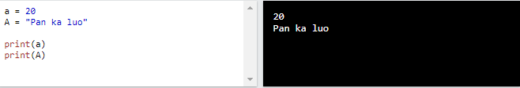
Python variables
Case-sensitive
Variable names are case-sensitive.

Slide 20
Python
Python numbers
There are three numeric types in Python:
int
float
complex

Slide 21
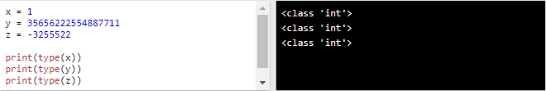
Python numbers
Python numbers: int
Variables of numeric types are created when you assign a value to them:

Slide 22
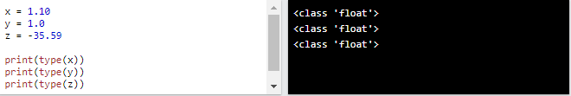
Python numbers
Python numbers: float
Float, or "floating point number" is a number, positive or negative, containing one or more decimals.

Slide 23
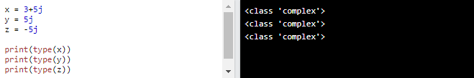
Python numbers
Python numbers: complex
Complex numbers are written with a "j" as the imaginary part:

Slide 24
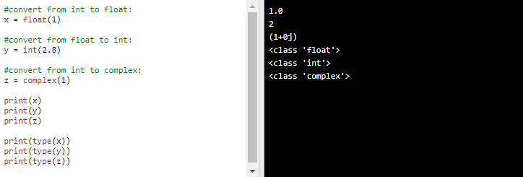
Python numbers
Type conversion
You can convert from one type to another with the int(), float(), and complex() methods:
Note: You cannot convert complex numbers into another number type.

Slide 25
Python numbers
Type conversion
You can convert from one type to another with the int(), float(), and complex() methods:
Note: You cannot convert complex numbers into another number type.

Slide 26
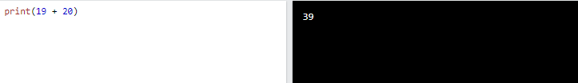
Python
Python operators
Operators are used to perform operations on variables and values.
In the example below, we use the + operator to add together two values:

Slide 27
Python
Python operators
Python divides the operators in the following groups:
Arithmetic operators
Assignment operators
Comparison operators
Logical operators
Identity operators
Membership operators
Bitwise operators

Slide 28
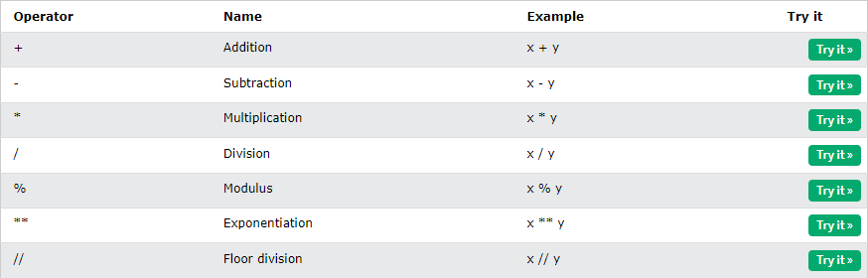
Python operators
Python arithmetic operators
Arithmetic operators are used with numeric values to perform common mathematical operations:

Slide 29
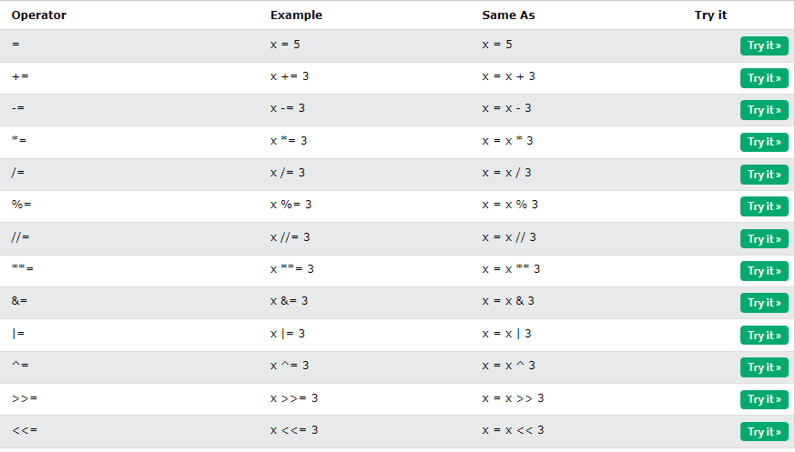
Python operators
Python assignment operators
Assignment operators are used to assign values to variables:

Slide 30
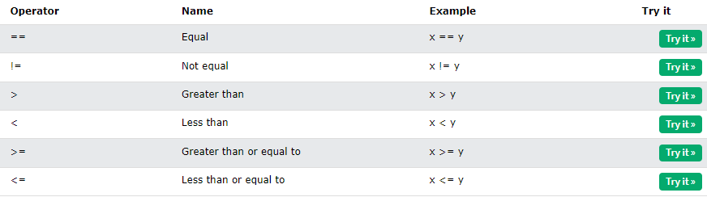
Python operators
Python comparison operators
Comparison operators are used to compare two values:

Slide 31
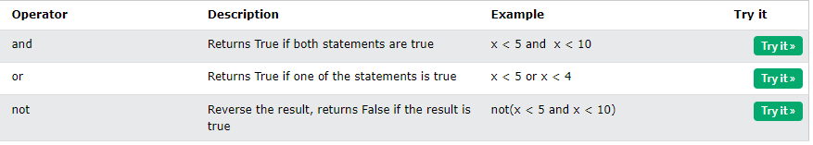
Python operators
Python logical operators
Logical operators are used to combine conditional statements:

Slide 32
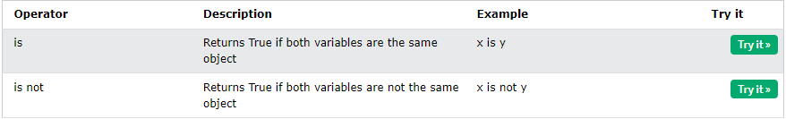
Python operators
Python identity operators
Identity operators are used to compare the objects, not if they are equal, but if they are actually the same object, with the same memory location:

Slide 33
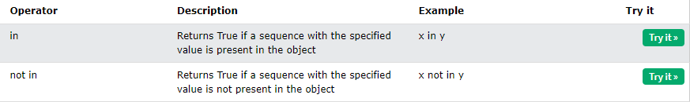
Python operators
Python membership operators
Membership operators are used to test if a sequence is presented in an object:

Slide 34
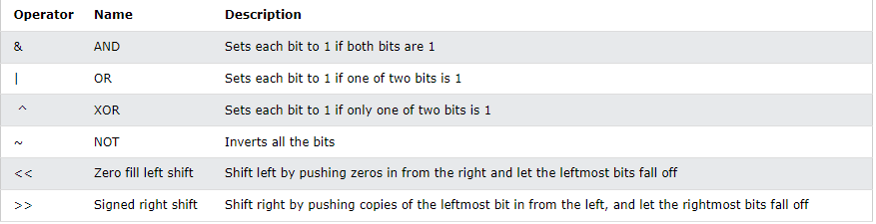
Python operators
Python bitwise operators
Bitwise operators are used to compare (binary) numbers:

Slide 35
Input and output

Slide 36
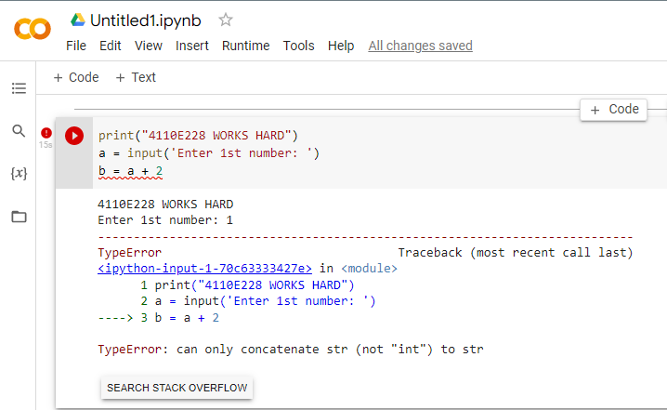
Input and output
Question:
Data Type

Slide 37
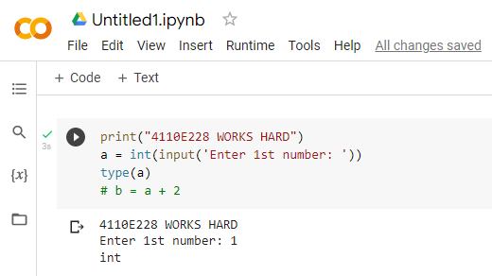
Input and output
Way: 1

Slide 38
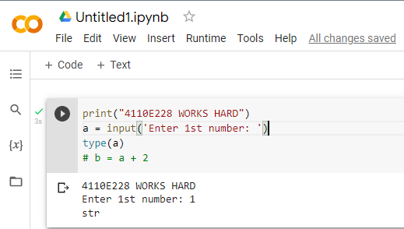
Input and output
Way: 2

Slide 39
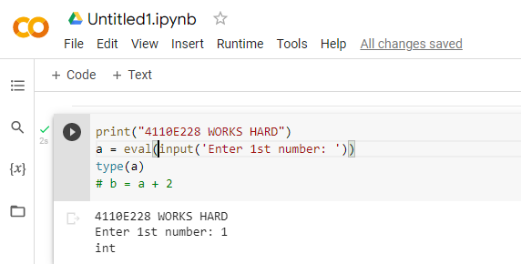
Input and output
Way: 3

Slide 40
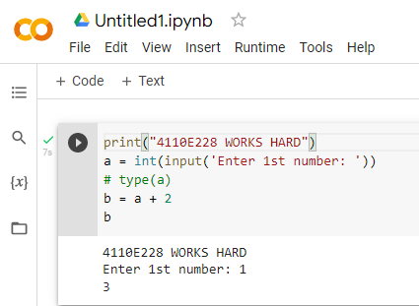
Input and output
Answer: 1

Slide 41
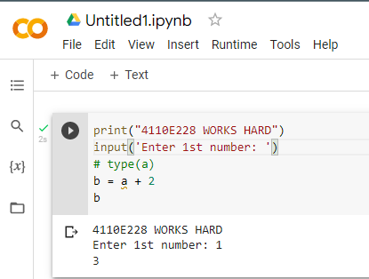
Input and output
Answer: 2

Slide 42
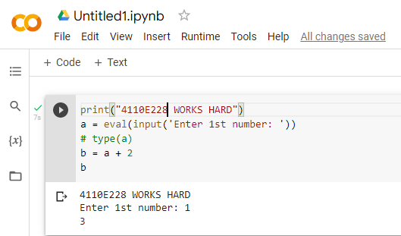
Input and output
Answer: 3

Slide 43
Python data types

Slide 44
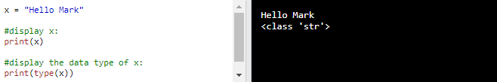
Python data types
Text Type: str

Slide 45
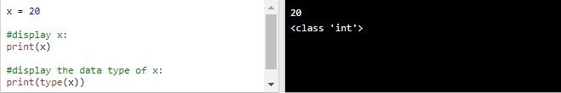
Python data types
Numeric Types: int

Slide 46
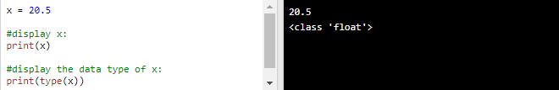
Python data types
Numeric Types: float

Slide 47
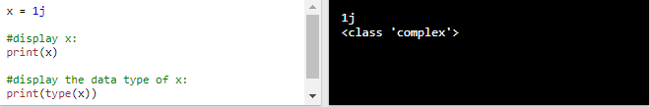
Python data types
Numeric Types: complex

Slide 48
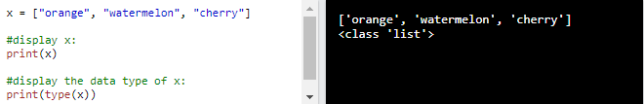
Python data types
Sequence Types: list

Slide 49
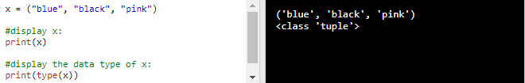
Python data types
Sequence Types: tuple

Slide 50
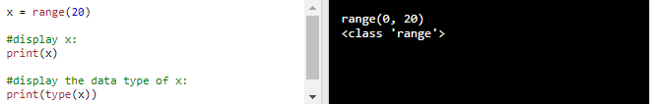
Python data types
Sequence Types: range

Slide 51
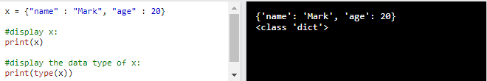
Python data types
Mapping Types: dict

Slide 52
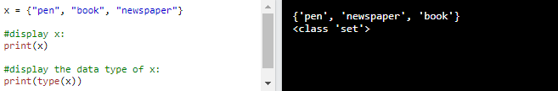
Python data types
Set Types: set

Slide 53
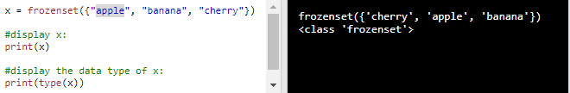
Python data types
Set Types: frozenset

Slide 54
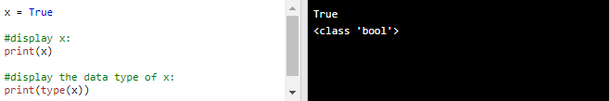
Python data types
Boolean Types: bool

Slide 55
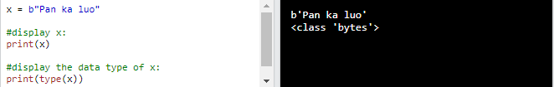
Python data types
Binary Types: bytes

Slide 56
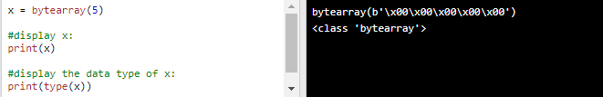
Python data types
Binary Types: bytearray

Slide 57
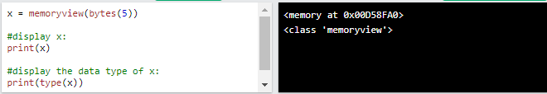
Python data types
Binary Types: memoryview

Slide 58
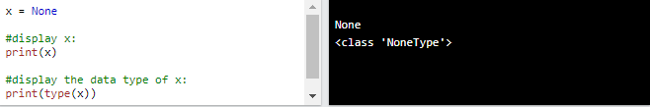
Python data types
None Type: NoneType

Slide 59
Python IF .. ELSE

Slide 60
Python if .. else
Python Conditions and If statements
Python supports the usual logical conditions from mathematics:
Equals: a == b
Not Equals: a != b
Less than: a < b
Less than or equal to: a <= b
Greater than: a > b
Greater than or equal to: a >= b

Slide 61

Python if .. else
Python - IF
These conditions can be used in several ways, most commonly in "if statements" and loops.
An "if statement" is written by using the if keyword.
In this example we use two variables, a and b, which are used as part of the if statement to test whether b is greater than a. As a is 33, and b is 200, we know that 200 is greater than 33, and so we print to screen that "b is greater than a".

Slide 62
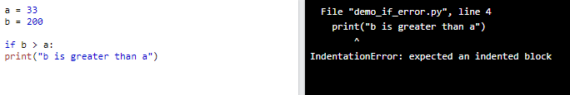
Python if .. else
Indentation
Python relies on indentation (whitespace at the beginning of a line) to define scope in the code. Other programming languages often use curly-brackets for this purpose.
If statement, without indentation (will raise an error):

Slide 63
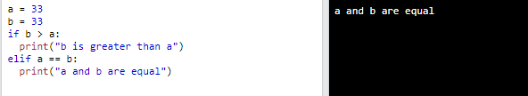
Python if .. else
Python - ELIF
The elif keyword is pythons way of saying "if the previous conditions were not true, then try this condition".
In this example a is equal to b, so the first condition is not true, but the elif condition is true, so we print to screen that "a and b are equal".

Slide 64
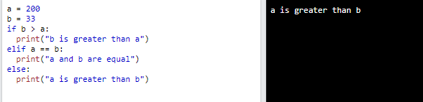
Python if .. else
Python - ELSE
The else keyword catches anything which isn't caught by the preceding conditions.
In this example a is greater than b, so the first condition is not true, also the elif condition is not true, so we go to the else condition and print to screen that "a is greater than b".

Slide 65
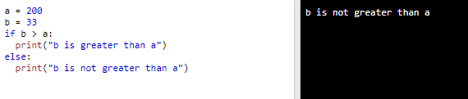
Python if .. else
Python - ELSE
You can also have an else without the elif:

Slide 66

Python if .. else
Python – SHORT HAND IF
If you have only one statement to execute, you can put it on the same line as the if statement.
One line if statement:

Slide 67

Python if .. else
Python – SHORT HAND IF .. ELSE
If you have only one statement to execute, one for if, and one for else, you can put it all on the same line:
One line if statement:

Slide 68

Python if .. else
Python – This technique is known as Ternary Operators, or Conditional Expressions.
You can also have multiple else statements on the same line:
One line if else statement, with 3 conditions:

Slide 69

Python if .. else
Test if a is greater than b, AND if c is greater than a:
Python – AND
The and keyword is a logical operator, and is used to combine conditional statements:
One line if else statement, with 3 conditions:

Slide 70

Python if .. else
Test if a is greater than b, AND if c is greater than a:
Python – OR
The or keyword is a logical operator, and is used to combine conditional statements:
Test if a is greater than b, OR if a is greater than c:

Slide 71

Python if .. else
Test if a is greater than b, AND if c is greater than a:
Python – NESTED IF
You can have if statements inside if statements, this is called nested if statements.

Slide 72

Python if .. else
Test if a is greater than b, AND if c is greater than a:
Python – THE PASS STATEMENT
if statements cannot be empty, but if you for some reason have an if statement with no content, put in the pass statement to avoid getting an error.

Slide 73
Python WHILE LOOPS

Slide 74
Python WHILE LOOPS
Test if a is greater than b, AND if c is greater than a:
Python – LOOPS
Python has two primitive loop commands:
for loops
while loops

Slide 75

Python WHILE LOOPS
Test if a is greater than b, AND if c is greater than a:
Python – THE WHILE LOOP
With the while loop we can execute a set of statements as long as a condition is true.
Print i as long as i is less than 6:

Slide 76

Python WHILE LOOPS
Test if a is greater than b, AND if c is greater than a:
Python – THE BREAK STATEMENT
With the break statement we can stop the loop even if the while condition is true:

Slide 77

Python WHILE LOOPS
Test if a is greater than b, AND if c is greater than a:
Python – THE CONTINUE STATEMENT
With the continue statement we can stop the current iteration, and continue with the next:
Continue to the next iteration if i is 3:

Slide 78

Python WHILE LOOPS
Test if a is greater than b, AND if c is greater than a:
Python – THE ELSE STATEMENT
With the else statement we can run a block of code once when the condition no longer is true:
Print a message once the condition is false:

Slide 79
Python FOR LOOPS

Slide 80

Python FOR LOOPS
Test if a is greater than b, AND if c is greater than a:
Python – FOR LOOPS
A for loop is used for iterating over a sequence (that is either a list, a tuple, a dictionary, a set, or a string).
This is less like the for keyword in other programming languages, and works more like an iterator method as found in other object-orientated programming languages.
With the for loop we can execute a set of statements, once for each item in a list, tuple, set etc.
Print each fruit in a fruit list:

Slide 81

Python FOR LOOPS
Test if a is greater than b, AND if c is greater than a:
Python – LOOPING THROUGH A STRING
Even strings are iterable objects, they contain a sequence of characters:
Loop through the letters in the word “Taiwan":

Slide 82


Python FOR LOOPS
Test if a is greater than b, AND if c is greater than a:
Python – THE BREAK STATEMENT
With the break statement we can stop the loop before it has looped through all the items:
Exit the loop when x is "banana":
Exit the loop when x is "banana", but this time the break comes before the print:

Slide 83

Python FOR LOOPS
Test if a is greater than b, AND if c is greater than a:
Python – THE RANGE () FUNCTION
To loop through a set of code a specified number of times, we can use the range() function,
The range() function returns a sequence of numbers, starting from 0 by default, and increments by 1 (by default), and ends at a specified number.
Using the range() function:

Slide 84

Python FOR LOOPS
Test if a is greater than b, AND if c is greater than a:
Python – THE RANGE () FUNCTION
The range() function defaults to 0 as a starting value, however it is possible to specify the starting value by adding a parameter: range(2, 6), which means values from 2 to 6 (but not including 6):
Using the start parameter:
Note that range(6) is not the values of 0 to 6, but the values 0 to 5.

Slide 85

Python FOR LOOPS
Test if a is greater than b, AND if c is greater than a:
Python – THE RANGE () FUNCTION
The range() function defaults to increment the sequence by 1, however it is possible to specify the increment value by adding a third parameter: range(2, 30, 3):
Increment the sequence with 3 (default is 1):

Slide 86

Python FOR LOOPS
Test if a is greater than b, AND if c is greater than a:
Python – ELSE IN FOR LOOP
The else keyword in a for loop specifies a block of code to be executed when the loop is finished:
Print all numbers from 0 to 5, and print a message when the loop has ended:

Slide 87

Python FOR LOOPS
Test if a is greater than b, AND if c is greater than a:
Python – ELSE IN FOR LOOP
Note: The else block will NOT be executed if the loop is stopped by a break statement.
Break the loop when x is 3, and see what happens with the else block:

Slide 88

Python FOR LOOPS
Test if a is greater than b, AND if c is greater than a:
Python – THE PASS STATEMENT
for loops cannot be empty, but if you for some reason have a for loop with no content, put in the pass statement to avoid getting an error.

Slide 89
Python FUNCTION

Slide 90
Python FUNCTION
Python FUNCTION
A function is a block of code which only runs when it is called.
You can pass data, known as parameters, into a function.
A function can return data as a result.

Slide 91

Python FUNCTION
CREATING A FUNCTION
In Python a function is defined using the def keyword:

Slide 92

Python FUNCTION
CALLING A FUNCTION
To call a function, use the function name followed by parenthesis:

Slide 93

Python FUNCTION
ARGUMENTS
Information can be passed into functions as arguments.
Arguments are specified after the function name, inside the parentheses. You can add as many arguments as you want, just separate them with a comma.
The following example has a function with one argument (fname). When the function is called, we pass along a first name, which is used inside the function to print the full name:
Arguments are often shortened to args in Python documentations.

Slide 94
Python FUNCTION
PARAMETERS OR ARGUMENTS?
The terms parameter and argument can be used for the same thing: information that are passed into a function.
From a function's perspective:
A parameter is the variable listed inside the parentheses in the function definition.
An argument is the value that is sent to the function when it is called.

Slide 95
Python FUNCTION
PARAMETERS OR ARGUMENTS?
The terms parameter and argument can be used for the same thing: information that are passed into a function.
From a function's perspective:
A parameter is the variable listed inside the parentheses in the function definition.
An argument is the value that is sent to the function when it is called.

Slide 96
Python FUNCTION
Python - recursion
Python also accepts function recursion, which means a defined function can call itself.
Recursion is a common mathematical and programming concept. It means that a function calls itself. This has the benefit of meaning that you can loop through data to reach a result.
The developer should be very careful with recursion as it can be quite easy to slip into writing a function which never terminates, or one that uses excess amounts of memory or processor power. However, when written correctly recursion can be a very efficient and mathematically-elegant approach to programming.
In this example, tri_recursion() is a function that we have defined to call itself ("recurse"). We use the k variable as the data, which decrements (-1) every time we recurse. The recursion ends when the condition is not greater than 0 (i.e. when it is 0).

Slide 97
Python FUNCTION
Python - recursion
Python also accepts function recursion, which means a defined function can call itself.
Recursion is a common mathematical and programming concept. It means that a function calls itself. This has the benefit of meaning that you can loop through data to reach a result.
The developer should be very careful with recursion as it can be quite easy to slip into writing a function which never terminates, or one that uses excess amounts of memory or processor power. However, when written correctly recursion can be a very efficient and mathematically-elegant approach to programming.
In this example, tri_recursion() is a function that we have defined to call itself ("recurse"). We use the k variable as the data, which decrements (-1) every time we recurse. The recursion ends when the condition is not greater than 0 (i.e. when it is 0).
To a new developer it can take some time to work out how exactly this works, best way to find out is by testing and modifying it.

Slide 98

Python FUNCTION
Python - recursion
Recursion Example:

Slide 99


Python FUNCTION
Python - lambda
A lambda function is a small anonymous function.
A lambda function can take any number of arguments, but can only have one expression.
Syntax
The expression is executed and the result is returned:
Add 10 to argument a, and return the result:
Lambda functions can take any number of arguments:
Multiply argument a with argument b and return the result:
lambda arguments : expression
Summarize argument a, b, and c and return the result:

Slide 100


Python FUNCTION
Python - lambda
Why Use Lambda Functions?
The power of lambda is better shown when you use them as an anonymous function inside another function.
Say you have a function definition that takes one argument, and that argument will be multiplied with an unknown number:
Use that function definition to make a function that always doubles the number you send in:

Slide 101


Python FUNCTION
Python - lambda
Or, use the same function definition to make a function that always triples the number you send in:
Or, use the same function definition to make both functions, in the same program:
Use lambda functions when an anonymous function is required for a short period of time.

