Slide 1
Gym Sandbox
Solution to InstaDeep’s RL code challenge

Slide 2
Outline
RL recap
Markov Decision Processes
Policy, state-values & action-values
Bellman optimality equation
Gymnasium
CartPole-v1
RL Algorithms
Policy Gradient Methods
Deep Q-Learning
Results
Browse gym_sandbox

Slide 3
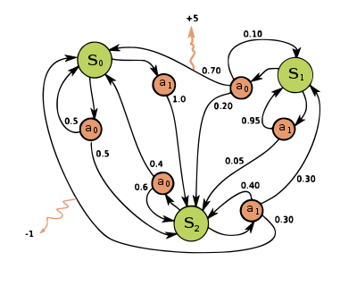
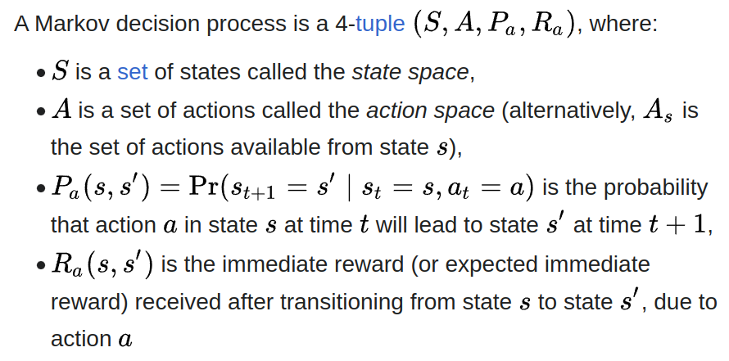
Markov Decision Process

Slide 4
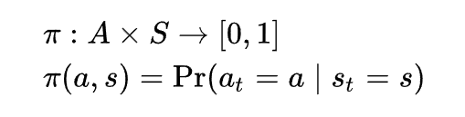
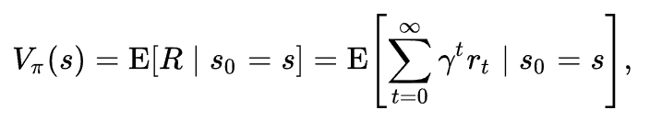
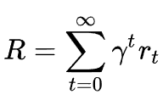

Policy, State-Values & Action-Values

Slide 5
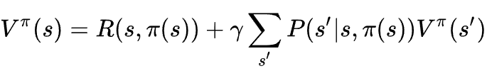
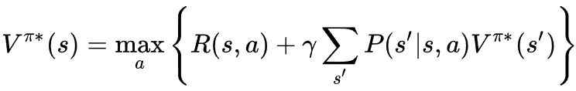
Bellman Optimality Equation

Slide 6
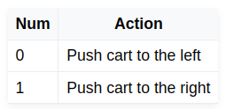
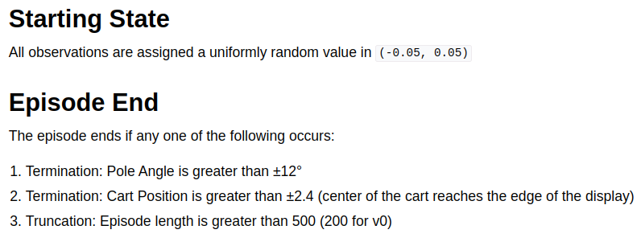
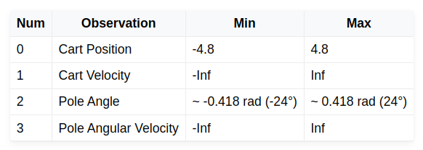
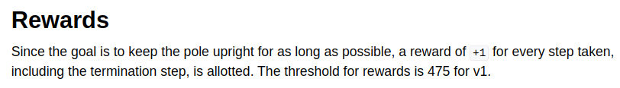
CartPole-v1

Slide 7
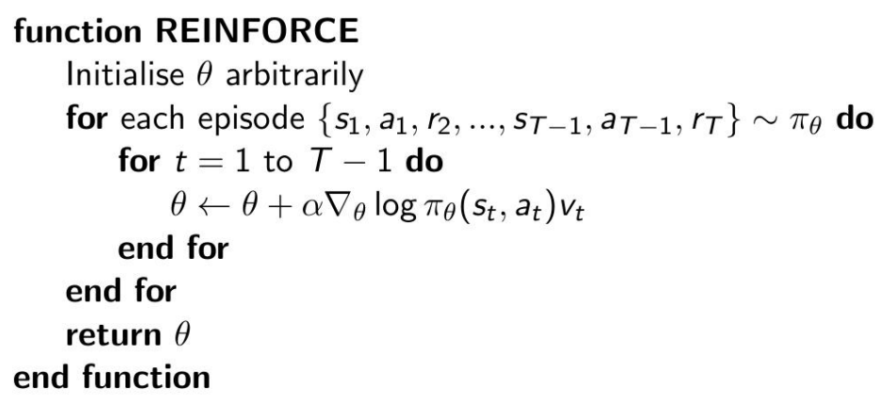
Policy Gradient Methods: REINFORCE

Slide 8
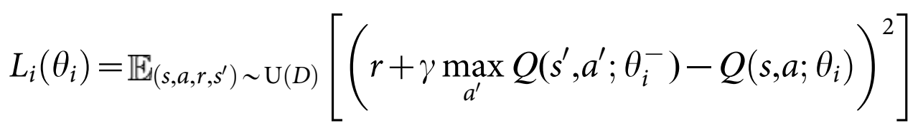
Deep Q-Learning

Slide 9
Results
Browse gym_sandbox…

