Slide 1
Currency Fair
Engineering Test

Slide 2
Purpose
Lay out a high-level design for a 3 component exchange system that illustrates key design principles and choices.
Implement key components to showcase the design.
Goal
Provide insight into my thought process, design acumen, and skill set in a bid to join the Currency Fair engineering team.

Slide 3
Design Considerations
Message Consumption
Secure
Fast
Scale horizontally
Ensure xtn integrity
Enforce data integrity
Safe
Message Processing
Efficient
Scale independent of other tiers
Scale vertically and horizontally
Maintain xtn integrity
Message Frontend
Flexible
Support multiple channels
Low impact to xtn system
Real-time

Slide 4
Message Consumption Implementation
Implement over secure channel taking into account AuthZ and AuthN considerations
Design to support multiple Qualities of Service (QoS) through multiple channel technologies
Ensure data validity
Capture meta-data with message
Transactional data store
Strict transaction management to ensure data integrity
Stateless to minimize footprint for scalability and maximize performance
Software technology - PHP

Slide 5
Message Consumption Logical Components
Load Balancer
Transport Adapter
HTTP
Message Consumption Service
Message Queue
Transport Adapter
Message Consumption Service
Message Sources
Message Consumption Service
File
Transport Adapter
Transaction DB

Slide 6
Message Processing Implementation
Asynchronous
Decoupled from message consumption
Real-time vs. near real-time requirements are a consideration here
Assumes processing is an expensive operation
Transaction integrity maintained
Queuing often a good option to achieve high QoS and asynchronous processing
Queuing via MQ product or database
Mechanism to handle exception processing
For this exercise “processing” performs roll-up in simple “star” reporting schema.
Software technology - Java

Slide 7

Logical Components
Exception Process
“Processing” rolls up statistics in reporting DB
Message Consumption Service
Reporting
DB
Message Consumption Service
Message Processing Service
Transaction DB
Implemented in xtn DB for this exercise

Slide 8
Message Frontent Implementation
Many options available
RESTful(-esque) services to maintain flexibility
MVC paradigm
Chose simple polling client for brevity for this exercise
Software technology - PHP

Slide 9
Message Consumption Logical Components
Browser
Push/Pull Client
Push/Pull Server
Device
App
Polling Client
Controller
Service
Chose simple polling based browser client for this exercise.
Reporting DB

Slide 10
Components Implemented for the Test
Randomizing Message Source
HTTP
Message Consumption Service
Transaction DB
Message Processing Service
Browser
Reporting DB
Polling Client
Controller
Service

Slide 11
Fine Print
Example is far from a complete system, attempted to show what’s possible and where key implementation points exist
Implemented as a proof of concept:
Lots of room for improvement
Did not use any frameworks, i.e. Spring, ORM, Logging, etc.
Could be more OO
Some liberties taken with respect to configuration, connection pooling, etc.
Frontend implementation less fancy than originally planned
Did not include security or all necessary transactional specifics although showed where these could be considered
Did not have environment to publicly host the project but all components are functional
Did not implement any automated unit or integration tests
Built on LAMP architecture

Slide 12
GitHub Directory Structure
/documentation
This overview
Readme.txt installation instructions
/data
SQL script to create and load schema and sample data
/src/messageprocessor
Java maven project with Main class
Requires MySQL client JAR as shown in pom.xml
/src/test/client
Bash script to simulate client messages
Randomizes sample data
Uses cURL to POST JSON data to the message consumer
/src/web_root
Contents can be copied straight to PHP-enabled web server

Slide 13
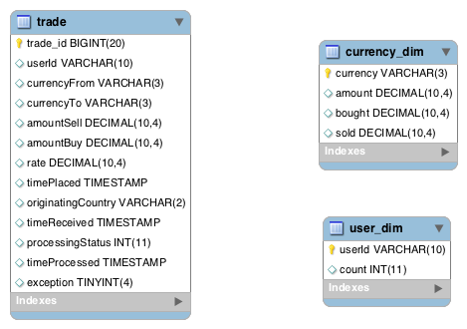
Database Schema

Slide 14
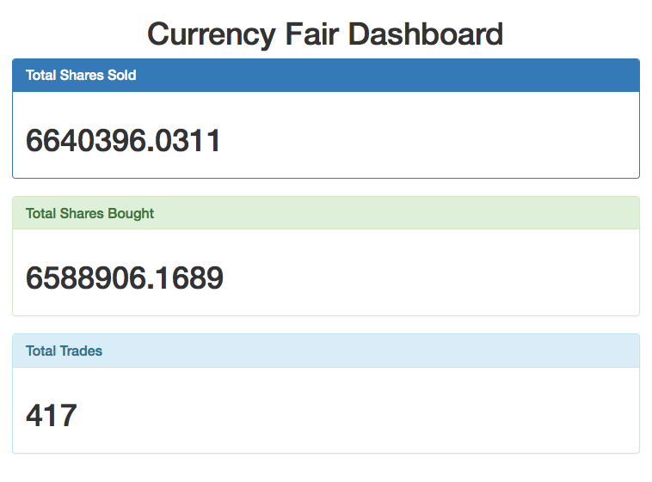
Frontend Screenshot

Slide 15
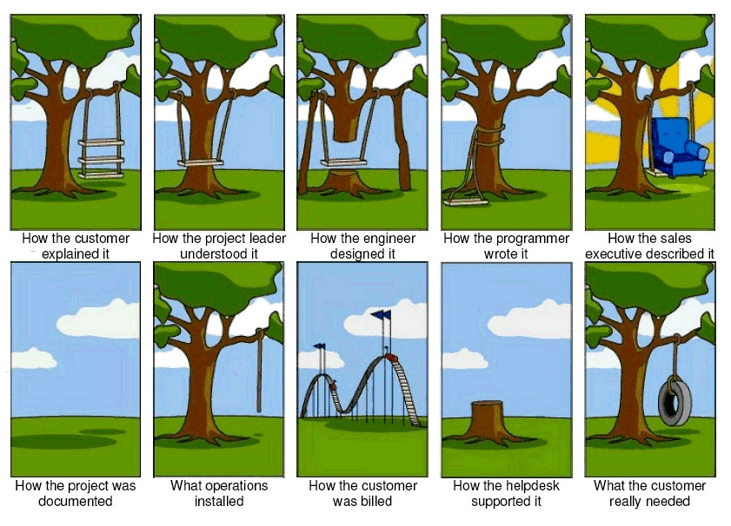
For Fun

