Slide 1
AWS Infrastructure Automation
Notes:
AWS Infrastructure Automation Overview, Executive Summary, Architecture Overview, AWS Services Used, CI/CD Pipeline, Security Features, Cost Optimization, Deployment Demo, Operational Benefits, Scalability Path, Risk Mitigation, Technical Highlights, Success Metrics, Next Steps, Questions & Discussion, Appendix - Technical Details

Slide 2
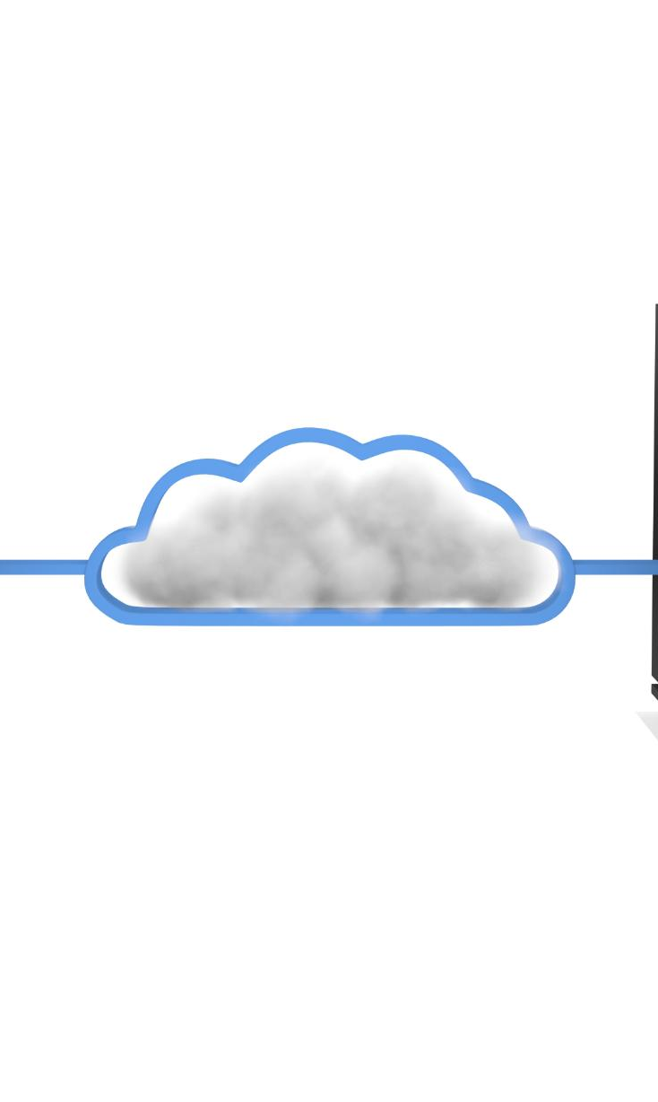
AWS Infrastructure Automation Overview
Modern DevOps Operating Model
  Transition to modern DevOps with automated CI/CD pipelines ensures faster, consistent deployments.
Production‑Grade Automation
  Provisioning and managing cloud infrastructure with minimal human intervention reduces operational risks.
Infrastructure as Code
  Treat infrastructure as software using Terraform and version control for review, testing, and deployment.
Security and Scalability
  Automation enables secure, scalable, and cost-efficient cloud environments aligned with governance needs.
Notes:
This slide introduces the overarching theme of AWS Infrastructure Automation, highlighting the transition to a modern DevOps operating model powered by automated CI/CD pipelines. The content emphasizes a production‑grade approach to provisioning, deploying, and managing cloud environments with minimal human intervention. Automation reduces both operational overhead and deployment risks by ensuring consistency, reliability, and repeatability across environments. This approach leverages AWS services, Terraform, and GitHub Actions to create a seamless workflow that is secure, scalable, and cost‑efficient. By employing automation as a foundational practice, organizations move toward a cloud‑native operating posture where infrastructure is no longer manually configured but treated as software—versioned, reviewed, tested, and deployed through standardized pipelines. The title highlights three core outcomes—modern DevOps, automated CI/CD, and simplified infrastructure lifecycle management—describing how these elements converge to deliver faster deployment cycles and reduced operational friction. The presentation also underscores the importance of eliminating manual configuration errors, implementing immutable infrastructure principles, and enabling one‑click deployment and teardown. This aligns with executive‑level priorities such as risk reduction, cost optimization, improved developer productivity, and governance through auditability and automation. As teams adopt these practices, they gain the ability to scale reliably, enforce secure patterns, and maintain a highly optimized operational footprint. By automating infrastructure end‑to‑end, organizations achieve a rapid time‑to‑market advantage and future‑proof their cloud environments against evolving security, compliance, and performance demands.

Slide 3
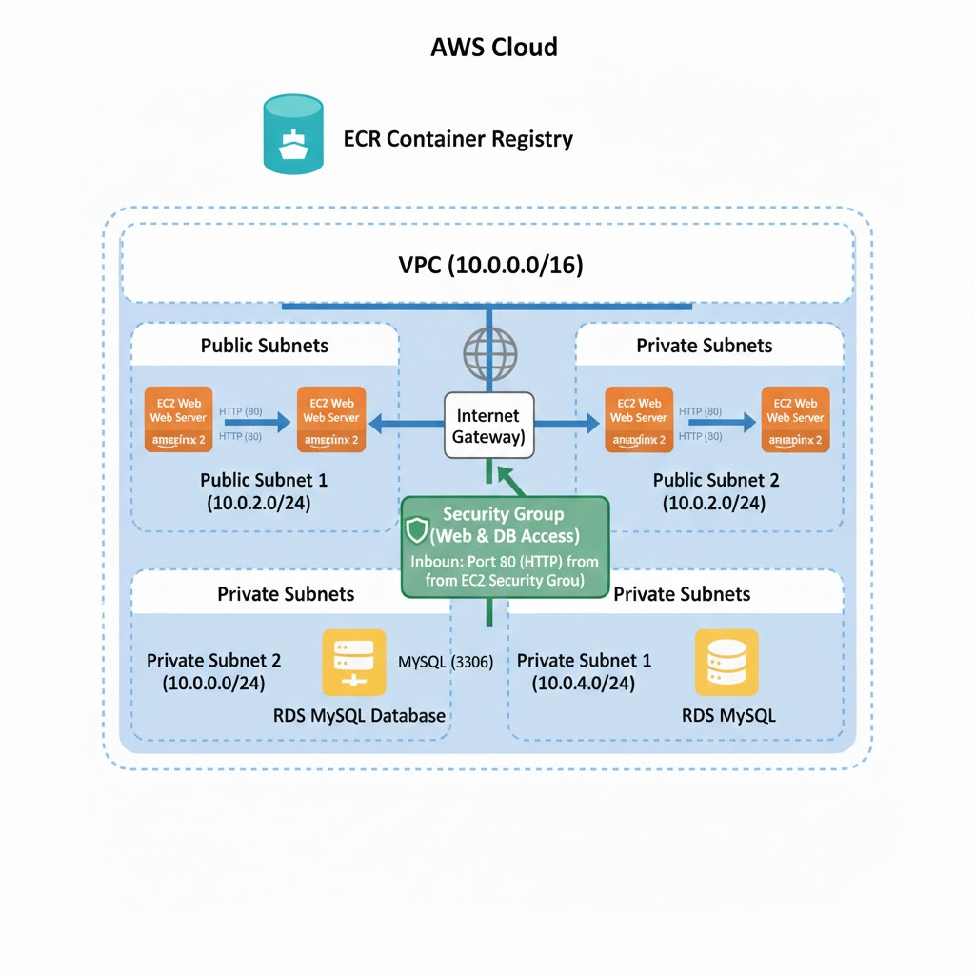
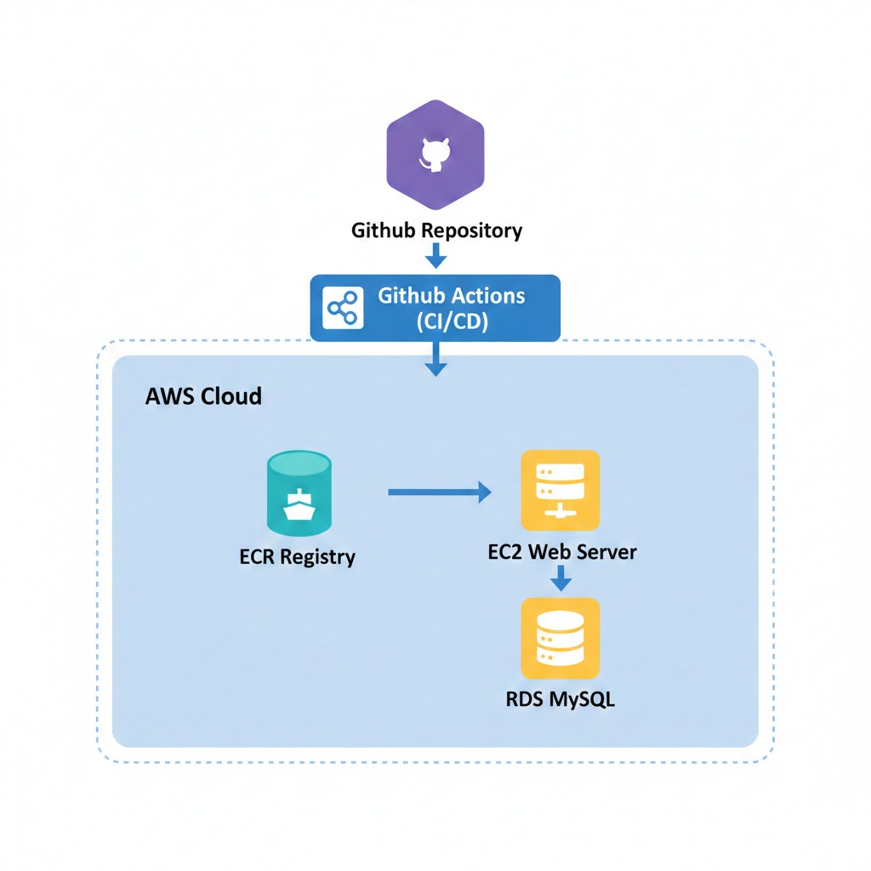
Architecture Overview
Notes:
The architecture overview illustrates a modern three‑tier cloud architecture orchestrated through a CI/CD pipeline. It begins with the source code stored in GitHub, where developers commit changes that automatically trigger GitHub Actions. Authentication into AWS is handled securely using OIDC federation, removing the need for static credentials. Within AWS, core services support the infrastructure: ECR hosts Docker images, EC2 runs the application workload, RDS MySQL provides persistent data storage, and Lambda performs autonomous shutdowns to control cost. This design demonstrates a clean separation of concerns: the presentation layer is handled by the application running in EC2, the application logic resides within containerized workloads, and the data layer is securely isolated in private subnets. The diagram emphasizes security boundaries, showing how the VPC provides network isolation and ensures the database is unreachable externally. The architecture also supports scalability and future improvements: additional tiers, auto scaling, load balancers, or microservices can be added with minimal friction due to the infrastructure‑as‑code foundation. The pipeline ensures that application and infrastructure deployments remain consistent, validated, and repeatable. Each time new code is pushed, the pipeline rebuilds Docker images, updates infrastructure as needed, and deploys workloads safely to the EC2 instance. The architecture is intentionally lightweight but production‑ready, allowing both rapid prototyping and expansion into high‑availability multi‑region deployments. It is intentionally cost‑optimized while preserving modern cloud design principles, making it suitable for organizations requiring secure, automated, and maintainable environments.

Slide 4
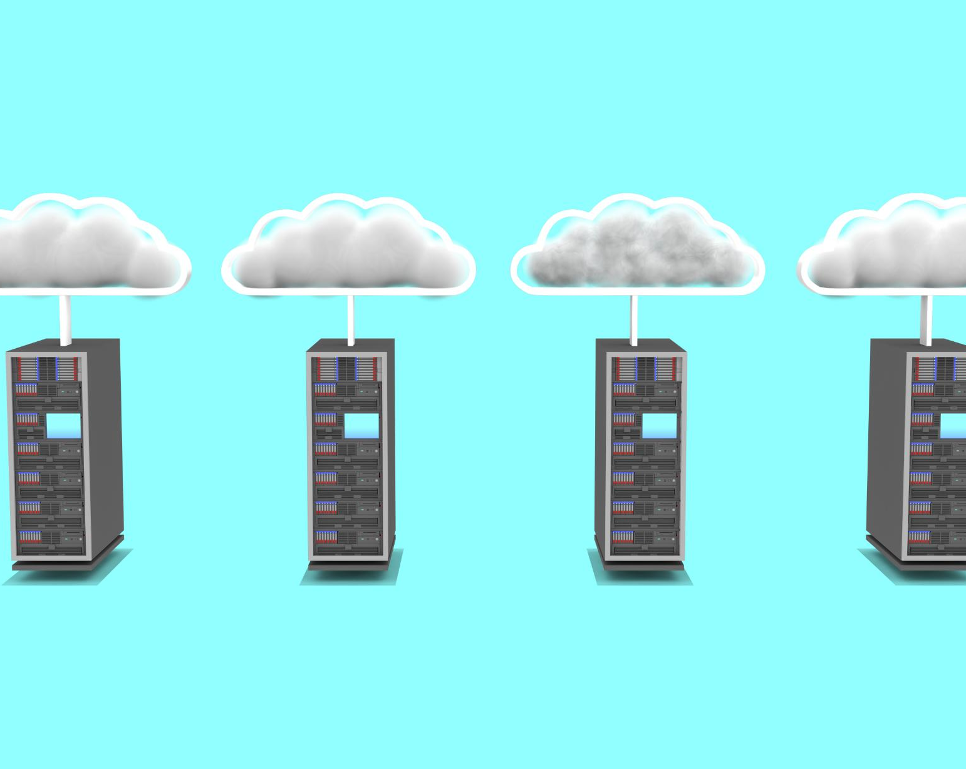
AWS Services Used
Compute with EC2 and Containers
  EC2 hosts containerized workloads using Docker, ensuring portability and deployment consistency.
Data Storage via RDS MySQL
  RDS MySQL provides reliable relational database services with automated backups, encryption, and patching.
Networking and Security Setup
  VPC isolates network with public and private subnets; IAM roles enforce least-privilege access for security.
Automation and Monitoring
  Lambda functions automate schedules; CloudWatch monitors resources; Systems Manager enables secure EC2 access.
Notes:
This slide details the AWS services that compose the infrastructure. EC2 serves as the core compute layer, hosting containerized workloads using Docker to ensure portability and consistency across deployments. RDS MySQL operates as the relational data store, providing automated backups, encryption, and patching capabilities essential for application reliability. ECR is the internal container registry that stores and manages Docker images securely within the AWS ecosystem. The VPC establishes an isolated network environment with public subnets for internet‑facing components and private subnets for restricted resources such as the RDS instance. On the automation and security side, Lambda functions orchestrate scheduled shutdowns to minimize cost without impacting development workflows. IAM roles enforce least‑privilege access patterns, with OIDC authentication eliminating the need for long‑lived AWS keys. CloudWatch provides monitoring and scheduled triggers for automation activities, while Systems Manager facilitates secure, keyless interactions with EC2 instances. Collectively, these services form a cohesive and securely architected environment that adheres to AWS Well‑Architected best practices. Each service is chosen not only for functionality but also for its ability to integrate seamlessly into an automated, cloud‑native operational model.

Slide 5
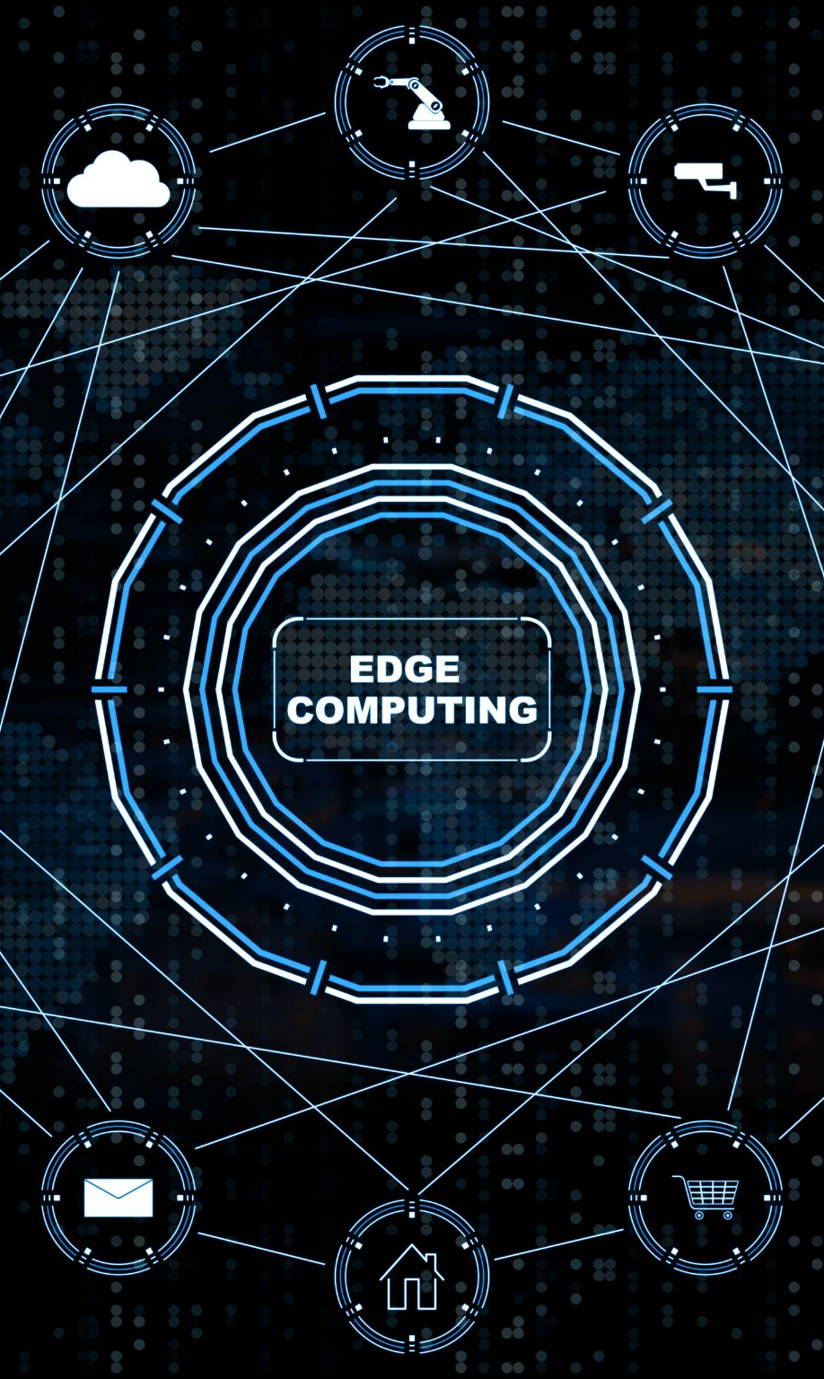
CI/CD Pipeline
Approval Gate Verification
  Human approval ensures safe production changes and aligns with governance requirements.
Infrastructure Provisioning
  Terraform provisions infrastructure from code to maintain environment consistency and prevent drift.
Container Build and Push
  Docker containers are built and pushed to a registry to keep application artifacts updated.
Deployment and Health Checks
  EC2 instances update images, run health checks, and ensure application availability.
Notes:
The CI/CD pipeline consists of four stages designed to create a safe, automated, and reproducible path from code commit to production deployment. The process begins with an approval gate, ensuring human verification for production‑impacting changes. This protects against unintended modifications while aligning with organizational governance requirements. Once approved, Terraform provisions or updates infrastructure components, ensuring that the environment is always declared and built from code. This avoids drift and maintains consistency across environments. The third stage builds and pushes Docker containers to ECR, ensuring the latest application artifacts are always available. Finally, the deployment stage updates the EC2 instance by pulling the new image, performing health checks, and ensuring application availability. The entire pipeline completes in approximately eight minutes, offering a dramatic improvement over manual deployments that might take hours. This streamlined workflow reinforces reliability, accelerates delivery, and strengthens security through automation and standardized patterns.

Slide 6

Security Features
Zero-Trust Architecture
  Security is based on a zero-trust model ensuring strict access controls and continuous verification.
Least Privilege IAM Roles
  IAM roles enforce least-privilege access to minimize permissions for each system component.
Network Isolation & Encryption
  Network isolation blocks public internet access to RDS; encrypted storage protects data at rest and in transit.
Governance and Compliance Automation
  Approval gates and immutable infrastructure ensure governance, audit trails, and scalable security automation.
Notes:
Security is foundational to the architecture and is implemented using a zero‑trust model. OIDC authentication ensures developers never handle AWS keys, reducing exposure to credential leakage. IAM roles are designed with least‑privilege principles, allowing only the minimum actions required for each component. Network isolation prevents the RDS instance from being reached from the public internet, significantly reducing the attack surface. Approval gates introduce governance controls that prevent unauthorized deployments. Compliance readiness is built‑in through immutable infrastructure: changes occur only through code, creating a complete audit trail. Encrypted storage ensures that both data at rest and in transit remain protected. These controls collectively create a robust, enterprise‑grade security posture that aligns with industry standards. Automation ensures that security is not bypassed, scaling governance as the system grows while ensuring operational efficiency.

Slide 7
Cost Optimization
Service | Configuration | Monthly Cost
EC2 t2.micro | 750 hrs free | $0
RDS db.t3.micro | 750 hrs free | $0
ECR | 500 MB free | $0
Lambda | 1M requests free | $0
Total (Free Tier) |  | $0
Total (After Free Tier) |  | ~$15
Notes:
Cost optimization strategies are embedded directly into the infrastructure. The Auto‑Shutdown Lambda ensures compute and database resources stop outside working hours, preventing unnecessary charges. Services are selected to align with AWS Free Tier limits, keeping monthly usage near zero for most development scenarios. Right‑sized instances prevent over‑provisioning while still offering strong performance. Infrastructure state remains local, avoiding backend storage fees. A cost breakdown table compares resource configurations and highlights how the combined footprint remains well under typical budgets. This approach allows organizations to adopt modern cloud infrastructure without incurring unexpected expenses, while automation ensures that cost controls are consistently enforced.

Slide 8

Deployment Demo
Automated CI/CD Workflow
  Code pushes trigger GitHub Actions to run automated checks and await approval, streamlining deployment initiation.
Infrastructure Provisioning
  Terraform provisions AWS infrastructure from version-controlled definitions to ensure consistent environments.
Container Deployment
  Docker images are built, pushed to ECR, and deployed to EC2 instances for application hosting.
Health Check and Cleanup
  Health checks validate application functionality, while one-click destruction cleans up environments quickly and cost-effectively.
Notes:
The deployment demonstration walks through the real‑time operational workflow. A code push triggers the GitHub Actions workflow, which begins automated checks and awaits approval. Once approved, Terraform provisions AWS infrastructure, ensuring that all components are built from version‑controlled definitions. Docker images are built, pushed to ECR, and subsequently deployed to the EC2 instance. Health checks validate that the application is functional before marking the deployment successful. Verification involves accessing the application through its public endpoint. One‑click destruction simplifies environment cleanup, completing in under three minutes and ensuring no residual cost. This workflow not only enhances developer productivity but also enforces consistent and compliant deployment patterns.

Slide 9
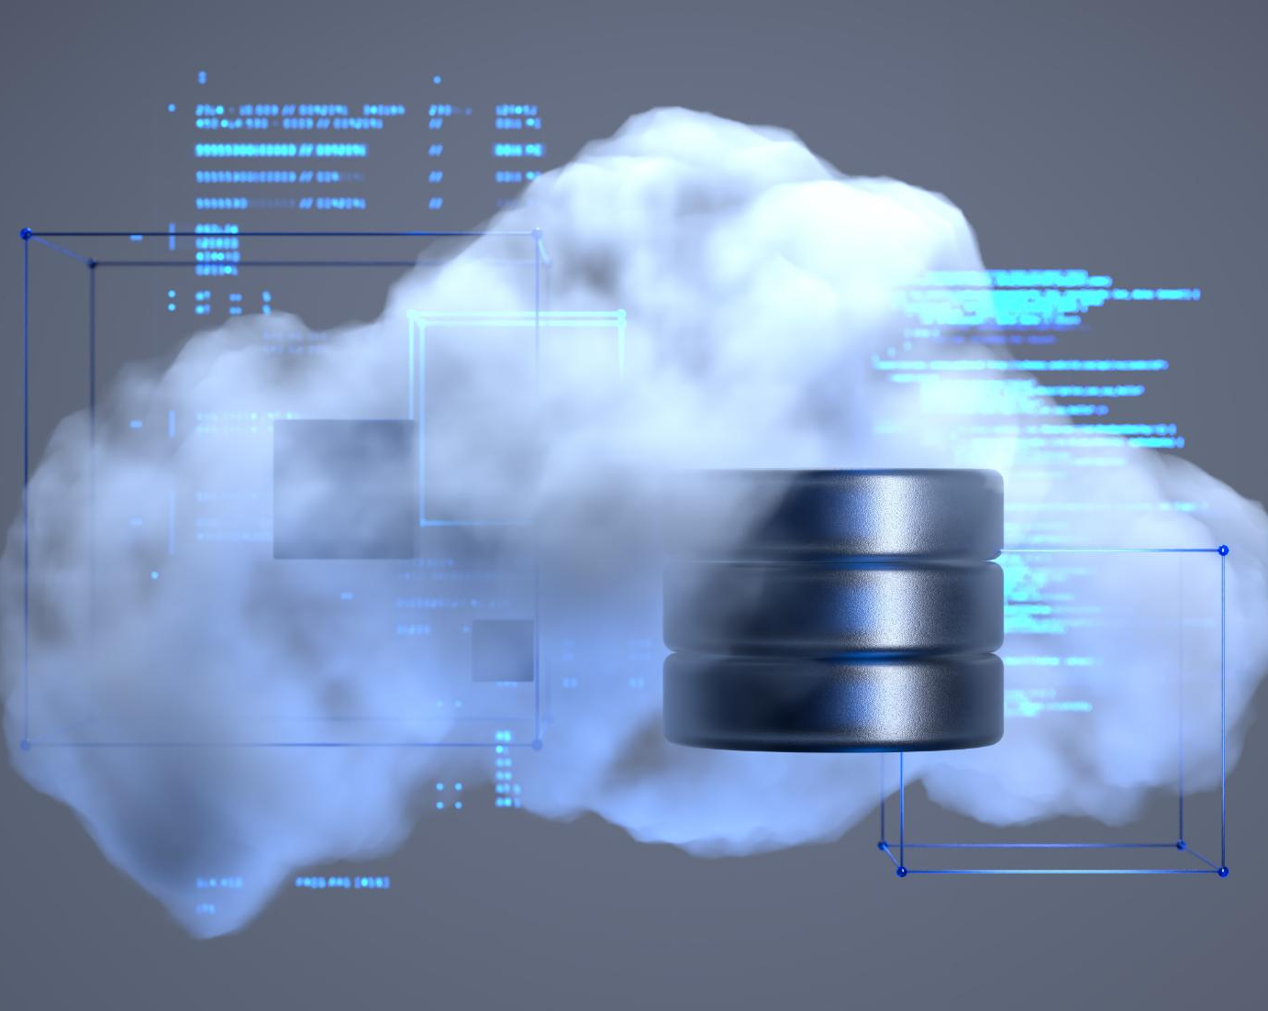
Technical Highlights
Infrastructure as Code
  Defining environments through code enables automation, repeatability, and traceability across deployments.
GitOps and Version Control
  GitOps workflows ensure all changes undergo peer review and are version controlled for robustness.
Containerization and Immutability
  Docker containers provide environment consistency, while immutable infrastructure reduces configuration errors.
Security and Observability
  Use of OIDC authentication improves security; CloudWatch offers monitoring for operational excellence.
Notes:
This slide highlights modern DevOps practices such as infrastructure as code, GitOps workflows, containerization, and immutable infrastructure. Every environment is declared in code, enabling automation, repeatability, and traceability. GitOps ensures all changes pass through peer review and version control. Docker containers guarantee consistency across environments by packaging applications with their dependencies. Immutable infrastructure eliminates manual adjustments, significantly reducing configuration errors. AWS Well‑Architected best practices—including security, reliability, and operational excellence—guide design choices. OIDC authentication removes static credentials, enhancing security. CloudWatch provides monitoring hooks for future observability. These elements demonstrate adherence to enterprise‑grade engineering standards.

