Slide 1


Hands-On with Serverless
Michael Bright, DevConf.cz Jan 2019

Slide 2
What is Serverless ?
Serverless is a programming paradigm largely popularized by AWS since launching the Lambda platform in Nov. 2014.
“Serverless” means that developers develop their code, their business logic without the distractions of installing, managing, patching servers.
The chosen Serverless platform takes care of scaling resources to ensure their availability to satisfy demand.

Slide 3
What is Serverless ?
Serverless = Functions as a Service(FaaS) + Backends as a Service (BaaS)
e.g. AWS Lambda functions + AWS Dynamo DB, API GW, S3, …
We have moved from deploying
monoliths on bare-metal, on virtual machines
micro-services on virtual machines, on containers
Serverless is the ultimate cloud native as developers deploy functions
“FaaS” element of Serverless is “Pay for usage”

Slide 4
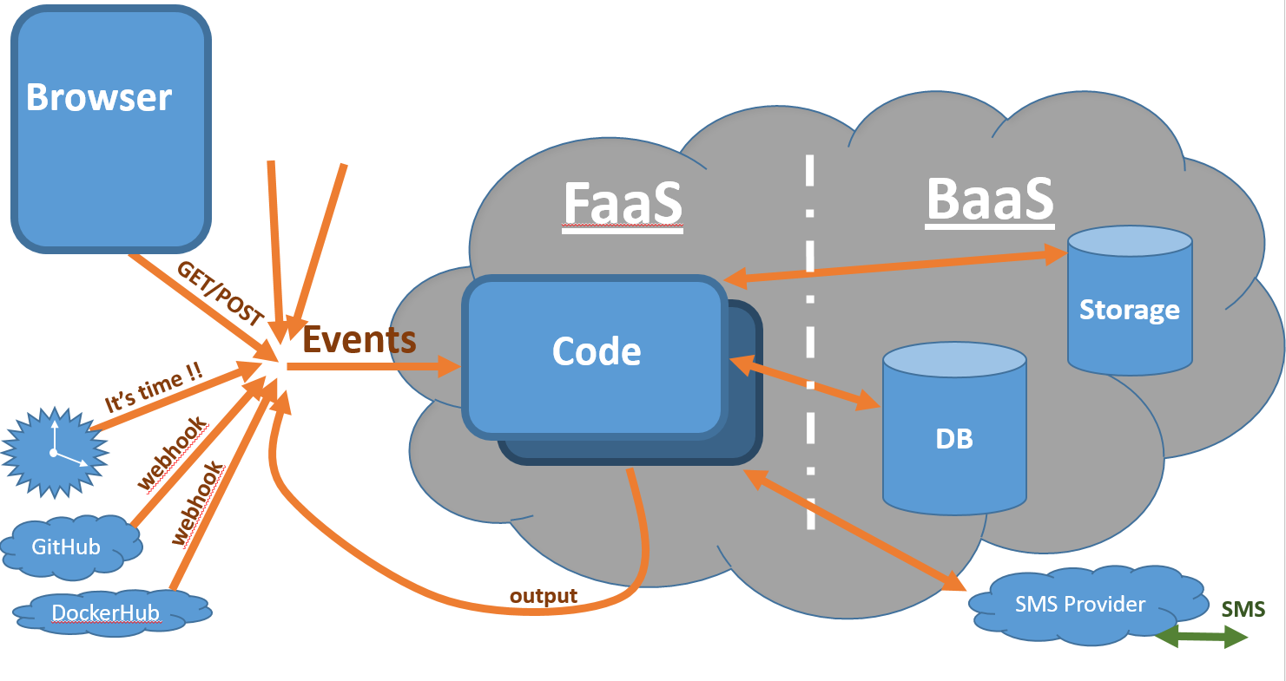
What is Serverless ?
It’s an event driven paradigm

Slide 5
Logistics – Prepared VMs
We have 30 VMs available each pre-configured with
command-line tools to work with
AWS S3, Lambda: awscli, awscli-cwlogs, gspread, oauth2client
Chalice (Py)
Claudia (Node.js)
Serverless (sls Node.js module)
Static site generators: Pelican, Hugo, create-react-app
OpenFaaS: git repo, cli tool: faas-cli
OpenWhisk: git repo, cli tools: wsk, wskdeploy

Slide 6
Logistics – Signup
You will need to connect to your VM via ssh.
http://bit.ly/20190126SIGNUP
Please signup by putting your name at least in this Google Sheet, thereby reserving a VM for yourself (I took node 1 already).
Then follow the link on that page to pickup your credentials.
If you added your name as LabGroup#2 then take ssh_node2_user1.zip, it contains rsa keys and a script, ssh_node2_user1.sh

Slide 7
Logistics – Accessing VMs
After signing up at http://bit.ly/20190126SIGNUP
If you added your name as LabGroup#2 then take ssh_node2_user1.zip, it contains rsa keys and a script, ssh_node2_user1.sh
Connect to your VM using ./ssh_node2_user1.sh
(or look at ip address, user name, keys to configure your client).
Start the exercises at http://bit.ly/20190129LAB

Slide 8
Logistics – Accounts
You will need to use, or create your own AWS account, all usage will be covered by the Free Tier.
Some exercises will optionally require access to MongoDB Atlas to which you should create an account.
Some exercises will optionally require access to Twilio (for sending SMS) to which you should create an account.

Slide 9
Logistics – Exercises
We have exercises for several platforms, frameworks.
You are invited to
Choose the exercises which interest you most, or just follow the proposed order of S3 -> Lambda -> OpenFaaS -> OpenWhisk
Be creative
Experiment with the proposed exercises
Don’t want to use Chalice/Python?, then try Claudia/Node.js or Go or …
Imagine new use cases using the proposed capabilities

Slide 10
Logistics – Scenarii
Given the capabilities of
Receiving web requests, scheduled triggers, DB updates, file uploads
Sending e-mail, SMS, Slack notifications
What Scenarii can you imagine?
Aggregator site like “Scoop.IT”
Image processing: thumbnail generation, colorization, object recognition, OCR
“Scheduled” Web site scraper
Why Serverless?
You only pay for usage, not for an idle server 99% of the time
No upfront capital investment needed

Slide 11
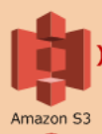
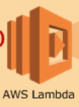
Logistics – Exercises - AWS
We have exercises using proprietary AWS cloud services because they are so popular and have greatly popularized the concept
AWS S3 for static web site hosting
AWS Lambda for Functions as a service
We will use Open Source frameworks (Chalice, Claudia, Serverless) with AWS. We will use cli tools for repeatability.
AWS provide 100’s of services and it’s easy to get locked-in (by own choices) … we will use a minimum of AWS services.

Slide 12



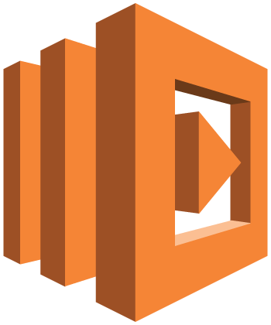





Architecture - AWS
API requests
Over HTTP(S)
Amazon S3
Amazon DynamoDB
Amazon API Gateway*
AWS
Lambda
bucket with objects
Amazon
SES
Lambda function
Chalice Framework
email
Amazon Cognito
Route53
CloudWatch
CloudFront

Slide 13

Logistics – Exercises - OpenFaaS
OpenFaaS is a popular Open Source Serverless platform for building and hosting Serverless applications.
It can run on Docker Swarm or Kubernetes platforms.
You will see how very easy it is to deploy to Docker Swarm from the provided github repo.
Some exercises are proposed.
There is also an official OpenFaaS workshop on github.

Slide 14
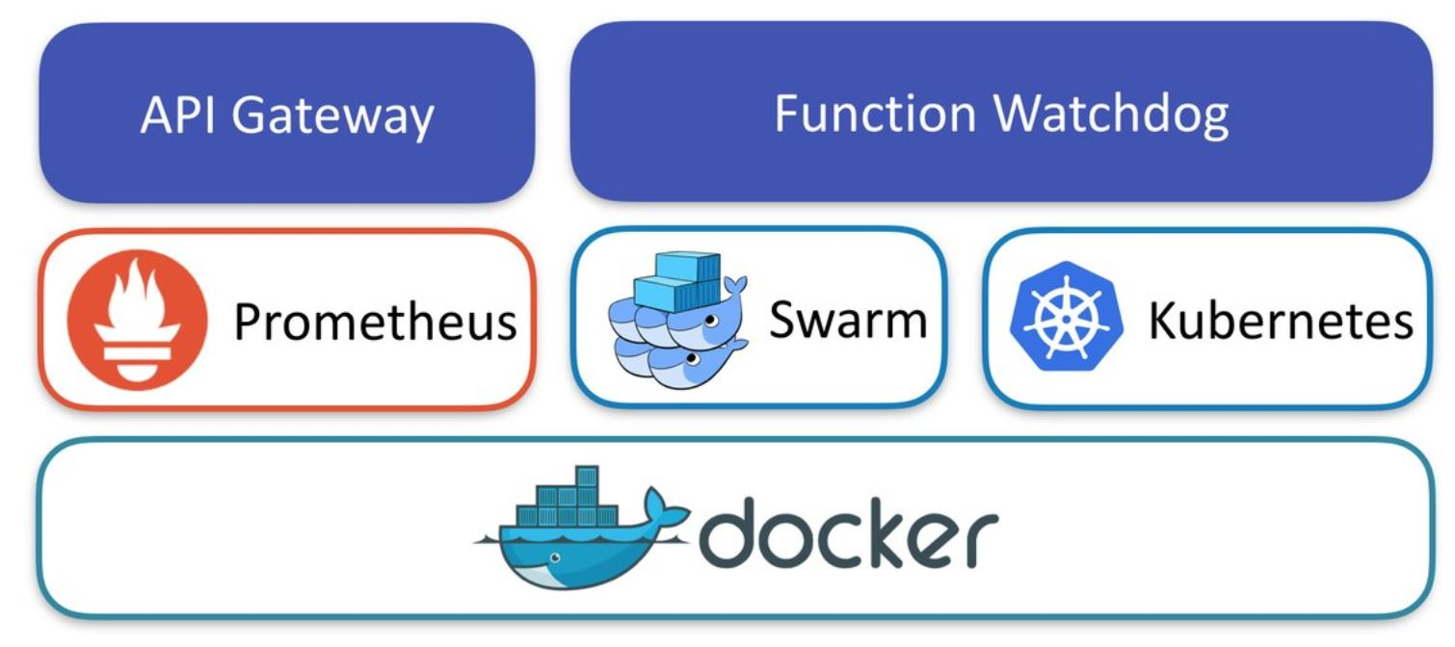
Architecture- OpenFaaS

Slide 15
Logistics – Exercises - OpenWhisk
OpenWhisk is an Open Source Serverless platform for building and hosting Serverless applications. Originally developed by IBM then donated to the Apache Software Foundation. Now Apache OpenWhisk.
It runs on Kubernetes platforms but can also be run on Docker Swarm for testing.
The git repo is present, but not installed. CLI tools wsk and wskdeploy are installed.
There is an official OpenWhisk workshop on github.

Slide 16
Architecture- OpenWhisk

