Slide 1
Scala Programming
Collections

Slide 2
Learning Overview
Review: types
Collections heirachy
Creating collections
Range
Array & array buffer
List & list buffer
Vector
Maps
Sets
Empty
Idioms
Pattern matching
For comprehnsions review
Zipping
Traits

Slide 3
Objectives
By the end of the session you will…
Use collections to analyse information about animals and ports.
Notes:
Monoids and Functors are certain kinds of containers which can be combined in interesting ways.
Functors allow you to apply a function within the container.
Monoids allow you to generically append two containers together.
In this exercise you will use these features to stream-line handling of user information.

Slide 4
REVIEW: TYPES
/*
T[A] T of A
A, B A and B
A => A to B
*/

Slide 5
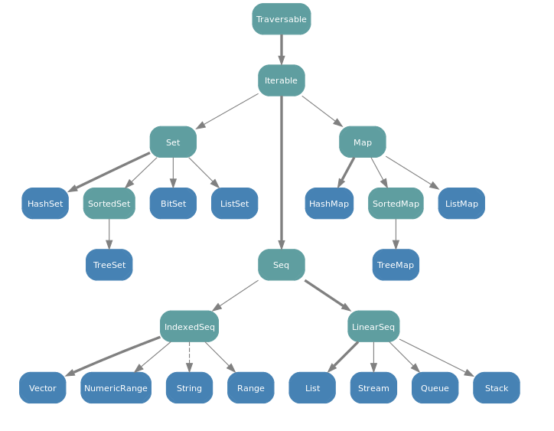
COLLECTIONS HEIRACHY
Notes:
The Traversable "implements the behavior common to all collections
in terms of a foreach method"
Iterable trait defines an iterator,
which lets you loop through a collection’s elements one at a time
An IndexedSeq indicates that random access of elements is efficient
A LinearSeq implies that the collection can be efficiently
split into head and tail components
Scala Map is a collection of key/value pairs, where all the keys must be unique.

Slide 6
CREATING COLLECTIONS
import scala.collection.immutable._
Traversable(1, 2, 3) // foreach: filter, ..
Iterable("x", "y", "z") // for(e <- xs)
IndexedSeq(1.0, 2.0) // fast xs(i)
LinearSeq("A", "B", "C") // fast xs.head
Map("x" -> 24, "y" -> 25, "z" -> 26)
Set('R', 'G', 'R', 'B')
SortedSet("hello", "world")
immutable.
Traversable[Int] = List(1, 2, 3)
immutable.
Iterable[String] = List(x, y, z)
Immutable
.IndexedSeq[Double] = Vector(1.0, 2.0)
Immutable
.LinearSeq[String] = List(A, B, C)
Immutable
.Map[String,Int] = Map(x -> 24, y -> 25, z -> 26)
immutable.Set[Char] = Set(R, G, B)
immutable.SortedSet[String] = TreeSet(hello, world)

Slide 7
CONVERTING BETWEEN TYPES OF COLLECTION
val a = "ABCD".toList
val b = Map("S" -> 1, "A" -> 2).toList
val c = List("UK", "UK", "US").toSet
val d = List( ("name", " sherlock"), ("email", "s@example.com") ).toMap
val e = (0 to 4).toList
val f = (0 to 4).toArray
List(A, B, C, D)
List((S,1), (A,2))
Set(UK, US)
Map(
name -> sherlock,
email -> s@example.com)
List(
0, 1, 2, 3, 4)
Array(
0, 1, 2, 3, 4)

Slide 8
RANGE
val rangeInt = 1 to 10 by 2
val rangeDouble = 1.0 to 5.0 by 0.2
val rangeChr = 'a' to 'z'
('a' to 'z').toList
1 to 10 by 2
1.0 to 5.0 by 0.2
println('a' to 'z' by 2)
println(('0' to '9').toList)
List(a, b, c, d, e, f, g, h, i, j, k, l, m, n, o, p, q, r, s, t, u, v, w, x, y, z)
List(0, 1, 2, 3, 4, 5, 6, 7, 8, 9)

Slide 9
ARRAY & ARRAY BUFFER
import scala.collection.mutable.ArrayBuffer
val _ab = IndexedSeq(1, 2, 3)
val ab = new ArrayBuffer[String]
ab += " Ho "
ab += " Ho "
ab += " Ho "
println(ab)
Ho Ho Ho

Slide 10
LIST & LIST BUFFER
import scala.collection.mutable._
val names = List("Michael", "Sherlcok", "Watson")
val mutNames = ListBuffer("Michael", "Sherlock")
val numbers = Seq(1,2,3)
val countries = "UK" :: "FRANCE" :: "US" :: Nil
List.empty
List.empty == Nil
List.fill(3)("foo")
"foo".toList
(for(c <- 'a' to ’c') yield c + 1).toList
numbers: Seq[Int] = ArrayBuffer(1, 2, 3)
countries: List[String] = List(UK, FRANCE, US)
List()
true
List(foo, foo, foo)
List(f, o, o)
List(98, 99, 100)
9899100

Slide 11
VECTOR
// the best, typical-use-case collection
val names = Vector("Fluffy", "Spot", "Fido")
val letters = for(c <- 'a' to 'c') yield c + 1
val cent = 100 +: Vector.empty
val dbl = 200 +: 100 +: Vector.empty
for (name <- names) println(name)
names: Vector[String] = Vector(Fluffy, Spot, Fido)
letters: IndexedSeq[Int] = Vector(98, 99, 100)
cent: immutable.Vector[Int] = Vector(100)
dbl: immutable.Vector[Int] = Vector(200, 100)
Fluffy
Spot
Fido

Slide 12
MAPs
val point = "A" -> 1
val prefs = Map("Michael" -> "DrPepper",
"Adam" -> "Coffee")
println(point._1) println(prefs("Michael"))
println(prefs - "Michael")
val value = prefs.get("Susan")
println(prefs + ("Lucie" -> "Beer"))
println(prefs.keySet)
for ((p, pr) <- prefs) println(p + pr)
A
DrPepper
Map(Adam -> Coffee)
Map(Michael -> DrPepper, Adam -> Coffee, Lucie -> Beer)
Set(Michael, Adam)
MichaelDrPepper
AdamCoffee
value: Option[String] = None

Slide 13
SETS
val people = Set("Adrian", "Michael", "Sherlock")
val good = Set("Michael")
val bad = Set("Adrian")
val ns = List("Michael", "Michael", "Sherlock")
people & good
people &~ bad
for (person <- people) println(person)
(ns.toSet &~ good).toList
val svcs = Source.fromFile("""/etc/services""")
val inUsePorts = (for {
line <- svcs.getLines
port <- """\d+""".r.findFirstIn(line)
} yield port.toInt).toSet
val freePorts = Set(1 to 200: _*) &~ inUsePorts
Set(Michael)
Set(Michael, Sherlock)
Michael
Sherlock
Adrian
List(Sherlock)
Set(71, 109, 74, 149, 81, 196, 146, 172, 72, 195, 110)

Slide 14
EMPTY
Nil
List.empty
List.empty[Int]
Seq.empty[Int]
Vector.empty[Int]
Map.empty[String,String]
List()
List()
List()
ArrayBuffer()
Vector()
Map()

Slide 15
Idioms

Slide 16
PATTERN MATCHING
val ingredients = List("Flour", "Sugar")
val List(f, s) = ingredients
val point = (1, 2)
val (x, y) = point
val people = "Michael" :: "Sherlock" :: List()
val pets = "Spot" :: "Fluffy" :: Nil
people match {
case head :: rest => s"H ${head} R: ${rest}"
case Nil => "X"
}
f: String=Flour
s: String=Sugar
x: Int = 1
y: Int = 2
people: List[String] = List(Michael, Sherlock)
pets: List[String] = List(Spot, Fluffy)
H Michael R: List(Sherlock)

Slide 17
FOR COMPREHNSIONS REVIEW
for(person <- List("Matt", "Mark", "Luke"))
println(person)
for(pair <-
Map("Cat" -> "Mammal", "Raven" -> "Bird"))
println(pair)
for((animal, kind) <-
Map("Dog" -> "Mammal", "Crow" -> "Bird"))
println(s"$animal is a $kind")
val simple = for((animal, kind) <-
Map("Dog" -> "Mammal", "Crow" -> "Bird")
) yield kind + ":" + animal
Matt
Mark
Luke
(Raven,Bird)
(Cat,Mammal)
Dog is a Mammal
Crow is a Bird
List(Mammal:Dog, Bird:Crow)

Slide 18
ZIPPING
val names = List("Michael", "Mark", "Tim")
val cs = Array("Purpl", "Green", "Blue")
for((name, c) <- names.zip(cs))
println(s"$name <3 $c")
println(names zip cs)
names.zip(cs).toMap
for((letter, index) <- ('a' to 'd').zipWithIndex)
println(s"$letter is ${index + 1}th")
Michael <3 Purpl
Mark <3 Green
Tim <3 Blue
List(
(Michael,Purpl),(Mark,Green), (Tim,Blue))
Map(Michael -> Purpl,
Mark -> Green, Tim -> Blue)
a is 1th
b is 2th
c is 3th
d is 4th

Slide 19
TRAIT FACTORIES
val orderedSupplies =
Seq("Apertif", "Soup", "Starter",
"Main Course", "Dessert", "Coffee",
"Digestif")
val randomSupplies =
IndexedSeq("Food", "Water", "Shelter")
orderedSupplies: Seq[String] = List(Apertif, Soup, Starter, Main Course, Dessert, Coffee, Digestif)
randomSupplies:
IndexedSeq
[String] = Vector(Food, Water, Shelter)

Slide 20
PROGRAMMING TO TRAITS
def total(prices: Seq[Double]) = prices.sum
def menu(ingr: Seq[String]) =
for(i <- ingr) println(i)
val lprices: Seq[Double] = List(2, 3, 4)
val vprices: Seq[Double] = Vector(4, 5, 6)
val aingr: Seq[String] =
Array("Flour", "Sugar", "Milk")
println(total(lprices))
println(total(vprices))
menu(aingr)
9.0
15.0
Flour
Sugar
Milk

Slide 21
Learning Overview
Review: types
Collections heirachy
Creating collections
Range
Array & array buffer
List & list buffer
Vector
Maps
Sets
Empty
Idioms
Pattern matching
For comprehnsions review
Zipping
Traits

Slide 22
Exercise
Use collections to analyse information about animals and ports.

