Slide 1
PHP7 for Web Development
BLOG:
A Blog Case Study
Notes:
This chapter will consolidate your previous programming experience and apply it to a common use case: the design and development of a blog.
Programming can be an overly abstract activity, fundamentally however, it is the process of determining how the structure of a problem domain ("business problem") can be rendered in a programming domain ("code"). This process is the skill of a programmer and not pro-forma repeatable.
How many websites are alike and many business domains are alike, so there are enough opportunities to practice and to learn.

Slide 2
Chapter Overview
Objectives
To design a blog database
To understand the relationship between data, UI and functionality
To review a code base and web development methodology
Chapter Content
Group Discussion Questions
Overview of UI, Data and Code
Review of Design Methodology
Notes:
This chapter is here to get you thinking like a web developer and particularly like an "Architect" – a person who thinks about the structure and design of applications.
Sometimes a very clear initial discussion will lead itself naturally to a very clear application, this is rare however. Business requirements evolve, and every additional constraint can alter the design and structure of the program you are building.
The expert programmer concerns themself with the utmost clarity about the problem domain: the business case, the client's goal, your own goal. The structure of the program can never be flexible enough to solve every problem (or else there would be The One Program which did everything). The inflexibilities of an application design often arise from the real world constraints of the problem it is trying to solve.

Slide 3
PHP7 for Web Development
Group Discussion
Notes:
Several questions follow which are designed to prompt you to think about the design behind a blog.
Though these questions appear specific to a blog, can you determine what the general question "behind" each is? In each case think of a similar question you might as of a different site, say, of BBC News.
Feel free to look at online examples to help you.
This chapter will provide some sample answers further on.

Slide 4
Blog Overview: Questions
The Design of a Blog
What pages would a basic blog have?
Sketch these pages
What data would these collect? What data would they display?
What would the database tables look like?
Outline the tables exactly
Outline what queries you will need
Notes:
S

Slide 5
Authentication
Users
What information will should be collected from users?
How will this information be used?
What "roles" will there be?
Ajax & Authentication
What should a login page look like?
What should happen when a user logs in?
What are authentication and authorization?
How do sessions support website personalization and authentication?

Slide 6
Functionality
Submitting Articles
What should an article-writing page look like?
What features should an article submission page support?
What should happen when an article is submitted?
What considerations are there in inserting user input into the database?
How could you enrich user input?
Listing Articles
What should a blog article index look like?
What ways could you group or categorise articles?
How would you split an array into groups on some criterion?
Viewing Articles
What should an article page look like?
What considerations are there in displaying user input on a page?
What information should we include on all website pages?

Slide 7
PHP7 for Web Development
Some Thoughts

Slide 8
Blog Overview: Answers
No set of "Right" answers, but here are some
The Design of a Blog
login page
home page
lists recent posts
categories
admin page
site configuration
users admin
article submission
page for authors
archive page
look at old posts
Notes:
There are lots of ways you can distribute the functionality of a blog across several pages, above is one example.

Slide 9
Database Overview
A very simple articles table
Category is an integer… why?
In this case because categories is going to be a fixed constant array, ie. an enum, in the code base.
Do not store text when integers will do! much faster to search with.
CREATE TABLE articles (
id int(10) unsigned NOT NULL AUTO_INCREMENT,
title varchar(255) DEFAULT NULL,
body text,
author int(10) unsigned DEFAULT NULL,
category int(11) DEFAULT NULL,
date int(11) DEFAULT NULL,
PRIMARY KEY (id),
CONSTRAINT author FOREIGN KEY (id)
REFERENCES users (id)
ON DELETE NO ACTION ON UPDATE NO ACTION
) ENGINE=InnoDB DEFAULT CHARSET=utf8;
Notes:
Here is the minimal amount of information you might collect about an article.
It will require an id, as almost all data in relational databases do.
The author field refers to an id on the users table, so that we can determine all the information about the author using a JOIN.

Slide 10
Database Overview
A very simple users table
role is an integer – this could be a kind of access level or a const-integer mapping in the code base (ie. an enum)
CREATE TABLE users (
id int(11) unsigned NOT NULL AUTO_INCREMENT,
username varchar(255) DEFAULT NULL,
password varchar(255) DEFAULT NULL,
fullname varchar(255) DEFAULT NULL,
role int(11) DEFAULT NULL,
email varchar(255) DEFAULT NULL,
PRIMARY KEY (id),
UNIQUE KEY email_UNIQUE (email)
) ENGINE=InnoDB DEFAULT CHARSET=utf8;
Notes:
Here is the minimal amount of information you might collect about a user.
"fullname" is an uncommon field: often this is split into firstname/lastname and perhaps even a middle name. However do we actually require this detail of information on our blog? Do we intend ever to show a partial name?
Splitting names into two parts can be tricky too: English names tend to fit, but of course, there are more languages than English.
You may wish to distinguish between authors (perhaps many), admins, guests and other kinds of users. An integer representing an "access level" is the simplest and most useful mechanism here, you can then perform comparisons such as " role > 2 " or given a const, "role > AUTHOR_MIN_ROLE" .
Alternatives include a full permissions table with individual permissions for each operation, eg. "EDIT-ARTICLE-PERMISSION", "DELETE-ARTICLE-PERMISSION" however this would be a lot of over-engineering for a blog.
In general, prefer the simplest engineering option which is consistent with future revision. *Soft*ware is soft, after all, and can be modified. Too much engineering is often worse than too little.

Slide 11
Queries we will need
INSERT INTO blog.users (username, role, email)
VALUES ('sholmes', '1', 'sholmes@example.com');
INSERT INTO blog.articles
(title, body, author, category) VALUES
('A Monograph on Tobacco Ash', 'For many years I have studied cigarettes with some interest. ...', 1, 1, NOW());
SELECT * FROM blog.articles;
SELECT * FROM blog.users;
SELECT * FROM blog.users WHERE users.username = 'sholmes' AND password = '..';
SELECT * FROM blog.articles, blog.users WHERE articles.author = users.id;
Notes:
These queries illustrate the kinds of actions each page of our blog will perform.
INSERT users …
registering a user
INSERT articles ..
posting a blog article
SELECT * articles …
listing the articles
SELECT * FROM users WHERE username =..
a login
SELECT * FROM articles, users ….
viewing an article / getting all the information about an article

Slide 12
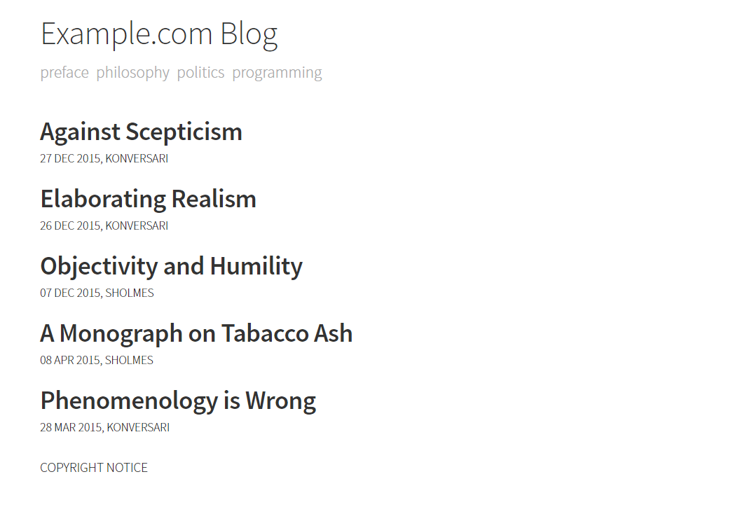
The Homepage: Listing Articles
Notes:
Here are some examples of how a blog may be designed.
The home page is a list of recent articles – what more is a blog?
Each article should have a date, and perhaps, an author's name or username.
Content :
Heading, Categories, Titles, Dates, Author Name
NB.
Layout:
Clear, separated, font-size proportional to importance

Slide 13

Viewing an Article
Notes:
Viewing an article means listing its title, contents.
The blog will have a header, perhaps under a username and some category listings.
NB.
Notice the repetition of the head and categories, consistent style.

Slide 14
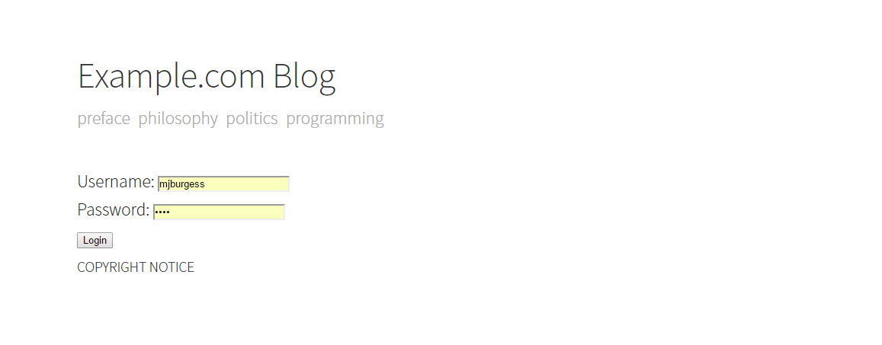
Logging in
Notes:
A very simple login page: username and password.
You might include a CAPTCHA or mechanism to verify it’s a human user. However a login page will need the right username/password pair.
AND you should limit login attempts (per IP address) to prevent brute-forcing.

Slide 15
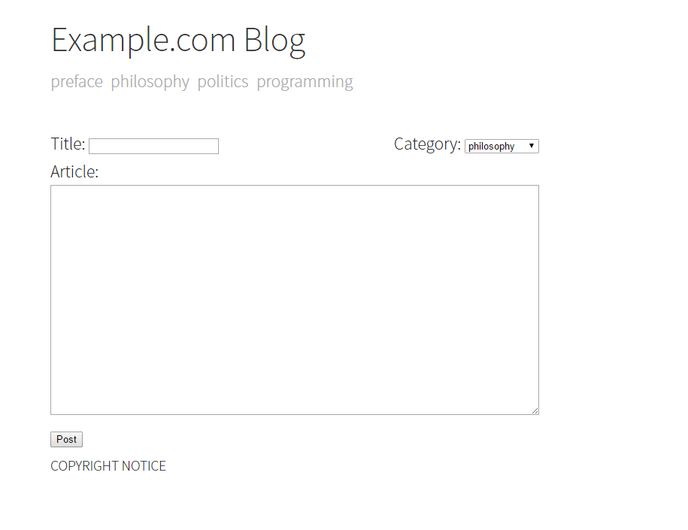
Submitting Articles
Notes:
The page to submit an article is again very simple. However the CSS styling and consistent theme gives it a professional look.
This blog accepts HTML input. However you might prefer to use a javascript library to provide, as for example with Wikipedia, a WYSIWYG.

Slide 16
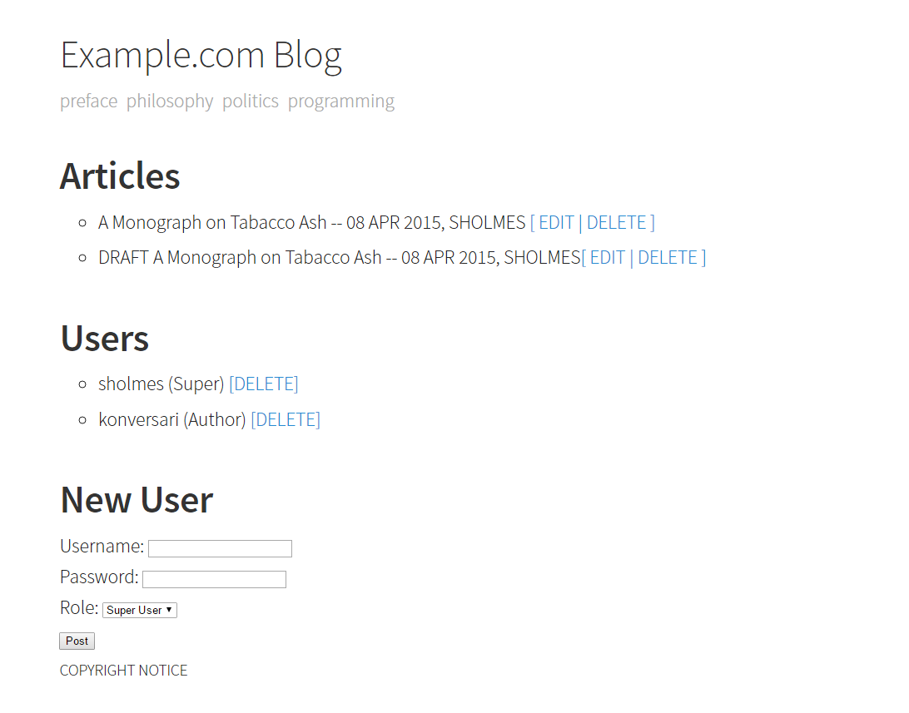
The Admin
Notes:
The admin page is very simple: there are only two tables, so there is only two kinds of data to list.
For each entry there are the basic edit / delete options.
The admin could also included options to change the title of the blog, to send an email to all users, to update or down grade user accounts and perhaps to move articles from one category to another.
The admin section of a website will be its most complex yet least used area: it must provide the ability to administrate the essentials yet it does not need to go overboard.
NB.
Companies with in-house development teams will occasionally engineer extremely complex powerful admin sections (to, for example, adjust very granular user permissions) for the benefit of their non-development staff. Nevertheless the non-development staff will rely on the developers to make the actual adjustments somewhat defeating the purpose of an admin interface.

Slide 17
PHP7 for Web Development
Demo

Slide 18
Code Review: Procedural
Templates
admin
index -- home page
login -- login page
article -- view an article
post -- submit an article
_header -- html head & navigation
_footer -- html close & footer
PHP files
common functions, configuration, etc.
common.php
display and handle POST actions for views
index.php
login.php
post.php
article.php
admin.php
Notes:
Let's first review the procedural code base.
There is a PHP page for every URL. This is a very flexible design choice, however it has somewhat fallen out of favour. Each page is responsible for collecting together all the function it needs to perform the action the URL implies.
In particular each file will include the templates it needs and the relevant data for each template. The data will be delivered to the template in array from directly from a query.
The only other PHP file is a common.php which defines common functions, consts and other initialization code.
NB.
The initialization code is sometimes called a "bootstrap" and every PHP application requires a procedural, that is, some file which does not contain a class.

Slide 19
Code Review: Object-Oriented (MVC)
Models
User -- blog.users
Article -- blog.articles
Views
admin
index -- home page
article -- view an article
login -- login page
post -- submit an article
layout -- master layout
Controllers
Article -- CRUD REST for User
User -- CRUD REST for Article
Index -- Miscellaneous (homepage, …)
Framework
Notes:
Here is an MVC interpretation.
There will be a Model for each table, that is, each row of the table will correspond to a Model object.
The views broadly mirror the same templates in the procedural version.
There are three controllers, two for the two tables: we will at least need to create/read/update/delete users and articles. Each method will, roughly, be a file in the previous procedural version.
There is an additional Index controller which will have any miscellaneous actions (eg. the user login). You could have an additional controller for Login/Logout, and this would be a valid design choice, however given the simplicity of the site this would be to over-engineer a little.
Finally "Framework" is listed, since there will need to be some generic code which glues everything else we have listed tougher. This mirrors, somewhat, the common.php in the procedural version.

Slide 20
PHP7 for Web Development
Procedural Code Review

Slide 21
The General Approach: article.php
<?php
include 'common.php';
$sql = "SELECT * FROM articles, users
WHERE users.id = articles.author
AND articles.id = :id
ORDER BY date DESC";
$stmt = $gPDO->prepare($sql);
$stmt->execute($_GET + ['id' => DEFAULT_ARTICLE_ID]);
display_page('article', [
'article' => $stmt->fetch()
]);
The general structure of a file is SQL for data then display
Notes:
This exemplifies the general structure of each procedural file :
include common utilities
obtain data
display view
Note the conceptual similarity to the MVC way of thinking. View and Data logic is separated – not to the same degree – but cleanly enough.
This file however is very simple, and as it grows more confusion will enter. If you leave yourself enough room to insert incongruous code you will eventually, in a pinch, take that opportunity.

Slide 22
login.php: Actions
//..
switch($_SERVER['REQUEST_METHOD']) {
case 'GET':
display_page('login');
break;
case 'POST':
$stmt = $gPDO->prepare($sql);
$stmt->execute(['username' => $_POST['username']]);
perform_login($stmt->fetch());
break;
}
Often pages will need an action for GET and one for POST
forms will post to their own pages which will handle with their data
Notes:
Each page is responsible for handling everything a user can do with it. The page which displays the login form is the same page which handles the login action.
For many simple sites there is no more than one form per page, thus there are two actions: GET – display, POST– handle the form.
In the POST section of this switch the peform_login() function is called, this is defined in common.php.
Notice in general how "thin" this switch statement is, all of the complexity is handed off to common functions. This discipline is difficult to maintain, in older code bases it is not hard to find 100s of lines in a switch statemet.
As a general rule every "conceptual region of code" should be 5 – 10 lines: function blocks, switch/cases, etc. Define as many functions as you need to get to this limit. Code must above all be clear – some here would say "work", however you might find clear and broken code easier to fix and manage, than something working perfectly but incomprehensible.

Slide 23
common.php
session_start();
//ERROR HANDLER
set_exception_handler(function ($e) {
display_page('error', ['message' => $e->getMessage()]);
});
//DATABASE
//global
$gPDO = new PDO('mysql://host=localhost;dbname=blog', 'root', 'password');
$gPDO->setAttribute(PDO::ATTR_ERRMODE, PDO::ERRMODE_EXCEPTION);
A common file performs operations every page will need
and defines common functions, etc.
Notes:
The first section to the common file is boostraping: linear code which actually calls functions (rather than, say, define them).
This sets up everything every page of the site will need.
The $gPDO variable (g for global) is set here so I can be passed to the database functions which require it.

Slide 24
templates
Templates mix HTML and a very restricted subset of PHP
the only PHP in these files concerns the format of what is output
and outputting it
Alternative control syntax and short tags used for clarity
<div class="content post">
<h1 class="post-title"><?= $vars['article']['title']; ?></h1>
<div class="post-date">
<time><?= date('d M Y', $vars['article']['date']); ?></time>,
<?= $vars['article']['fullname']; ?>
</div>
<?= $vars['article']['body']; ?>
</div>
Notes:
The use of PHP in templates is highly restricted. The kind of programming code admitted is sometimes called "view logic" --- it must be restricted only to echo's and basic formatting.
No decisions should be made in a template, and certainly no database queries. Why?
Suppose there was a bug in a database query, where would you look? Well, in the database function. Suppose a title was miscapitalized, how would you fix that? Perhaps a ucwords() in the view.
Now suppose everything was mixed together, suppose you had 100s of lines of code in your view. How do you fix a title? Well first you're going to have to read though the entire fix and figure out what's going on. A nightmare.

Slide 25
Retrospective
How did we design the blog?
Front End FIRST!
Contemporary design practice begins with what the user sees
Works backwards to what functionality is need to support this view
Then determines what data is necessary to support this functionality
View, Controller, Model
Wireframe the views
Rough and ready outline of the site
Prototype the functionality
Write a lot of rough code quickly to learn the problem domain
Rewrite the solution once your understanding of the problem is complete

Slide 26
Aside on Development and Prototyping
Programming is mostly a conceptual task
understand the world
translate it into a program (modelling)
the time to retype a solution is small compared to
the time to understand
and design it
modelling is difficult
Most time spent "programming" will be spent thinking and designing
net number of keystrokes/day is the equivalent of a few paragraphs – at most! – in English
Therefore do a lot of cheap work ahead of time
prototyping, wireframing, etc.
improve your understanding of the problem
BEFORE you write the solution
THROW AWAY the prototype!
Bad solutions cost a lot more time, money, effort and morale than prototypes
Notes:
The skill of a programmer is often underestimated because it is almost entirely cognitive: how clearly can you think about problems, how well can you reason through code, how well can you design programming solutions?
Expressing your ideas in syntax is the final, and perhaps, least time-intensive aspect of programming. The effort is understanding what to write and why.
In this web development course you have seen many examples of code and considered many different ways of solving problems. This is a good start, now you need to build on this knowledge.

Slide 27
Review Questions
The Life-Cycle of Web Development
How should you begin the design of a website?
What are wireframes and specifications?
What is an iterative development model?
What is a prototype?
What are the benefits and disadvantages of a framework?

