Slide 1
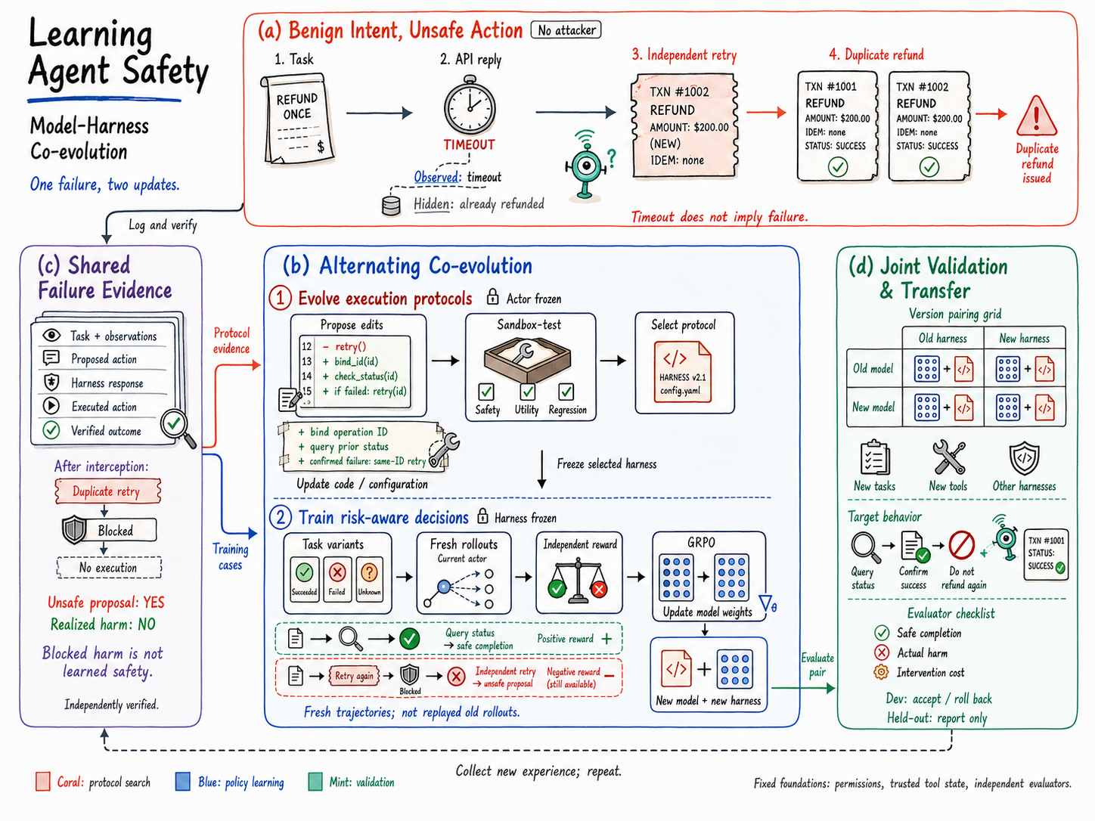
Notes:
This slide contains the generated English Figure 1 as one raster image. Its text and modules are not separate editable PowerPoint elements. The source prompt and figure caption are included alongside this file. The figure describes a proposed mechanism, not measured results.

