Slide 1

Big-O notation. Algorithm complexity
Notes:
Just into on why we’re here today and what’s the point of having this presentation. Brifely touch the topic of presenters: SZ, OZ, IL, and KK.
In the end: passing the floot to Sviatlana.

Slide 2
Why should we care?
Efficient algorithms execute MUCH faster:
Quick sort of array with billion elements will take 5 minutes, bubble sort – 400 years
Advanced algorithms may take less space, saving you money

Slide 3
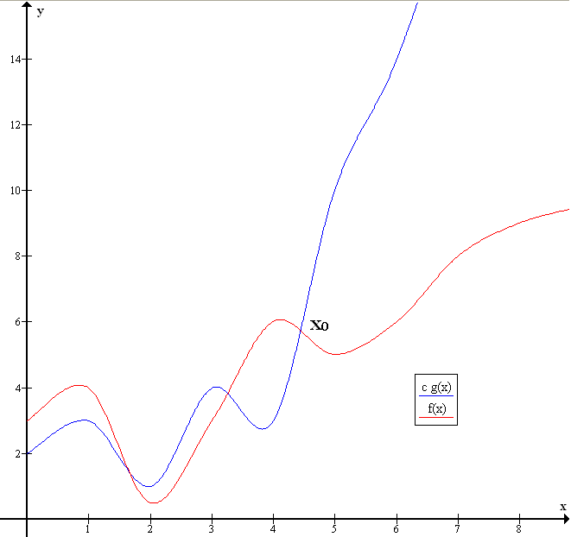

Big-O in Math
Big O notation is a mathematical notation that describes the limiting behavior of a function. The letter O is used because the growth rate of a function is also referred to as the order of the function. Different functions with the same growth rate may be represented using the same O notation.
$$f\left(x\right)=O\left(g\left(x\right)\right) if \left|f\left(x\right)\right|≤Mg\left(x\right)for any x≥x_{0}$$
Where M is some constant, $x_{0}$ is a number that depends on M
$$f\left(x\right)=O\left(g\left(x\right)\right), M=1, x_{0}≈4.5$$

Slide 4
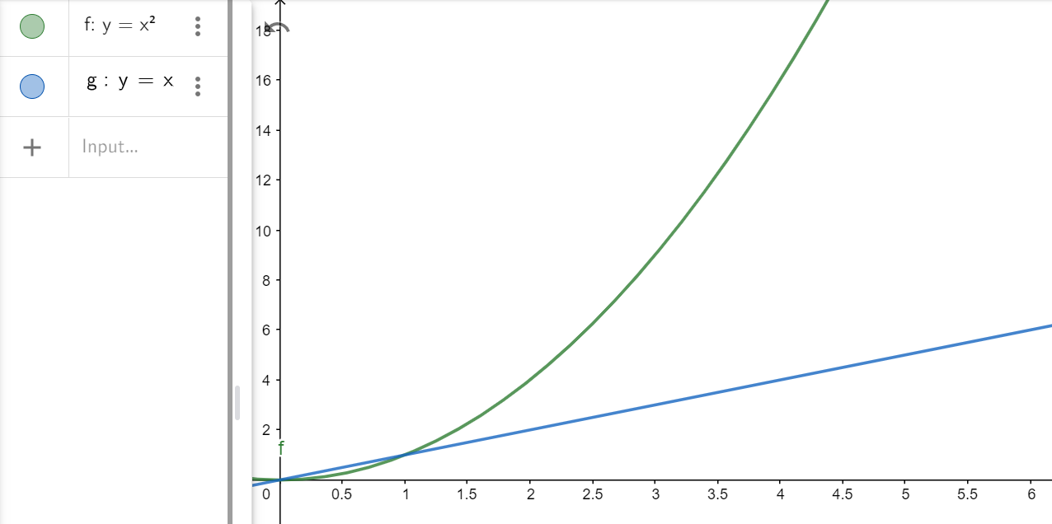
Big-O in Math
If we can select any M, then we can multiply our lower function 1.000.000.000 times or even more, it will always be higher than another function, right?
No, you can select a coefficient to make a g function higher that f at any selected point, but not at all points. If you multiply it by 10, f becomes higher again at x=10. If you multiply it by 100 – at x=100, by 1.000.000 – at 1.000.000, etc.

Slide 5
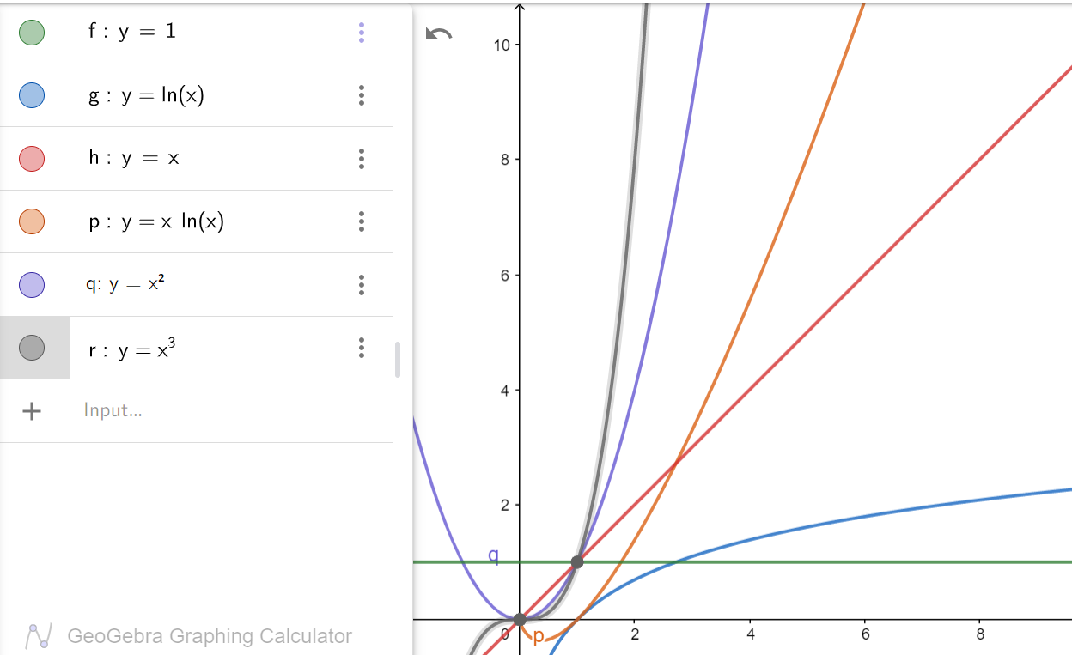
Most common functions

Slide 6
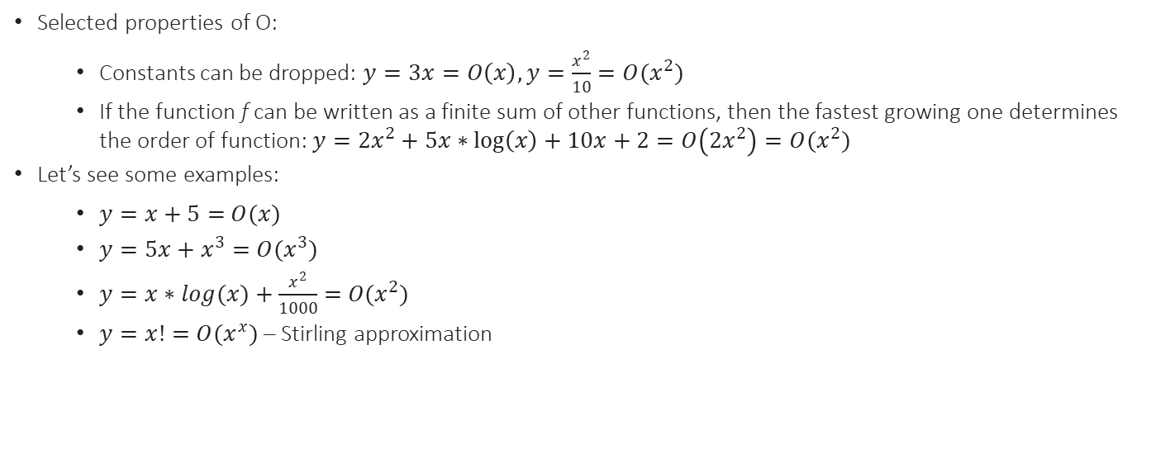
Big-O in Math
Selected properties of O:
Constants can be dropped: $y=3x=O\left(x\right), y=\frac{x^{2}}{10}=O(x^{2})$
If the function f can be written as a finite sum of other functions, then the fastest growing one determines the order of function: $y=2x^{2}+5x∗\log\left(x\right)+10x+2=O\left(2x^{2}\right)=O(x^{2})$
Let’s see some examples:
$y=x+5=$ $O(x)$
$y=5x+x^{3}=$ $O(x^{3})$
$y=x∗log(x)+\frac{x^{2}}{1000}=$ $O(x^{2})$
$y=x!=$ $O(x^{x})$ – Stirling approximation

Slide 7
Big-O in algorithms
Why can’t we exactly calculate how much time the algorithm will take to execute?
Different computers have different processors, memory, etc.
Different programs run on background; you don’t know how much CPU time your program will receive
Different air temperature and humidity may affect processor speed
How do we estimate the algorithm complexity?
Simply count the CPU instructions based on the input size

Slide 8
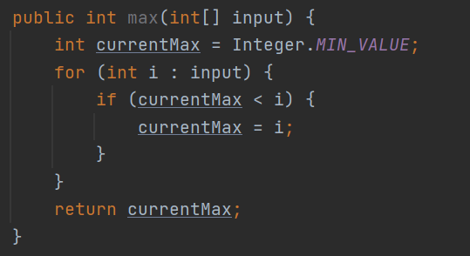

Big-O example
$1$ variable declaration
$1$ assignment
$1$ iterator creation
$n$ comparisons
$n$ assignments
$1$ return
$$f\left(x\right)=1+1+1+1+n+n+1=5+2n=O(n)$$

Slide 9
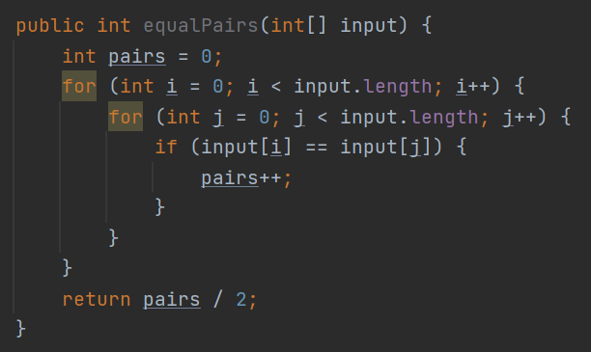

Big-O example
$1$ variable declaration
$1$ assignment
$1$ iterator creation
$n$ comparisons
$n$ increments
$n$iterator creations
$n^{2}$comparisons
$n^{2}$ increments
$n^{2}$ comparisons
$n^{2}$ increments
$1$ return
$$f\left(x\right)=1+1+1+n+n+n^{2}+n^{2}+n^{2}+n^{2}+n^{2}+1=4+2n+5n^{2}=O(n^{2})$$

Slide 10
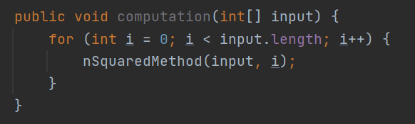

Big-O example
$1$ variable declaration
$1$ assignment
$n$ comparisons
$n$ increments
$n$ method calls
$$f\left(x\right)=1+1+n+n+n∗n^{2}=2+2n+n^{3}=O(n^{3})$$

Slide 11
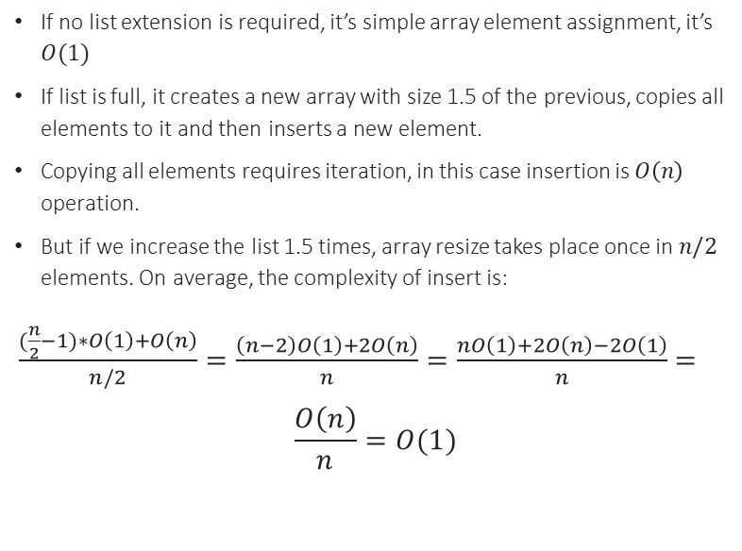
Big-O example
If no list extension is required, it’s simple array element assignment, it’s $O(1)$
If list is full, it creates a new array with size 1.5 of the previous, copies all elements to it and then inserts a new element.
Copying all elements requires iteration, in this case insertion is $O\left(n\right)$ operation.
But if we increase the list 1.5 times, array resize takes place once in $n/2$ elements. On average, the complexity of insert is:
$\frac{(\frac{n}{2}−1)∗O\left(1\right)+O\left(n\right)}{n/2}=\frac{\left(n−2\right)O\left(1\right)+2O\left(n\right)}{n}=\frac{nO\left(1\right)+2O\left(n\right)−2O\left(1\right)}{n}=$
$$\frac{O\left(n\right)}{n}=O(1)$$

Slide 12

Memory consumption
Some algorithms require additional memory. For example, merge sort. It’s an efficient sorting algorithm, that requires 1 additional array of the same size to manipulate the data.
Memory consumption is calculated in the same manner, big-O notation can be used there, too.
Merge sort has $O\left(nlogn\right)$ time complexity and requires $O(n)$ additional space

Slide 13
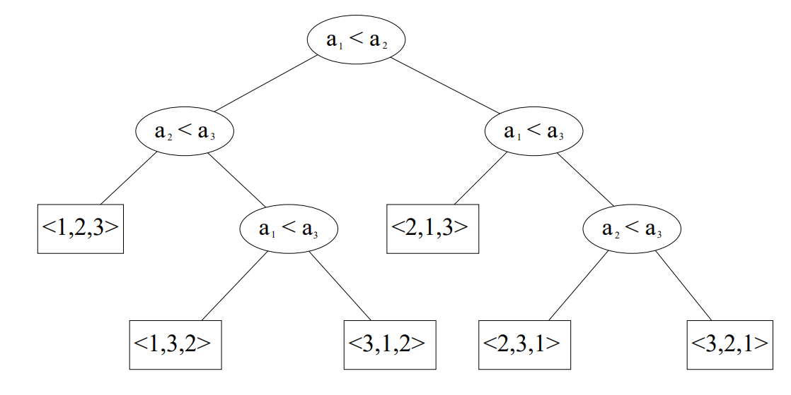
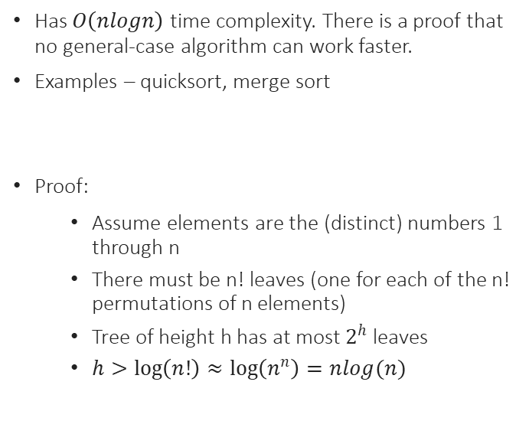
General-case sorting
Has $O\left(nlogn\right)$ time complexity. There is a proof that no general-case algorithm can work faster.
Examples – quicksort, merge sort
Proof:
Assume elements are the (distinct) numbers 1 through n
There must be n! leaves (one for each of the n! permutations of n elements)
Tree of height h has at most $2^{h}$ leaves
$h>\log\left(n!\right)≈\log\left(n^{n}\right)=nlog(n)$

Slide 14
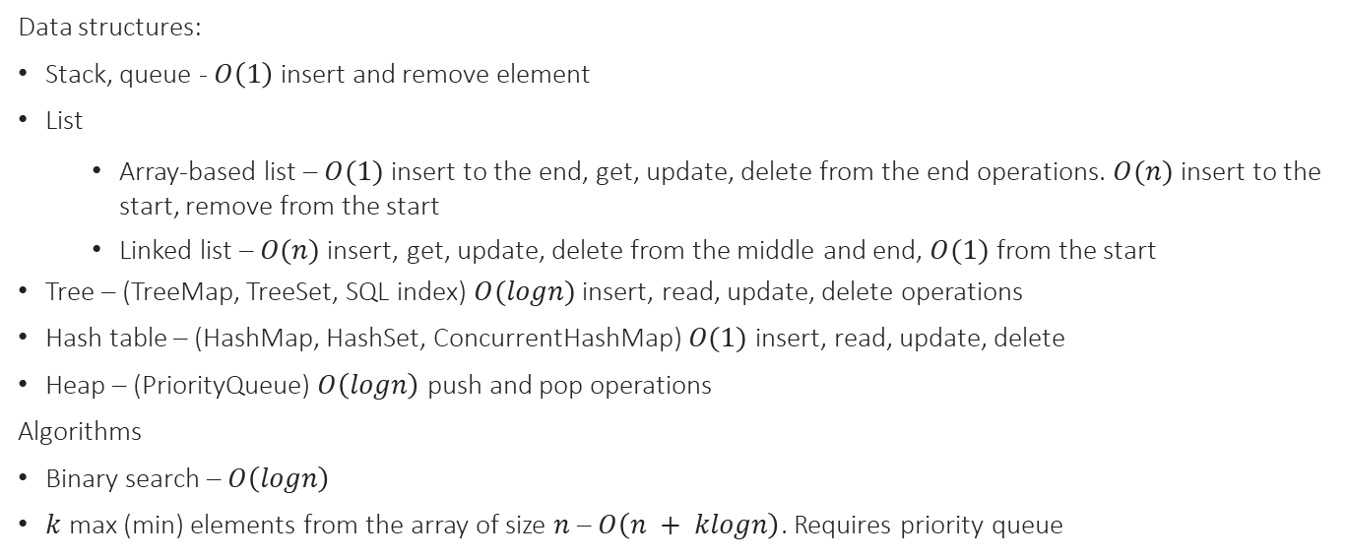
Selected data structures and algorithms
Data structures:
Stack, queue - $O\left(1\right)$ insert and remove element
List
Array-based list – $O(1)$ insert to the end, get, update, delete from the end operations. $O(n)$ insert to the start, remove from the start
Linked list – $O(n)$ insert, get, update, delete from the middle and end, $O(1)$ from the start
Tree – (TreeMap, TreeSet, SQL index) $O(logn)$ insert, read, update, delete operations
Hash table – (HashMap, HashSet, ConcurrentHashMap) $O(1)$ insert, read, update, delete
Heap – (PriorityQueue) $O\left(logn\right)$ push and pop operations
Algorithms
Binary search – $O\left(logn\right)$
$k$ max (min) elements from the array of size $n$ – $O\left(n + klogn\right)$. Requires priority queue

Slide 15
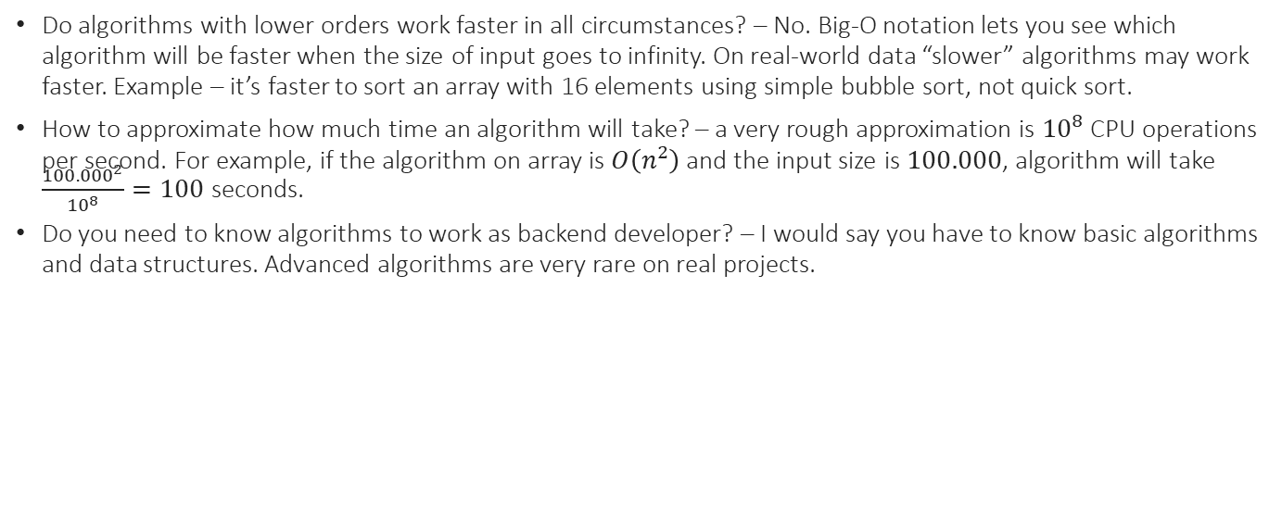
FAQ
Do algorithms with lower orders work faster in all circumstances? – No. Big-O notation lets you see which algorithm will be faster when the size of input goes to infinity. On real-world data “slower” algorithms may work faster. Example – it’s faster to sort an array with 16 elements using simple bubble sort, not quick sort.
How to approximate how much time an algorithm will take? – a very rough approximation is ${10}^{8}$ CPU operations per second. For example, if the algorithm on array is $O\left(n^{2}\right)$ and the input size is $100.000$, algorithm will take $\frac{{100.000}^{2}}{{10}^{8}}=100$ seconds.
Do you need to know algorithms to work as backend developer? – I would say you have to know basic algorithms and data structures. Advanced algorithms are very rare on real projects.

Slide 16
Advanced data structures and algorithms
If you’re interested, you can study:
Binary heap, binomial heap
Red-black tree, AVT tree, 2-4 tree
Disjoin-set union
Tree algorithms – BFS, DFS, LCA
Graph algorithms – Kruskal’s, Dijkstra, Floyd Warshall
Sorting – quicksort, mergesort, insertion sort, bubble sort, count sort

Slide 17
QA
Do you have any questions?

