Slide 1

NoSQL Introduction
Notes:
Just into on why we’re here today and what’s the point of having this presentation. Brifely touch the topic of presenters: SZ, OZ, IL, and KK.
In the end: passing the floot to Sviatlana.

Slide 2


Scaling approaches
Horizontal
Vertical

Slide 3
Relational Databases limitations
Scalability
Performance
Cost
Fixed schema

Slide 4
NoSQL vs Relational databases
 | Relational databases | NoSQL databases
Schema | Fixed, hard to change | Dynamic or none
Data structure | Table-based | Depending on type – documents, graphs, key-value
Scaling | Primarily vertical, expensive | Both horizontal and vertical, cheap
Data access | Joins | Denormalization
Transaction models | ACID | BASE

Slide 5
ACID vs BASE
ACID model provides a consistent system
BASE model provides high availability
BASE stands for:
Basically available – ensure availability by spreading data between servers
Soft state – enforcing consistency is a job of a programmer
Eventually consistent – eventually consistency will be achieved

Slide 6



NoSQL Cluster
Read
Write
Read
Write

Slide 7
Main NoSQL databases types
 | Example | Description
Document DB | MongoDB | Stores whole documents, usually in JSON format
Key-value store | Redis | Simple and super-fast database, can be thought of as Map<String, String>
Graph DB | Neo4j | Stores objects and their relations

Slide 8
Demo time!

Slide 9
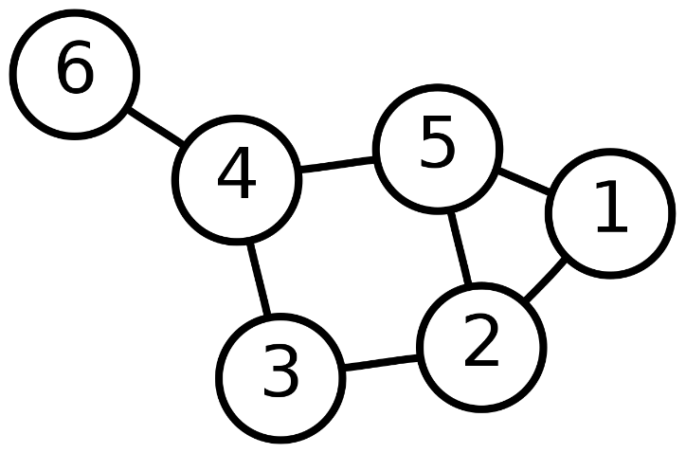
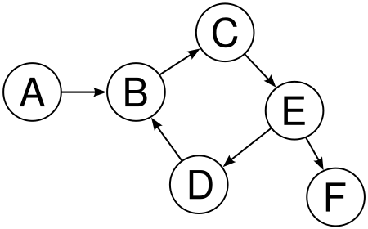
Graphs
Graph – mathematical object, that describes some entities (vertices) and their relations (edges). Graph can represent anything, for example social networks, railways, family tree. Graphs can be directed and undirected.

Slide 10
Demo time!

Slide 11
Other NoSQL DB types
Wide-column databases – like SQL, but each row can contain thousands of cells. Joins are either not supported, or work very slowly
Time series databases – for example, for smart thermometers
Full text search engines – for searching in text documents, indexing web

Slide 12
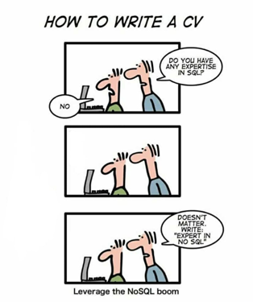
Will SQL databases die?

Slide 13
QA
Do you have any questions?

