Slide 1

Software Development Methodologies
Notes:
Add images, write speech, meme at the end? Practical tool screenshot/more details on tools

Slide 2
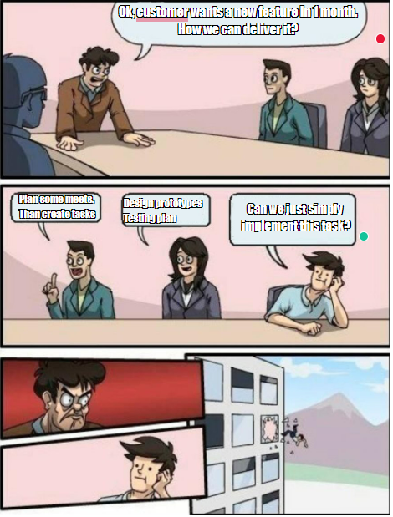
Developing application
Waterfall
Agile
Scrum
Kanban
Notes:
Dive into history https://scrumtrek.ru/blog/agile-scrum/3406/agile-history-1/
+ Discuss that work is not only development

Slide 3
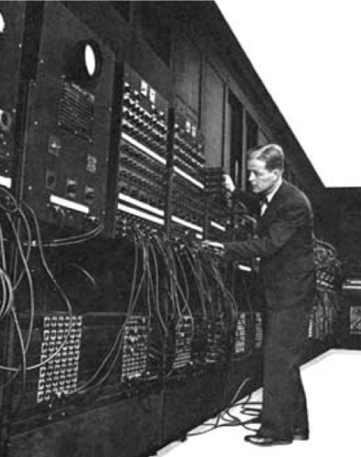
History
Projects have always exceeded budgets;
The implementation of the project has always exceeded the agreed time;
The final software inefficiently solved the task assigned to several gears (slowed down, instability, etc.);
The result was loss of quality;
Projects were unmanageable and code was difficult to follow.
Notes:
Dive into history https://scrumtrek.ru/blog/agile-scrum/3406/agile-history-1/
+ Discuss that work is not only development

Slide 4
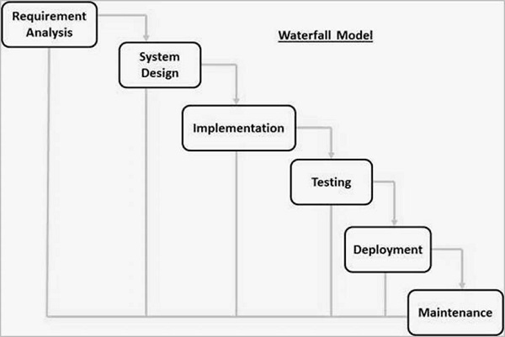
Waterfall

Slide 5
Waterfall – pros and cons
Disadvantages:
No working software is produced until late during the life cycle.
High amounts of risk and uncertainty.
Not a good model for complex and object-oriented projects.
Poor model for long and ongoing projects.
Not suitable for the projects where requirements are at a moderate to high risk of changing. So, risk and uncertainty is high with this process model.
It is difficult to measure progress within stages.
Cannot accommodate changing requirements.
Adjusting scope during the life cycle can end a project.
Integration is done as a "big-bang. at the very end, which doesn't allow identifying any technological or business bottleneck or challenges early.
Advantages:
Simple and easy to understand and use
Easy to manage
Works well for smaller projects where requirements are very well understood.
Clearly defined stages.

Slide 6
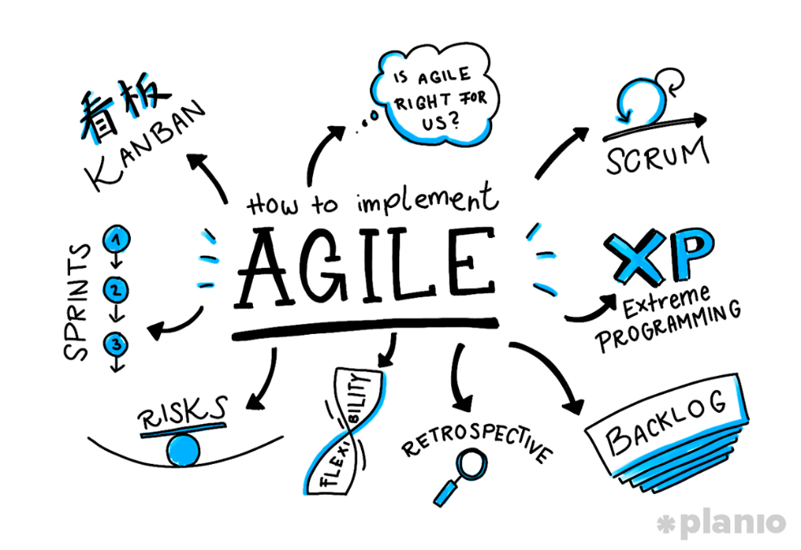
Agile
Agile - iterative approach to project management and software development that helps teams deliver value to their customers faster and with fewer headaches.
4 values + 12 principles - agilemanifesto.org
Agile is a way, not the goal
Included methodologies:
Kanban
Scrum
Lean software development
Dynamic systems development method (DSDM)
Crystal
Atern

Slide 7
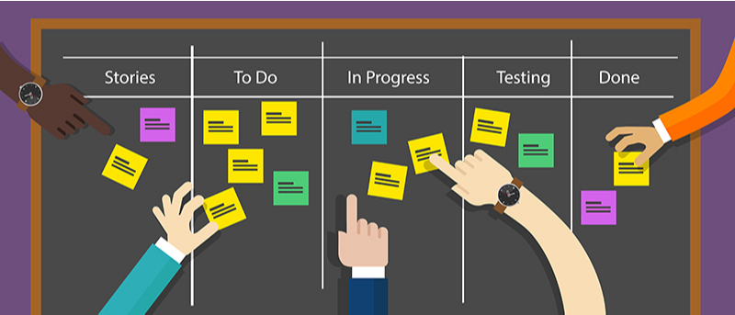
Kanban
Implementing Agile
Real-time communication
Transparency of work
Visual representation on Kanban board
Principles:
Start With What You Do Now
Agree to Pursue Incremental, Evolutionary Change
Encourage Acts of Leadership at All Levels

Slide 8
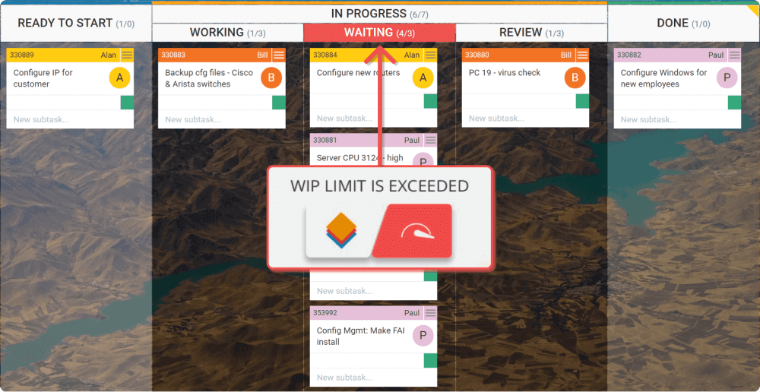
How to Kanban?
Visualize the Workflow
Limit Work In Progress (WIP)
Manage Flow
Make Process Policies Explicit
Feedback Loops
Improve Collaboratively
Notes:
Include Tools

Slide 9
Kanban – pros and cons
Advantages:
Easy to use
Continuous development Adaptability
Collaboration
Reduces costs
Disadvantages:
Require stable plans
Timeless (no deadlines)
Require regular updates for Kanban board

Slide 10
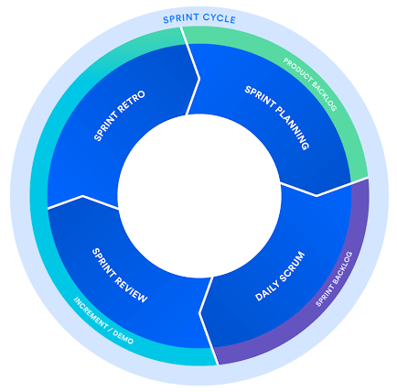
Scrum
Scrum is a framework for getting work done, where agile is a mindset
Principles:
Control over the empirical process.
Self-organization.
Collaboration
Value-based prioritization
Time-boxing
Iterative development

Slide 11
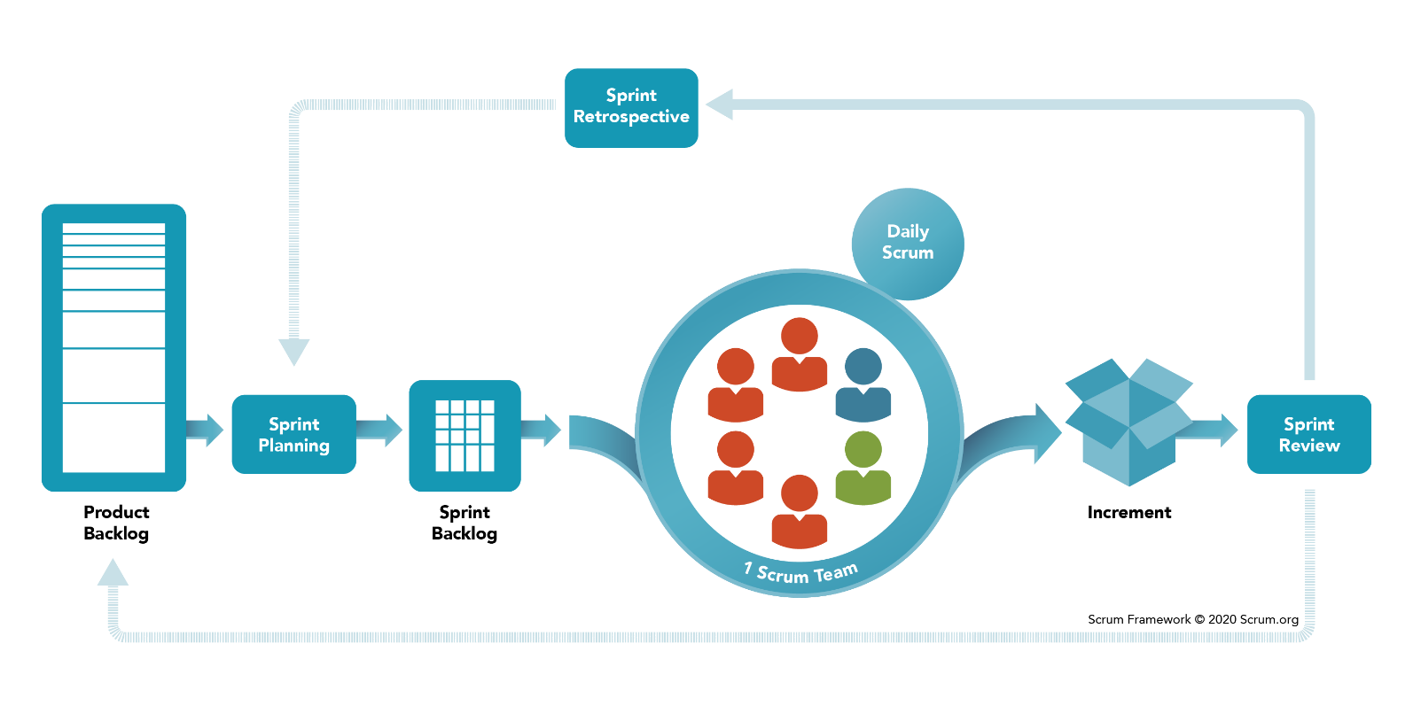
How to Scrum?
Scrum artifacts:
Product backlog
Sprint backlog
Increment
Scrum ceremonies:
Organize backlog (Grooming)
Sprint planning
Sprint
Daily scrum or stand-up
Sprint review
Scrum roles:
Product Owner (PO)
Scrum master
Development team
Read more:
Scrum and XP from the Trenches - 2nd Edition
Henrik Kniberg
Notes:
Include Tools!

Slide 12
Scrum – pros and cons
Advantages:
It's adaptable and flexible.
It encourages creative approaches.
It involves low costs.
It usually leads to better quality work.
It improves customer satisfaction.
It typically results in more satisfied employees.
Disadvantages:
It requires the use of small teams.
It requires experienced personnel.
It can be difficult to integrate with a classic project management approach.
It may require major transformations within the organization.
It can be difficult to scale.

Slide 13
Scrum vs Kanban
 | Scrum | Kanban
Origin | Software development | Lean manufacturing
Ideology | Learn through experiences, self-organize and prioritize, and reflect on wins and losses to continuously improve. | Use visuals to improve work-in-progress
Cadence | Regular, fixed-length sprints (i.e. two weeks) | Continuous flow
Practices | Sprint planning, sprint, daily scrum, sprint review, sprint retrospective | Visualize the flow of work, limit work-in-progress, manage flow, incorporate feedback loops
Roles | Product owner, scrum master, development team | No required roles
Origin | Software development | Lean manufacturing

Slide 14
Additional topic to think
Burn-down chart
Estimation techniques
Metrics
Conflicts resolving
Engineering Excellence

Slide 15
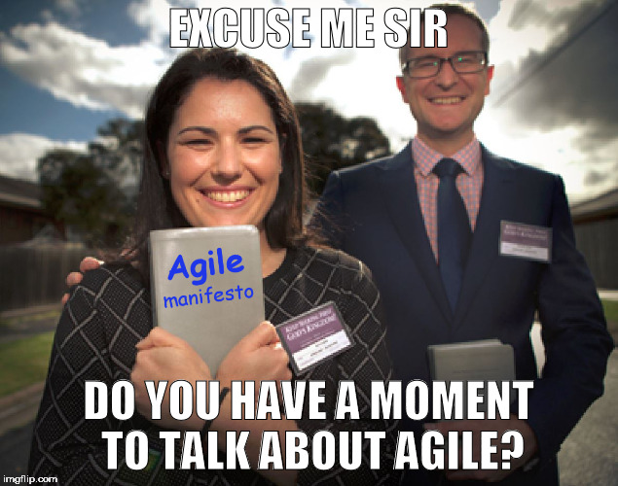
Some meme

Slide 16
QA
Do you have any questions?

