Slide 1
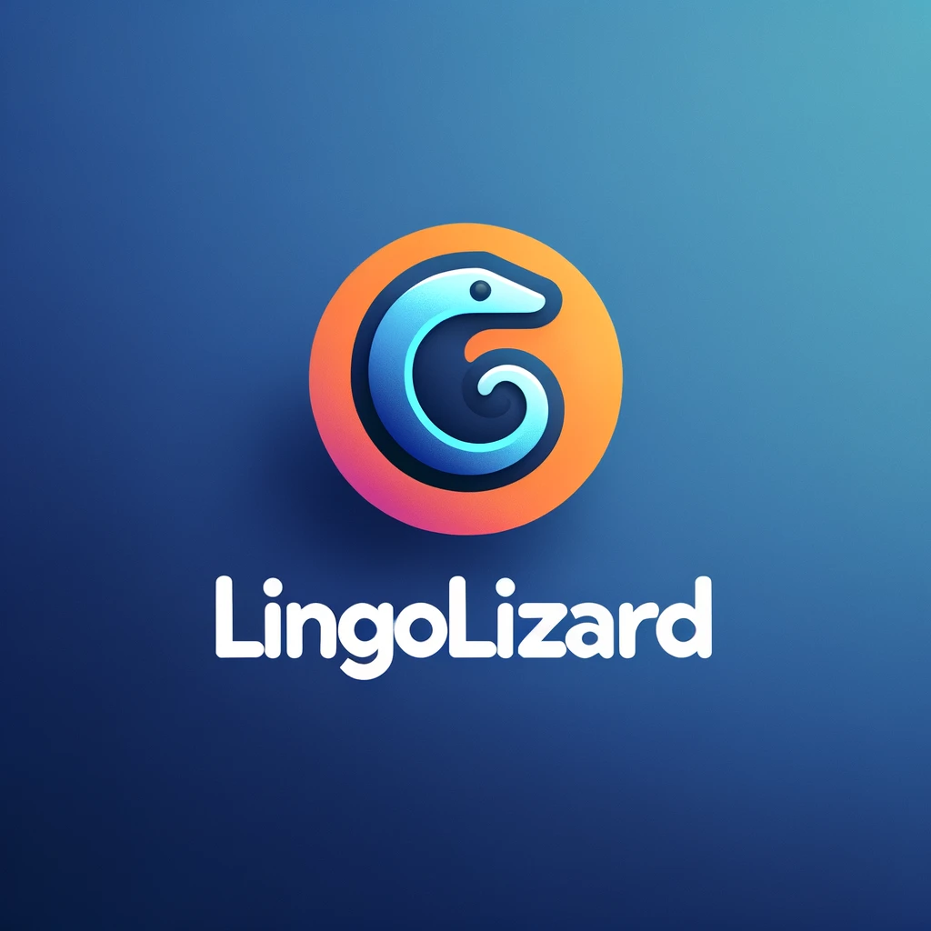
LingoLizard
Michael Cullen
C00261635
24/02/2024

Slide 2

Overview
language learning tool that goes beyond traditional methods like flashcards and grammar exercises
AI to simulate interactions in different languages and give feedback.
Cheaper and more accessible

Slide 3
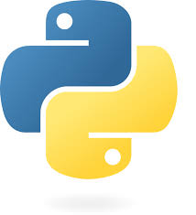
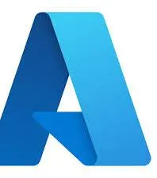
Technologies
Python
Microsoft Bot Framework
Azure: APIs + Web hosting
AI & ML: Sentence Transformer model and cosine similarity

Slide 4
My progress
Basic Structure of Scenarios
Translation and Analytics APIs
Feedback
Deployment

Slide 5
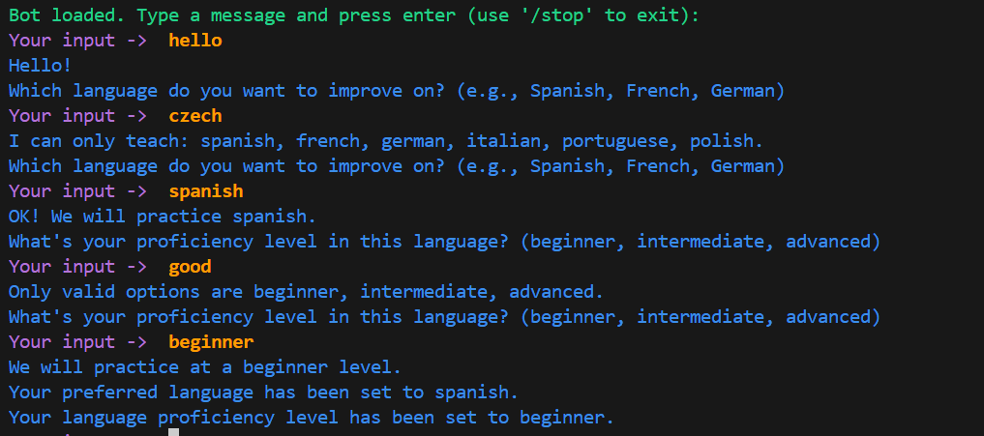

Slide 6
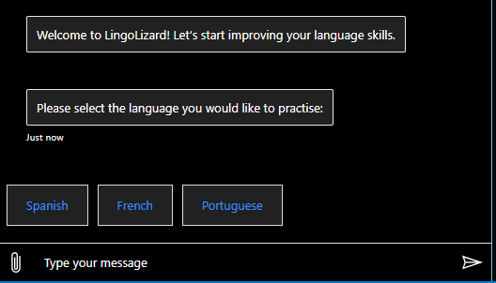

Slide 7
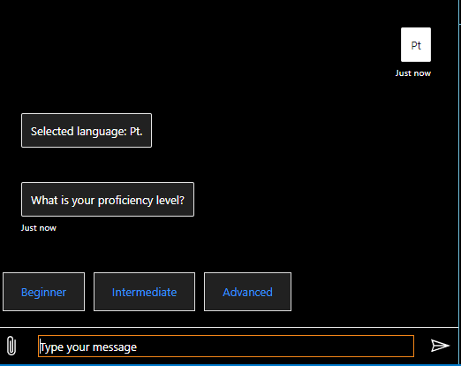

Slide 8
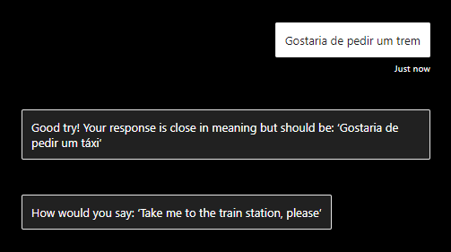

Slide 9
Challenges Faced
Rasa to Microsoft
Learning Azure
Continuous Integration
How to make feedback
Handling Different Proficiency Levels

Slide 10
What’s next
Gamification & Leaderboards
UI
More complex dialogue
Text-to-speech / speech-to-text input

Slide 11
Questions?

