Slide 1
LingoLizard
Michael Cullen
C00261635
24/10/2024

Slide 2

Overview
LingoLizard is a tool designed to help people learn languages using real time lessons and conversations.
It will do this using AI to simulate interactions in different languages.
It will be able to give real time feedback and corrections to spelling and grammar.

Slide 3
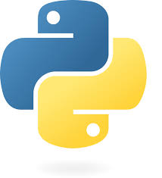
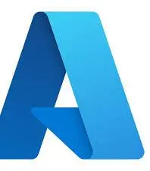
Technologies
Microsoft Bot Framework: Building enterprise-grade conversational AI experiences
Python: Handles Backend with supported AI libraries
Azure Services: Translation and text analytics with Scalable, secure web hosting
AI & ML: Sentence Transformer models and cosine similarity

Slide 4
Status of Implementation
Dialog Flows: Conversation paths for scenarios are almost complete and integrated.
Translation: Successfully integrated with Azure Translator for language conversion.
Feedback: AI-driven evaluation using machine learning models is operational.
User State Management: Tracks language, proficiency, and scores effectively.
Deployment: Web hosting via aiohttp is in progress.

Slide 5
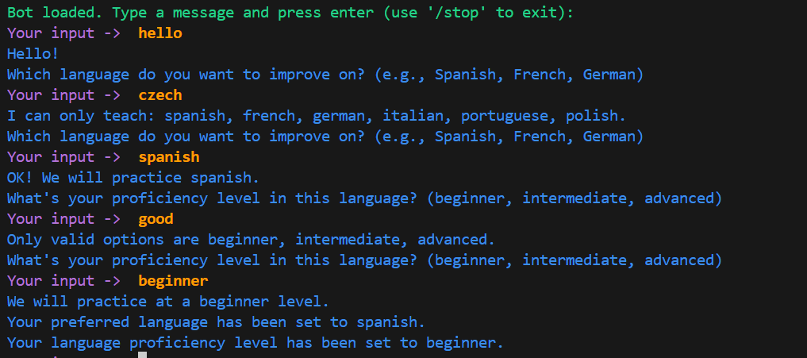

Slide 6
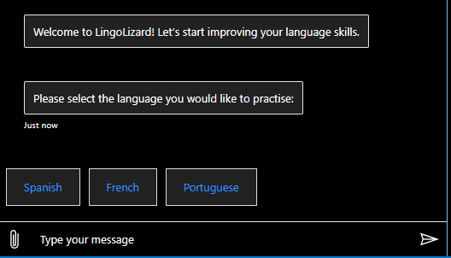
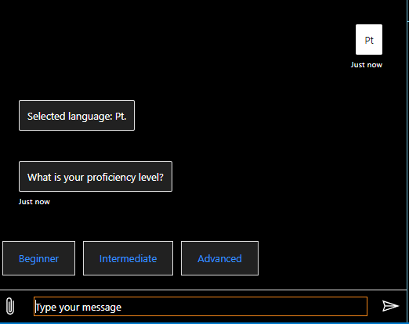
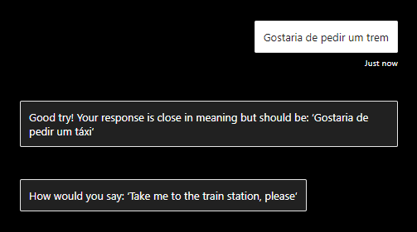

Slide 7
Questions?

