Slide 1
LingoLizard
Michael Cullen
C00261635
24/10/2024

Slide 2
Introduction
LingoLizard is a tool designed to help people learn languages using real time lessons and conversations.
It will do this using AI to simulate interactions in different languages.
It will be able to give real time feedback and corrections to spelling and grammar.

Slide 3

Target Audience
Language Learners
Teachers and students
Travellers and expats

Slide 4
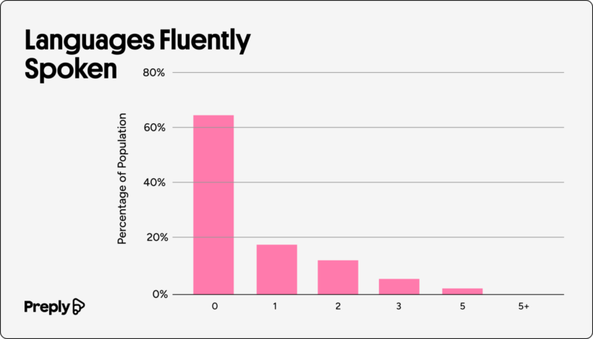
Problem Statement
“only 20% of public school students have studied foreign languages. By college, this number drops to a staggering 10%.” [2]
School based language learning is not effective for everyone. LingoLizard could be the solution.
Fig .2 Graph of non native languages uk adults can speak [1]

Slide 5
Motivation
The motivation behind Lingolizard is to provide a new approach to practice language that is more engaging and practical.
For many people the school based method of learning languages is either not affordable or not effective for them.
LingoLizard is a tool they can use to get that immersive experience if they do not know a native speaker.

Slide 6


Technologies
Rasa is used to build and manage intelligent conversational systems
It also has built-in Natural Language Understanding (NLU) capabilities that understand user intents and extract information.
DeepTranslator is a Python library that helps in translating text across multiple languages
It allows the bot to respond in a preferred language, providing a personalised learning experience.

Slide 7
Features
Many supported languages for wide audience
Gamified features such as streaks, leaderboard and points
Provide real time conversation type lessons and corrections
Provide reminders and notifications to users
LingoLizard will be hosted on the web, making it accessible to users worldwide.

Slide 8

Related Work Analysis
Duolingo: offers gamified method to learn languages but is limited to basic phrases and grammar while Lingo lizard will have real time conversations.
HelloTalk: users practice languages with a native speaker where LingoLizard automates this without depending on others.

Slide 9
What i have so far?
Gather understanding of technologies
Documentation
Developed the greeting

Slide 10
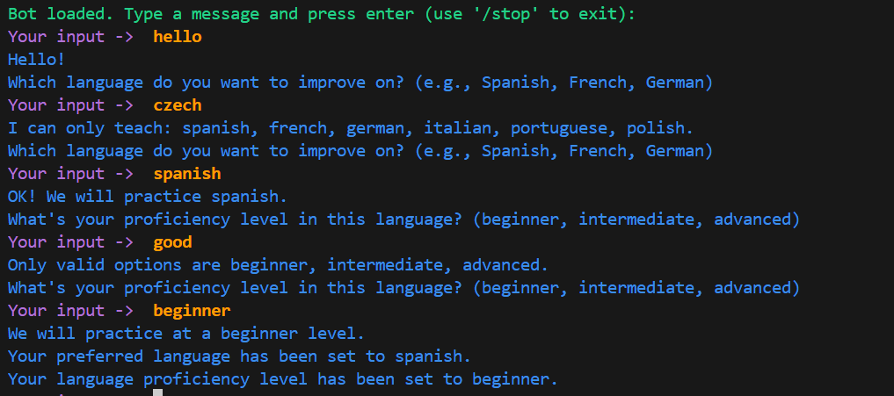

Slide 11

Conclusions
In conclusion, LingoLizard looks to help people learn languages and help decrease the number of people who quit and give up from using the school based method to learn.

Slide 12
References
[1] Preply. (2021) Multilingual UK adults. Available at: https://preply.com/wp-content/uploads/2021/11/Multilingual-UK-adults.png (Accessed: 17 October 2024).
[2] Preply 2024, Americans’ Foreign Language Learning Survey, Preply. Available at: https://preply.com/en/blog/americans-foreign-language-survey/ (Accessed: 17 October 2024).

Slide 13
Questions?

