Slide 1


Machine Learning Portfolio Demonstration
Michael Cullen
C00261635
29/11/2024

Slide 2
Introduction
Models
Which I Used
And why?
Data
Pre processing
Challenges

Slide 3
Description
Linear Regression: House Price Predictor
Decision Tree: Titanic Survival Predictor
Decision Tree: Fraud Detection
Random Forest: Car Price Predictor

Slide 4
House Price Predictor
Linear Regression
Numerical data
relationship between features and the target
Data
141,000 rows
The data spans from 1968 to 2024

Slide 5
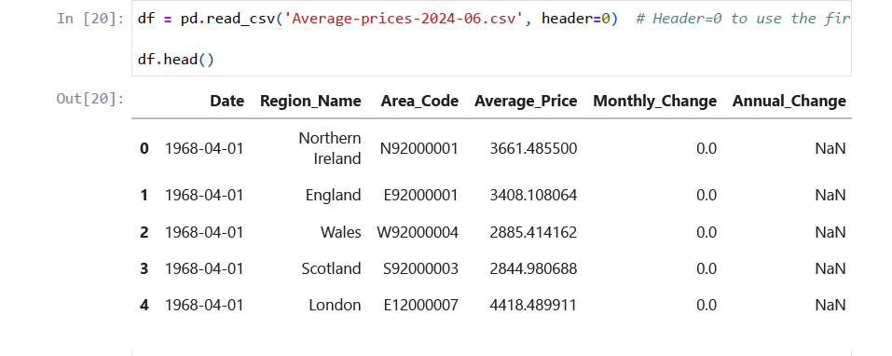

Slide 6
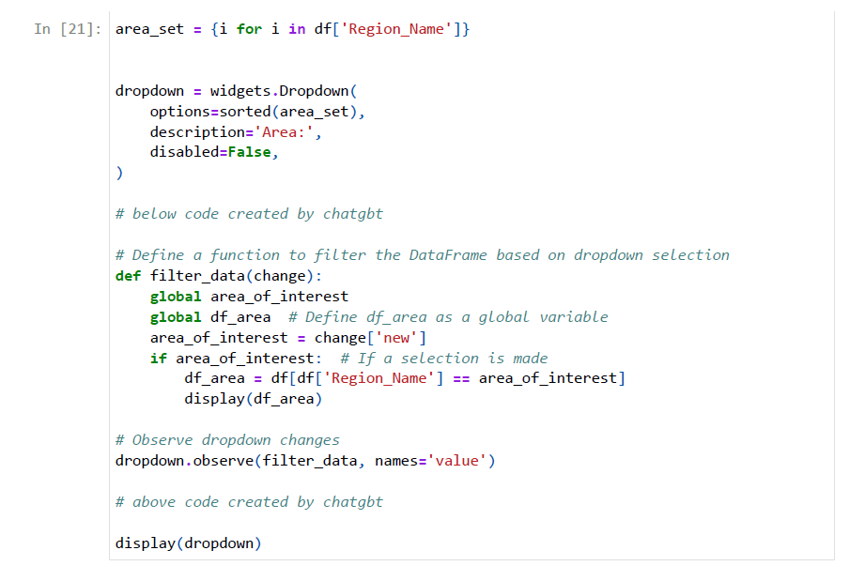

Slide 7
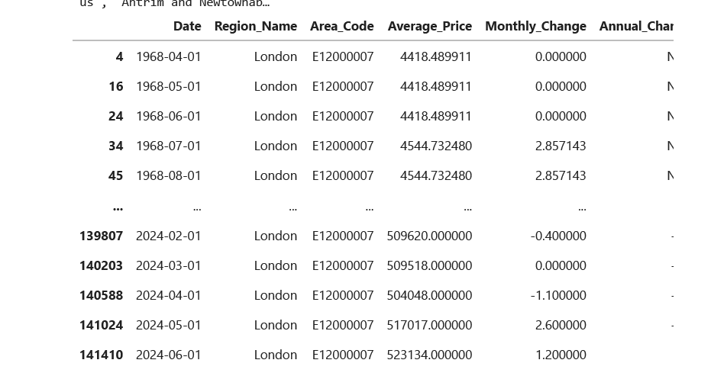

Slide 8
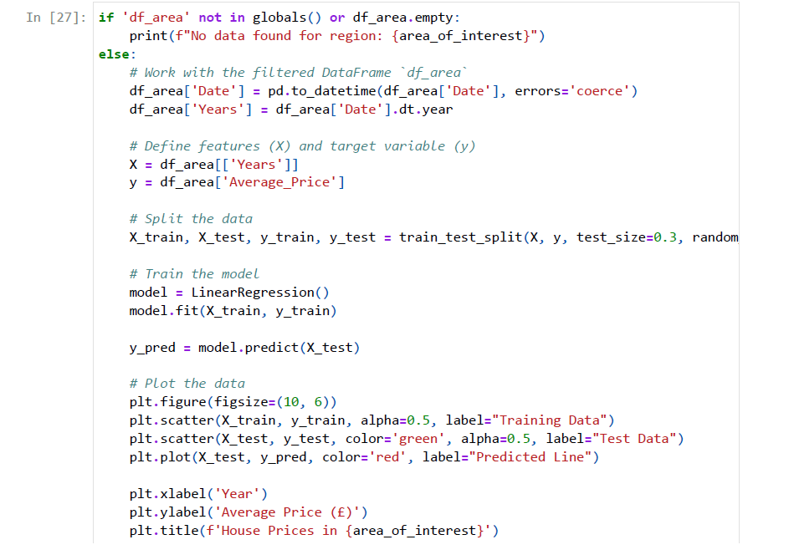

Slide 9
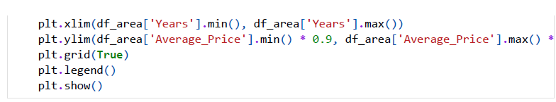

Slide 10
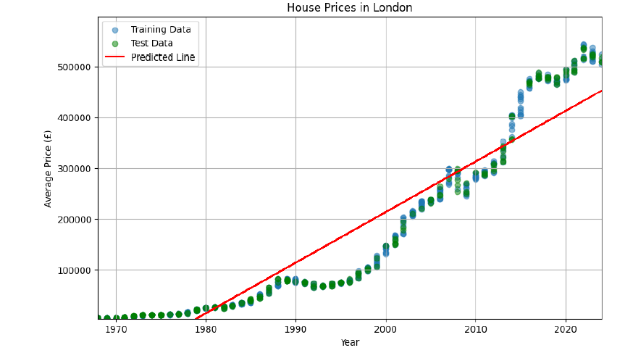

Slide 11
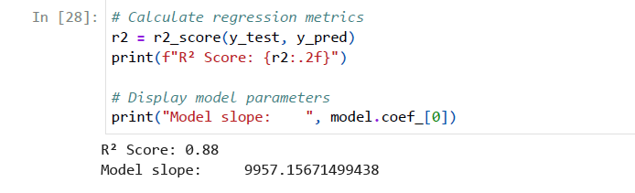

Slide 12
Challenges

Slide 24
Challenges

Slide 25
Demo

Slide 26
Conclusion

