Slide 1

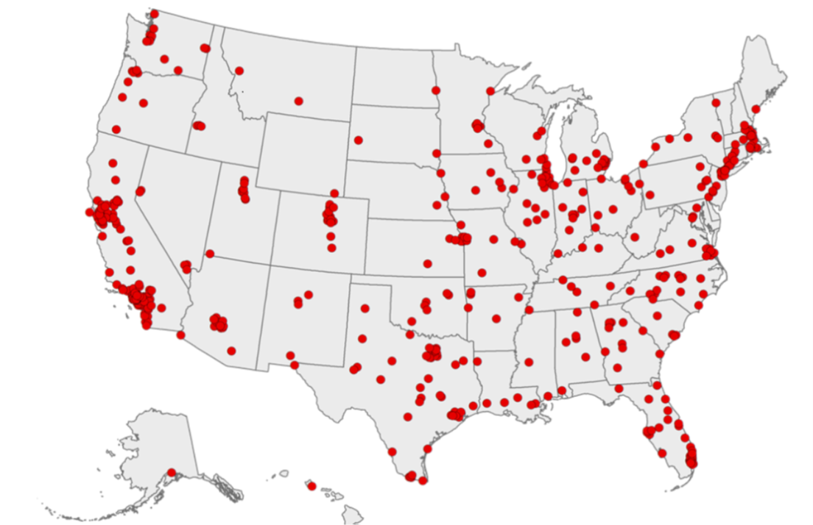

Metropolitan Health:
500 U.S. Cities
Douglas Franklin, Hisham Hammour, Mason Carnahan, Muhammad Ahsan

Slide 2
Motivation
Health
*Pertinent to us all
*Bankruptcy
Community Matters
*Access
*Quality

Slide 3
What we asked Why we asked
Which state has the healthiest cities?
What about the least healthy?
We are all in the US job market
We all think about health

Slide 4
Answering health questions:
Satisfaction
Health is hard.
Correlation trouble
Causation?

Slide 5

Data source & Contents
Source
  Data.gov
  Dataset includes
    2015 - 2016
    27 measures of chronic disease
    Unhealthy behaviors, use of preventive services, health outcomes
Data were provided by
  Centers for Disease Control and Prevention (CDC)
  Division of Population Health
  Epidemiology and Surveillance Branch.

Slide 6
Data Cleanup & Exploration
800,000 rows, 24columns, a lot of problems
  Git size limit
  Dropping redundancies
    Columns
    Means
How to tell a story across all of this data
  Issue of measures

Slide 7
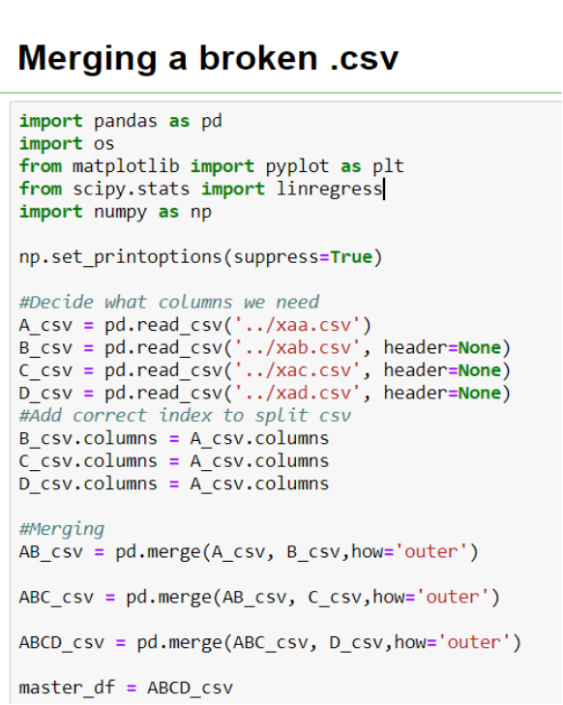
Data Cleanup & Exploration cont.
    Jupyter notebook images#Function###
    #Know your data
    Pandas is awesome
    Functions are powerful

Slide 8
Data Analysis
How to compare 26 measures for 50 states?
Ranking
*Categories
*Metaranking
*True ranking

Slide 9
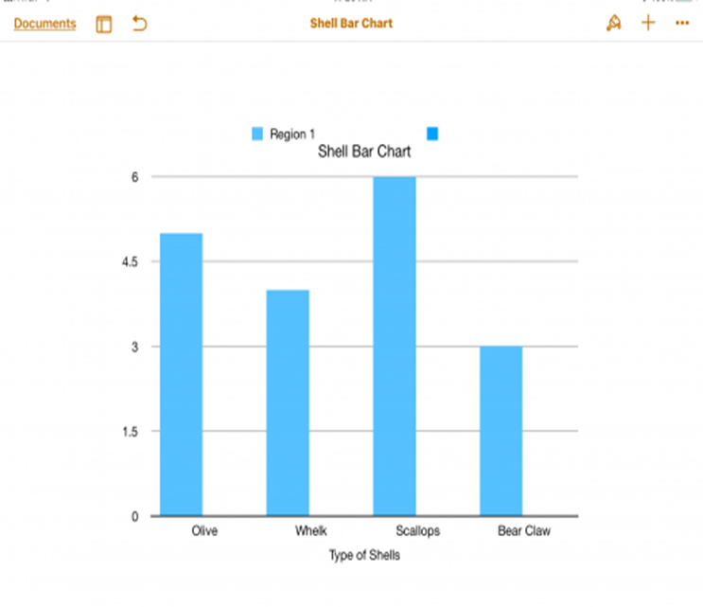

Healthy States
Ranking DF X Measure

Slide 10
Plotly Representation healthy

Slide 11
Unhealthy States
DF1 X Measure

Slide 12
Plotly Representation unhealthy

Slide 13
Outcomes
Outcome DataFrame
Comparison Bar chart

Slide 14
Discussion & Post-Mortem
What we expected
Sorry Mississippi, it was Michigan
California? Nope, Virginia
Initial expectations are often wrong
Biases
Health is hard, so are groups.
Roles & delegation

Slide 15
Post Mortem
Difficulties
  Git problems
  New data scientist problems
  Big goals
    Interactive plotly down to districts
Questions Unanswered
  What are the death rates by disease?
  Does incidence show a correlation with death?
  What does this tell us about access, quality, and or culture?

Slide 16
Thank you! → Q & A
Thank you : Trilogy Education
special_thanks_to =
[
Ed, Dylan, and Ryan,
Stack Overflow, Jupyter notebooks, matplotlib, plotly
Various Documentations
Government collected opensource data
Civil classmates
]

