Slide 1

Updated Agenda
12:00PM–1:00PM | Session #1
1:00PM–2:00PM | Lunch

Slide 3
Building Network Aware Applications Using Azure Resource Provider (RP)
2-647
Yousef Khalidi & Stephen Malone
Azure Networking

Slide 4

Agenda slide
Why do you care about Networking?
Azure Resource Manager (ARM) 101
Azure Core RPs Public Preview
Hands-on Azure Networking APIs
Demo – let’s code some networks!
Network Aware Applications

Slide 5

Networking – Why should developers care?
DevOps
You own the E2E solutions including infrastructure!
The hidden costs of physical hardware
Lost weeks and $$$ due to hardware delivery/config lead times
Specialist per-device or per-vendor expertise required
Software Defined Networking (SDN) becoming the new norm
Programmable networks using standardized interfaces
Create, configure and deploy network solutions in minutes
Consistent troubleshooting across device types
Deliver projects faster and cheaper
Deliver predictability and repeatability
Internet
LB
Public IP
151.2.3.4
VM1
VM2
Private IP
10.0.1.4
Private IP
10.0.1.5
Microsoft Azure

Slide 6
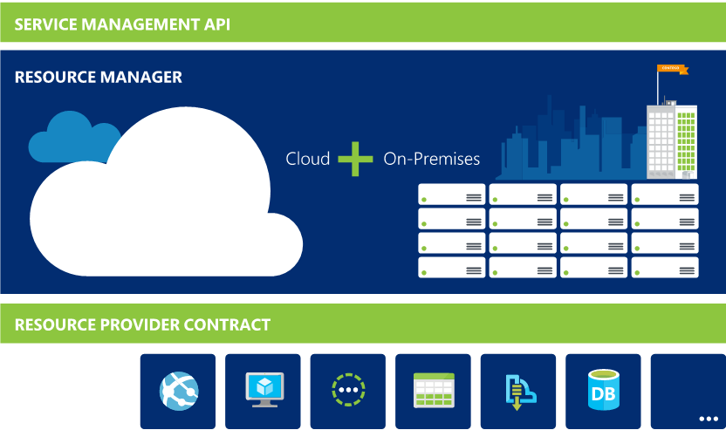
Azure Resource Manager (ARM) 101
Azure components as Resources through Resource Providers (RP) and REST APIs
Orchestrates changes across Azure Resource Providers
Consistent interface for Azure Resources
Resource
Providers

Slide 7
ARM – Key Customer Benefits
Resource Groups – manage collections of diverse Resources as atomic units
Consistent management interface between Azure and on-premises with Windows Azure Pack
Role-Based Access Control (RBAC) and Tagging on any resource
Regionalized Management
RESOU
R
CE G
R
OUP

Slide 8
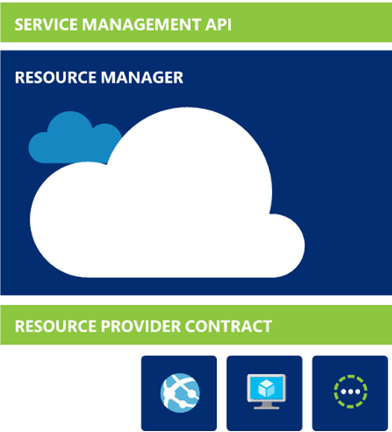
Azure core RPs Public Preview Compute, Storage & Network RPs
New for
//Build 2015
Manage your Compute, Storage & Networking on Azure using new ARM RPs
Model dependencies between VM, Network and Storage in declarative models
Imperatively manage disparate resources using consistent REST APIs and experiences (portal, PowerShell, cross-platform CLI)

Slide 9


The Big (Network) Picture
Virtual Network
“Bring Your Own Networks” – Specify your address spaces & subnet topology in Azure
Azure
Virtual Network
Service consumers
(Internet)
Front-End Network Access
Public IP addresses (VIPs) with direct, Internet-facing TCP/UDP ports
Load-balanced by Azure Software Load Balancer (SLB)
ACL for restricting inbound access
WATM for DNS-based service balancing
DDoS protection
Backend Connectivity
S2S and P2S – Secure cross premise connectivity over the Internet
Direct- / Carrier-based dedicated, high-bandwidth connectivity into Azure*
Backend Connectivity
S2S & P2S
On premises Datacenter

Slide 10

Network Resource Provider (NRP) Public Preview
New for
//Build 2015
Internet
Microsoft Azure
Wire up your Azure Networks as you want them
Standalone VMs or Load Balanced (LB) VMs
Create internal or external Load Balancers by attaching a Public IP
Lock down your networks with ACLs you define
Declarative and imperative management
Supports Virtual Networks, Network Interfaces, Public IP Addresses, Load Balancers, Traffic Manager and Network Security Groups
Scale up/out your Azure Networks dynamically
Public VIP
Customer Virtual Network
External load balancer
Internal VIP
Internal
load balancer
Back end
Front end
Web frontend tier
Logic tier

Slide 11
Core RP – Conceptional Object Model

Slide 12
Managing ARM and Core RP Resources

Slide 13
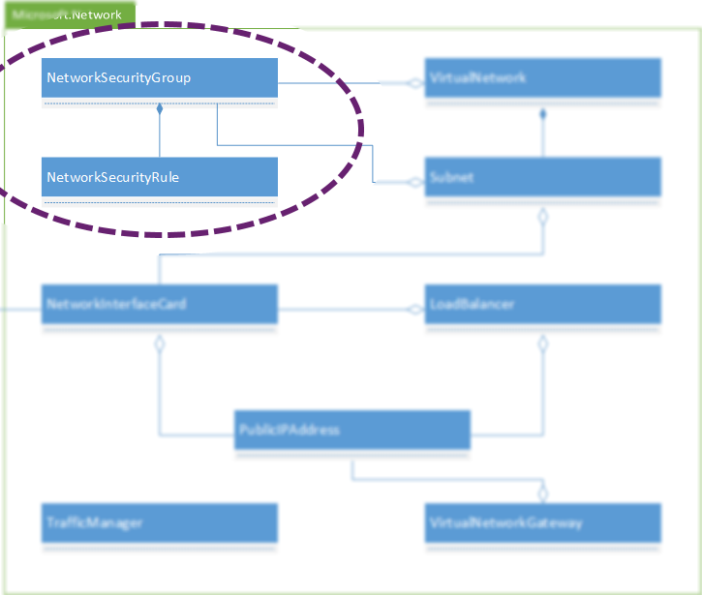
Looking Closer – Network Security Groups

Slide 14
Create a Network Security Group with REST
Method | Url
PUT | https://management.azure.com/subscriptions/{subscriptionId}/resourceGroups/{resourceGroupName}/providers/Microsoft.Network/networkSecurityGroups/{NSGName}?api-version={api-version}
Request
{
"location": "East US",
"tags": { },
"properties": {
"securityRules": [
{
"name": “ssh_rule",
"properties": {
"description": "Allow SSH",
"protocol": "Tcp",
"sourcePortRange": "*",
"destinationPortRange": “22",
"sourceAddressPrefix": "*",
"destinationAddressPrefix": "*",
"access": "Allow",
"priority": "100",
"direction": "Inbound"
}
}
]
}
}
Response
{ "name": "DevNSG",
"location": "East US",
"id": “{Unique Resource URI}",
"etag": "W/\"e74f63d5-d816-4a6c-8c66-619f5117f088\"",
"properties": {
"provisioningState": "Succeeded",
"securityRules": [ {
"name": “ssh_rule",
"id": “{Unique Resource URI}",
"etag": "W/\"e74f63d5-d816-4a6c-8c66-619f5117f088\"",
"properties": {
"provisioningState": "Succeeded",
"description": "Allow SSH",
"protocol": "Tcp",
"sourcePortRange": "*",
"destinationPortRange": “22",
"sourceAddressPrefix": "Internet",
"destinationAddressPrefix": "*",
"access": "Allow",
"priority": 100,
"direction": "Inbound"
} } ],
"defaultSecurityRules": [ ... ]
} }

Slide 15
Create a Network Security Group with C#
// Get the JWT token for the subscription
string jwt = ARMHelper.GetAuthorizationResult(tenantId: ARMHelper.GetSubscriptionTenantId(ConfigHelper.SubscriptionID), alwaysPrompt: false);
// Create the creds for the request
TokenCloudCredentials tcCreds = new TokenCloudCredentials(ConfigHelper.SubscriptionID, jwt);
// Create the NRP client for the request
Microsoft.Azure.Management.Network.NetworkResourceProviderClient nrpclient = new NetworkResourceProviderClient(tcCreds);
// Create a Security Rule for allowing SSH
SecurityRule nsrSSHRule = new SecurityRule() {
Name = “ssh_rule",
Description = "Allow SSH",
Protocol = "Tcp",
SourceAddressPrefix = "*",
SourcePortRange = "*",
DestinationAddressPrefix = "*",
DestinationPortRange = “22",
Direction = "Inbound",
Priority = 100,
Access = "Allow"
};
// Create a Network Security Group containing the allow RDP rule
NetworkSecurityGroup nsg = new NetworkSecurityGroup("East US")
{
SecurityRules = new List<SecurityRule>()
};
nsg.SecurityRules.Add(nsrSSHRule);
// Create the Put request for the new object
nrpclient.NetworkSecurityGroups.CreateOrUpdate("Dev", "DevNSG", nsg);

Slide 16
Create a Network Security Group with PowerShell
PowerShell Command
$ssh_rule = New-AzureNetworkSecurityRuleConfig `
-Name “ssh_rule" `
-Description "Allow SSH" `
-Protocol Tcp `
-SourcePortRange "*" `
-DestinationPortRange “22" `
-SourceAddressPrefix "*" `
-DestinationAddressPrefix "*" `
-Access Allow `
-Priority "100" `
-Direction Inbound
New-AzureNetworkSecurityGroup `
-Name "DevNSG" `
-ResourceGroupName "Dev" `
-Location "East US" `
-SecurityRules $ssh_rule
PowerShell Output
Name : DevNSG
ResourceGroupName : Dev
Location : eastus
Id : {Unique URI}
Etag : W/"db726436-0d63-4a72-9635-6d9724d60a4d"
ProvisioningState : Succeeded
Tags :
SecurityRules : [
{
"Description": "Allow SSH",
"Protocol": "Tcp",
"SourcePortRange": "*",
"DestinationPortRange": “22",
"SourceAddressPrefix": "*",
"DestinationAddressPrefix": "*",
"Access": "Allow",
"Priority": 100,
"Direction": "Inbound",
"ProvisioningState": "Succeeded",
"Name": “ssh_rule",
"Etag":
"W/\"db726436-0d63-4a72-9635-6d9724d60a4d\"",
"Id": "{Unique URI}"
}
]
DefaultSecurityRules : [ ... ]
NetworkInterfaces : []
Subnets : []

Slide 17
Network Security Group REST operations
Action | Verb | Relative URL | Request | Response
Create or Update NSG | PUT | /networkSecurityGroups/{NSGName} | JSON | JSON
Get NSG | GET | /networkSecurityGroups/{NSGName} | None | JSON
List NSGs | GET | /networkSecurityGroups | None | JSON
Delete NSG | DELETE | /networkSecurityGroups/{NSGName} | None | Status Code
Create Rule within NSG | PUT | /networkSecurityGroups/{NSGName}/securityRules/{SRName} | JSON | JSON
Get Rule within NSG | GET | /networkSecurityGroups/{NSGName}/securityRules/{SRName} | None | JSON
List Rules within NSG | GET | /networkSecurityGroups/{NSGName}/securityRules | None | JSON
Delete Rule from NSG | DELETE | /networkSecurityGroups/{NSGName}/securityRules/{SRName} | None | Status Code

Slide 18
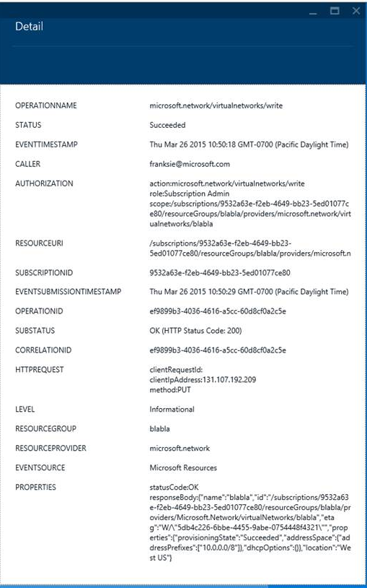
Download Network Security Group Audit Logs
PowerShell Command
Get-AzureSubscriptionIdLog -StartTime $start -end $end
Available also via Portal
PowerShell Output
Authorization:
Scope: /subscriptions/953/resourceGroups/users1/providers
/microsoft.network/networkSecurityGroups/user1nsg2
Action: microsoft.network/networkSecurityGroups/write
Role: Subscription Admin
Caller: user1@yourcompany.com
EventSource: Microsoft.Resources
EventTimestamp: 3/12/2015 3:16:58 AM
OperationName: microsoft.network/networkSecurityGroups/write
ResourceGroupName: user1RG1
ResourceId: /subscriptions/953/resourceGroups/user1/providers
/microsoft.network/networkSecurityGroups/user1nsg2
CorrelationId: {Unique URI}
Status: Succeeded
SubscriptionId: 953
SubStatus: Created

Slide 19
Creating applications with ARM JSON templates
Template file
{
"$schema": "http://schema.management.azure.com/schemas/2014-04-01-preview/deploymentTemplate.json#",
"parameters": { … },
"variables": { … },
"resources": [
{
"type": "Microsoft.Storage/storageAccounts",
"name": "[parameters('newStorageAccountName')]",
"location": "[resourceGroup().location]",
"properties": { … }
},
{
"type": "Microsoft.Network/virtualNetworks",
"name": "[parameters('virtualNetworkName')]",
"location": "[resourceGroup().location]",
"properties": { … }
},
{
"type": "Microsoft.Network/networkInterfaces",
"name": "[parameters('networkInterfaceName')]",
"location": "[resourceGroup().location]",
"dependsOn": [
"[concat('Microsoft.Network/virtualNetworks/', parameters('virtualNetworkName'))]"
],
"properties": { … }
},
{
"type": "Microsoft.Network/loadBalancers",
"name": "[parameters('loadBalancerName')]",
"location": "[resourceGroup().location]",
"dependsOn": [
"[concat('Microsoft.Network/networkInterfaces/', parameters('networkInterfaceName'))]",
"[concat('Microsoft.Network/publicIpAddresses/', parameters('publicIpAddressName'))]"
],
"properties": { … }
},
{
"type": "Microsoft.Compute/virtualMachines",
"name": "[parameters('vmName')]",
"location": "[resourceGroup().location]",
"dependsOn": [
"[concat('Microsoft.Storage/storageAccounts/', parameters('newStorageAccountName'))]",
"[resourceId('Microsoft.Network/networkInterfaces', parameters('networkInterfaceName'))]"
],
"properties": { … }
}
]
}
PowerShell
New-AzureResourceGroup -Name 'NRP-DemoRG' –TemplateFile 'C:\sampletemplate.json' -Location 'West US‘ `
-NamedParameter1 “value” `
-NamedParameter2 “value”

Slide 20
Demo - let’s code some networks!

Slide 21
Network Aware Applications
Back to the start – why should you care?
Liberate your development & testing with Azure
Model your solutions in templates, abstracting variance as parameters
Repeatable and predictable creation of your Dev/Test environments
Best of class infrastructure with consistent interfaces, fast provisioning and massive scale

Slide 22
And not to forget – manage the way you want
X-Plat cli
sudo npm install azure-cli-[version].tgz –global
Azure login –u <your email address>
Azure config mode arm
azure network vnet create …
Java SDK
import com.microsoft.azure.storage.*;
import com.microsoft.azure.storage.table.*;
import com.microsoft.azure.storage.table.TableQuery.*;
…
Node.JS
var azure = require('azure-storage');
var blobSvc = azure.createBlobService();
blobSvc.createContainerIfNotExists ...

Slide 23
Call to Action
Attend these talks to learn more
Wed 11:30 – 12:30pm – 3-618 - The Next-Generation Azure Compute Platform with Mark Russinovich
Wed 5:00 – 6:00pm – 2-646 - Introduction and What’s New in Azure IaaS
Thu 11:30 - 12:30pm - 2-667 – Lessons from Scale: Building Applications for Azure
Fri 12:30 – 1:30pm - 2-688 – Azure Virtual Machines Deep Dive
Try out the new ARM Core Resource Providers
And take control of your networks!

Slide 24
Resources
Improve your skills by enrolling in our free cloud development courses at the Microsoft Virtual Academy.
Try Microsoft Azure for free and deploy your first cloud solution in under 5 minutes!
Easily build web and mobile apps for any platform with AzureAppService for free.

