Slide 1
Lab1 Backpropagation and Basic Pytorch

Slide 2
Outline
Backpropagation
Dataset
Task1
Task2
Regulations

Slide 3
Outline
Backpropagation
Dataset
Task1
Task2
Rules

Slide 4
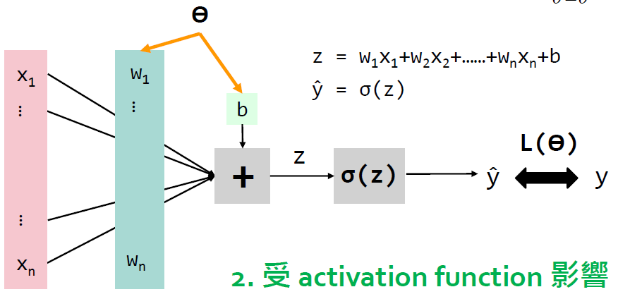
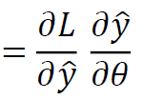




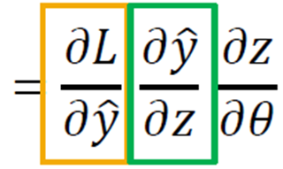
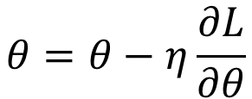
Back Propagation
沿著 gradient 的反方向走
Learning rate
$$θ=θ−η\frac{∂L}{∂θ}$$
Chain rule (又叫 Back propagation 倒傳遞)
Source: Lecture slide chapter 2
Notes:
Source: slide

Slide 5
Outline
Backpropagation
Dataset
Task1
Task2
Rules

Slide 6
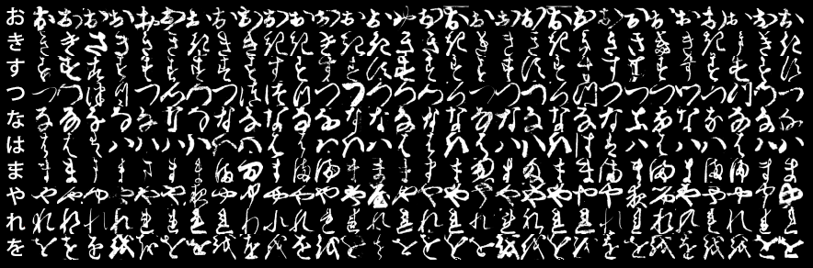
Dataset: Kuzushiji-MNIST
Image Classification
Classes: 10, image size =28*28 grayscale
Training: 50,000 Validation: 10,000 Testing: 10,000

Slide 7
Outline
Backpropagation
Dataset
Task1
Task2
Rules

Slide 8
Task 1 – NN from scratch
You need to build a neural network from scratch
layer.py : Define the functions of each layer (include forward & backward)
network.py : Build a network with layers you defined in layer.py
Lab1_task1.ipynb : Decide the hyperparameters and run your code
The settings for training have been written by TA
For task1, you are not allowed to use deep learning frameworks.

Slide 9
Package available in Task 1
numpy
pandas
Scikit-learn
Pytorch, tensorflow, keras

Slide 10
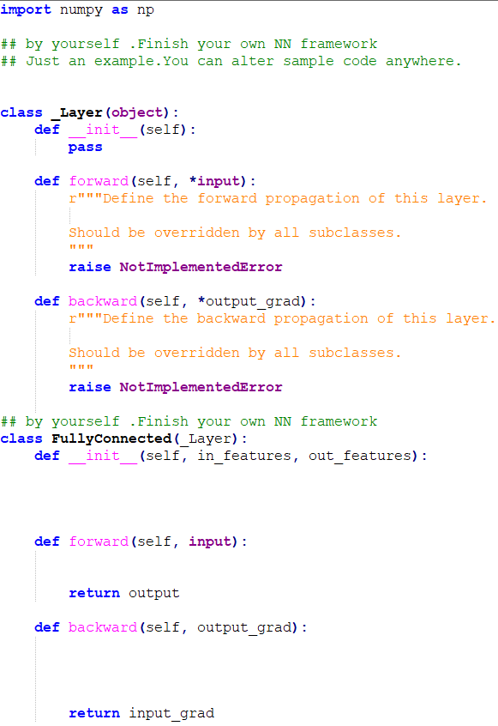
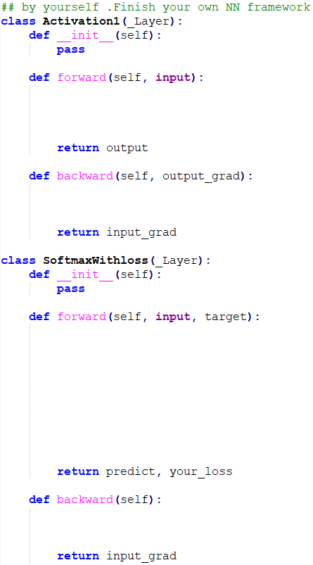
model/layer.py

Slide 11
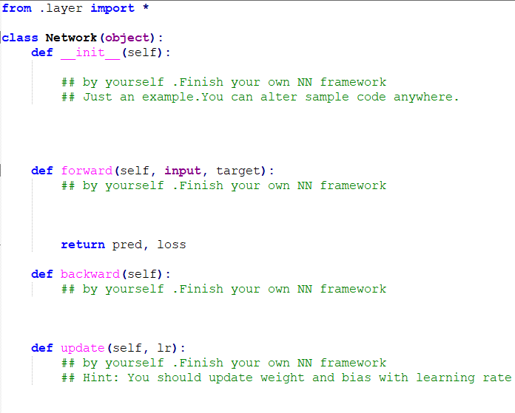
model/network.py

Slide 12
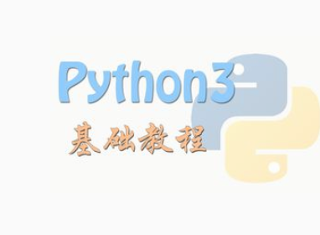
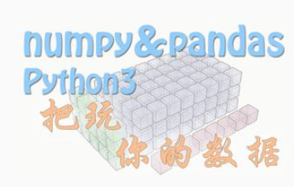
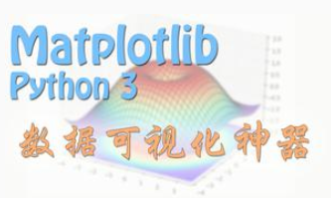
Task1 Overview
You need to be familiar with jupyter python and useful library
numpy, pandas, matplot, etc…
If you are not familiar with python, I strongly recommend you to see 莫凡’s python tutorial. (or other online materials)
https://morvanzhou.github.io/
Source: 2023_DL_Lab1
Notes:
Source : 2023_DL_Lab1

Slide 13
Outline
Backpropagation
Dataset
Task1
Task2
Rules

Slide 14
Task2 – Build neural network using PyTorch
In Lab1_task2.ipynb
You need to rewrite the network you built in Task 1 using PyTorch
The settings for training have been written by TA
Network should be the same as Task 1
You may only use pytorch in Task 2

Slide 15
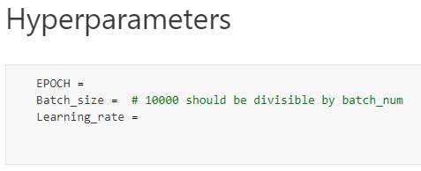
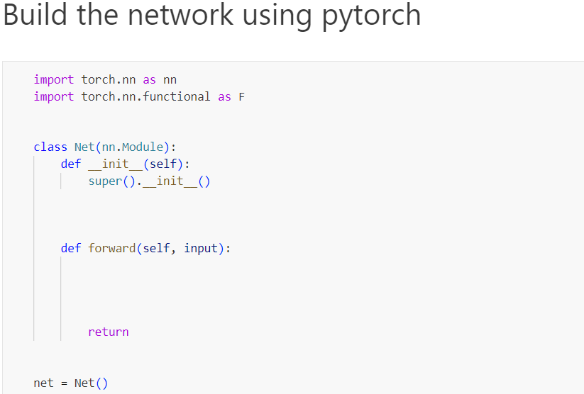
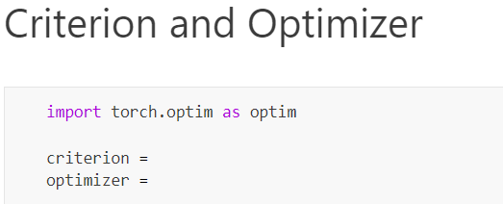
Task2 Code

Slide 16
PyTorch tutorial
Official tutorial
https://pytorch.org/tutorials/
莫凡
https://mofanpy.com/tutorials/machine-learning/torch/
AssemblyAI - PyTorch Crash Course
https://www.youtube.com/watch?v=OIenNRt2bjg

Slide 17
Outline
Backpropagation
Dataset
Task1
Task2
Rules

Slide 18
Assignment Regulation
Please use Google Colab to finish this lab
Please refer to “Colab_Tutorial_2024.pptx” for further details
You don’t need to use GPU in this lab

Slide 19
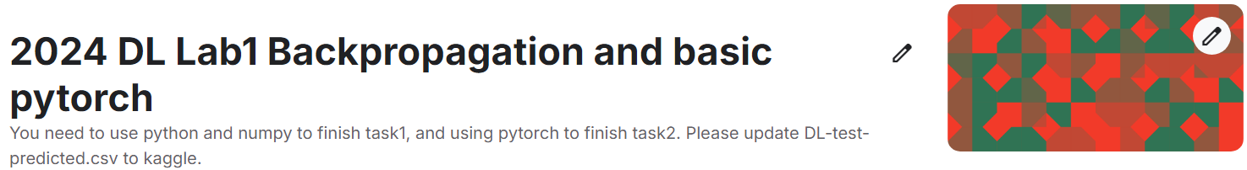
Join Kaggle competition
Competition URL:
https://www.kaggle.com/t/9a54f52550064f998d346bdff61dd47c
Upload your test prediction (DL-test-predicted.csv)
Maximum daily submission limit: 20
Change your team name to your student ID

Slide 20
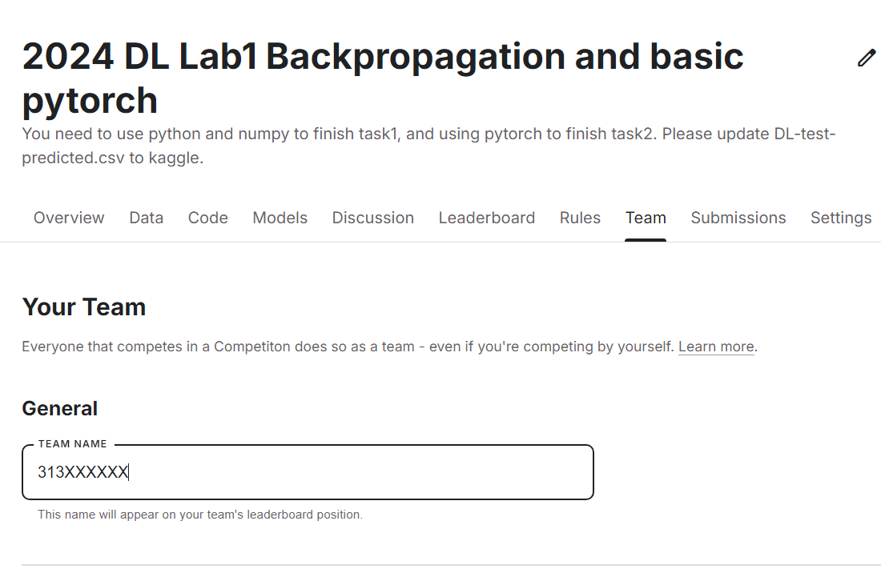
Change your team name to your student ID
If TA can not find your ID, you will loss 30% of score for this lab directly

Slide 21
Reminder
Submit Deadline : 2 weeks (2024/9/23 11:59 PM)
You need to submit your code and result to New E3
Hand in your code and in the following format (5 files)
Lab1_task1_studentid.ipynb
network.py
layer.py
Lab1_task2_studentid.ipynb
Lab1_report_studentid.pdf

Slide 22
Grading policy
Lab1
Submit your homework to E3 (60%)
Task1 (40%) (validation accuracy should >= 85%, put the screenshot in your report)
Task2 (20%) (validation accuracy should >= 85%, put the screenshot in your report)
Performance (30%) (submit to Kaggle, test accuracy should >= 82%)
The results you upload to Kaggle should be generated only by task1
Report (10%)
Please do not plagiarize (0 points will be calculated if caught)

Slide 23
Report
How to improve the accuracy (list your method)
Your network?
Loss function?
Activation function?
Hyperparameters?
Etc…
What differences do you find between the results of Task1 and Task2?

Slide 24
Convolution Block
Input
Batch
Normalization
Leaky
ReLU
Convolution
Max Pooling
…
…
…
…

Slide 25
Input
Convolution Block (1, 16, 3x3, S=1)
Feature
Extraction
Convolution Block (16, 32, 3x3, S=1)
Fully Connected(128)
Batch Normalization
Classification
Fully Connected(10)
Softmax

