Slide 1
Lab3 Machine Translation

Slide 2
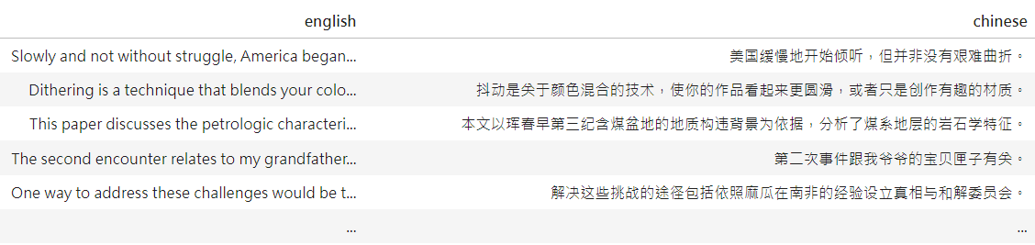
Dataset: English-Chinese Translation
20k-en-zh-translation-pinyin-hsk
https://huggingface.co/datasets/swaption2009/20k-en-zh-translation-pinyin-hsk

Slide 3
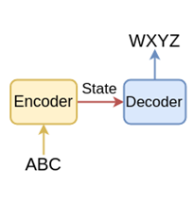

Seq2Seq Model
Encoder-Decoder structure
Applications: machine translation, chatbot…

Slide 4
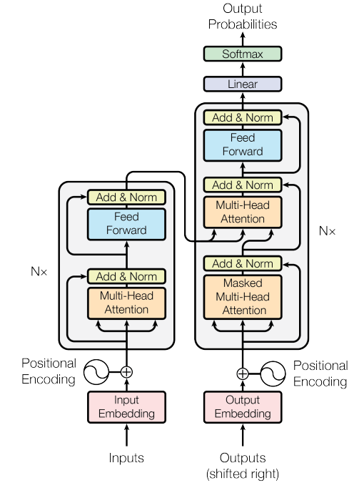
Transformer Model Architecture
Embedding Layer
Positional Encoding
Encoder
Multi-head self attention
FFN
Decoder
Masked multi-head self attention
Multi-head cross attention
FFN

Slide 5
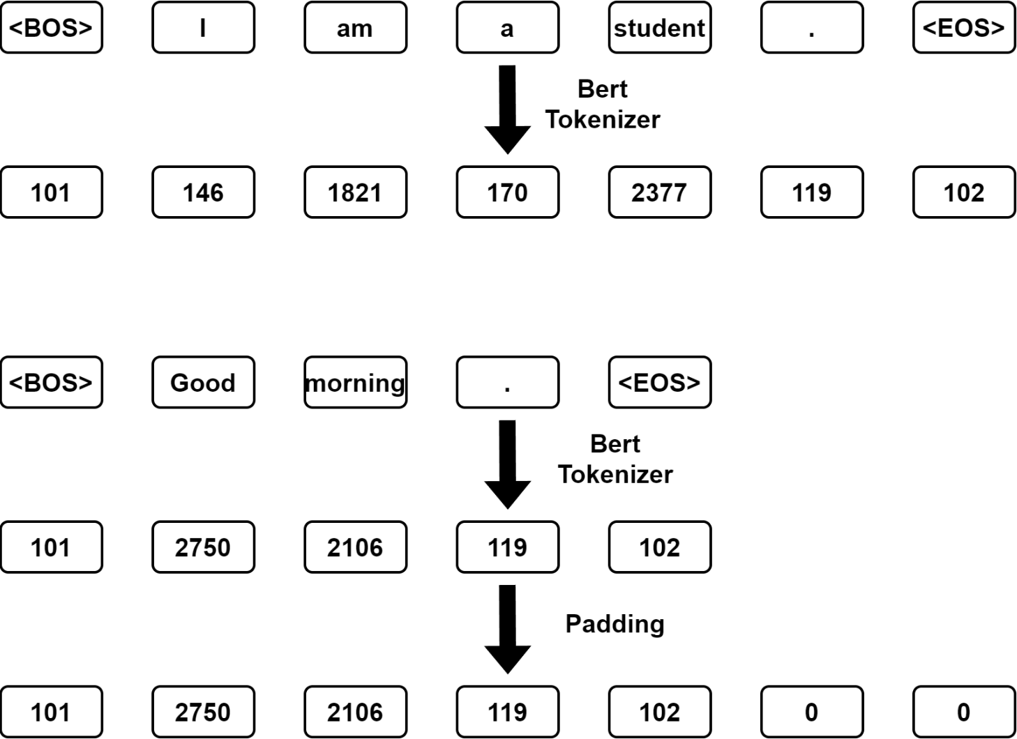
Input Paddings
Make the input sentence equal-length
Padding tokens

Slide 6
Masks
<BOS>
student
I
am
a
Masking is directly applied in attention score
Future mask
Used in decoder self attention
Prevent from attending to the future tokens
Padding mask
Used in encoder, decoder self attention both
Prevent from attending to the padding tokens
<BOS>
-∞ | -∞ | -∞ | -∞ | -∞
 | -∞ | -∞ | -∞ | -∞
 |  | -∞ | -∞ | -∞
 |  |  | -∞ | -∞
 |  |  |  | -∞
I
am
a
student
<BOS>
morning
<PAD>
<PAD>
Good
<EOS>
.
 |  |  |  |  | -∞ | -∞

Slide 7
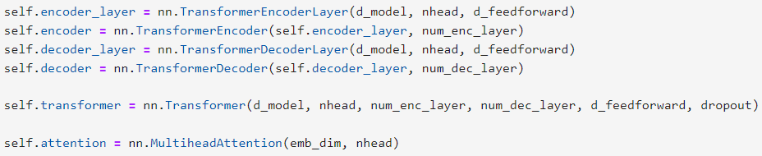
Tasks in this lab
1. In “Lab03.ipynb”
Build vanilla transformer (from Attention is All You Need) by yourself
https://arxiv.org/abs/1706.03762
You should build the encoder, decoder by yourself
Inside the encoder/decoder, you should build the attention mechanism (multi-head attention) by yourself
(You can’t call the model directly with the command)

Slide 8
Tasks in this lab
1. In “Lab03.ipynb”
The parameter size of transformer encoder block should be less than 100M !
(put the screenshot in your report)
Achieve at least 0.18 validation accuracy (BLEU score)
(put the screenshot in your report)

Slide 9
Tasks in this lab
1. In “Lab03.ipynb”
You can NOT use the following models, TA will check your code!
torch.nn.TransformerEncoderLayer
torch.nn.TransformerEncoder
torch.nn.TransformerDecoderLayer
torch.nn.TransformerDecoder
torch.nn.Transformer
torch.nn.MultiheadAttention

Slide 10
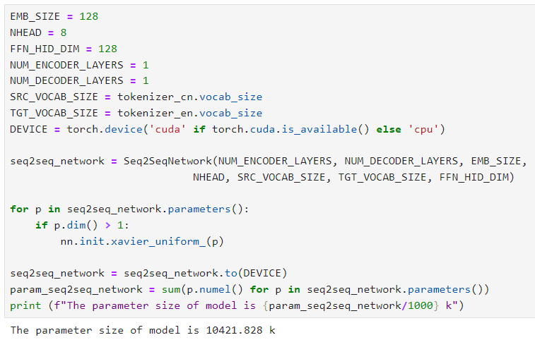
Code
You can set whatever you want Hint：The larger isn’t always the better.
The parameter size of transformer encoder block should be less than 100M !

Slide 11
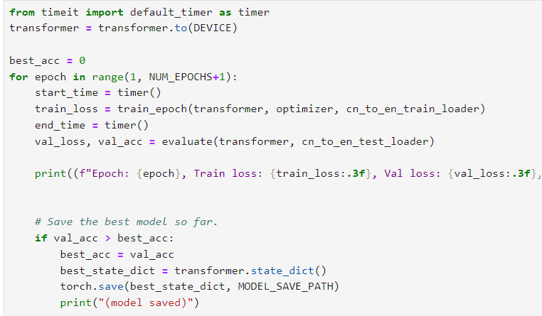
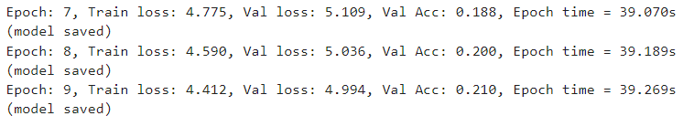
Code
Achieve at least 0.18 BLEU score (validation accuracy)

Slide 12
Tasks in this lab
2. Write a report
Required
Screenshot of task-1
Parameter size
Accuracy (BLEU score)
In task-1
The structure of Transformer you implement (ex. number of encoder layers, decoder layers)
Training strategy (ex. learning rate scheduler)
Anything you do to improve the performance.
Any difficulty you encounter
Plagiarism is forbidden !!!
There should be comment in your code
You should make sure your code is executable

Slide 13
Score
Two requirements in Task-1 are fulfilled (50%)
Parameter size < 100M
Validation accuracy (BLEU score) > 0.18
Report (30%)
Performance (20%)
Performance rank for Task-1

Slide 14
Reminder
Submit Deadline : 2 week (2024/10/21 23:59 PM)
Please compress a folder into a zip file named StudentID.zip (example: 313555555.zip) and upload it to new e3
The folder should include:
Lab3.ipynb
Model.ckpt
StudentID_report.pdf (example: 313555555_report.pdf)

Slide 15
HAVE FUN !!!

