Slide 1
Lab2 Super Resolution

Slide 2
Pytorch tutorial
Official tutorial
https://pytorch.org/tutorials/
莫凡
https://mofanpy.com/tutorials/machine-learning/torch/
AssemblyAI - PyTorch Crash Course
https://www.youtube.com/watch?v=OIenNRt2bjg
You can only use pytorch in this Lab!!

Slide 3
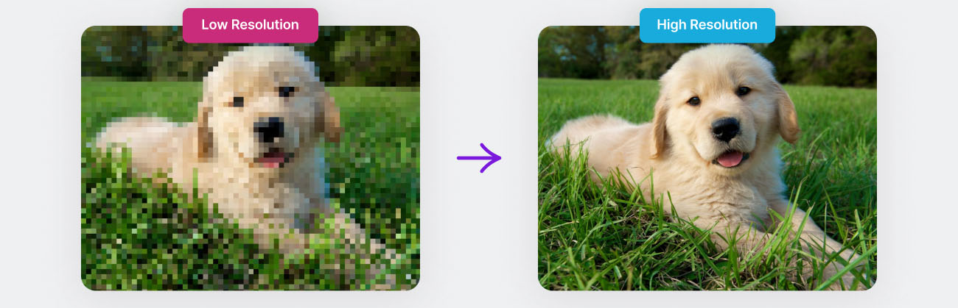
Super Resolution
Super Resolution is a technique in computer vision aimed at increasing the resolution of an image, i.e., enhancing the quality of a low-resolution (LR) image to generate a high-resolution (HR) image.
Applications: NVIDIA DLSS/AMD FSR, Medical Imaging, …

Slide 4
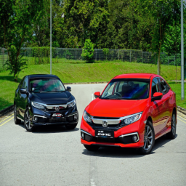
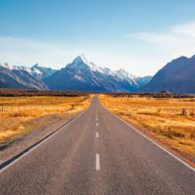

Dataset
Super Resolution
image size = (High resolution)256*256;
(Low resolution) 64*64
Training: 288 Validation: 72 Testing: 40

Slide 5
Task1 of this lab
In “Lab2_SRResNet.ipynb”
Build SRResNet by yourself
(You can’t call the model directly with a command)
Achieve at least 21 dB PSNR on testing data
(put the screenshot in your report)

Slide 6
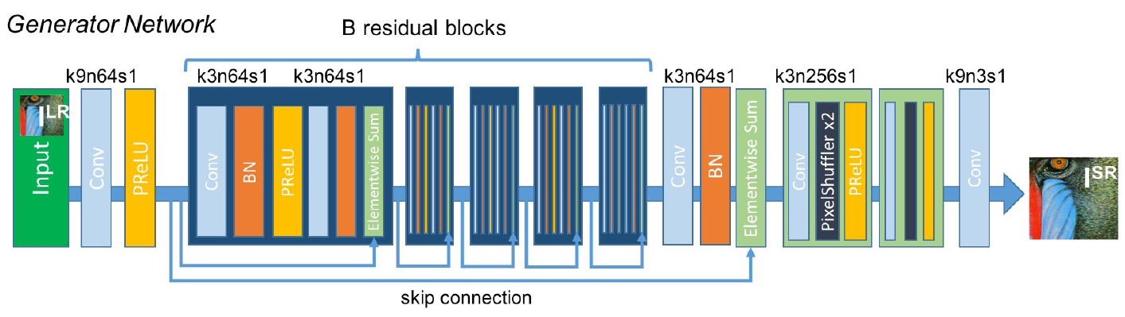
SRResNet
SRResNet is inspired by the ResNet architecture and uses residual blocks for super-resolution tasks. It contains multiple residual blocks similar to those in ResNet, along with upsampling layers to enhance the resolution of input images.
We use B = 16 in this lab.

Slide 7

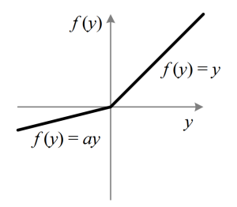
SRResNet
PReLU(Parametric Rectified Linear Unit) is an activation function that extends the popular ReLU (Rectified Linear Unit) by making the negative slope a learned parameter rather than a constant. In PReLU, for negative inputs, the function is defined as:
Where a is a learnable parameter, allowing the model to adapt the slope of the negative part during training, providing more flexibility in learning complex patterns.

Slide 8
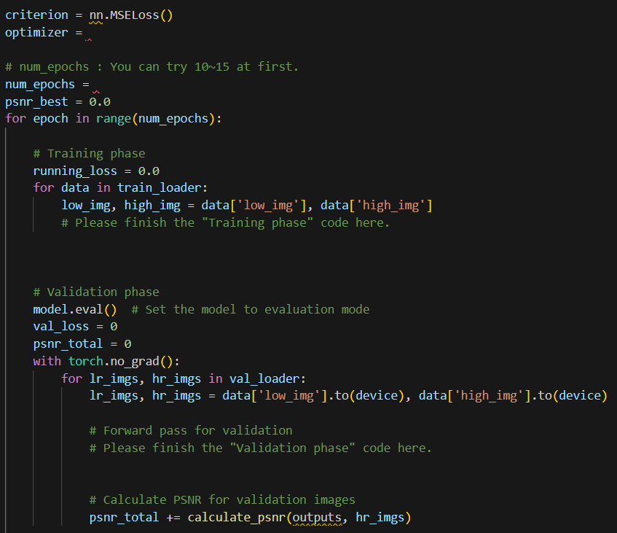
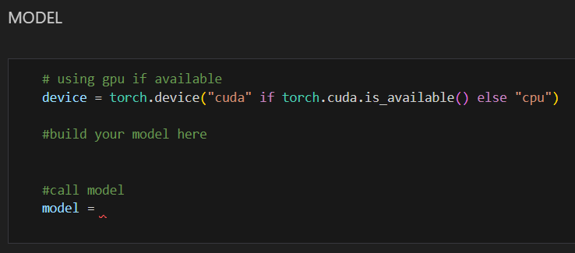
Task1 of this lab
Finish the blank part.

Slide 9
Task2 of this lab
In Task2
Do your best to improve the quality of the photos
Calling different models with pretrained weight is allowed
Basically any methods you learn are allowed
Achieve at least 23 dB PSNR on testing data (put the screenshot in your report)

Slide 10
Report
Write a report
Required
Screenshot of task-1 (PSNR on testing data >= 21 dB)
Screenshot of task-2 (PSNR on testing data >= 23 dB)
In task-2
What model do you choose？
The advantage of chosen model.
Explain what is PixelShuffle.
Explain what is PSNR and discuss why it is not the only metric used for evaluating super-resolution.
And give some other metrics that provide different perspectives on image quality.
Anything you do to improve the quality of the output photos.
You can discuss any challenges you faced.

Slide 11
Score
PSNR on testing data in Task 1 >= 21 dB (30%)
PSNR on testing data in Task 2 >= 23 dB (30%)
Report (30%)
Performance rank for Task-1 (10%)
Ranked based on PSNR on testing data in Task 1
Please do not plagiarize (0 points will be calculated if caught)

Slide 12
Reminder
Submit Deadline : 2 week (2024/10/7 11:59 PM)
Upload 3 files to new e3
Lab02_SRResNet.ipynb
model.pth (of Task1)
StudentID_report.pdf (example: 311555555_report.pdf)

Slide 13
Supplement: SRResNet
paper
https://arxiv.org/abs/1609.04802

Slide 14
HAVE FUN !!!

Slide 15
Shallow feature extraction
Image reconstruction
Deep feature extraction

