Slide 1
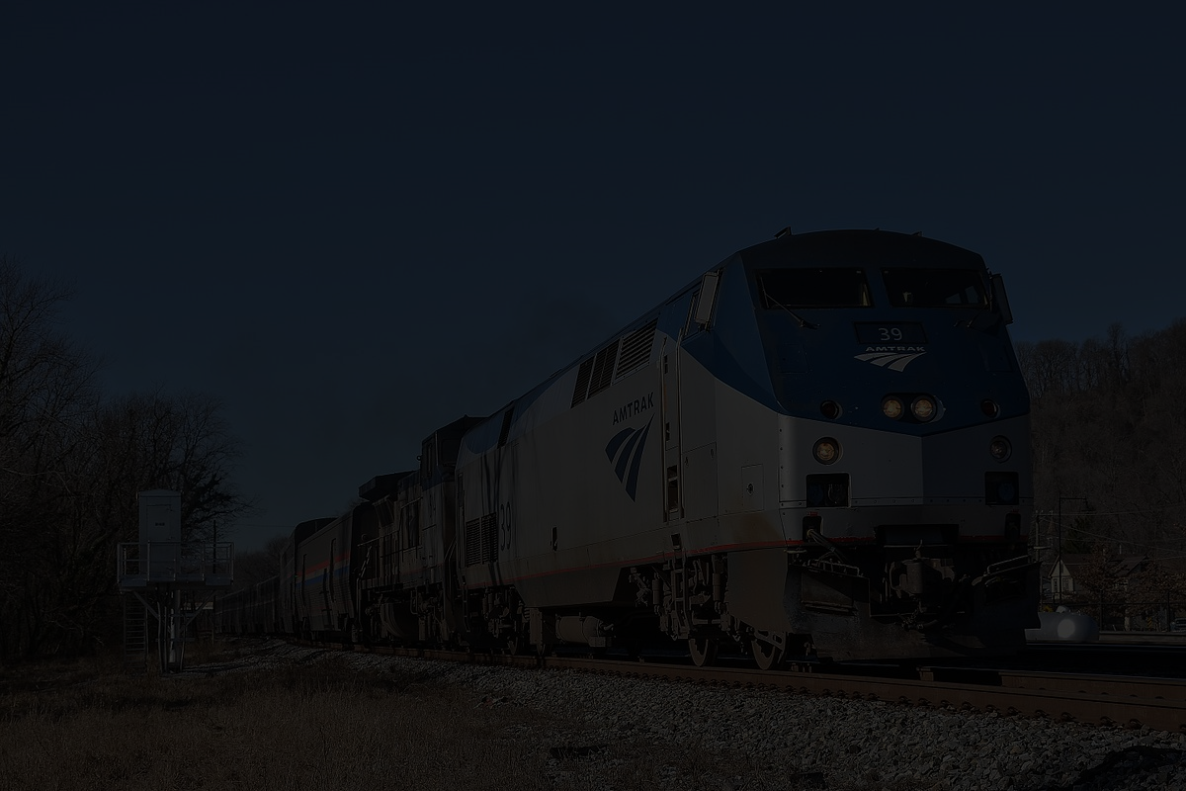
Accessibility of Amtrak's Long Distance Network
Michael Cattell
Pennsylvania State University
michaelcattell@psu.edu
Photo Credit: Mark Levisay via Wikimedia Commons

Slide 2
What is Amtrak?

Slide 3
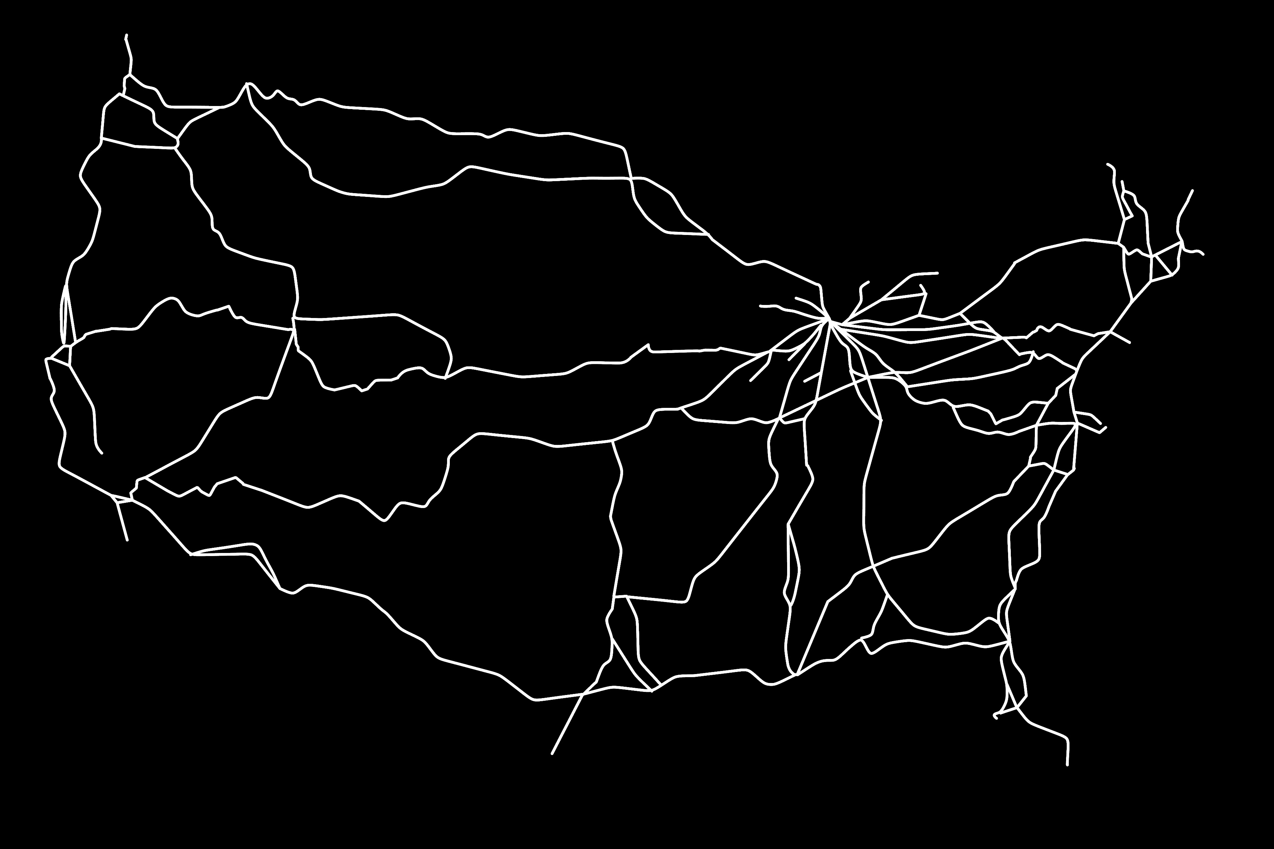

Slide 4
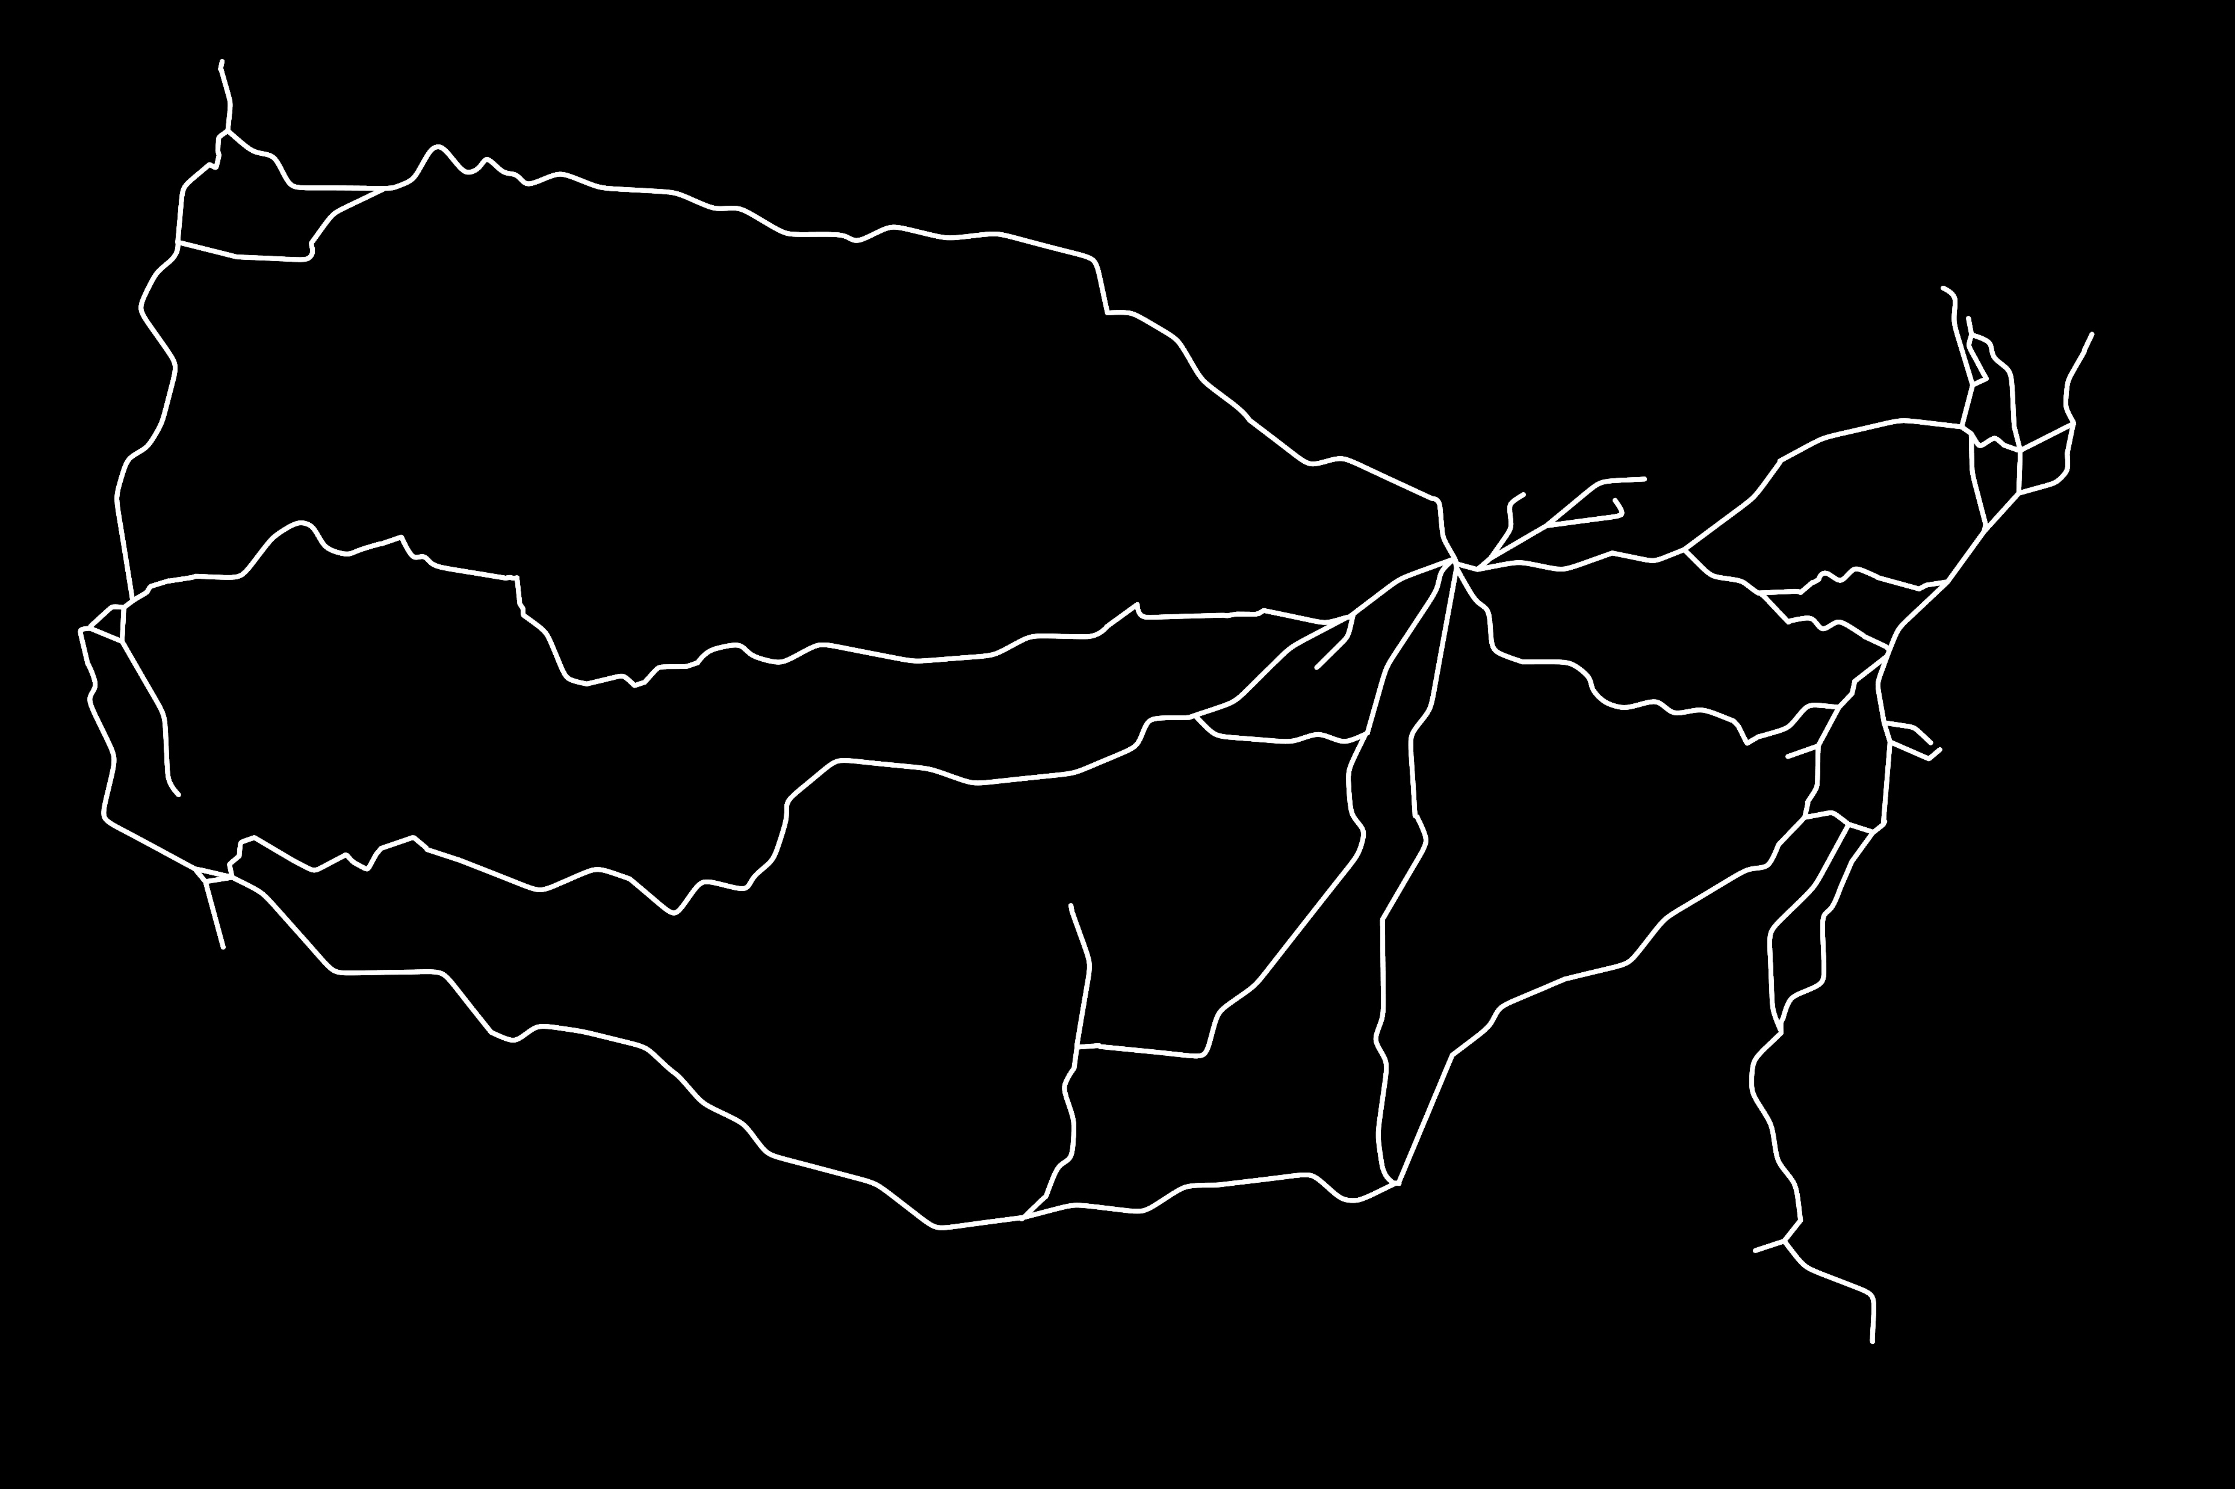

Slide 5
Amtrak Route Categories

Slide 6
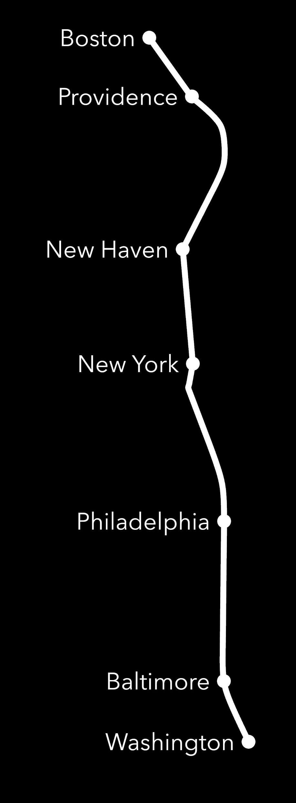
Northeast Corridor

Slide 7
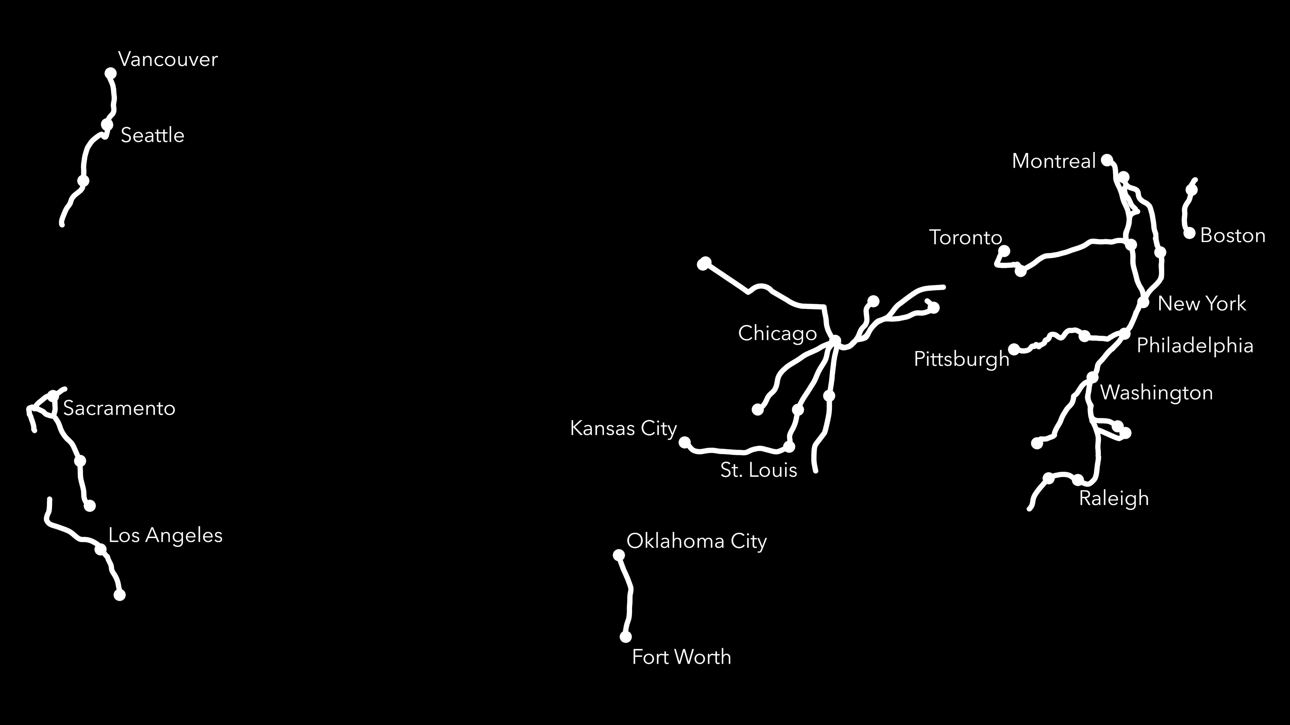
State-Supported Routes

Slide 8
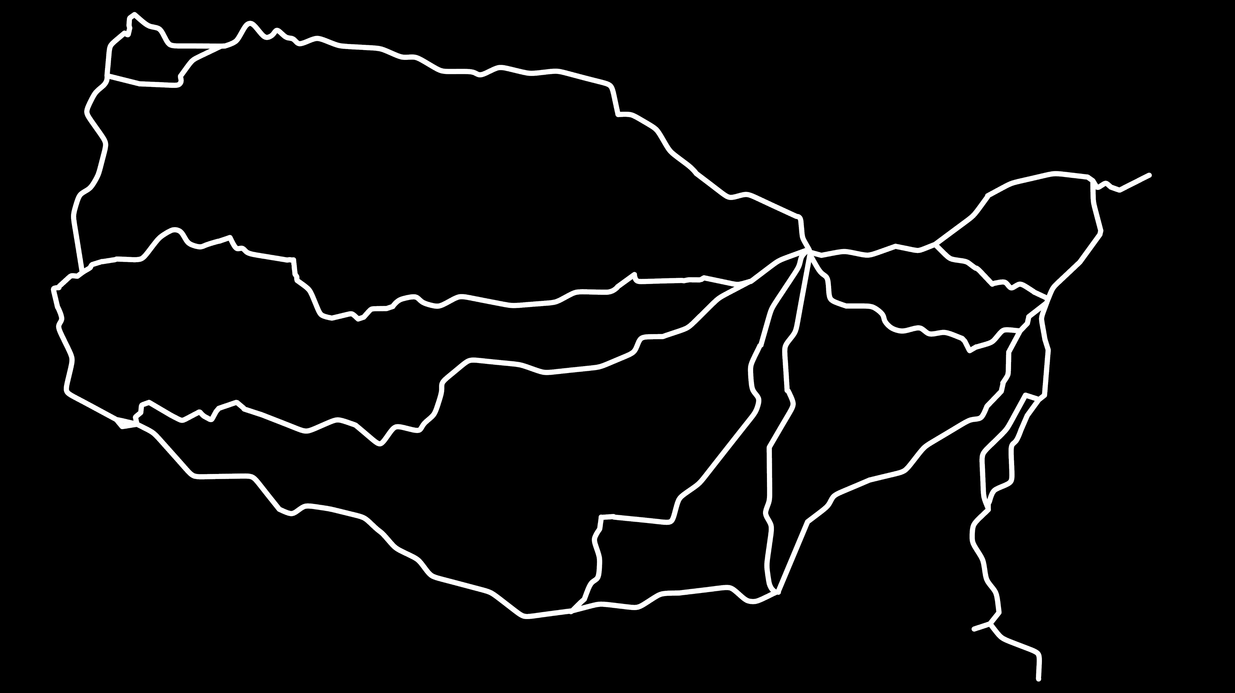
Long Distance Routes

Slide 9
Why Trains?

Slide 10
Why Focus on Long-Distance?

Slide 11
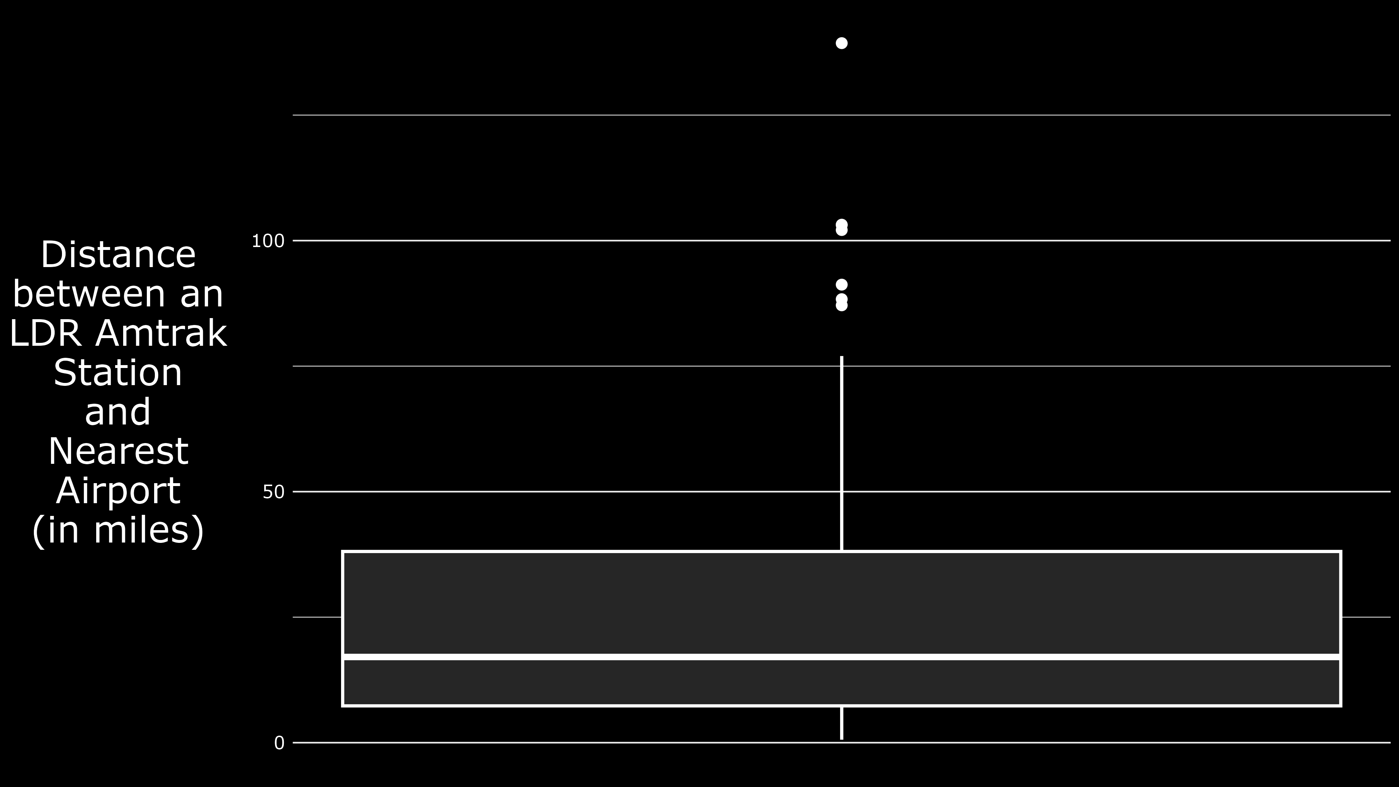

Slide 12
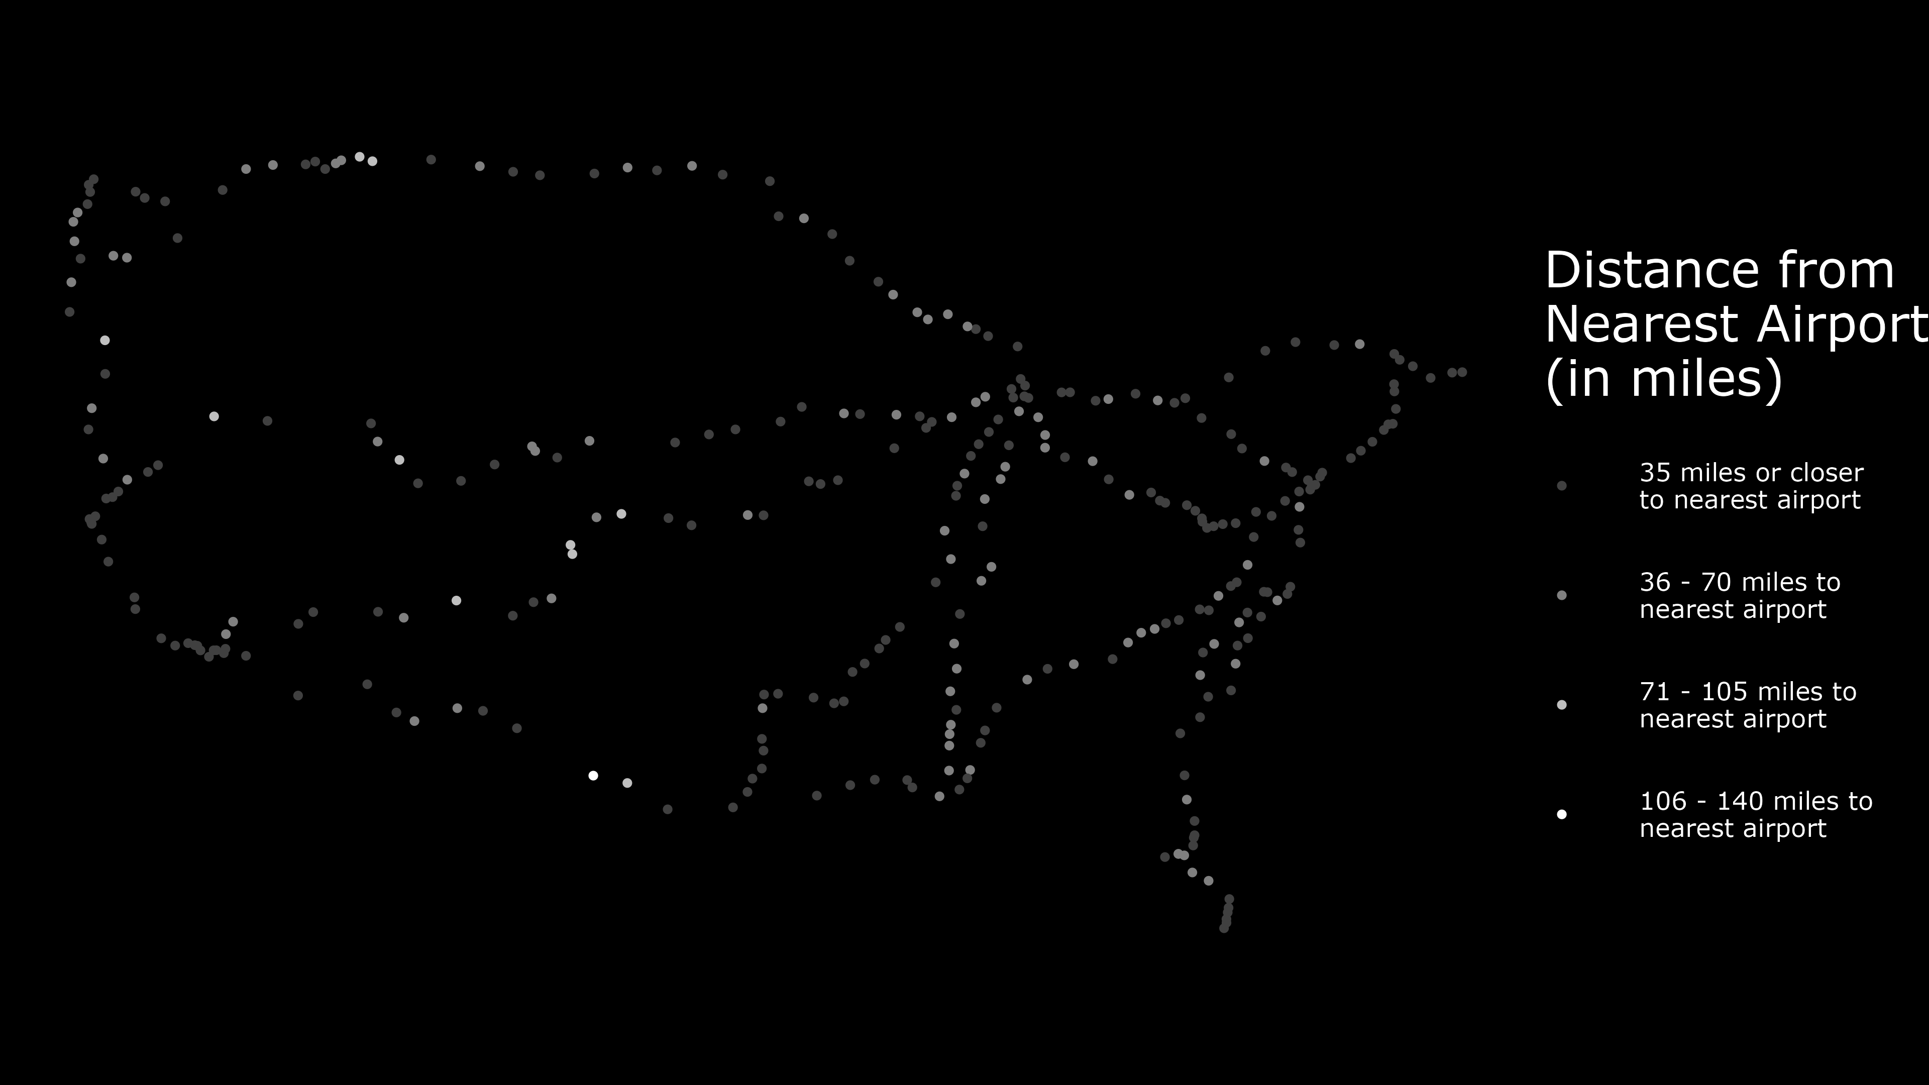

Slide 13
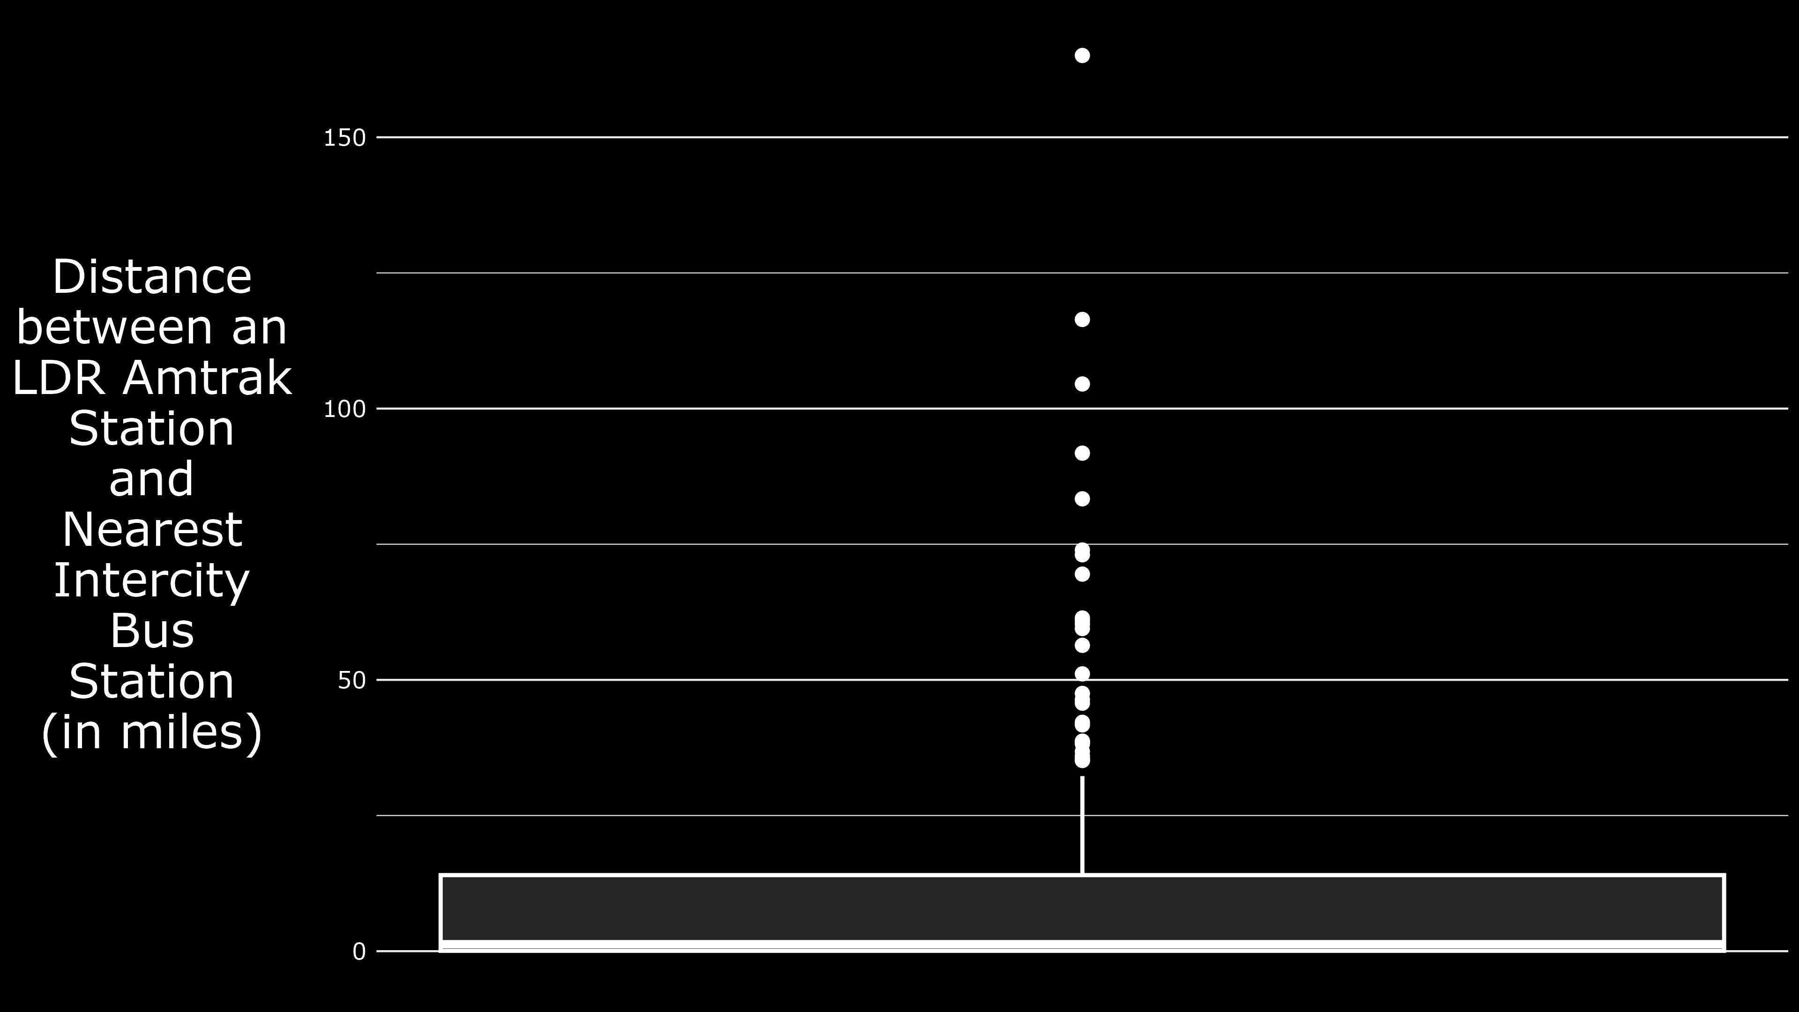

Slide 14
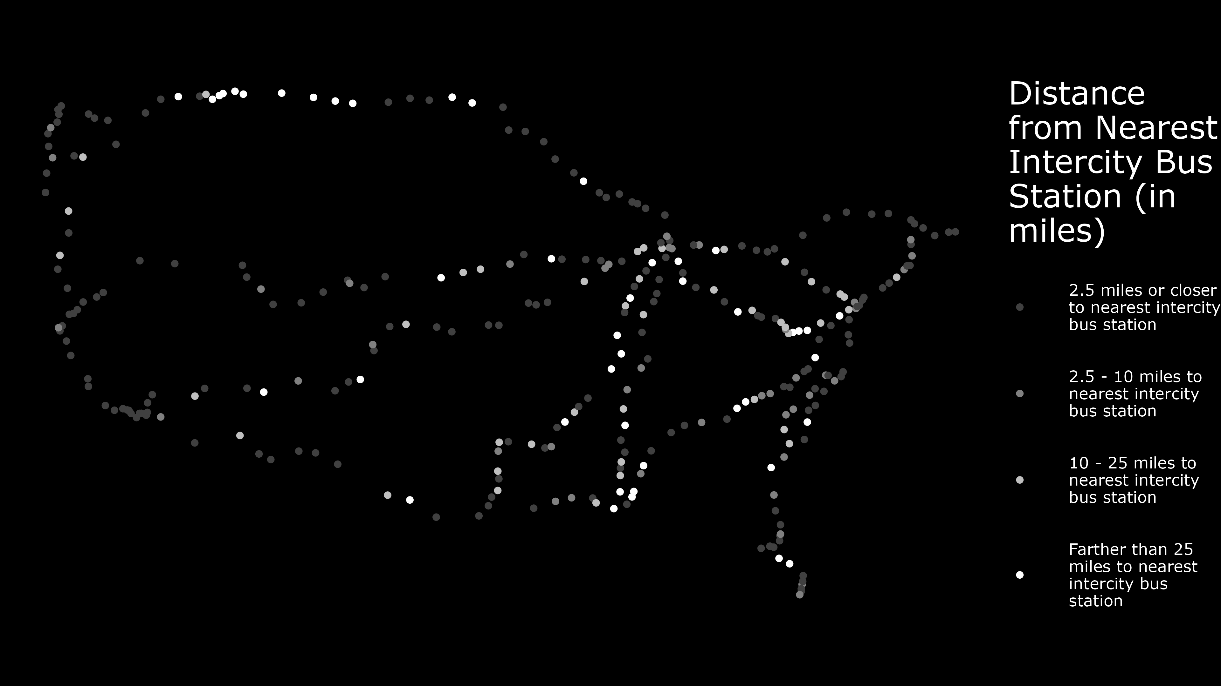

Slide 15
Accessibility Metrics Used

Slide 16
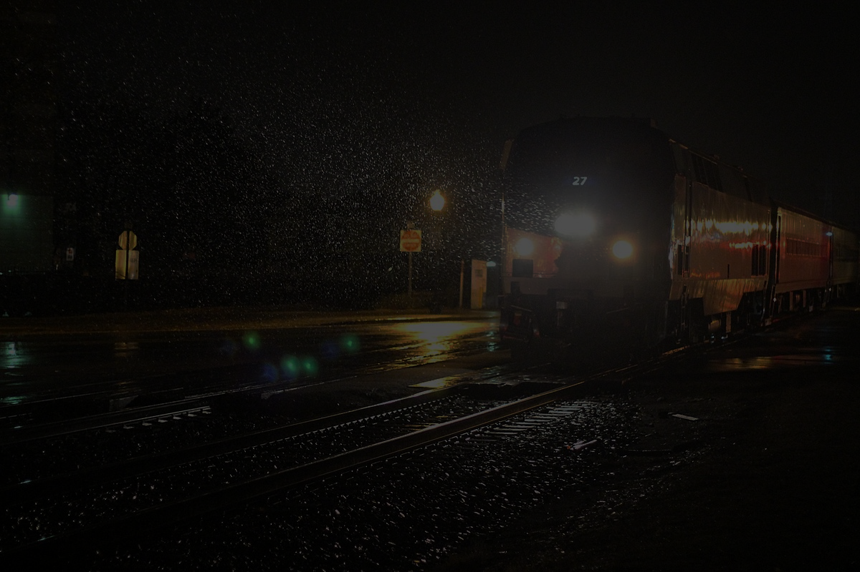
Departure Times
Photo Credit: Jeff Dunn via Wikimedia Commons

Slide 17

Delays
Photo Credit: Steve Morgan via Wikimedia Commons

Slide 18
Results

Slide 19
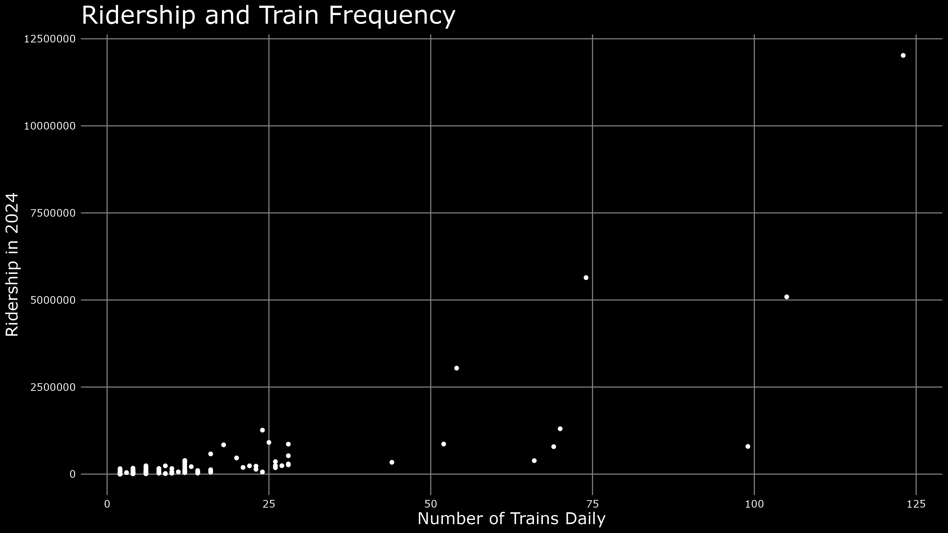

Slide 20
