Slide 1
AJAX
Asynchronous Javascript And XML

Slide 2
AJAX
A lot of hype
  It has been around for a while
  Not complex
Powerful approach to building websites
  Think differently
Allows for more interactive web applications
  Gmail, docs.google.com, Flickr, ajax13, etc.

Slide 3
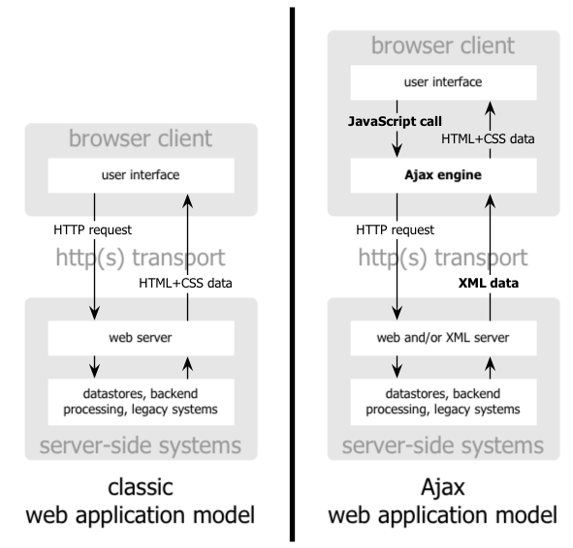

Slide 4
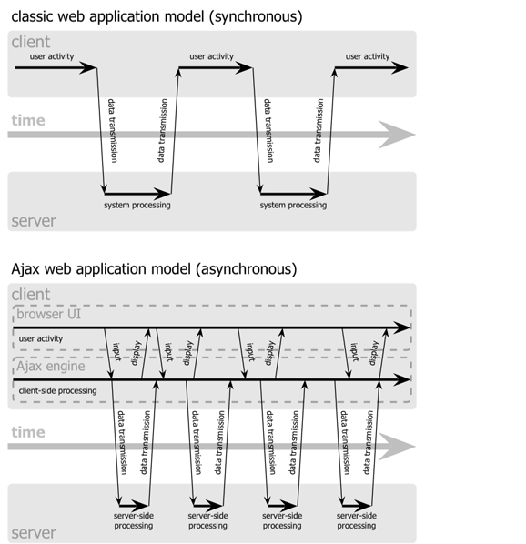

Slide 5
AJAX Technologies
HTML
  Used to build web forms and identify fields
Javascript
  Facilitates asynchronous communication and modification of HTML in-place
DHTML - Dynamic HTML
  Additional markup for modifying and updating HTML
DOM - Document Object Model
  Used via Javascript to work with both the structure of your HTML and also XML from the server

Slide 6
The XMLHttpRequest Object
Base object for AJAX
  Used to make connections, send data, receive data, etc.
Allows your javascript code to talk back and forth with the server all it wants to, without the user really knowing what is going on.
Available in most browsers
  But called different things

Slide 7
The XMLHttpRequest Object
_x0016_<script language="javascript" type="text/javascript">
var request;
function createRequest() {
try {
request = new XMLHttpRequest();
if (request.overrideMimeType) {
request.overrideMimeType('text/xml');
}
} catch (trymicrosoft) {
try {
request = new ActiveXObject("Msxml2.XMLHTTP");
} catch (othermicrosoft) {
try {
request = new ActiveXObject("Microsoft.XMLHTTP");
} catch (failed) {
request = false;
}
}
}
if (!request)
alert("Error initializing XMLHttpRequest!");
}
</script>

Slide 8
Communicating
Steps
  Gather information (possibly from HTML form)
  Set up the URL
  Open the connection
  Set a callback method
  Send the request
function getCustomerInfo()
{
var phone = document.getElementById("phone").value;
var url = "/cgi-local/lookupCustomer.php?phone=" + escape(phone);
request.open("GET", url, true);
request.onreadystatechange = updatePage;
request.send(null);
}

Slide 9
Handling Server Responses
When the server responds, your callback method will be invoked.
  It is called at various stages of the process
  Test readyState
function updatePage()
{
if (request.readyState == 4) {
if (request.status == 200) {
// Handle the response
} else
alert("status is " + request.status);
}
}

Slide 10
HTTP Ready States
0: The request is uninitialized
  Before calling open()
1: The request is set up, but hasn’t been sent
  Before calling send()
2: The request is sent and is being processed
  Sometimes you can get content headers now
3: The request is being processed
  The server hasn’t finished with its response
4: The response is complete

Slide 11
The XMLHttpRequest Object
Methods
  abort()
    cancel current request
  getAllResponseHeaders()
    Returns the complete set of http headers as a string
  getResponseHeader(“headername”)
    Return the value of the specified header
  open(“method”, “URL”, async, “uname”, “passwd”)
    Sets up the call
  setRequestHeader(“label”, “value”)
  send(content)
    Actually sends the request

Slide 12
The XMLHttpRequest Object
Properties
  onreadystatechange
    Event handler for an event that fires at every state change
  readyState
    Returns the state of the object
  responseText
    Returns the response as a string
  responseXML
    Returns the response as XML - use W3C DOM methods
  status
    Returns the status as a number - ie. 404 for “Not Found”
  statusText
    Returns the status as a string - ie. “Not Found”

Slide 13
Typical AJAX Flow
Make the call
  Gather information (possibly from HTML form)
  Set up the URL
  Open the connection
  Set a callback method
  Send the request
Handle the response (in callback method)
  When request.readyState == 4 and request.status == 200
  Get the response in either text or xml
    request.responseText or request.responseXML
  Process the response appropriately for viewing
  Get the objects on the page that will change
    document.getElementById or document.getElementByName, etc.
  Make the changes

Slide 14
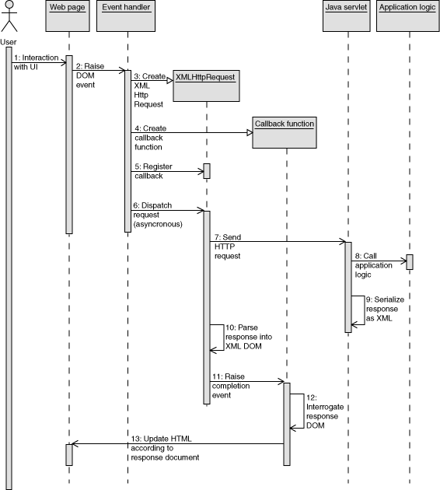

Slide 15
AJAX Response Handler
function updatePage()
{
if (request.readyState == 4) {
if (request.status == 200) {
var response = request.responseText.split("|");
document.getElementById("order").value = response[0];
document.getElementById("address").innerHTML = response[1];
} else
alert("status is " + request.status);
}
}

Slide 16
The Document Object Model
When a document is loaded in the web browser, a number of objects are created.
  Most commonly used are window and document
Window
  open(), close(), alert(), confirm(), prompt()
Document
  Contains arrays which store all the components of your page
  You can access and call methods on the components using the arrays
  An object may also be accessed by its name
    document.myform.address.value = “123 Main”
    document.myform.reset()
  Can also search for element by name or id
    document.getElementById(“myelementid”)
    document.getElementsByName(“myelementname”)

Slide 17
W3C DOM with Javascript
Each xml document also has a DOM
  Using Ajax you can get the returned value in xml
    XMLfile = request.responseXML
Parse using the DOM methods from the documentElement
var rootElement = XMLfile.documentElement;
document.write("The root node of the XML file is: ");
document.writeln("<b>" + rootElement.nodeName +"</b>");
//traverse through each child of the root element
//and print out its name
for (i=0; i<rootElement.childNodes.length; i++)
{
var node = rootElement.childNodes.item(i);
document.write("The name of the node is ");
document.write("<b>" + node.nodeName + "</b>");
}

Slide 18
The Document Object
Properties
  childNodes - returns a NodeList of child nodes
  documentElement - returns the root node
  documentURI - sets or returns the location of the document
  firstChild, lastChild, nodeName, nodeType, nodeValue
Methods
  createAttribute, createComment, createElement
  getElementById
  getElementsByTagName
    Return a NodeList of all elements with a specified name

Slide 19
function loadMap(filename)
{
var request = GXmlHttp.create();
request.open("GET", filename, true);
request.onreadystatechange = function()
{
if (request.readyState == 4)
{
var xmlDoc = request.responseXML;
var markers = xmlDoc.documentElement.getElementsByTagName("marker");
mapmarkers.length=0;
for (var i = 0; i < markers.length; i++)
{
mapmarkers.push(createMarker(new GLatLng(parseFloat(markers[i].getAttribute("lat")), parseFloat(markers[i].getAttribute("lng"))), markers[i].getAttribute("note")));
map.addOverlay(mapmarkers[i]);
}
map.setCenter(new GLatLng(parseFloat(markers[0].getAttribute("lat")), parseFloat(markers[0].getAttribute("lng"))), 13);
mappoints.length = 0;
var trailpoints = xmlDoc.documentElement.getElementsByTagName("point");
for (var i = 0; i < trailpoints.length; i++)
{
var tpoint = new GLatLng(parseFloat(trailpoints[i].getAttribute("lat")), parseFloat(trailpoints[i].getAttribute("lng")));
mappoints.push(tpoint);
}
map.addOverlay(new GPolyline(mappoints));
}
}
request.send(null);
}
// Download the data in data.xml and load it on the map. The format we expect is:
// <markers>
// <marker lat="37.441" lng="-122.141" note="marker notes"/>
// <marker lat="37.322" lng="-121.213" note="marker notes"/>
// </markers>
// <trail>
// <point lat="37.441" lng="-122.141"/>
// <point lat="37.322" lng="-121.213"/>
// </trail>

Slide 20
The Document Object
Go to: http://www.w3schools.com/dom/default.asp

Slide 21
AJAX Libraries
Prototype
  http://www.prototypejs.org/
Scriptaculous
  http://script.aculo.us/
Jquery
  http://jquery.com/
Mochikit
  http://mochikit.com/

Slide 22
Prototype Sample
new Ajax.Request('/some_url', {
method:'get',
onSuccess: function(transport)
{
var response = transport.responseText || "no response text";
alert("Success! \n\n" + response);
},
onFailure: function()
{
alert('Something went wrong...')
}
});

Slide 23
Prototype Example
<html>
<head>
<title>Testing Prototype</title>
<script src="http://www.prototypejs.org/assets/2008/9/29/prototype-1.6.0.3.js"></script>
<script>
function getProducts()
{
new Ajax.Updater('products', 'products.html', { method: 'get' });
}
</script>
</head>
<body>
<h2>Our fantastic products</h2>
<div id="products"><a href = "#" onClick="getProducts();">(fetch product list ...)</a></div>
</body>
</html>

