Slide 1
An introduction to statistical inverse problems and model calibration
Mitchel J. Colebank
8/16/2023

Slide 2
Goals
See a few examples of biological, mechanistic models
Work through the basics of model calibration
Discuss frequentist and Bayesian model calibration
Get hands on experience with parameter confidence/credible intervals, OLS, and Markov chain Monte Carlo (MCMC)

Slide 3
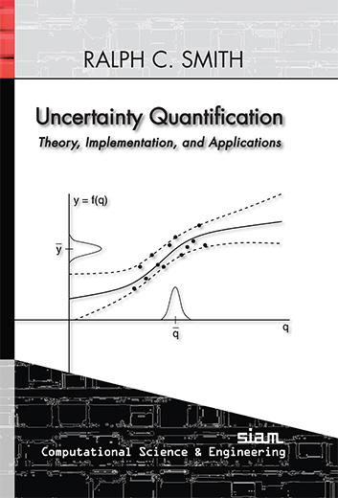
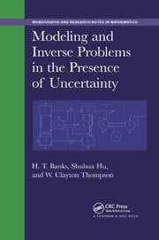
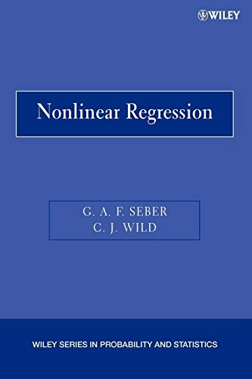
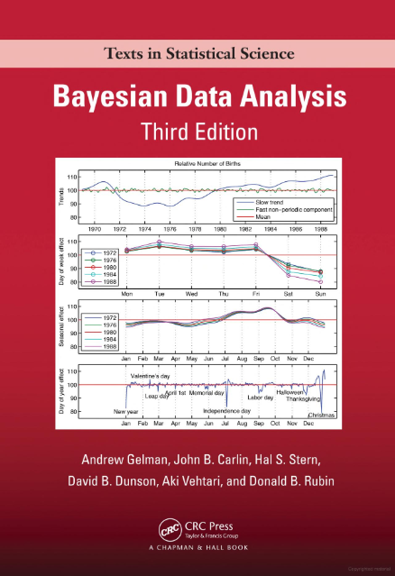
Reference Texts

Slide 4
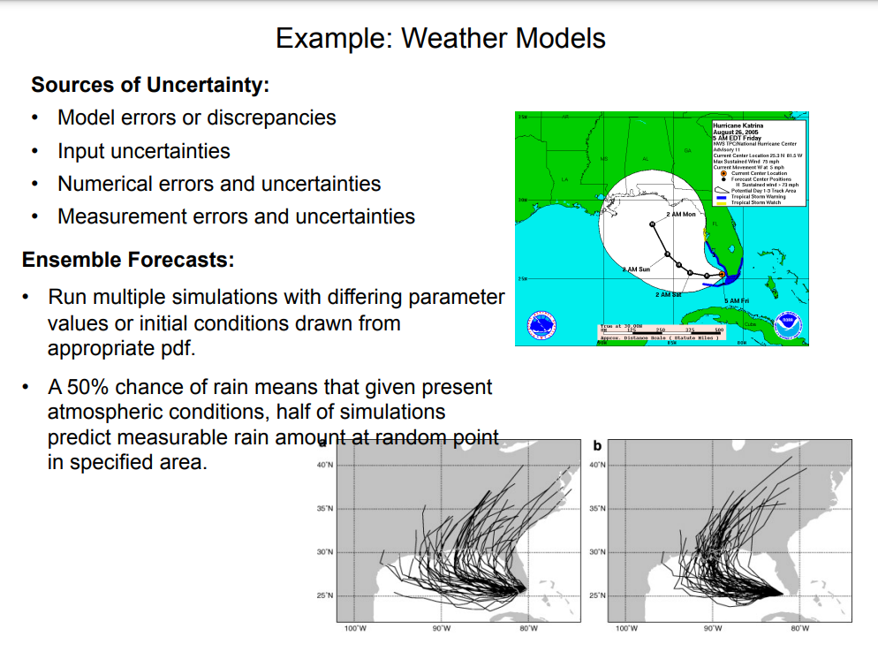
An example from Ralph Smith

Slide 5
What is a forward problem?
Generally, we solve a forward problem by:
Providing a mathematical model
Providing parameters describing the system
Providing parameter bounds
And observe
Model output
Uncertainty in model output within bounds

Slide 6
What is an inverse problem?
Generally, we solve an inverse problem by:
Providing a mathematical model
Providing some measured (or simulated) data from the true system
Providing a statistical model
And determine
Model parameters that best explain the data
Uncertainty in model parameters based on the data

Slide 7
Forward versus Inverse Problems
Forward
problem
Known
Unknown
Biophysical parameters:
Arterial stiffness
Receptor firing rates
Cytokine production rate
Mathematical model:
Fluid dynamics
Systems biology
Solid mechanics
Data/output:
Heart rate
Blood pressure
ECG signals
Inverse
problem
Unknown
Known

Slide 8
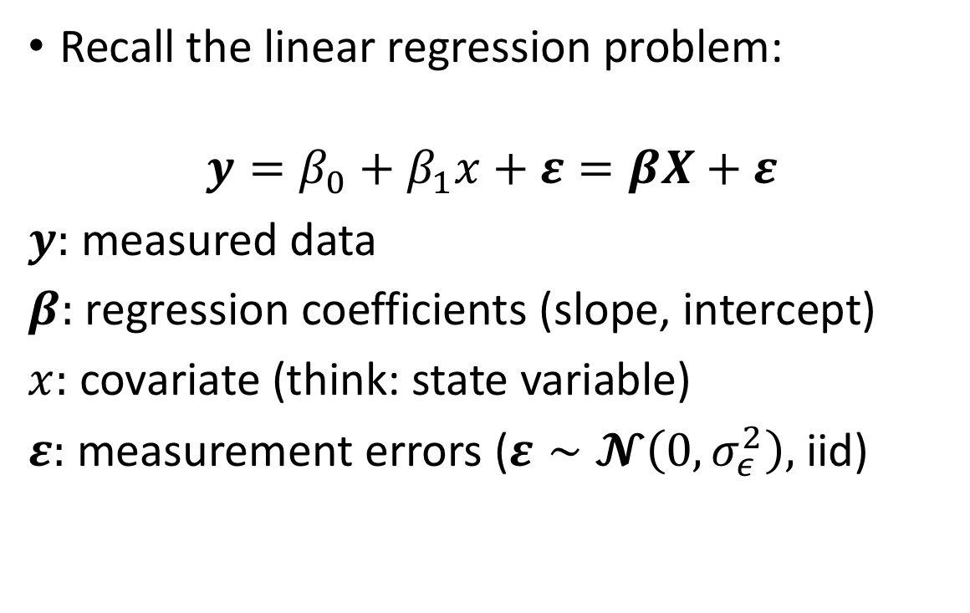
Regression
Recall the linear regression problem:
$$y=β_{0}+β_{1}x+ε=βX+ε$$
$y:$ measured data
$β:$ regression coefficients (slope, intercept)
$x:$ covariate (think: state variable)
$ε:$ measurement errors ($ε∼𝓝\left(0,σ_{ε}^{2}\right),$ iid)

Slide 9
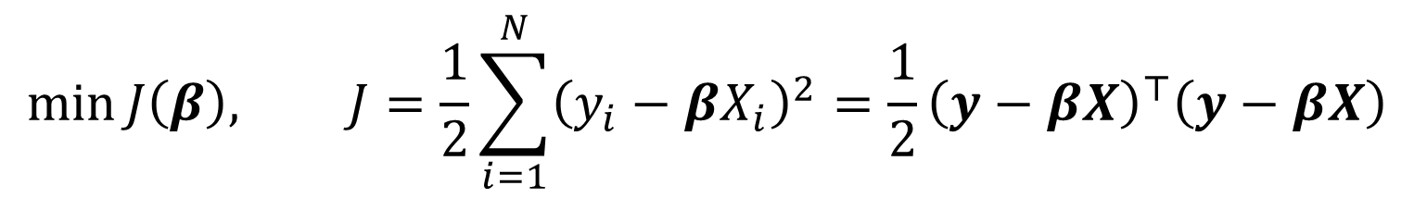
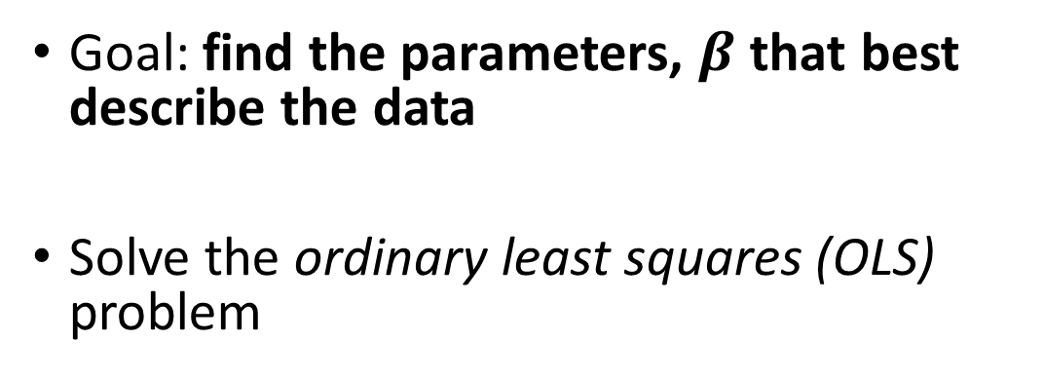
Regression
Goal: find the parameters, $β$ that best describe the data
Solve the ordinary least squares (OLS) problem
$$\min{J\left(β\right), J=\frac{1}{2}\sum_{i=1}^{N}{{\left(y_{i}−βX_{i}\right)}^{2}}=\frac{1}{2}{{\left(y−βX\right)}^{⊤}\left(y−βX\right)}^{ }}$$

Slide 10
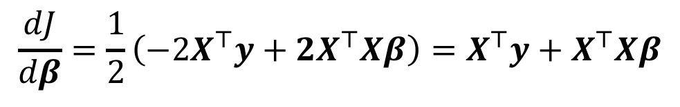
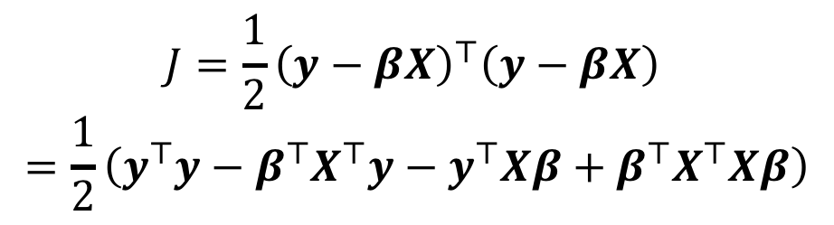
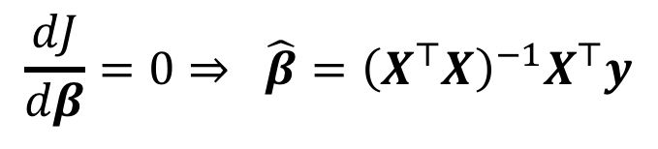
Regression
Calculus: minimum occurs where the derivative is zero
$$J=\frac{1}{2}{{\left(y−βX\right)}^{⊤}\left(y−βX\right)}^{ }$$
$$=\frac{1}{2}\left(y^{⊤}y−β^{⊤}X^{⊤}y−y^{⊤}Xβ+β^{⊤}X^{⊤}Xβ\right)$$
$$\frac{dJ}{dβ}=\frac{1}{2}\left(−2X^{⊤}y+2X^{⊤}Xβ\right)=X^{⊤}y+X^{⊤}Xβ$$
$$\frac{dJ}{dβ}=0⇒ \hat{β}={\left(X^{⊤}X\right)}^{−1}X^{⊤}y$$

Slide 11
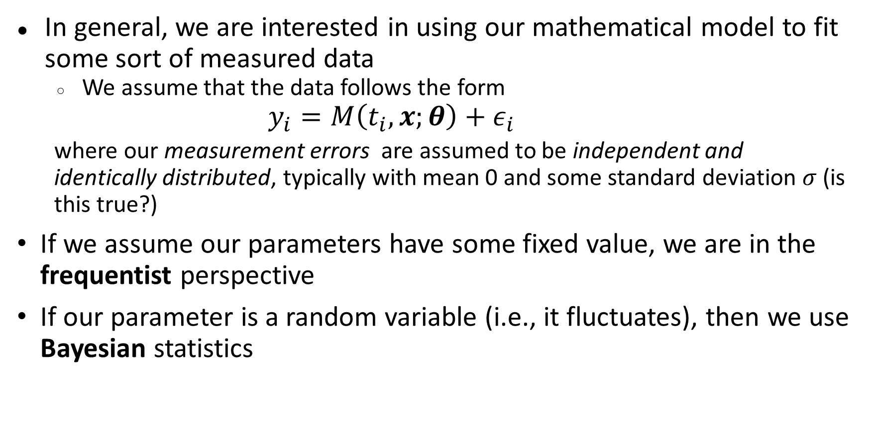
Parameter Inference
In general, we are interested in using our mathematical model to fit some sort of measured data
We assume that the data follows the form
$$y_{i}=M\left(t_{i},x;θ\right)+ε_{i}$$
where our measurement errors are assumed to be independent and identically distributed, typically with mean 0 and some standard deviation $σ$ (is this true?)
If we assume our parameters have some fixed value, we are in the frequentist perspective
If our parameter is a random variable (i.e., it fluctuates), then we use Bayesian statistics

Slide 12
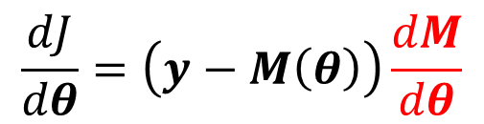

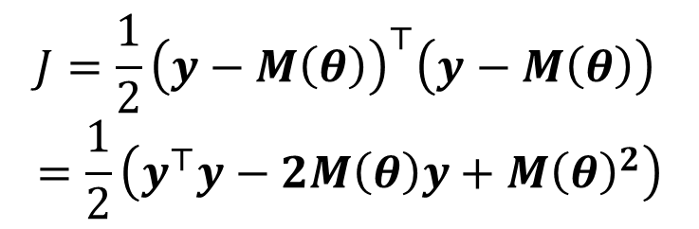

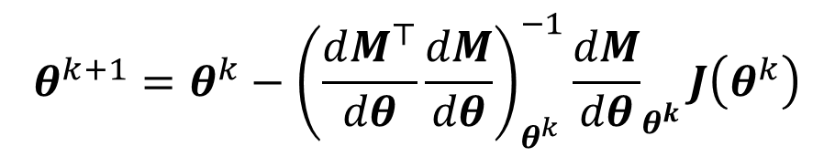
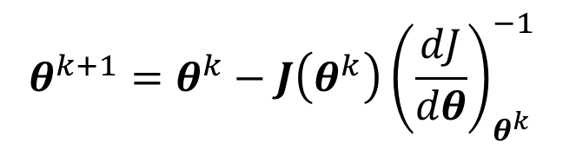
Nonlinear Regression
Calculus: minimum occurs where the derivative is zero
$$J\left(θ\right)$$
$$J=\frac{1}{2}{{\left(y−M\left(θ\right)\right)}^{⊤}\left(y−M\left(θ\right)\right)}^{ }$$
$$=\frac{1}{2}\left(y^{⊤}y−2M\left(θ\right)y+M{\left(θ\right)}^{2}\right)$$
$$θ_{i}$$
Newton’s method
$$θ^{k+1}=θ^{k}−J\left(θ^{k}\right){\left(\frac{dJ}{dθ}\right)}_{θ^{k}}^{−1}$$
$$\frac{dJ}{dθ}=\left(y−M\left(θ\right)\right)\frac{dM}{dθ}$$
Gauss-Newton
Model sensitivity
$$θ^{k+1}=θ^{k}−{\left(\frac{dM^{⊤}}{dθ}\frac{dM}{dθ}\right)}_{θ^{k}}^{−1}{\frac{dM}{dθ}}_{θ^{k}}J\left(θ^{k}\right)$$

Slide 13
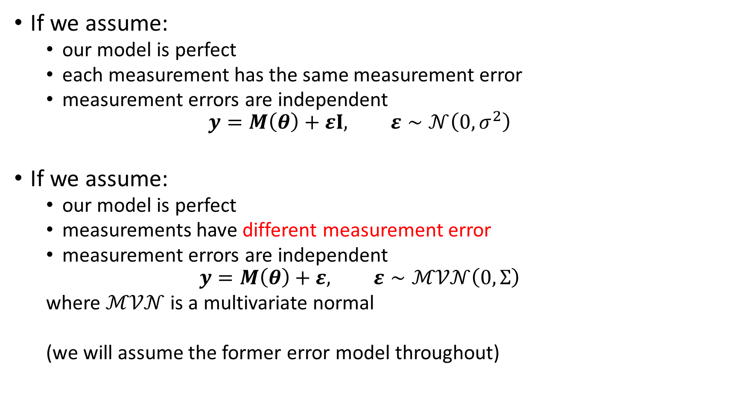
Parameter Inference
If we assume:
our model is perfect
each measurement has the same measurement error
measurement errors are independent
$$y=M\left(θ\right)+εI, ε∼𝒩\left(0,σ^{2}\right)$$
If we assume:
our model is perfect
measurements have different measurement error
measurement errors are independent
$$y=M\left(θ\right)+ε, ε∼ℳ𝒱𝒩\left(0,Σ\right)$$
where $ℳ𝒱𝒩$ is a multivariate normal
(we will assume the former error model throughout)

Slide 14
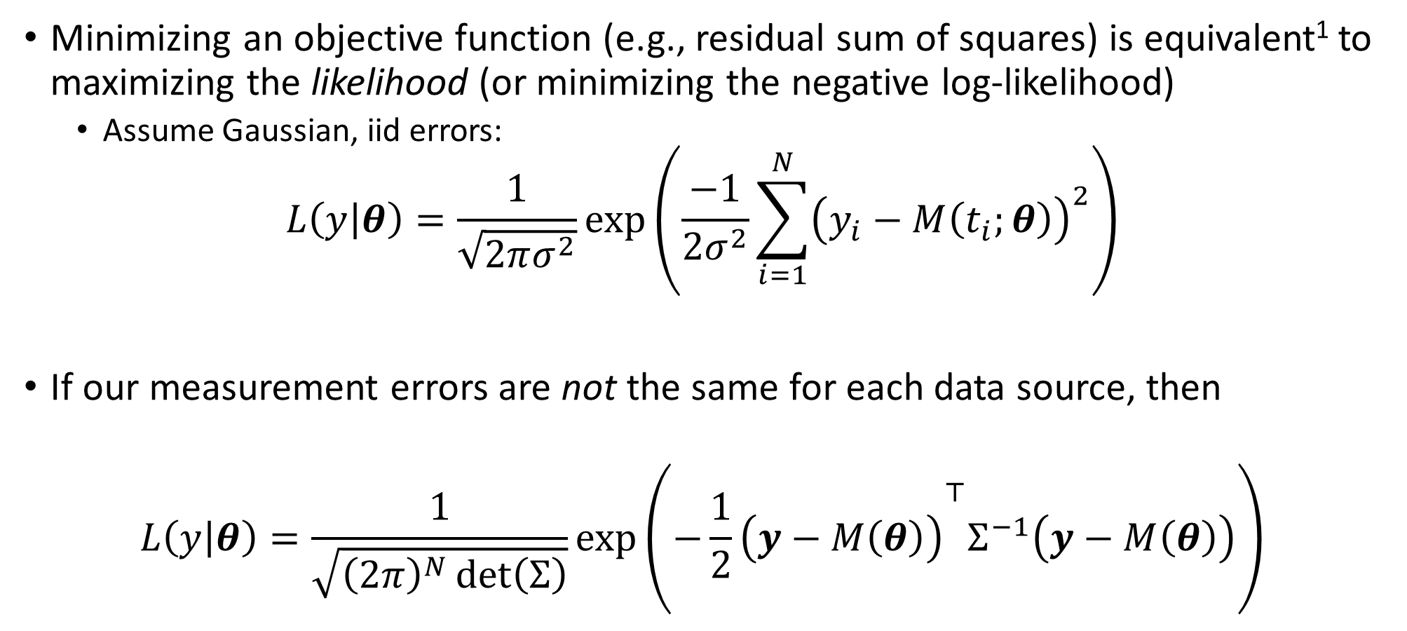
Parameter Inference
Minimizing an objective function (e.g., residual sum of squares) is equivalent¹ to maximizing the likelihood (or minimizing the negative log-likelihood)
Assume Gaussian, iid errors:
$$L\left(y | θ\right)=\frac{1}{\sqrt{2πσ^{2}}}\exp\left(\frac{−1}{{2σ}^{2}}\sum_{i=1}^{N}{{\left(y_{i}−M\left(t_{i};θ\right)\right)}^{2}}\right)$$
If our measurement errors are not the same for each data source, then
$$L\left(y | θ\right)=\frac{1}{\sqrt{{\left(2π\right)}^{N}\det\left(Σ\right)}}\exp\left({−\frac{1}{2}\left(y−M\left(θ\right)\right)}^{⊤}Σ^{−1}\left(y−M\left(θ\right)\right)\right)$$
(we will assume the former error model throughout)

Slide 15
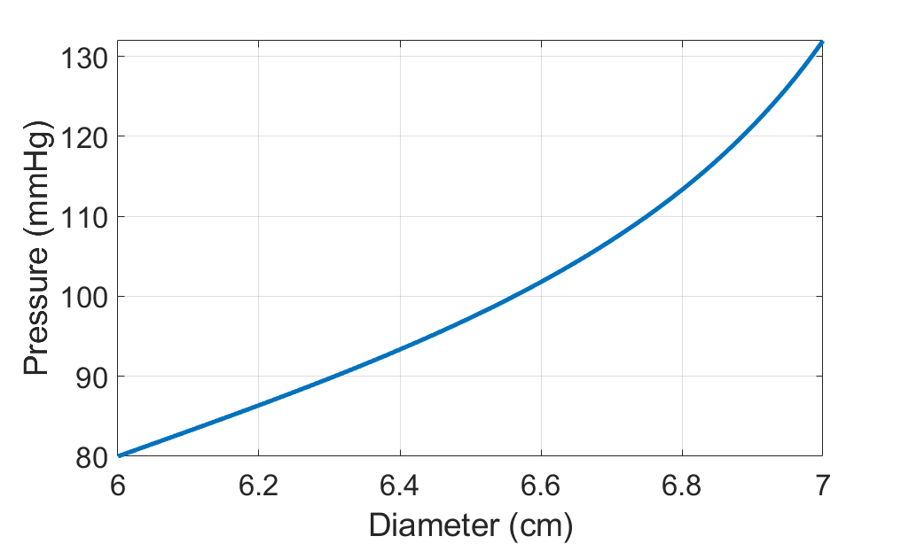

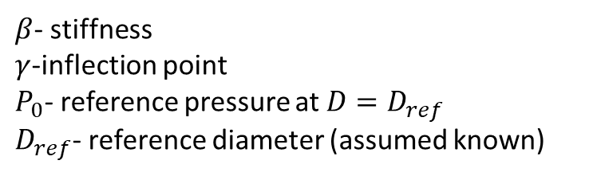
Example Models
Algebraic Model – Pressure-diameter function
$$P\left(D\right)=β\tan\left(\frac{π}{γ}\left(\frac{D}{D_{ref}}−1\right)\right)+P_{0}$$
$β$- stiffness
$γ$-inflection point
$P_{0}$- reference pressure at $D=D_{ref}$
$D_{ref}$- reference diameter (assumed known)

Slide 16
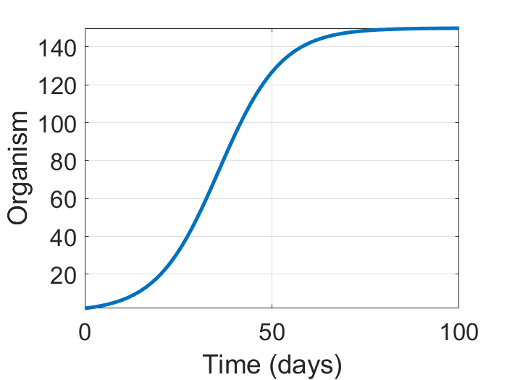

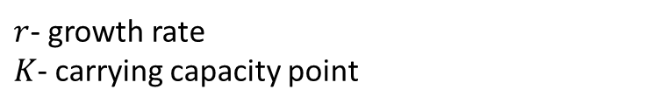
Example Models
Single ODE model – Logistic Growth
$$\frac{dx}{dt}=rx\left(1−\frac{x}{K}\right)$$
$r$- growth rate
$K$- carrying capacity point

Slide 17
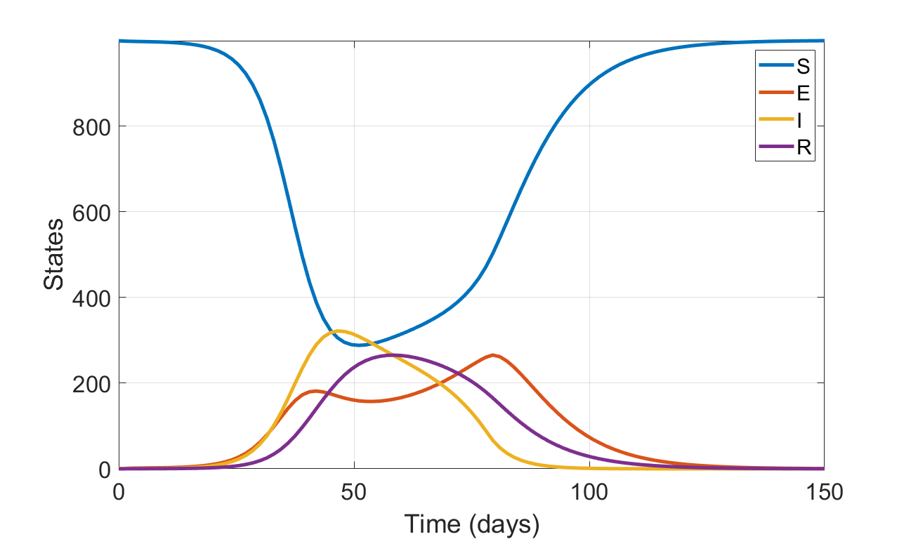













Example Models
S
E
$$δ\left(t\right)E$$
I
$$γI$$
R
$$βSI$$
$$μN$$
$$μS$$
$$μE$$
$$μI$$
$$μR$$
System of ODEs – Epidemic Model
$$\frac{dS}{dt}=μN−\frac{βSI}{N}−μS$$
$$\frac{dE}{dt}=\frac{βSI}{N}−δ\left(t\right)E −μE$$
$$\frac{dI}{dt}=δ\left(t\right)E −γI −μI$$
This is where we will assume we have data
$$\frac{dR}{dt}=γI −μR$$
$δ\left(t\right)≡$periodic or impulse parameter

Slide 18
Frequentist Statistics
Also called “classical” statistics
Assumes that parameters are fixed and unknown.
We place uncertainty in our estimates on the measurements.
If you’ve calculated confidence intervals, regression coefficients, etc., you’ve being using these statistics.

Slide 19

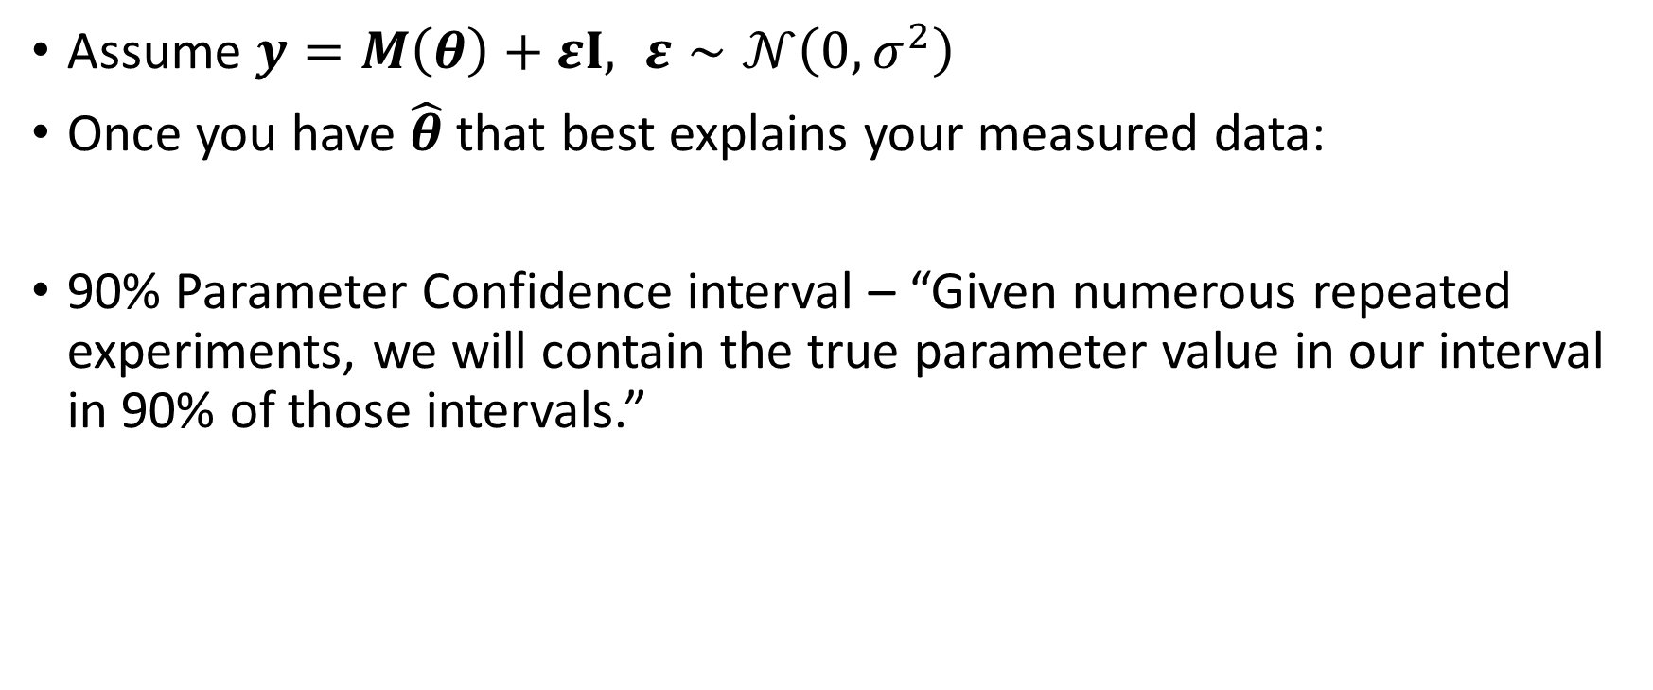

Frequentist Statistics
Assume $y=M\left(θ\right)+εI, ε∼𝒩\left(0,σ^{2}\right)$
Once you have $\hat{θ}$ that best explains your measured data:
90% Parameter Confidence interval – “Given numerous repeated experiments, we will contain the true parameter value in our interval in 90% of those intervals.”
$$CI$$
$$θ^{∗}$$
Experiments

Slide 20
Frequentist Confidence Intervals
From TowardsDataScience.com
Confidence Interval
The frequentist confidence interval has the following long-run frequency idea: random samples from the same target population and with the same sample size would yield CIs that contain the true (unknown) estimate in a frequency (percentage) set by the confidence level. In practice, it’s quite complicated to have several random samples drawn from the same population; rather, we gather data from a single sample of the population of interest and calculate the CI for that sample. The interpretation of this particular CI would be: we can be XX% (90%, 95%, 99%) confident that the true (unknown) estimate would lie within the lower and upper limits of the CI, based on hypothesized repeats of the experiment.
Having said that, an XX% confidence level does not mean that for a given realized interval there is an XX% probability that the population parameter lies within the interval!
https://towardsdatascience.com/statistics-101-credible-vs-confidence-interval-af7b7e8fdd79

Slide 21
Explanation from chatGPT
Frequentist Statistics: Frequentist statistics, often referred to as the classical or orthodox approach, is based on the concept of frequency probability. It focuses on analyzing the properties of data and making inferences about population parameters. In this approach, probability is interpreted as the long-term relative frequency of an event occurring in repeated experiments.
Key characteristics of frequentist statistics include:
Parameter Estimation: Frequentists use methods like maximum likelihood estimation to estimate population parameters (such as means, variances, etc.) based on observed sample data.
Hypothesis Testing: Hypothesis tests involve setting up null and alternative hypotheses and determining the likelihood of observing the sample data under these hypotheses. The p-value, which represents the probability of obtaining the observed data under the null hypothesis, is used to make decisions about whether to reject the null hypothesis.
Confidence Intervals: Frequentist statistics provides confidence intervals, which are ranges of values that are likely to contain the true population parameter with a specified level of confidence. The confidence level represents the proportion of intervals that would contain the true parameter value in repeated sampling.

Slide 22

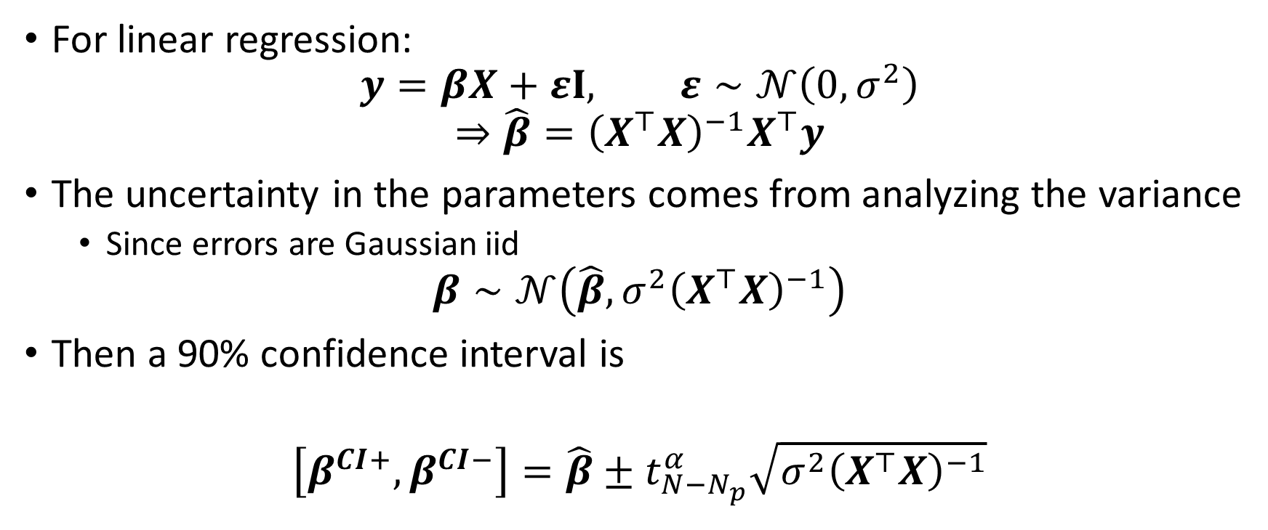

Frequentist Statistics
$$CI$$
$$θ^{∗}$$
For linear regression:
$$y=βX+εI, ε∼𝒩\left(0,σ^{2}\right)$$
$$⇒\hat{β}={\left(X^{⊤}X\right)}^{−1}X^{⊤}y$$
The uncertainty in the parameters comes from analyzing the variance
Since errors are Gaussian iid
$$β∼𝒩\left(\hat{β},σ^{2}{\left(X^{⊤}X\right)}^{−1}\right)$$
Then a 90% confidence interval is
$$\left[β^{CI+},β^{CI−}\right]=\hat{β}±t_{N−N_{p}}^{α}\sqrt{σ^{2}{\left(X^{⊤}X\right)}^{−1}}$$
Experiments

Slide 23
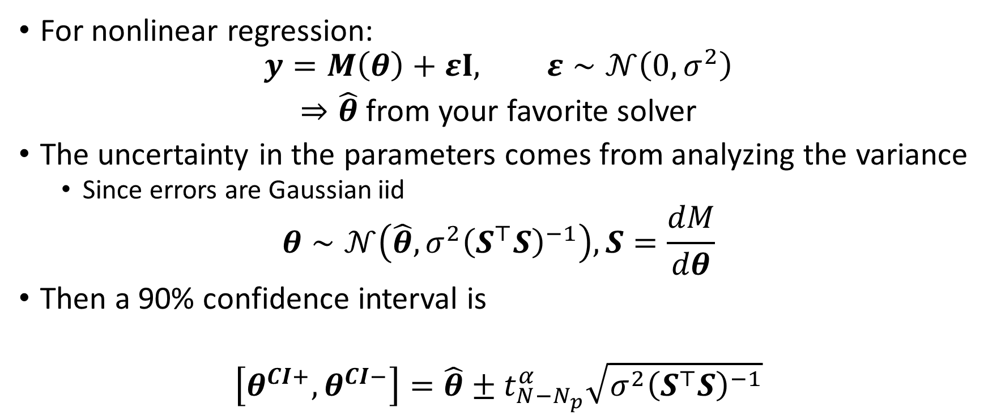
Frequentist Statistics
$$CI$$
$$θ^{∗}$$
For nonlinear regression:
$$y=M\left(θ\right)+εI, ε∼𝒩\left(0,σ^{2}\right)$$
$⇒\hat{θ}$ from your favorite solver
The uncertainty in the parameters comes from analyzing the variance
Since errors are Gaussian iid
$$θ∼𝒩\left(\hat{θ},σ^{2}{\left(S^{⊤}S\right)}^{−1}\right), S=\frac{dM}{dθ}$$
Then a 90% confidence interval is
$$\left[θ^{CI+},θ^{CI−}\right]=\hat{θ}±t_{N−N_{p}}^{α}\sqrt{σ^{2}{\left(S^{⊤}S\right)}^{−1}}$$
Experiments

Slide 24
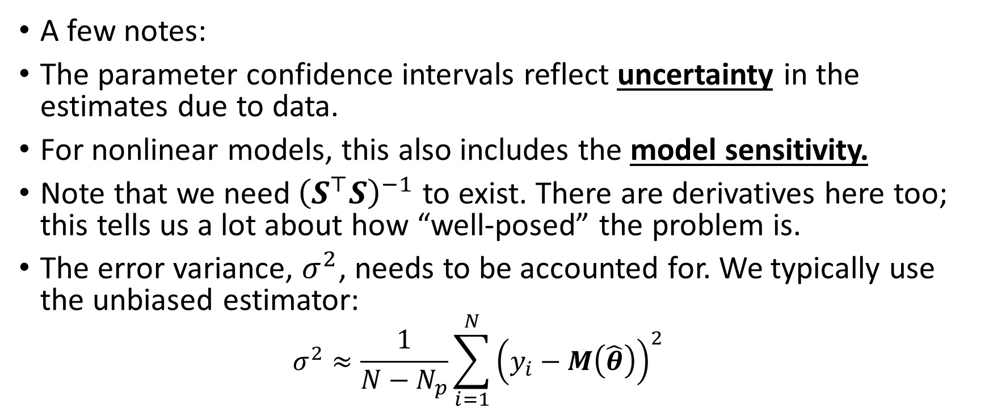
Frequentist Statistics
A few notes:
The parameter confidence intervals reflect uncertainty in the estimates due to data.
For nonlinear models, this also includes the model sensitivity.
Note that we need${\left(S^{⊤}S\right)}^{−1}$ to exist. There are derivatives here too; this tells us a lot about how “well-posed” the problem is.
The error variance, $σ^{2}$, needs to be accounted for. We typically use the unbiased estimator:
$$σ^{2}≈\frac{1}{N−N_{p}}\sum_{i=1}^{N}{{\left(y_{i}−M\left(\hat{θ}\right)\right)}^{2}}$$

Slide 25
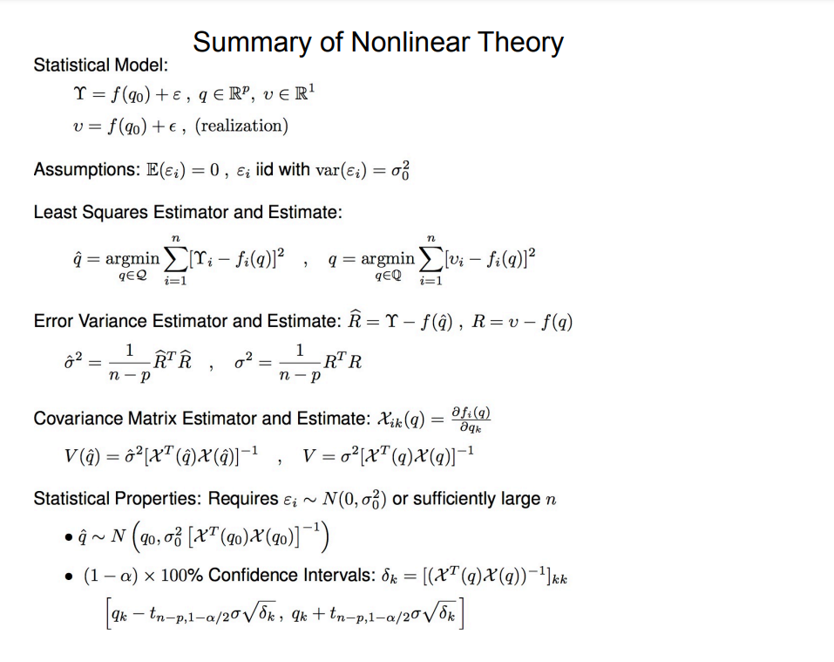
Summary of Frequentist Statistics (from Ralph Smith)

Slide 26
To the MATLAB examples! (Example_XX_OLS.m) (Example_XX_frequentist.m)

Slide 27
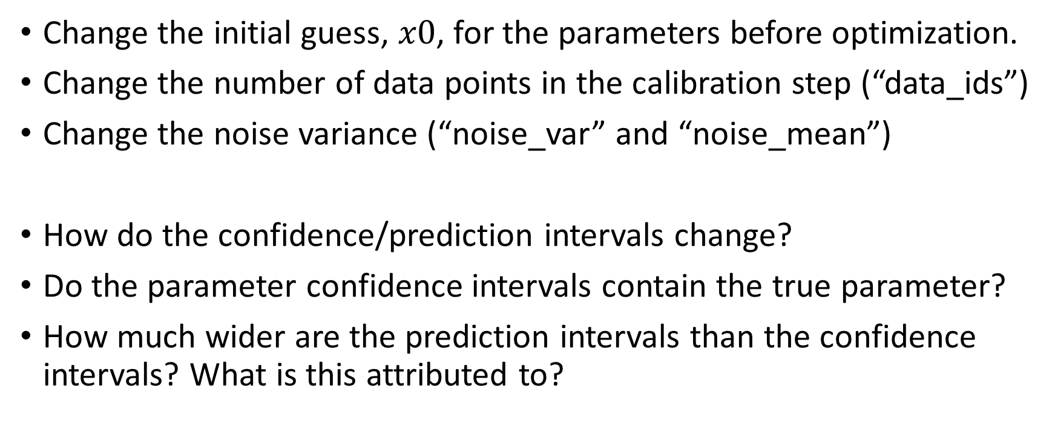
Things to investigate
Change the initial guess, $x0$, for the parameters before optimization.
Change the number of data points in the calibration step (“data_ids”)
Change the noise variance (“noise_var” and “noise_mean”)
How do the confidence/prediction intervals change?
Do the parameter confidence intervals contain the true parameter?
How much wider are the prediction intervals than the confidence intervals? What is this attributed to?

Slide 28
Questions or thoughts?

Slide 29
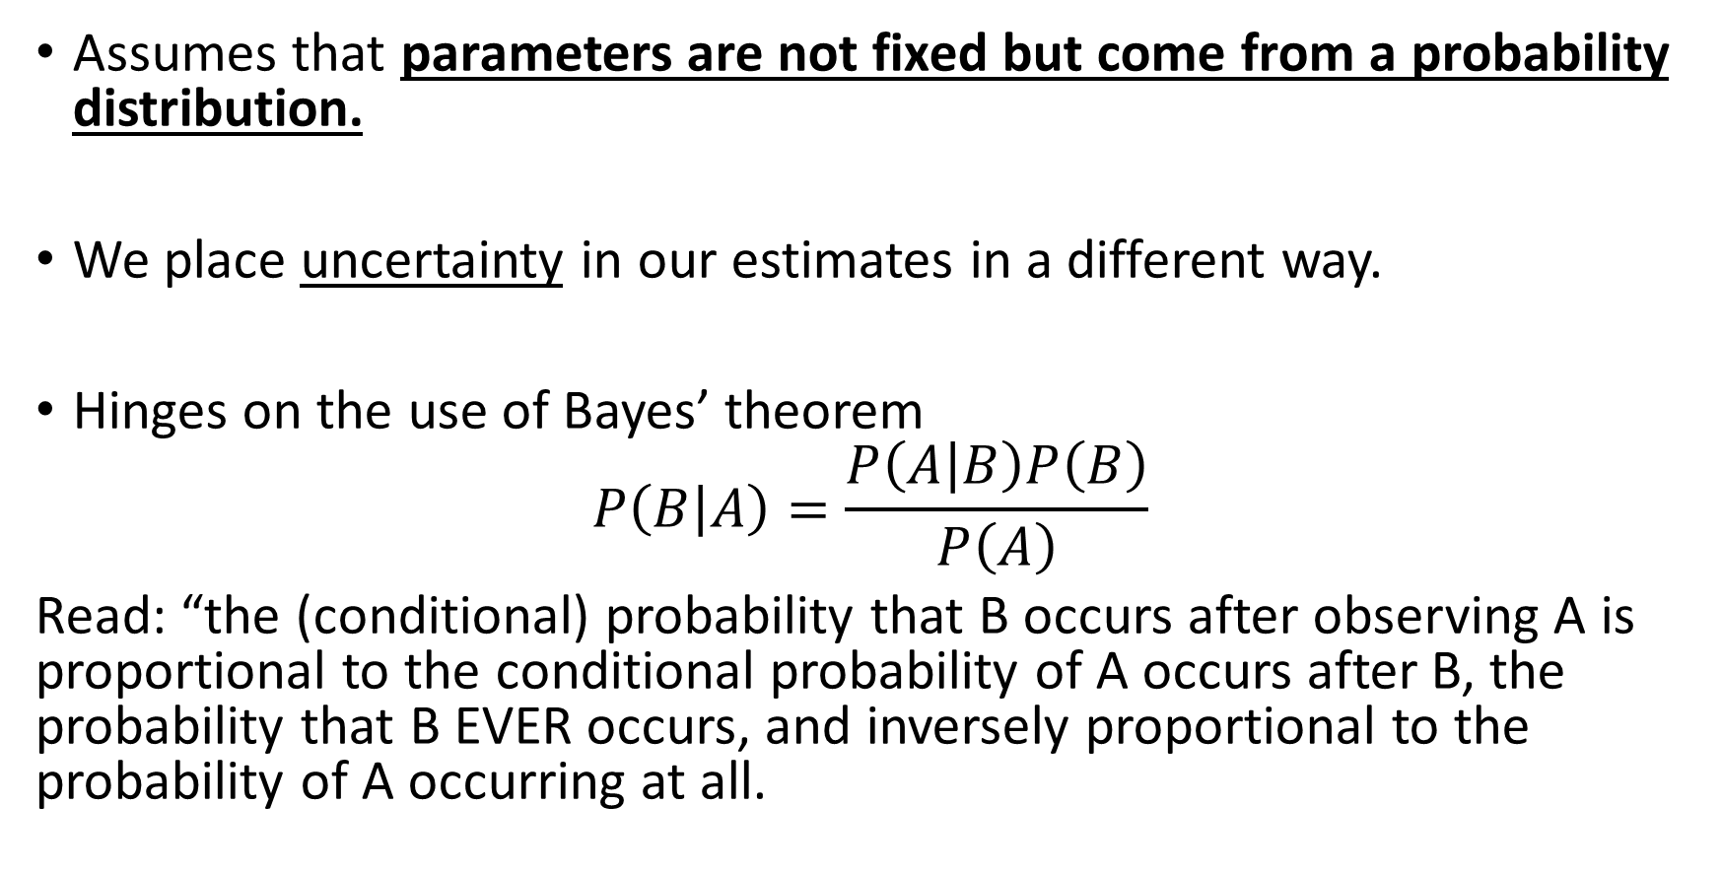
Bayesian Statistics
Assumes that parameters are not fixed but come from a probability distribution.
We place uncertainty in our estimates in a different way.
Hinges on the use of Bayes’ theorem
$$P\left(B | A\right)=\frac{P\left(A | B\right)P\left(B\right)}{P\left(A\right)}$$
Read: “the (conditional) probability that B occurs after observing A is proportional to the conditional probability of A occurs after B, the probability that B EVER occurs, and inversely proportional to the probability of A occurring at all.

Slide 30
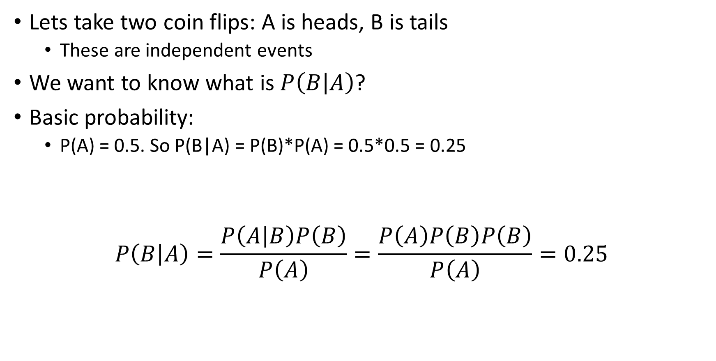
Bayesian Statistics
Lets take two coin flips: A is heads, B is tails
These are independent events
We want to know what is $P\left(B | A\right)$?
Basic probability:
P(A) = 0.5. So P(B|A) = P(B)*P(A) = 0.5*0.5 = 0.25
$$P\left(B | A\right)=\frac{P\left(A | B\right)P\left(B\right)}{P\left(A\right)}=\frac{P\left(A\right)P\left(B\right)P\left(B\right)}{P\left(A\right)}=0.25$$

Slide 31
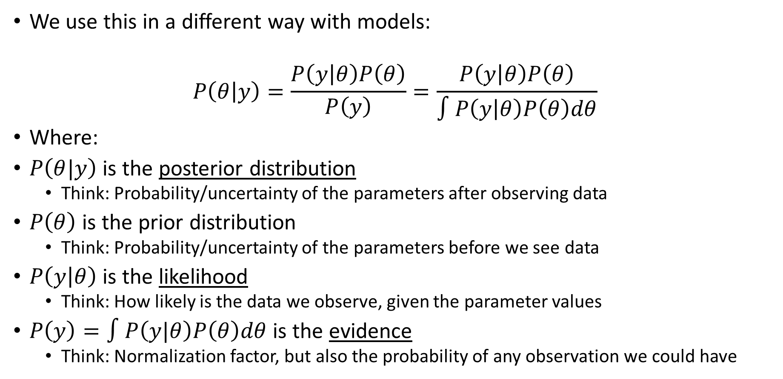
Bayesian Statistics
We use this in a different way with models:
$$P\left(θ | y\right)=\frac{P\left(y | θ\right)P\left(θ\right)}{P\left(y\right)}=\frac{P\left(y | θ\right)P\left(θ\right)}{∫P\left(y | θ\right)P\left(θ\right)dθ}$$
Where:
$P\left(θ|y\right)$ is the posterior distribution
Think: Probability/uncertainty of the parameters after observing data
$P\left(θ\right)$ is the prior distribution
Think: Probability/uncertainty of the parameters before we see data
$P\left(y | θ\right)$ is the likelihood
Think: How likely is the data we observe, given the parameter values
$P\left(y\right)=∫P\left(y|θ\right)P\left(θ\right)dθ$ is the evidence
Think: Normalization factor, but also the probability of any observation we could have

Slide 32
Bayesian Statistics
What are the benefits of Bayesian statistics?
A 90% parameter “credible” interval is intuitive: the parameter has 90% probability of taking on values in the interval.
Parameters are allowed to fluctuate; this makes sense in a lot of biological applications.
Uncertainty is provided for free!
Issue: computation time (which is why we use it more now)

Slide 33
Explanation from chatGPT
Bayesian Statistics: Bayesian statistics is based on Bayes' theorem, which describes how to update beliefs about a hypothesis as new evidence is obtained. This approach incorporates both prior beliefs and observed data to compute a posterior distribution, which represents updated beliefs about the unknown parameters.
Key characteristics of Bayesian statistics include:
Prior and Posterior Distributions: Bayesian analysis begins with specifying a prior distribution, which reflects existing knowledge or beliefs about the parameters before observing any data. This prior is then combined with the likelihood function (probability of observing the data given the parameters) to compute the posterior distribution using Bayes' theorem. The posterior distribution represents updated beliefs after observing the data.
Parameter Estimation: Instead of point estimates, Bayesian statistics provides posterior distributions for parameters. The mean, median, and other summary statistics of the posterior distribution can be used as estimates.
Hypothesis Testing: Bayesian hypothesis testing involves comparing the posterior probabilities of different hypotheses. The Bayes factor, which measures the strength of evidence for one hypothesis over another, is often used in Bayesian hypothesis testing.
Subjective Interpretation of Probability: Bayesian probability is interpreted as a measure of uncertainty or belief. It allows for the incorporation of both data and prior beliefs, making it suitable for situations where prior knowledge is available.

Slide 34
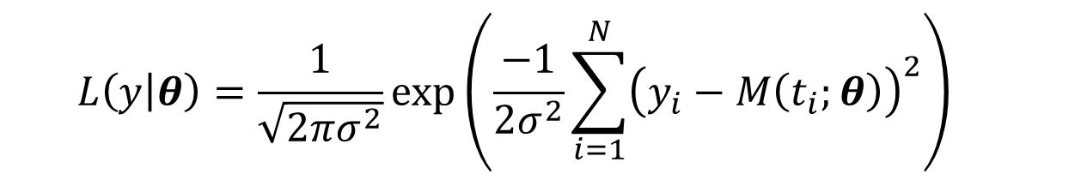
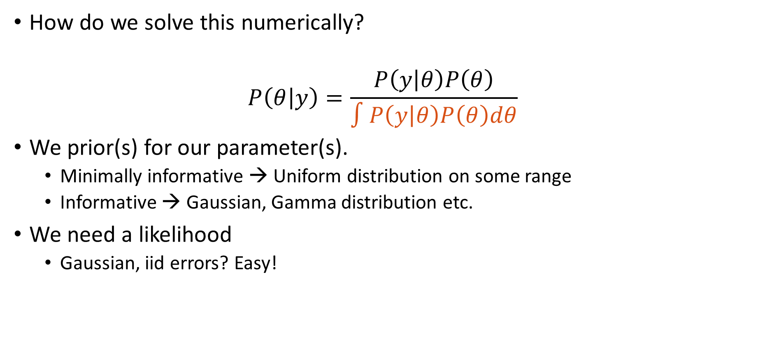
Bayesian Statistics
How do we solve this numerically?
$$P\left(θ | y\right)=\frac{P\left(y | θ\right)P\left(θ\right)}{∫P\left(y | θ\right)P\left(θ\right)dθ}$$
We prior(s) for our parameter(s).
Minimally informative → Uniform distribution on some range
Informative → Gaussian, Gamma distribution etc.
We need a likelihood
Gaussian, iid errors? Easy!
$$L\left(y | θ\right)=\frac{1}{\sqrt{2πσ^{2}}}\exp\left(\frac{−1}{{2σ}^{2}}\sum_{i=1}^{N}{{\left(y_{i}−M\left(t_{i};θ\right)\right)}^{2}}\right)$$

Slide 35
Bayesian Statistics
Methods for solving
Quadrature (e.g., approximate the integral)
Expensive
Monte Carlo sampling
Can be somewhat useful; requires numerous solutions.
Markov chain Monte Carlo
Still sampling, but with better efficiency and convergence
Laplace Approximation
Variation Inference
Approximate Bayesian Computation

Slide 36
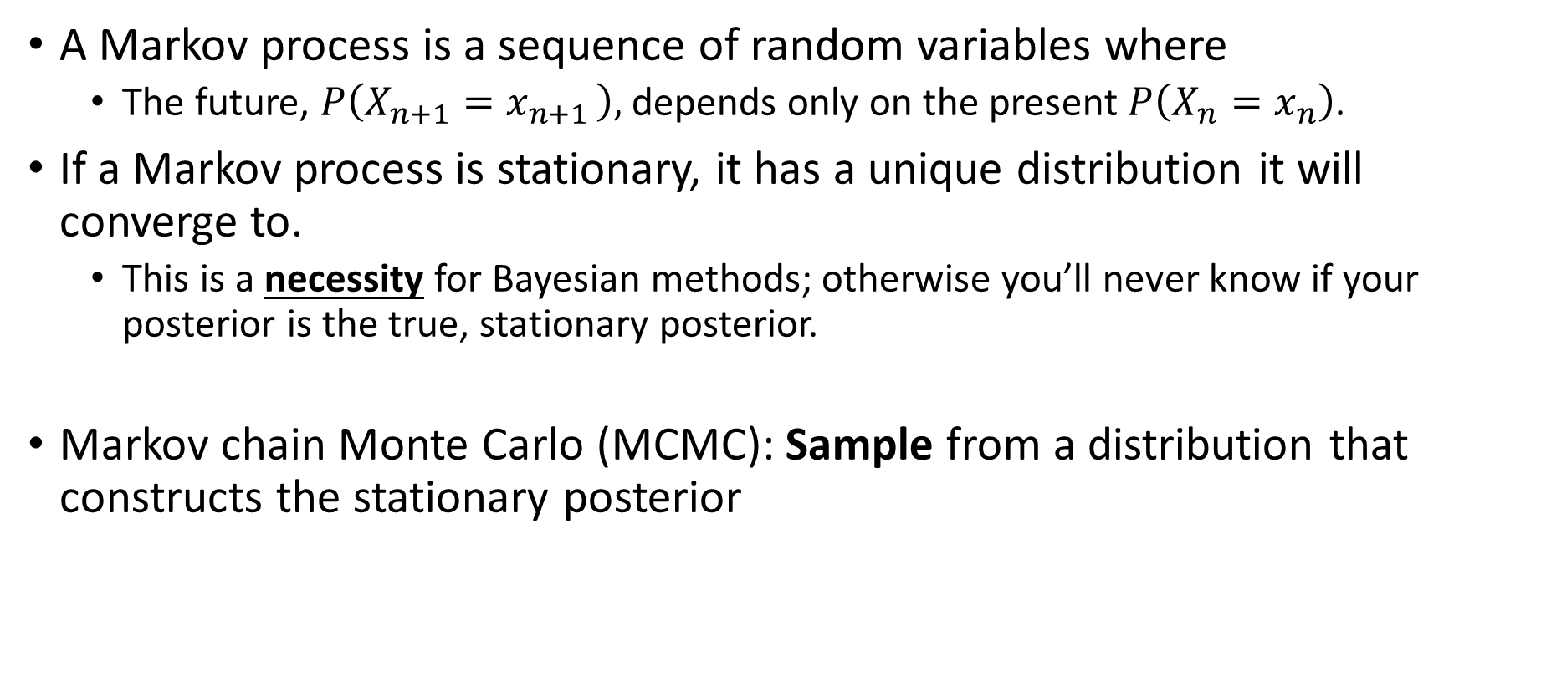
Markov chain Monte Carlo
A Markov process is a sequence of random variables where
The future, $P\left(X_{n+1}=x_{n+1 }\right),$ depends only on the present $P\left(X_{n}=x_{n}\right)$.
If a Markov process is stationary, it has a unique distribution it will converge to.
This is a necessity for Bayesian methods; otherwise you’ll never know if your posterior is the true, stationary posterior.
Markov chain Monte Carlo (MCMC): Sample from a distribution that constructs the stationary posterior

Slide 37

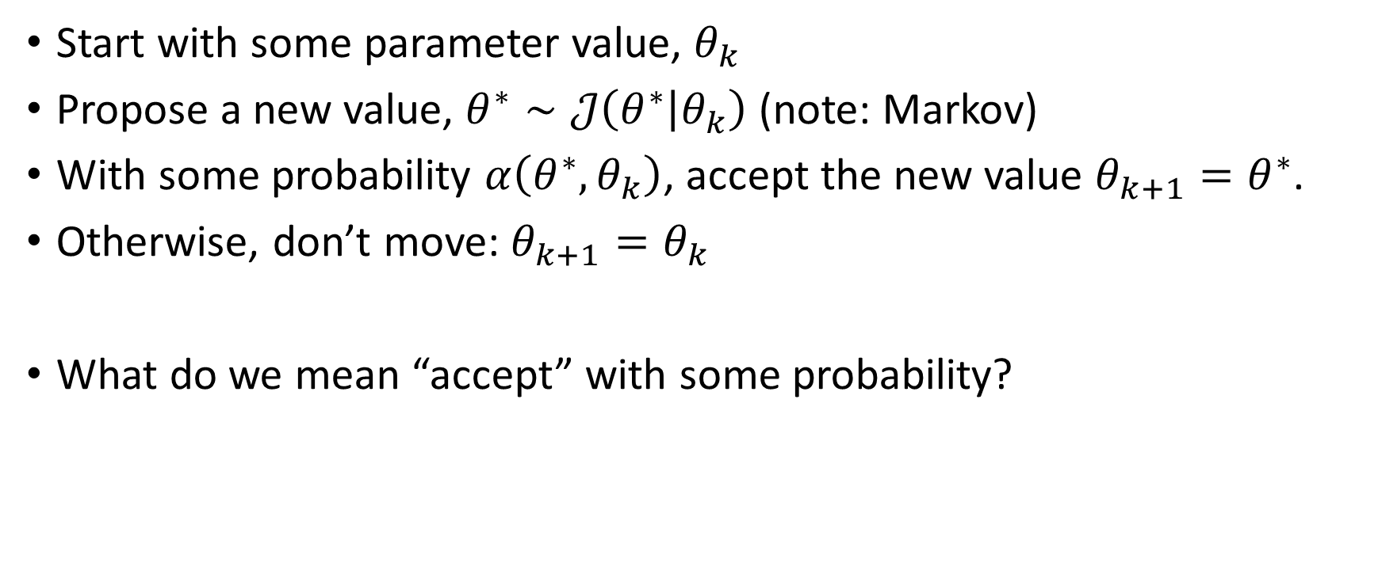
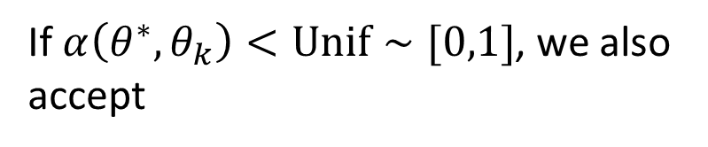
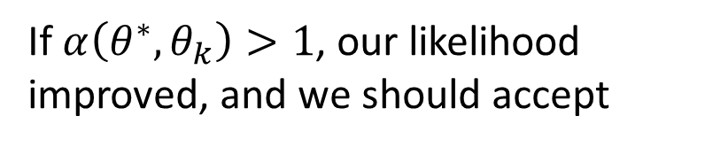
General idea of MCMC
Start with some parameter value, $θ_{k}$
Propose a new value, $θ^{∗}∼𝒥\left(θ^{∗} | θ_{k}\right)$ (note: Markov)
With some probability $α\left(θ^{∗},θ_{k}\right)$, accept the new value $θ_{k+1}=θ^{∗}$.
Otherwise, don’t move: $θ_{k+1}=θ_{k}$
What do we mean “accept” with some probability?
If $α\left(θ^{∗},θ_{k}\right)>1$, our likelihood improved, and we should accept
$$α\left(θ^{∗},θ_{k}\right)=\frac{P\left(y | θ^{∗}\right)P\left(θ^{∗}\right)}{P\left(y | θ_{k}\right)P\left(θ_{k}\right)}$$
If $α\left(θ^{∗},θ_{k}\right)<Unif∼[0,1]$, we also accept

Slide 38
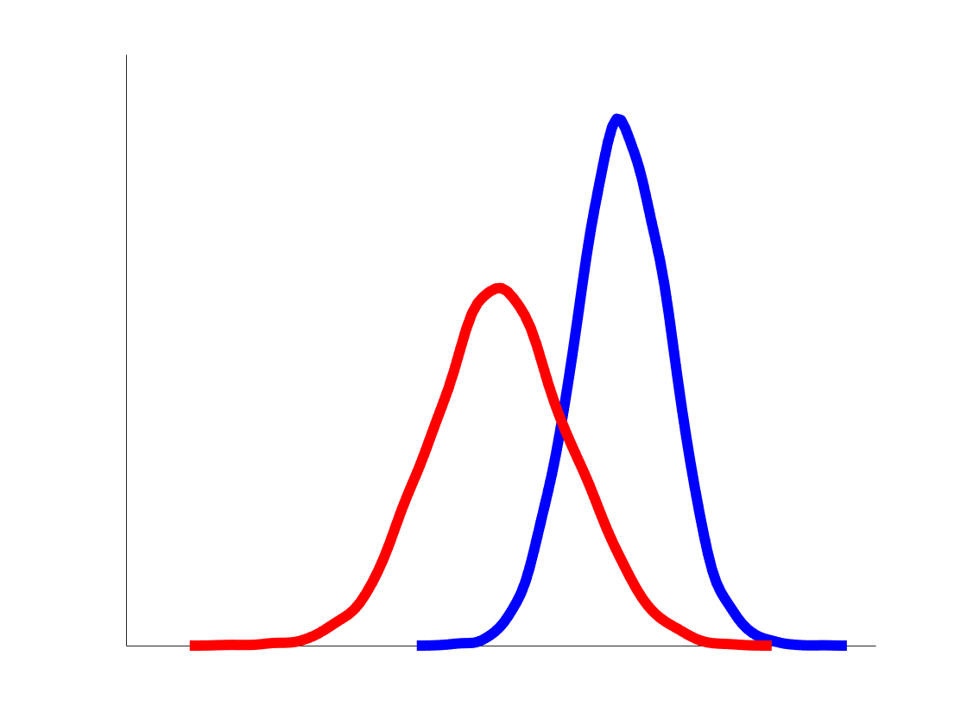
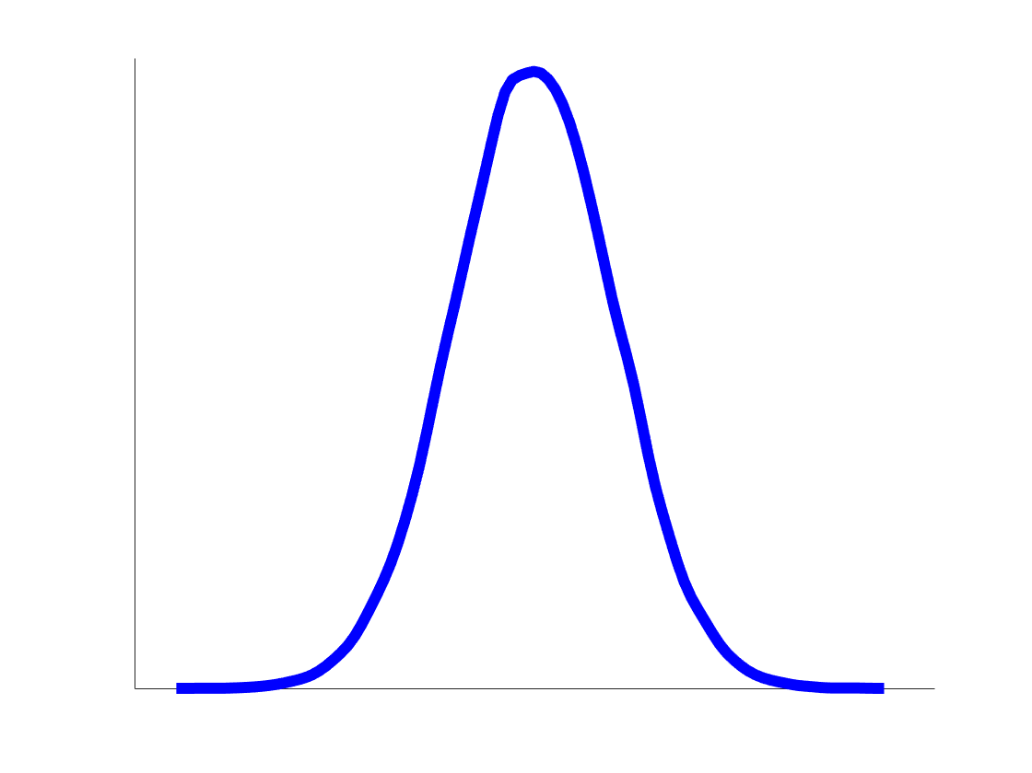
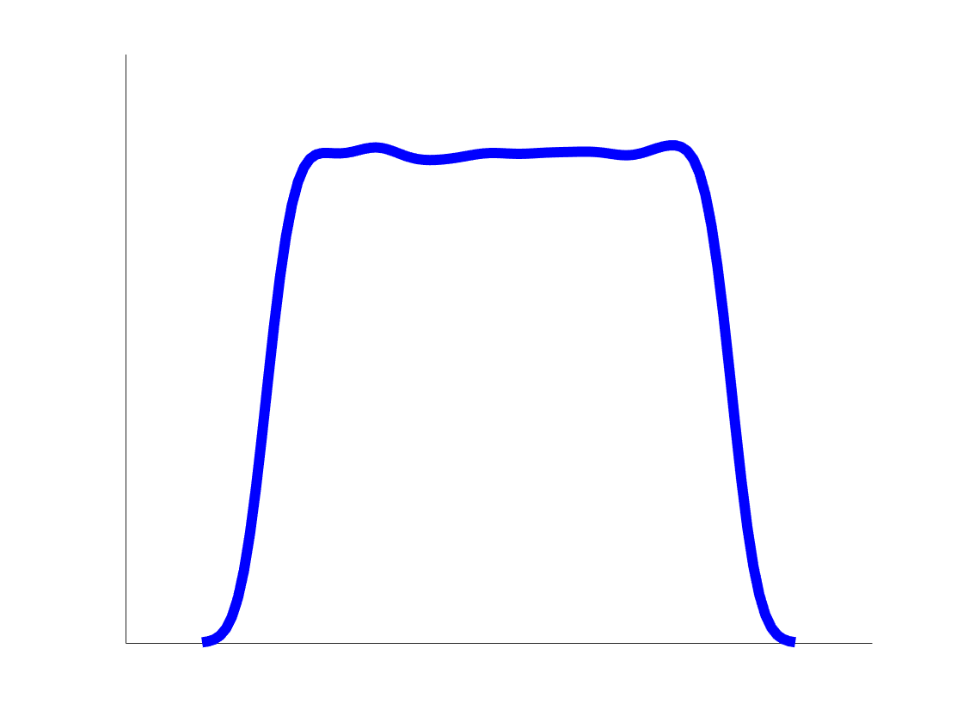





Markov chain Monte Carlo (MCMC)
True posterior of the parameter
$$θ_{2}$$
$$θ_{3}$$
$$θ_{1}$$
$$θ_{2}^{ }$$
$$θ_{0}$$
Iteration
38

Slide 39
The Metropolis-Hastings Algorithm
Any guesses on when this was developed?
Hint: you might’ve saw a movie related to this earlier this month…
1943 – Metropolis led a theoretical physics division at Los Alamos in Robert Oppenheimer’s team
1953 – Algorithm developed

Slide 40
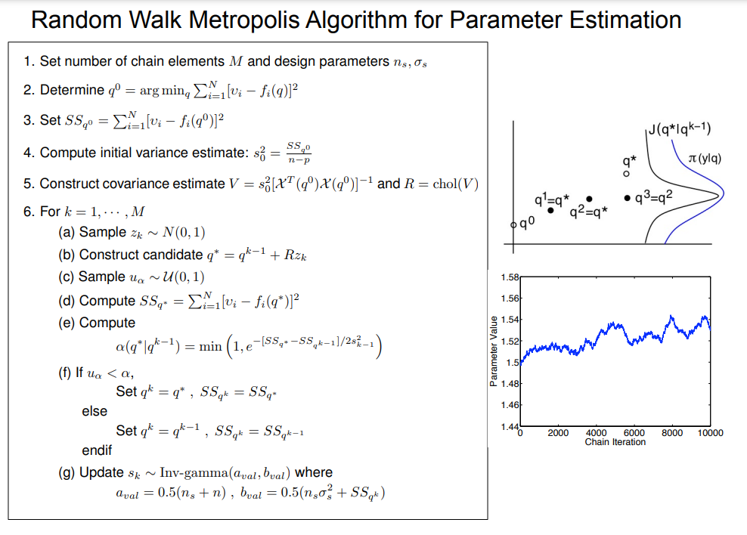
Summary of MH algorithm (from Ralph Smith)

Slide 41
To the MATLAB examples! (Example_XX_Bayesian.m)

Slide 42
Things to investigate
Try running an optimization before running MH.
Change the number of data points in the calibration step (“data_ids”)
Change the noise variance (“noise_var” and “noise_mean”)
Try setting “inputs.update_sig = 1” to estimate the error variance.
Comment out use the adaptive metropolis algorithm “AM_Algorithm”
Try using a Gaussian prior (inputs.prior, inputs.thetamu, inputs.thetasig) and look at the shape of the posterior.

Slide 43
Questions or thoughts?

Slide 44
Things we did not discuss
Frequentist methods are still used everywhere
Think any paper that reports confidence intervals, regression, ANOVA, etc.
Frequentist methods also include bootstrapping methods, non-asymptotic methods, etc.
Bayesian methods are expensive but fruitful
If your model is expensive, you can construct an emulator.
Output uncertainty in Bayesian → sample the posterior
What if our errors are correlated? What if our models are wrong?

Slide 45
Summary of differences from chatGPT
In summary, frequentist statistics focuses on the properties of data and uses long-term relative frequencies to make inferences, while Bayesian statistics incorporates prior beliefs and observed data to update beliefs about parameters and hypotheses. The choice between these approaches often depends on the context, available information, and philosophical preferences of the analyst.

Slide 46
Thanks for attending!

Slide 47
Example – Frequentist (ChatGPT)
Example 1: Drug Efficacy Study
Imagine a pharmaceutical company is testing a new drug for a certain medical condition. They conduct a clinical trial with a sample of 500 patients. The goal is to determine whether the new drug is more effective than the current standard treatment.
In frequentist statistics:
Parameter Estimation: Researchers would estimate the population mean effectiveness of the new drug based on the sample data. They might calculate the sample mean and standard deviation of patient improvements and use them as point estimates for the population mean and standard deviation.
Hypothesis Testing: The null hypothesis might state that the new drug is equally effective as the standard treatment, while the alternative hypothesis could state that the new drug is more effective. Researchers would collect data on patient improvements and calculate a p-value. If the p-value is very small (e.g., less than 0.05), they would reject the null hypothesis and conclude that there's evidence that the new drug is indeed more effective.
Confidence Intervals: Researchers might also provide a confidence interval for the difference in effectiveness between the new drug and the standard treatment. For example, they might say they are 95% confident that the true difference in effectiveness lies between a certain range of values.
Example 2: Genetics Study
Consider a genetic study aiming to understand the heritability of a specific trait, such as height, in a population. Researchers collect data from a large sample of individuals and measure their heights and the heights of their parents.
In frequentist statistics:
Parameter Estimation: Researchers would estimate the heritability of height by calculating the correlation coefficient between the heights of parents and their offspring. This correlation coefficient would serve as an estimate of the population parameter that quantifies the degree of genetic influence on height.
Hypothesis Testing: The null hypothesis might state that there's no significant correlation between parental height and offspring height (i.e., no genetic influence), while the alternative hypothesis could state the opposite. Researchers would compute a p-value based on the correlation coefficient and the sample size. If the p-value is below a certain significance level, they might reject the null hypothesis in favor of the alternative.
Confidence Intervals: Researchers could provide a confidence interval for the correlation coefficient. This interval would express the range of values within which the true population correlation likely falls with a certain level of confidence.
In both examples, frequentist statistics is used to draw conclusions based on the observed data, taking into account the inherent variability in the data and making probabilistic statements about the results.

Slide 48
Example – Bayesian (ChatGPT)
Example 1: Disease Diagnosis
Imagine a medical scenario where a patient undergoes a diagnostic test for a rare disease. The disease is known to occur in only 1% of the population. The test has a reported sensitivity of 95% (correctly identifies positive cases) and a specificity of 90% (correctly identifies negative cases).
In Bayesian statistics:
Prior Beliefs: Before conducting the test, the doctor might have prior beliefs about the patient's likelihood of having the disease. These beliefs could be based on the patient's medical history, symptoms, and risk factors. Let's say the doctor assigns a relatively low prior probability of 0.01 (1%) for the patient having the disease.
Likelihood: Given the test's sensitivity and specificity, a likelihood function can be constructed. If the test is positive, the likelihood of a positive result given that the patient has the disease would be 0.95, and the likelihood of a positive result given that the patient does not have the disease (false positive) would be 0.10.
Posterior Probability: Using Bayes' theorem, the doctor combines the prior beliefs and the likelihood to calculate the posterior probability of the patient having the disease given the positive test result. The posterior probability is updated based on both the prior beliefs and the test result. This updated probability reflects the doctor's new level of confidence about the patient's disease status.
Example 2: Species Distribution Modeling
Consider a study that aims to model the distribution of a certain species of bird across different ecological regions. Researchers collect data on bird sightings in various locations and also gather information about environmental variables such as temperature, vegetation type, and altitude.
In Bayesian statistics:
Prior Distribution: Before analyzing the data, researchers might have prior beliefs about the likely distribution of the bird species based on their knowledge of its habitat preferences. These prior beliefs could be expressed as a probability distribution over different ecological regions.
Likelihood Function: Researchers use the collected data to build a likelihood function that models the probability of observing bird sightings given the environmental variables. This function captures the relationship between the species presence and the environmental conditions.
Posterior Distribution: Bayes' theorem is employed to combine the prior distribution and the likelihood function, resulting in a posterior distribution. This distribution represents the updated beliefs about the species distribution after incorporating both prior knowledge and the observed data.
In both examples, Bayesian statistics involves incorporating prior beliefs or knowledge with observed data to update beliefs and make probabilistic statements about uncertain quantities, such as disease probability or species distribution. This approach provides a way to quantify uncertainty and adjust beliefs as new evidence becomes available.

Slide 49
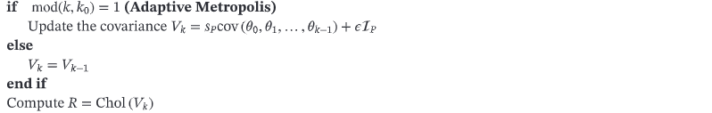
Summary of Adaptive metropolis algorithm (from Ralph Smith + Colebank)

Slide 50
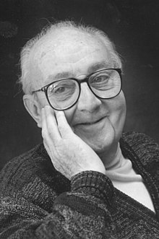
Model Discrepancy
The famous quote we all tend to use…
“All models are wrong, but some are useful.”
Actual quote:
... all models are approximations. Essentially, all models are wrong, but some are useful. However, the approximate nature of the model must always be borne in mind....
How wrong are they?
Are useful are they?
George Box - Statistician
https://en.wikipedia.org/wiki/All_models_are_wrong

Slide 51
Model discrepancy
We typically assume:
$$y^{data}=y\left(t;θ\right)+ε, ε∼𝒩\left(0,σ^{2}\right)$$
In words: our model is perfect, and our inability to fit the model is because the measurements are imperfect
What does $ε∼𝒩\left(0,σ^{2}\right)$ mean?
My measurement errors all have the same uncertainty and are independent/not correlated.

Slide 52
Model discrepancy
What do we actually want to write?
Our model is wrong AND the errors are correlated (e.g., time series/multiple compartments
$$y^{data}=y\left(t;θ\right)+δ\left(t\right)+ε, δ∼GP\left(m\left(t\right),k\left(x,x′\right)\right), ε∼𝒩\left(0,V\right)$$
My model is wrong, so there is model discrepancy.
My measurement errors are correlated.

Slide 53
A toy problem
I
$$γI$$
R
$$βSI$$
S
$$vS$$
V

Slide 54
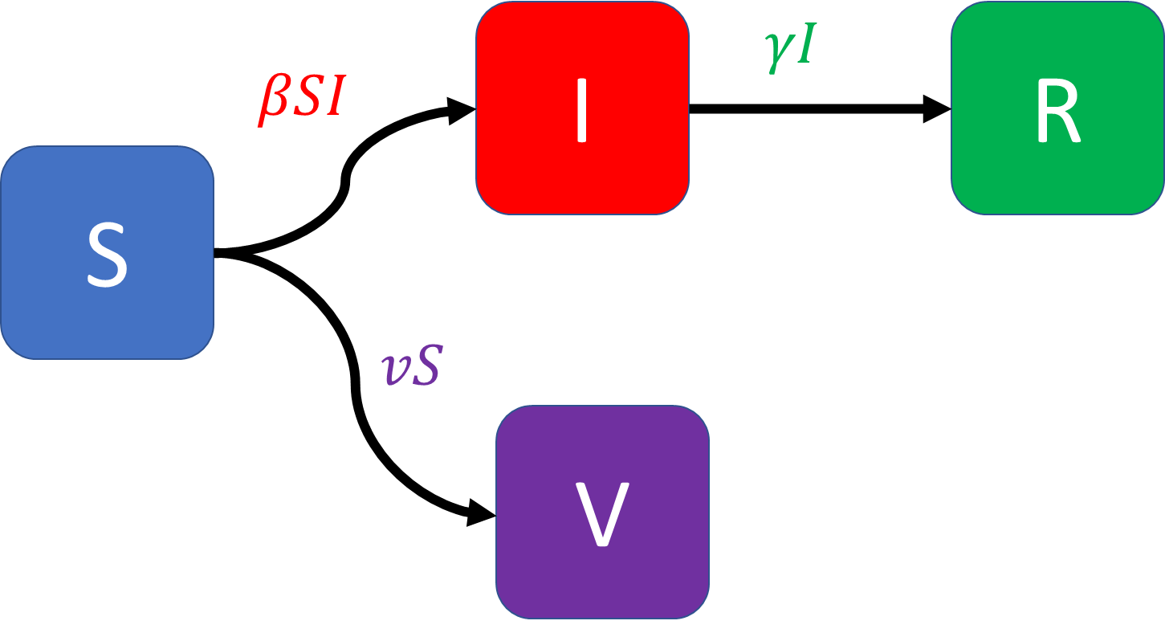
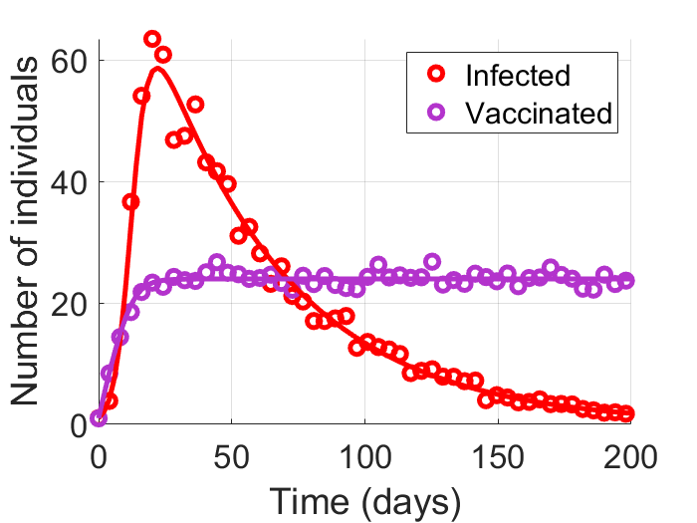
A Toy Problem – Correlated Noise

Slide 55
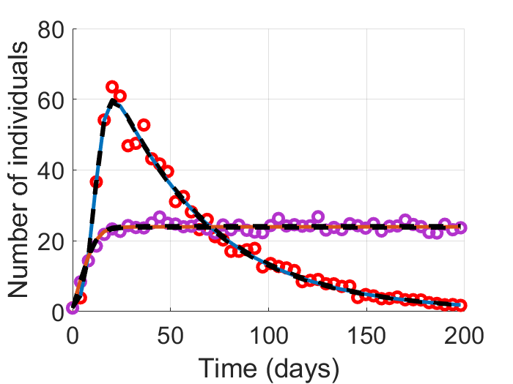
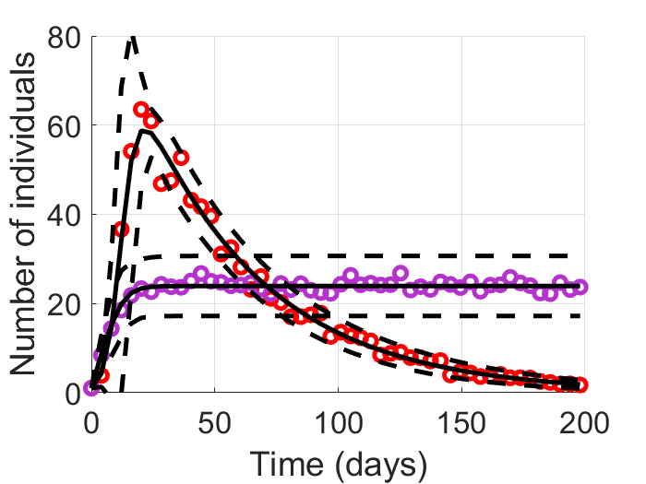
A Toy Problem – Correlated Noise
Correlated errors
Wrong statistical Model
Correct uncertainty estimate

