Slide 1
An introduction to statistical inverse problems and model calibration
Mitchel J. Colebank
8/16/2023

Slide 2
Goals
See a few examples of biological, mechanistic models
Work through the basics of model calibration
Discuss frequentist and Bayesian model calibration
Get hands on experience with parameter confidence/credible intervals, OLS, and Markov chain Monte Carlo (MCMC)

Slide 3
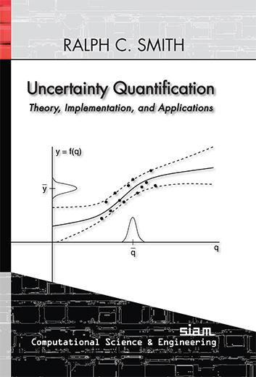
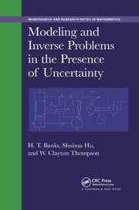
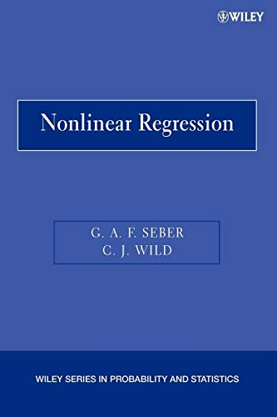
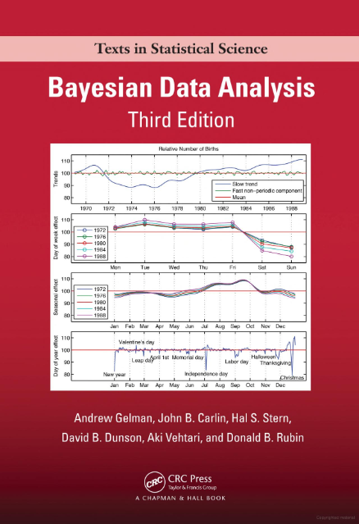
Reference Texts

Slide 4
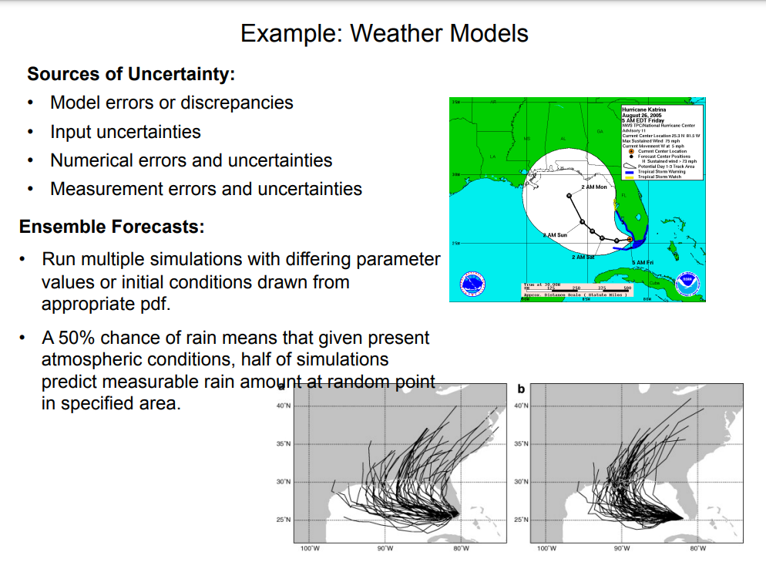
An example from Ralph Smith

Slide 5
What is a forward problem?
Generally, we solve a forward problem by:
Providing a mathematical model
Providing parameters describing the system
Providing parameter bounds
And observe
Model output
Uncertainty in model output within bounds

Slide 6
What is an inverse problem?
Generally, we solve an inverse problem by:
Providing a mathematical model
Providing some measured (or simulated) data from the true system
Providing a statistical model
And determine
Model parameters that best explain the data
Uncertainty in model parameters based on the data

Slide 7
Forward versus Inverse Problems
Forward
problem
Known
Unknown
Biophysical parameters:
Arterial stiffness
Receptor firing rates
Cytokine production rate
Mathematical model:
Fluid dynamics
Systems biology
Solid mechanics
Data/output:
Heart rate
Blood pressure
ECG signals
Inverse
problem
Unknown
Known

Slide 8
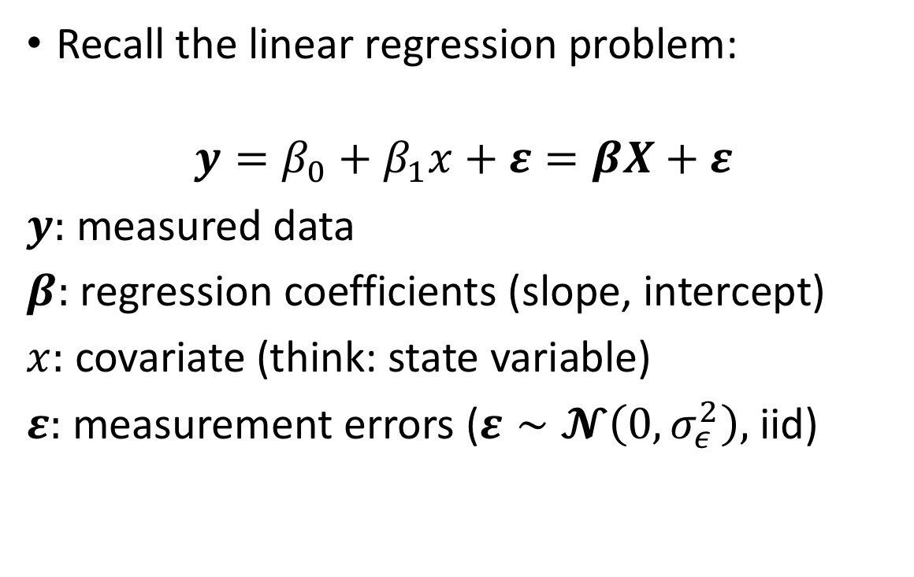
Regression
Recall the linear regression problem:
$$y=β_{0}+β_{1}x+ε=βX+ε$$
$y:$ measured data
$β:$ regression coefficients (slope, intercept)
$x:$ covariate (think: state variable)
$ε:$ measurement errors ($ε∼𝓝\left(0,σ_{ε}^{2}\right),$ iid)

Slide 9
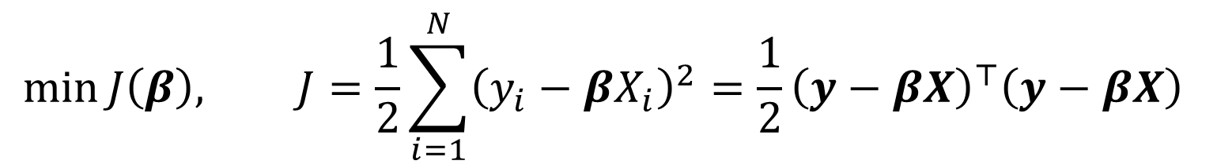
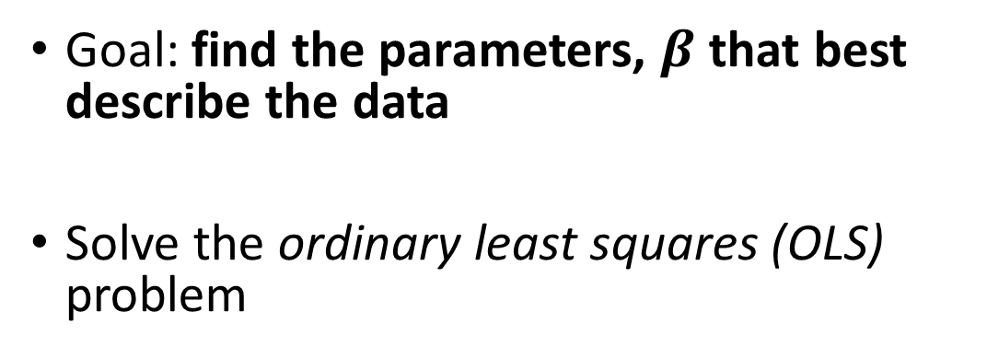
Regression
Goal: find the parameters, $β$ that best describe the data
Solve the ordinary least squares (OLS) problem
$$\min{J\left(β\right), J=\frac{1}{2}\sum_{i=1}^{N}{{\left(y_{i}−βX_{i}\right)}^{2}}=\frac{1}{2}{{\left(y−βX\right)}^{⊤}\left(y−βX\right)}^{ }}$$

Slide 10
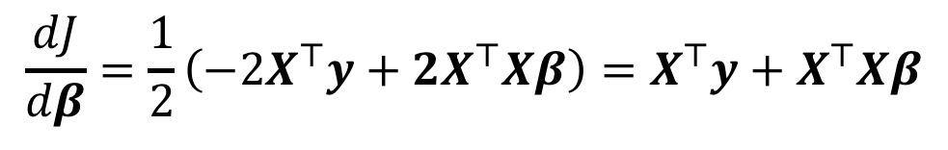
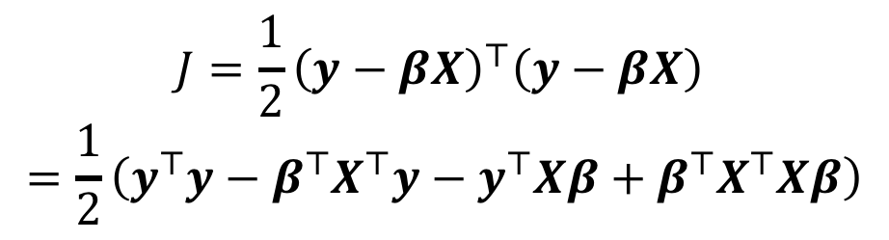
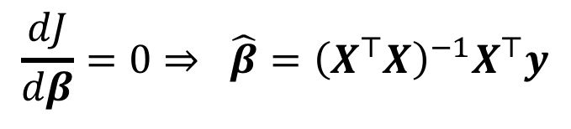
Regression
Calculus: minimum occurs where the derivative is zero
$$J=\frac{1}{2}{{\left(y−βX\right)}^{⊤}\left(y−βX\right)}^{ }$$
$$=\frac{1}{2}\left(y^{⊤}y−β^{⊤}X^{⊤}y−y^{⊤}Xβ+β^{⊤}X^{⊤}Xβ\right)$$
$$\frac{dJ}{dβ}=\frac{1}{2}\left(−2X^{⊤}y+2X^{⊤}Xβ\right)=X^{⊤}y+X^{⊤}Xβ$$
$$\frac{dJ}{dβ}=0⇒ \hat{β}={\left(X^{⊤}X\right)}^{−1}X^{⊤}y$$

Slide 11
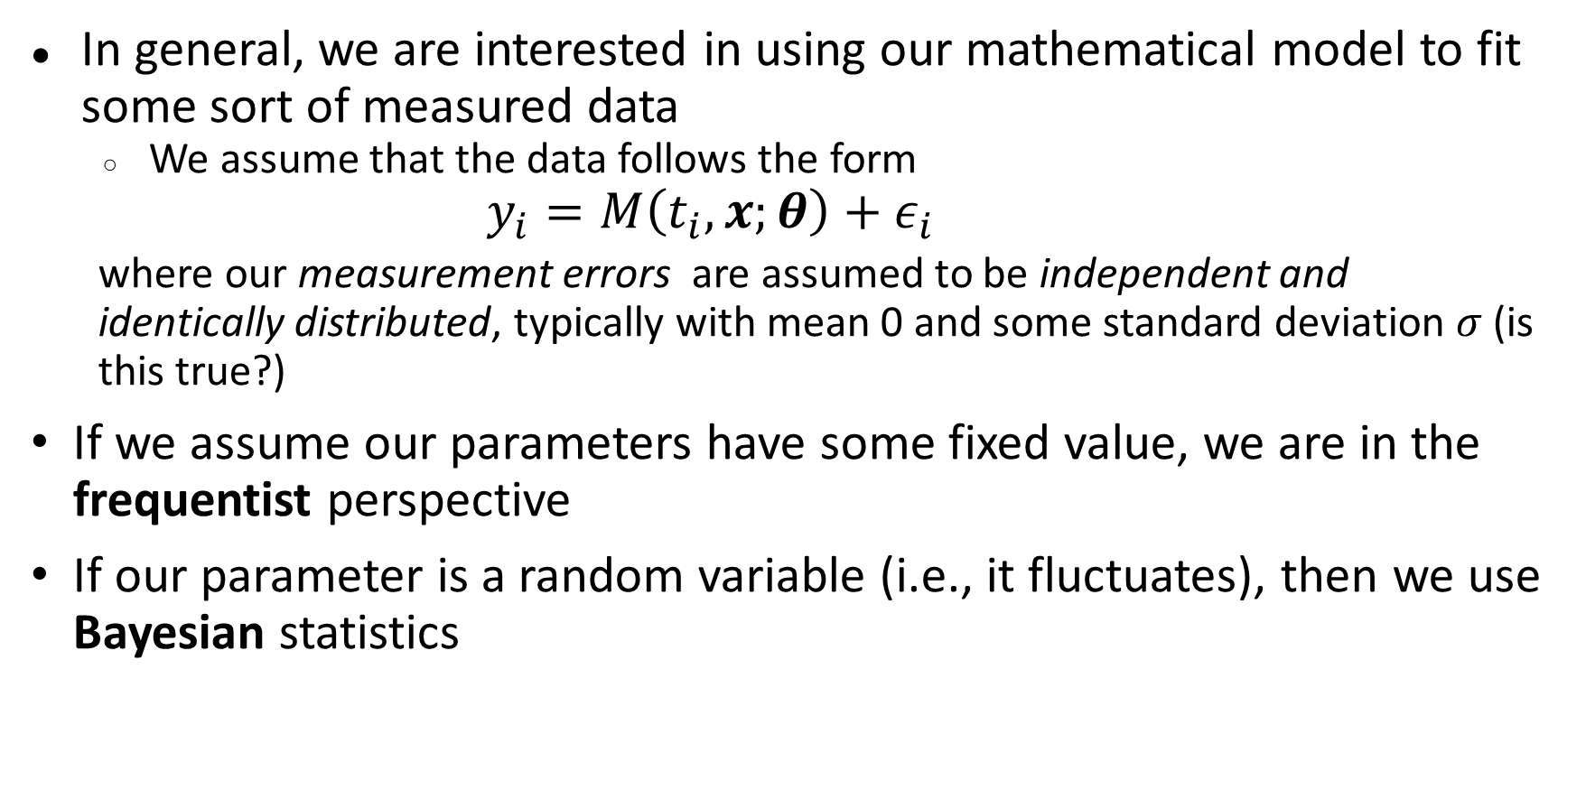
Parameter Inference
In general, we are interested in using our mathematical model to fit some sort of measured data
We assume that the data follows the form
$$y_{i}=M\left(t_{i},x;θ\right)+ε_{i}$$
where our measurement errors are assumed to be independent and identically distributed, typically with mean 0 and some standard deviation $σ$ (is this true?)
If we assume our parameters have some fixed value, we are in the frequentist perspective
If our parameter is a random variable (i.e., it fluctuates), then we use Bayesian statistics

Slide 12
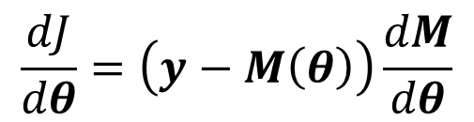
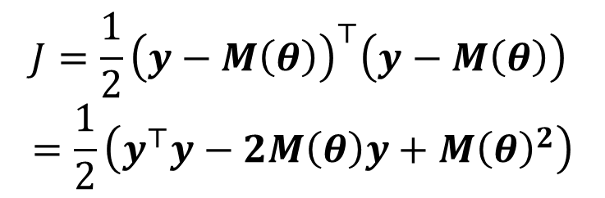

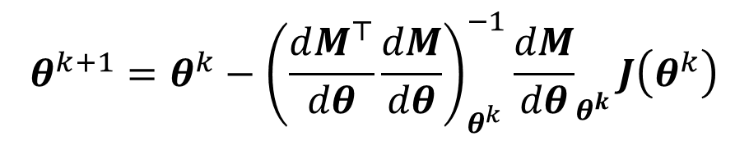
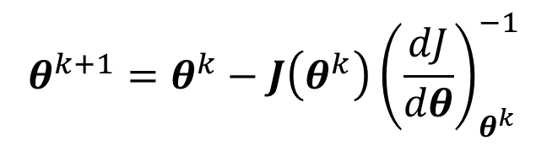
Nonlinear Regression
Calculus: minimum occurs where the derivative is zero
J
$$J=\frac{1}{2}{{\left(y−M\left(θ\right)\right)}^{⊤}\left(y−M\left(θ\right)\right)}^{ }$$
$$=\frac{1}{2}\left(y^{⊤}y−2M\left(θ\right)y+M{\left(θ\right)}^{2}\right)$$
$$θ_{i}$$
Newton’s method
$$θ^{k+1}=θ^{k}−J\left(θ^{k}\right){\left(\frac{dJ}{dθ}\right)}_{θ^{k}}^{−1}$$
$$\frac{dJ}{dθ}=\left(y−M\left(θ\right)\right)\frac{dM}{dθ}$$
Gauss-Newton
$$θ^{k+1}=θ^{k}−{\left(\frac{dM^{⊤}}{dθ}\frac{dM}{dθ}\right)}_{θ^{k}}^{−1}{\frac{dM}{dθ}}_{θ^{k}}J\left(θ^{k}\right)$$

Slide 13
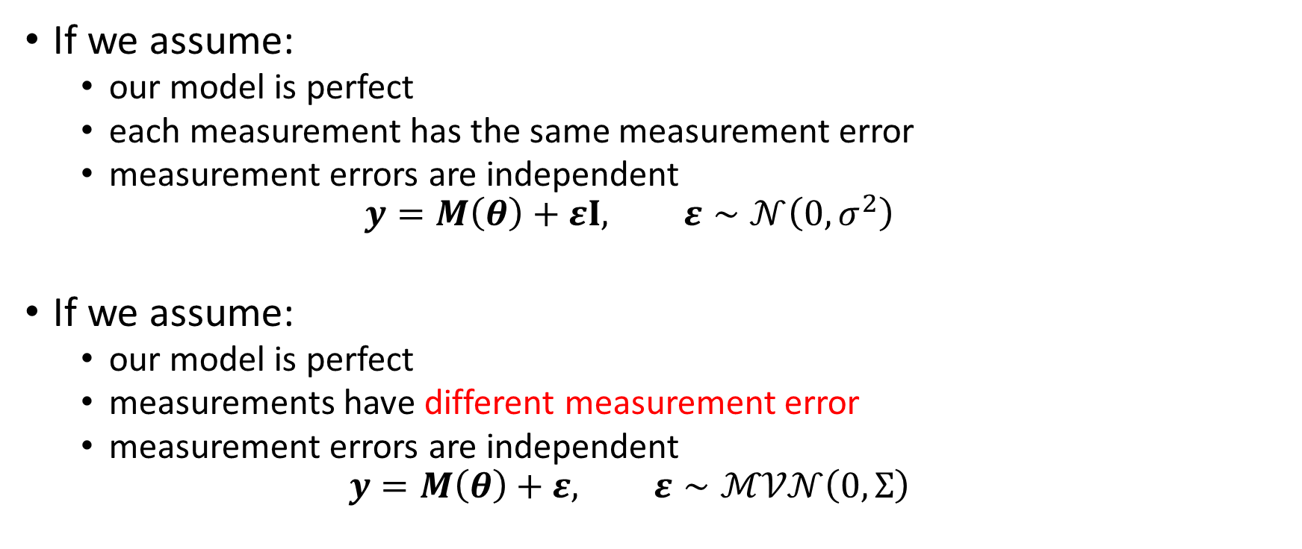
Parameter Inference
If we assume:
our model is perfect
each measurement has the same measurement error
measurement errors are independent
$$y=M\left(θ\right)+εI, ε∼𝒩\left(0,σ^{2}\right)$$
If we assume:
our model is perfect
measurements have different measurement error
measurement errors are independent
$$y=M\left(θ\right)+ε, ε∼ℳ𝒱𝒩\left(0,Σ\right)$$

Slide 14
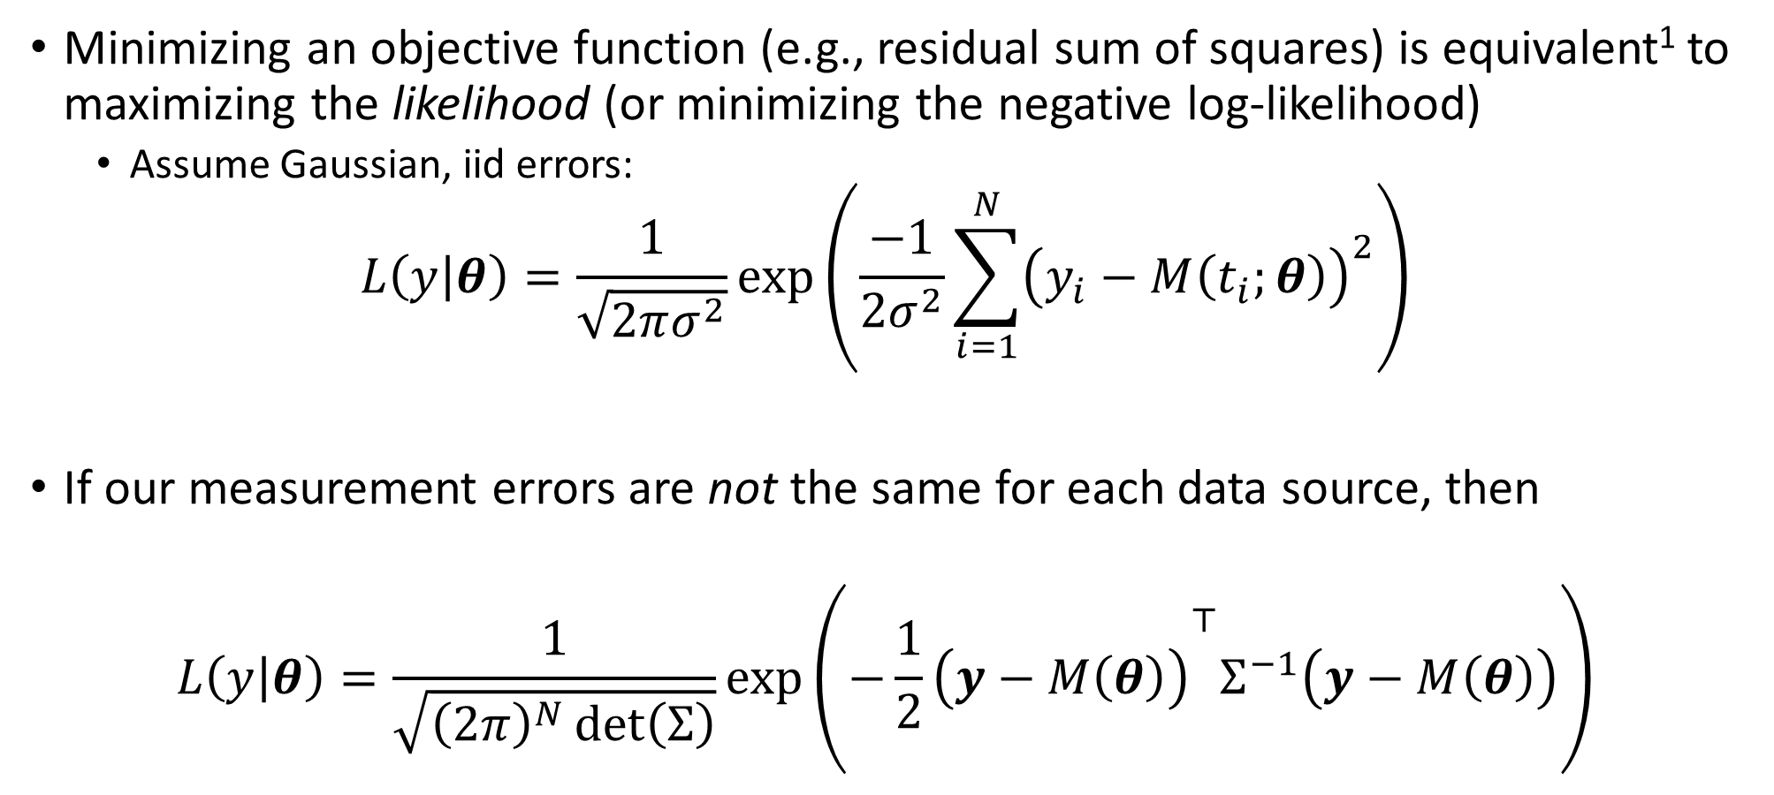
Parameter Inference
Minimizing an objective function (e.g., residual sum of squares) is equivalent¹ to maximizing the likelihood (or minimizing the negative log-likelihood)
Assume Gaussian, iid errors:
$$L\left(y | θ\right)=\frac{1}{\sqrt{2πσ^{2}}}\exp\left(\frac{−1}{{2σ}^{2}}\sum_{i=1}^{N}{{\left(y_{i}−M\left(t_{i};θ\right)\right)}^{2}}\right)$$
If our measurement errors are not the same for each data source, then
$$L\left(y | θ\right)=\frac{1}{\sqrt{{\left(2π\right)}^{N}\det\left(Σ\right)}}\exp\left({−\frac{1}{2}\left(y−M\left(θ\right)\right)}^{⊤}Σ^{−1}\left(y−M\left(θ\right)\right)\right)$$

Slide 15
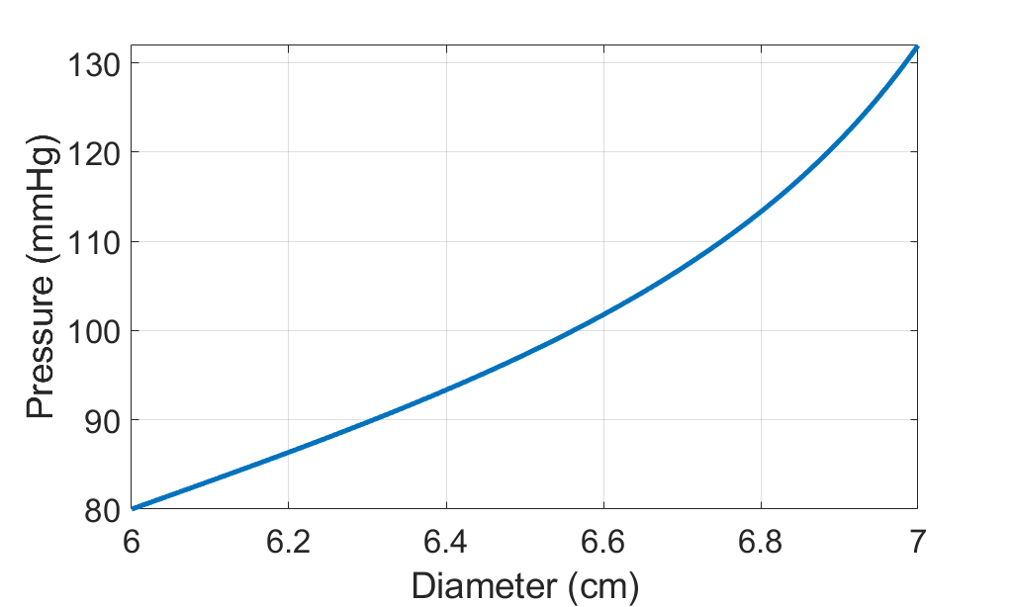

Example Models
Algebraic Model – Pressure-diameter
$$P\left(D\right)=β\tan\left(\frac{π}{γ}\left(\frac{D}{D_{ref}}−1\right)\right)+P_{0}$$

Slide 16
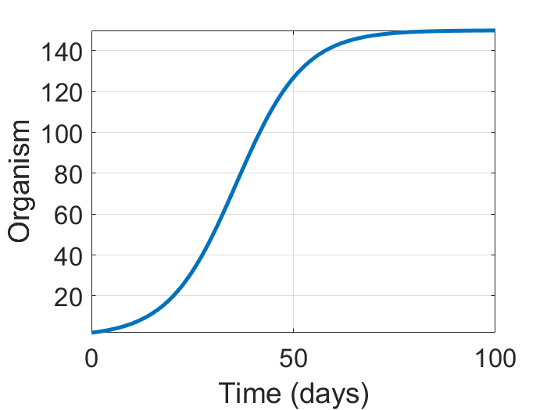

Example Models
Single ODE model – Logistic Growth
$$\frac{dx}{dt}=rx\left(1−\frac{x}{K}\right)$$

Slide 17
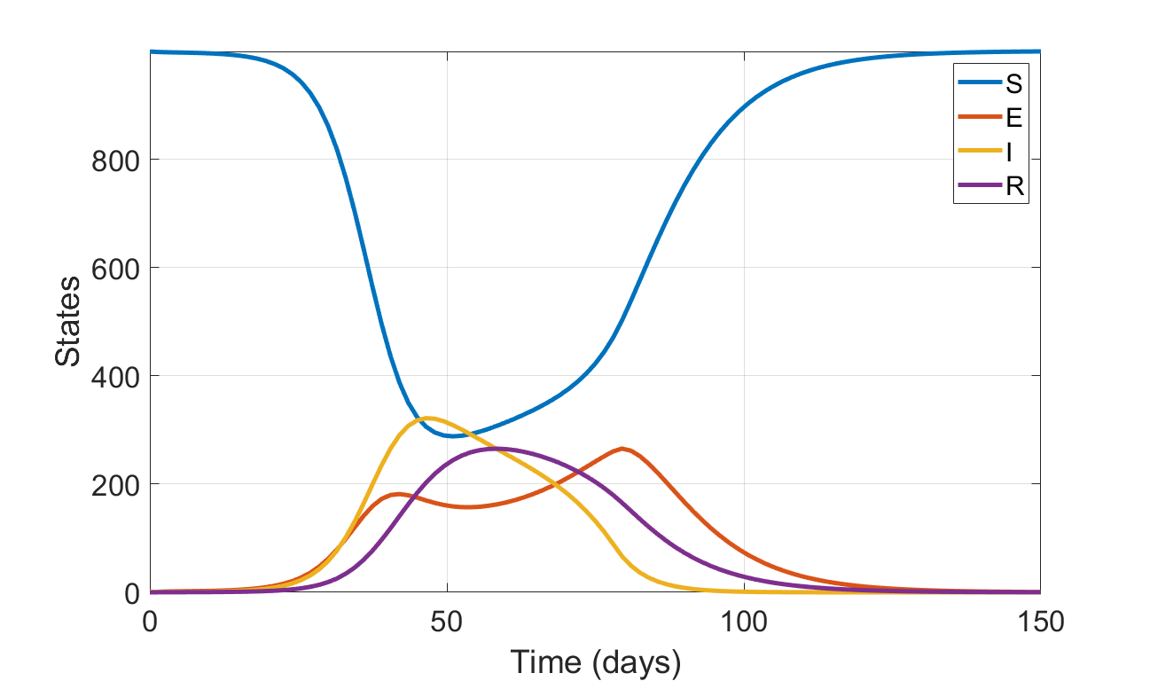













Example Models
S
E
$$δ\left(t\right)E$$
I
$$γI$$
R
$$βSI$$
$$μN$$
$$μS$$
$$μE$$
$$μI$$
$$μR$$
System of ODEs – Epidemic Model
$$\frac{dS}{dt}=μN−\frac{βSI}{N}−μS$$
$$\frac{dE}{dt}=\frac{βSI}{N}−δ\left(t\right)E −μE$$
$$\frac{dI}{dt}=δ\left(t\right)E −γI −μI$$
This is where we will assume we have data
$$\frac{dR}{dt}=γI −μR$$
$δ\left(t\right)≡$periodic or impulse parameter

Slide 18
Frequentist Statistics
Also called “classical” statistics
Assumes that parameters are fixed and unknown.
We place uncertainty in our estimates on the measurements.
If you’ve calculated confidence intervals, regression coefficients, etc., you’ve being using these statistics.

Slide 19

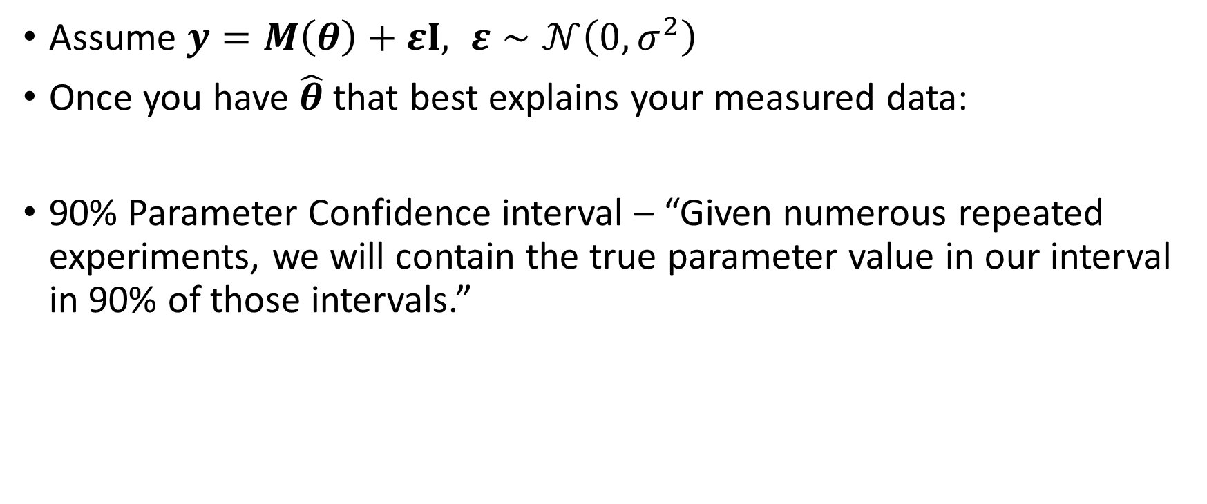

Frequentist Statistics
Assume $y=M\left(θ\right)+εI, ε∼𝒩\left(0,σ^{2}\right)$
Once you have $\hat{θ}$ that best explains your measured data:
90% Parameter Confidence interval – “Given numerous repeated experiments, we will contain the true parameter value in our interval in 90% of those intervals.”
$$CI$$
$$θ^{∗}$$
Experiments

Slide 20
Frequentist Confidence Intervals
From TowardsDataScience.com
Confidence Interval
The frequentist confidence interval has the following long-run frequency idea: random samples from the same target population and with the same sample size would yield CIs that contain the true (unknown) estimate in a frequency (percentage) set by the confidence level. In practice, it’s quite complicated to have several random samples drawn from the same population; rather, we gather data from a single sample of the population of interest and calculate the CI for that sample. The interpretation of this particular CI would be: we can be XX% (90%, 95%, 99%) confident that the true (unknown) estimate would lie within the lower and upper limits of the CI, based on hypothesized repeats of the experiment.
Having said that, an XX% confidence level does not mean that for a given realized interval there is an XX% probability that the population parameter lies within the interval!
https://towardsdatascience.com/statistics-101-credible-vs-confidence-interval-af7b7e8fdd79

Slide 21

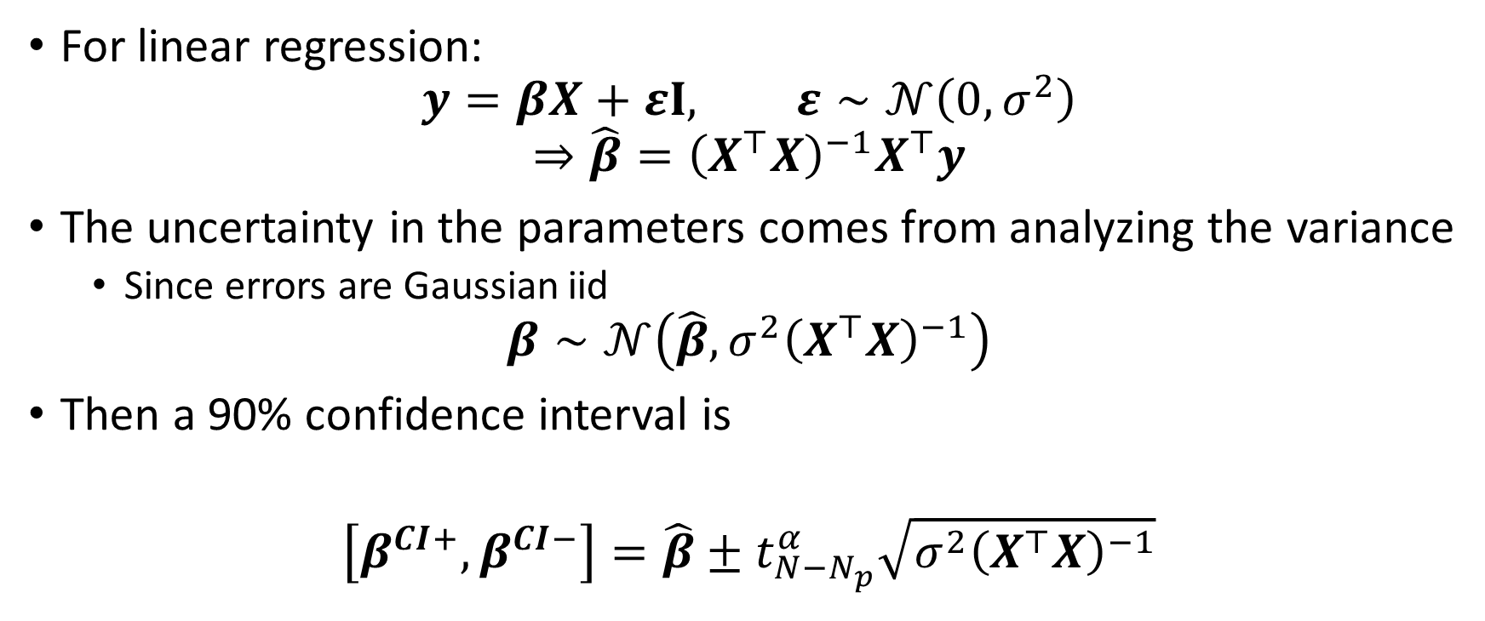

Frequentist Statistics
$$CI$$
$$θ^{∗}$$
For linear regression:
$$y=βX+εI, ε∼𝒩\left(0,σ^{2}\right)$$
$$⇒\hat{β}={\left(X^{⊤}X\right)}^{−1}X^{⊤}y$$
The uncertainty in the parameters comes from analyzing the variance
Since errors are Gaussian iid
$$β∼𝒩\left(\hat{β},σ^{2}{\left(X^{⊤}X\right)}^{−1}\right)$$
Then a 90% confidence interval is
$$\left[β^{CI+},β^{CI−}\right]=\hat{β}±t_{N−N_{p}}^{α}\sqrt{σ^{2}{\left(X^{⊤}X\right)}^{−1}}$$
Experiments

Slide 22
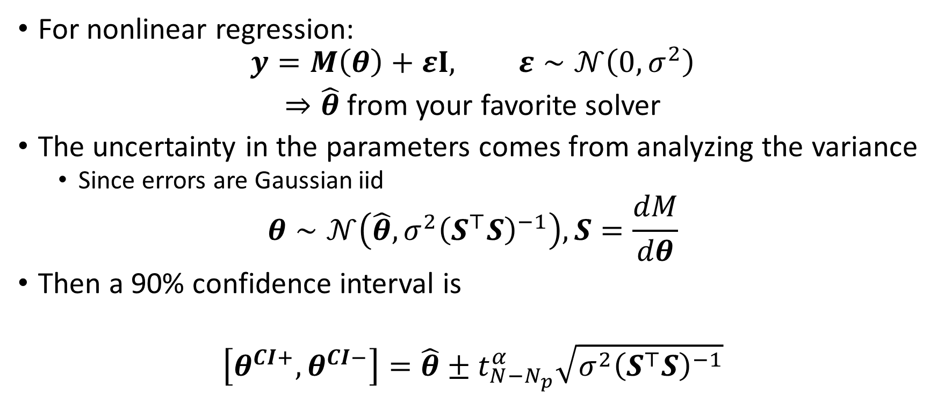
Frequentist Statistics
$$CI$$
$$θ^{∗}$$
For nonlinear regression:
$$y=M\left(θ\right)+εI, ε∼𝒩\left(0,σ^{2}\right)$$
$⇒\hat{θ}$ from your favorite solver
The uncertainty in the parameters comes from analyzing the variance
Since errors are Gaussian iid
$$θ∼𝒩\left(\hat{θ},σ^{2}{\left(S^{⊤}S\right)}^{−1}\right), S=\frac{dM}{dθ}$$
Then a 90% confidence interval is
$$\left[θ^{CI+},θ^{CI−}\right]=\hat{θ}±t_{N−N_{p}}^{α}\sqrt{σ^{2}{\left(S^{⊤}S\right)}^{−1}}$$
Experiments

Slide 23
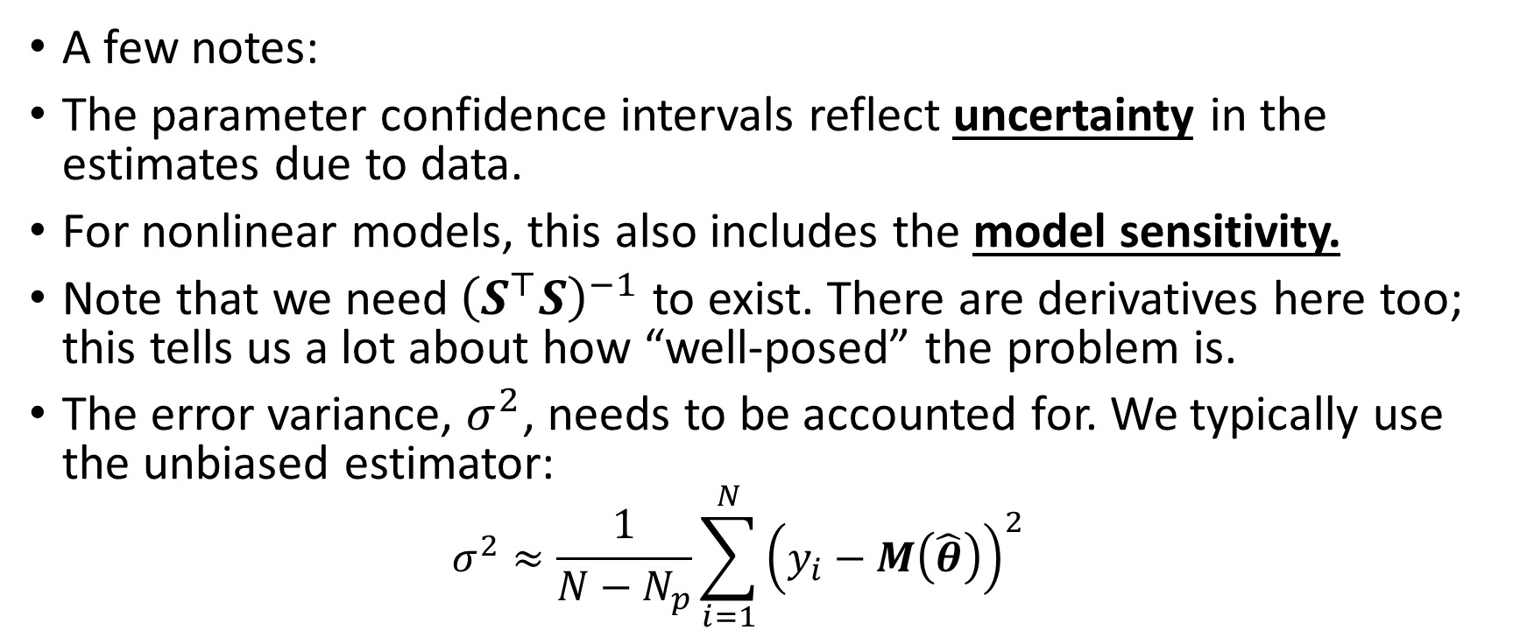
Frequentist Statistics
A few notes:
The parameter confidence intervals reflect uncertainty in the estimates due to data.
For nonlinear models, this also includes the model sensitivity.
Note that we need${\left(S^{⊤}S\right)}^{−1}$ to exist. There are derivatives here too; this tells us a lot about how “well-posed” the problem is.
The error variance, $σ^{2}$, needs to be accounted for. We typically use the unbiased estimator:
$$σ^{2}≈\frac{1}{N−N_{p}}\sum_{i=1}^{N}{{\left(y_{i}−M\left(\hat{θ}\right)\right)}^{2}}$$

Slide 24
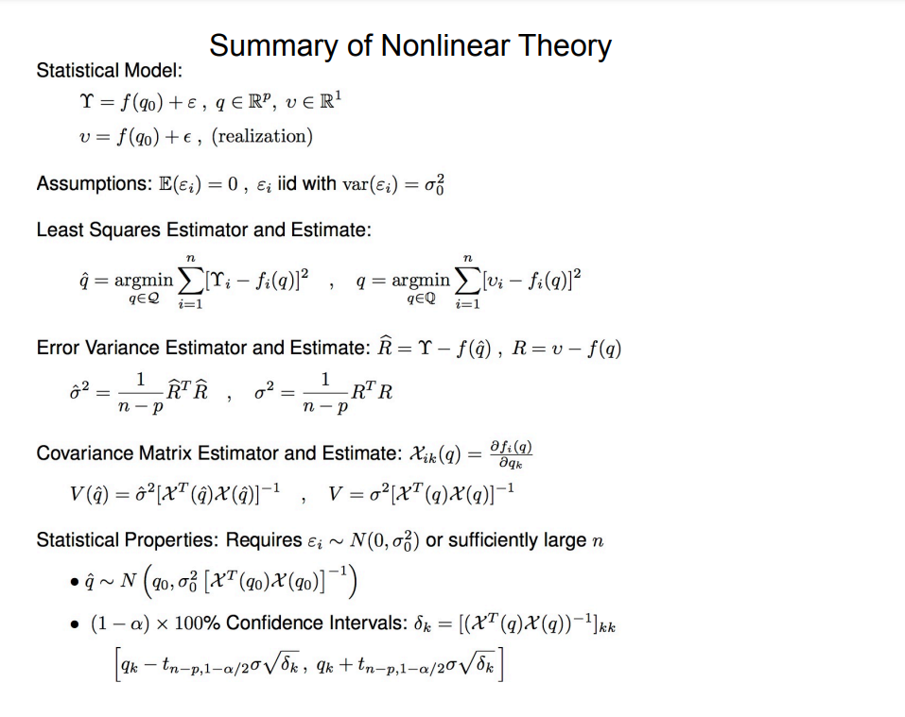
Summary of Frequentist Statistics (from Ralph Smith)

Slide 25
To the MATLAB examples!

Slide 26
Questions or thoughts?

Slide 27
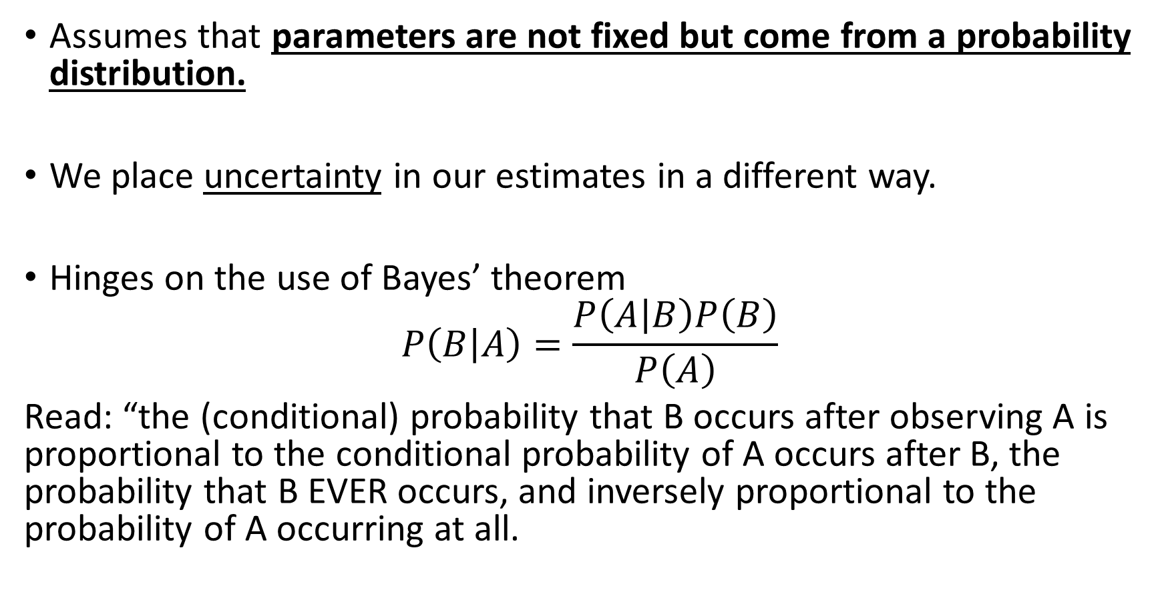
Bayesian Statistics
Assumes that parameters are not fixed but come from a probability distribution.
We place uncertainty in our estimates in a different way.
Hinges on the use of Bayes’ theorem
$$P\left(B | A\right)=\frac{P\left(A | B\right)P\left(B\right)}{P\left(A\right)}$$
Read: “the (conditional) probability that B occurs after observing A is proportional to the conditional probability of A occurs after B, the probability that B EVER occurs, and inversely proportional to the probability of A occurring at all.

Slide 28
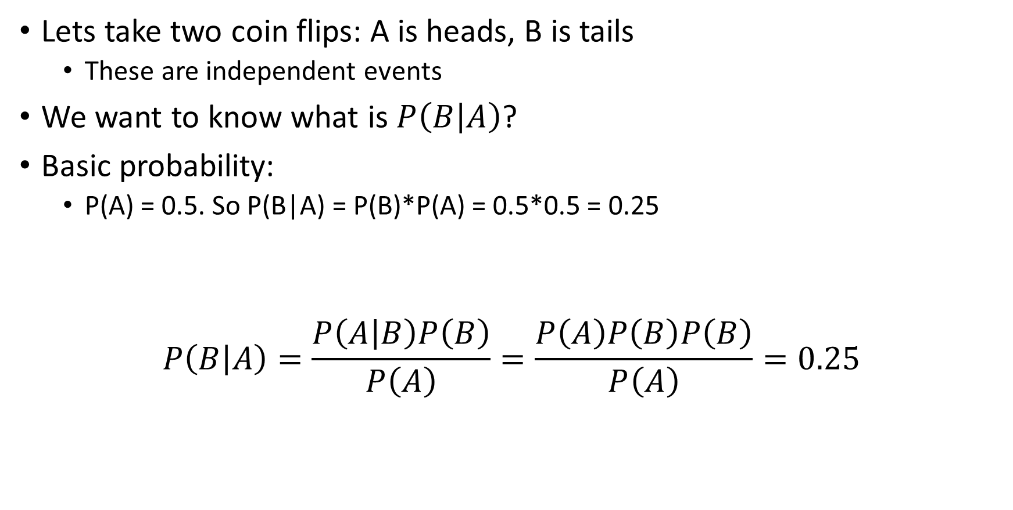
Bayesian Statistics
Lets take two coin flips: A is heads, B is tails
These are independent events
We want to know what is $P\left(B | A\right)$?
Basic probability:
P(A) = 0.5. So P(B|A) = P(B)*P(A) = 0.5*0.5 = 0.25
$$P\left(B | A\right)=\frac{P\left(A | B\right)P\left(B\right)}{P\left(A\right)}=\frac{P\left(A\right)P\left(B\right)P\left(B\right)}{P\left(A\right)}=0.25$$

Slide 29
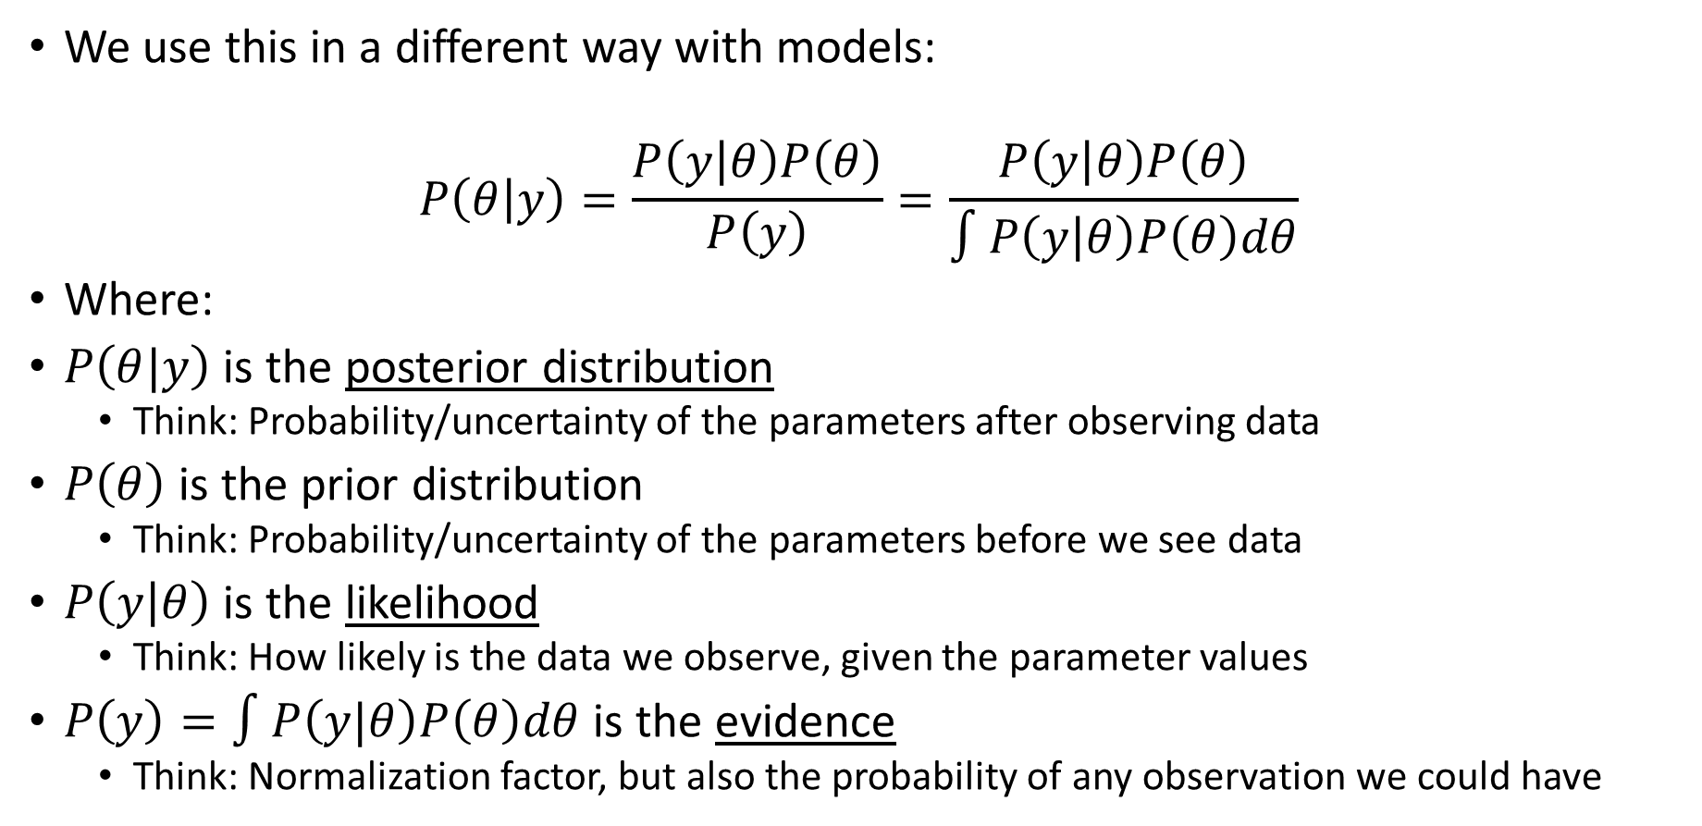
Bayesian Statistics
We use this in a different way with models:
$$P\left(θ | y\right)=\frac{P\left(y | θ\right)P\left(θ\right)}{P\left(y\right)}=\frac{P\left(y | θ\right)P\left(θ\right)}{∫P\left(y | θ\right)P\left(θ\right)dθ}$$
Where:
$P\left(θ|y\right)$ is the posterior distribution
Think: Probability/uncertainty of the parameters after observing data
$P\left(θ\right)$ is the prior distribution
Think: Probability/uncertainty of the parameters before we see data
$P\left(y | θ\right)$ is the likelihood
Think: How likely is the data we observe, given the parameter values
$P\left(y\right)=∫P\left(y|θ\right)P\left(θ\right)dθ$ is the evidence
Think: Normalization factor, but also the probability of any observation we could have

Slide 30
Bayesian Statistics
What are the benefits of Bayesian statistics?
A 90% parameter “credible” interval is intuitive: the parameter has 90% probability of taking on values in the interval.
Parameters are allowed to fluctuate; this makes sense in a lot of biological applications.
Uncertainty is provided for free!
Issue: computation time (which is why we use it more now)

Slide 31
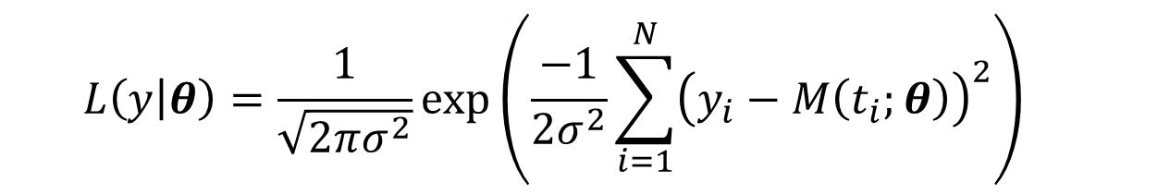
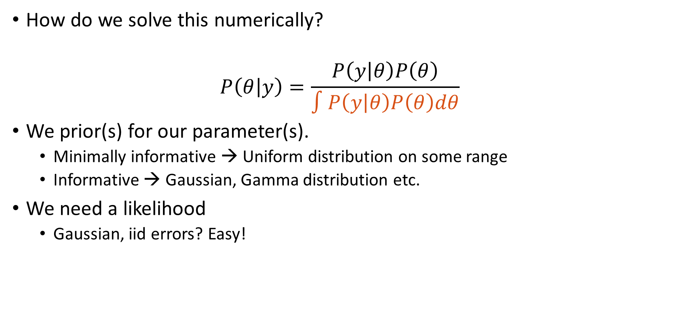
Bayesian Statistics
How do we solve this numerically?
$$P\left(θ | y\right)=\frac{P\left(y | θ\right)P\left(θ\right)}{∫P\left(y | θ\right)P\left(θ\right)dθ}$$
We prior(s) for our parameter(s).
Minimally informative → Uniform distribution on some range
Informative → Gaussian, Gamma distribution etc.
We need a likelihood
Gaussian, iid errors? Easy!
$$L\left(y | θ\right)=\frac{1}{\sqrt{2πσ^{2}}}\exp\left(\frac{−1}{{2σ}^{2}}\sum_{i=1}^{N}{{\left(y_{i}−M\left(t_{i};θ\right)\right)}^{2}}\right)$$

Slide 32
Bayesian Statistics
Methods for solving
Quadrature (e.g., approximate the integral)
Expensive
Monte Carlo sampling
Can be somewhat useful; requires numerous solutions.
Markov chain Monte Carlo
Still sampling, but with better efficiency and convergence
Laplace Approximation
Variation Inference
Approximate Bayesian Computation

Slide 33
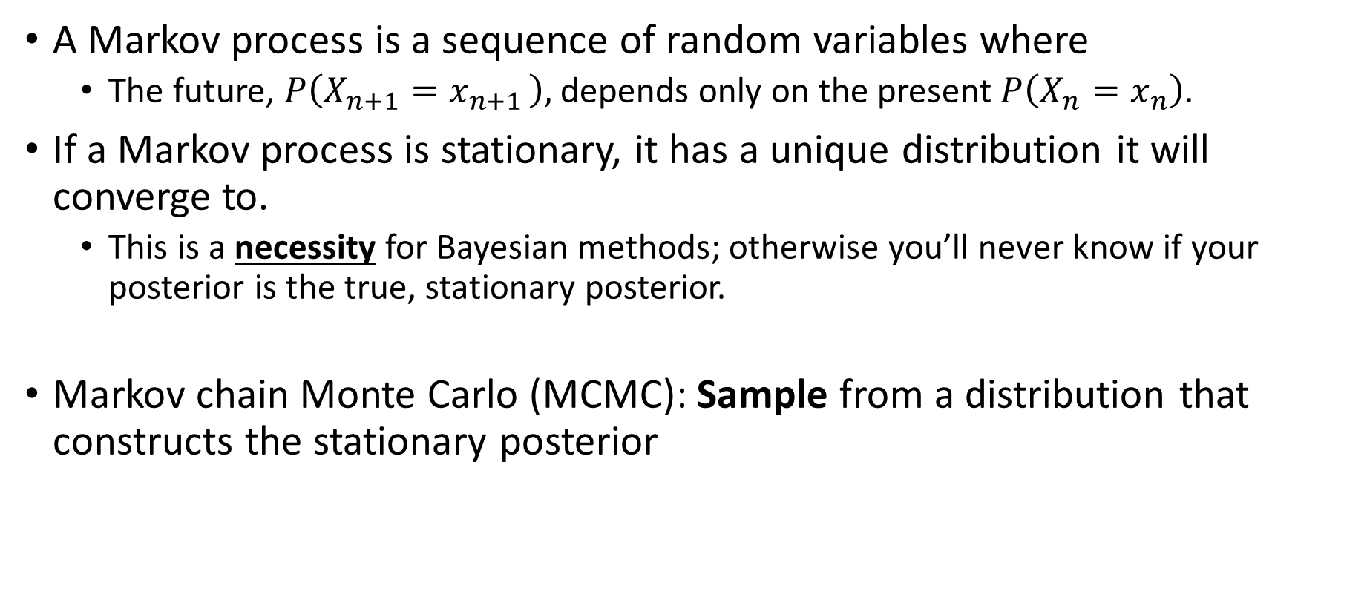
Markov chain Monte Carlo
A Markov process is a sequence of random variables where
The future, $P\left(X_{n+1}=x_{n+1 }\right),$ depends only on the present $P\left(X_{n}=x_{n}\right)$.
If a Markov process is stationary, it has a unique distribution it will converge to.
This is a necessity for Bayesian methods; otherwise you’ll never know if your posterior is the true, stationary posterior.
Markov chain Monte Carlo (MCMC): Sample from a distribution that constructs the stationary posterior

Slide 34

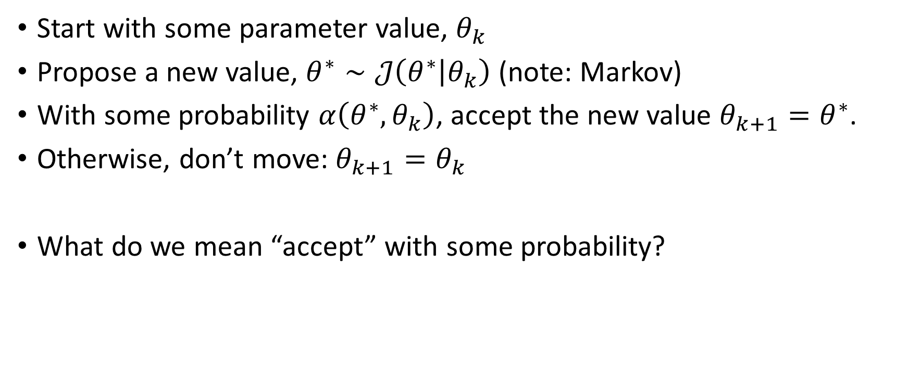
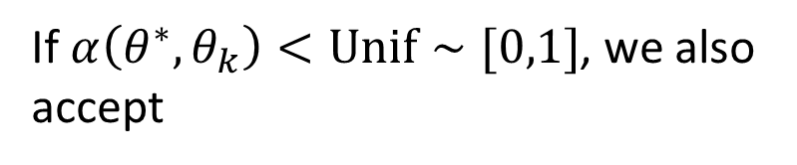
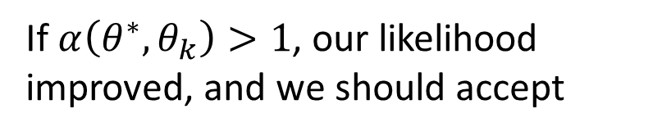
General idea of MCMC
Start with some parameter value, $θ_{k}$
Propose a new value, $θ^{∗}∼𝒥\left(θ^{∗} | θ_{k}\right)$ (note: Markov)
With some probability $α\left(θ^{∗},θ_{k}\right)$, accept the new value $θ_{k+1}=θ^{∗}$.
Otherwise, don’t move: $θ_{k+1}=θ_{k}$
What do we mean “accept” with some probability?
If $α\left(θ^{∗},θ_{k}\right)>1$, our likelihood improved, and we should accept
$$α\left(θ^{∗},θ_{k}\right)=\frac{P\left(y | θ^{∗}\right)P\left(θ^{∗}\right)}{P\left(y | θ_{k}\right)P\left(θ_{k}\right)}$$
If $α\left(θ^{∗},θ_{k}\right)<Unif∼[0,1]$, we also accept

Slide 35
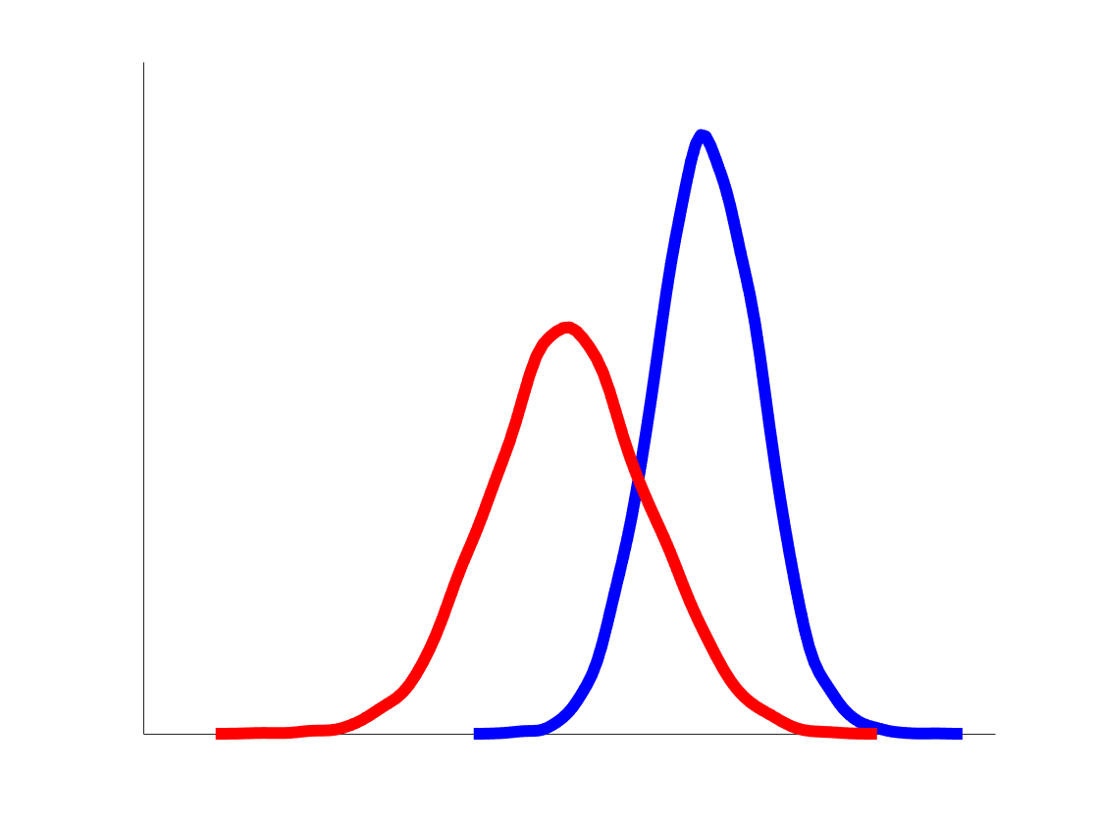
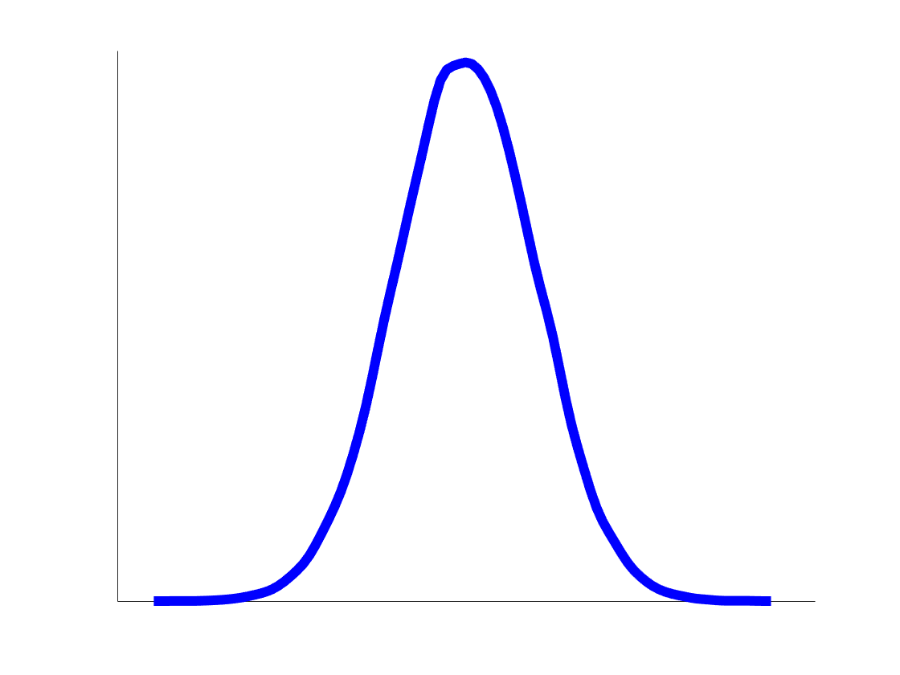
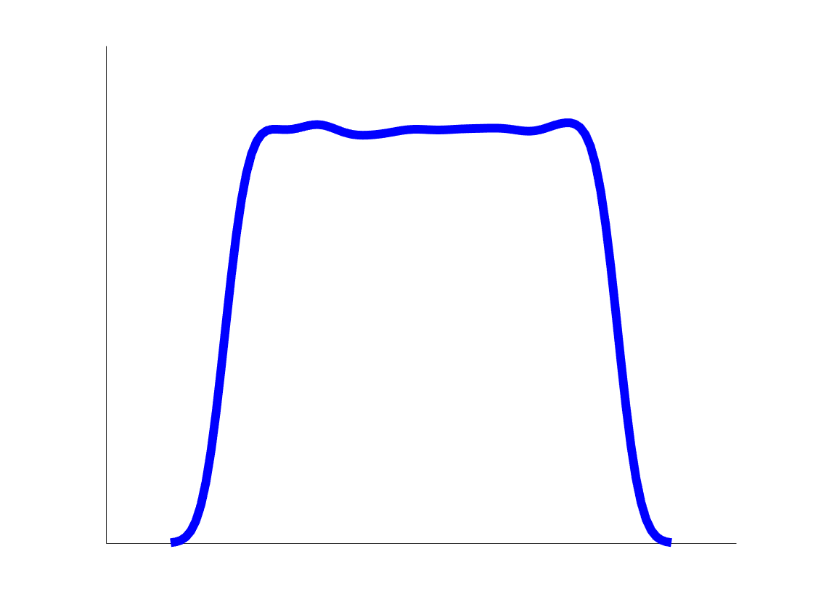





Markov chain Monte Carlo (MCMC)
True posterior of the parameter
$$θ_{2}$$
$$θ_{3}$$
$$θ_{1}$$
$$θ_{2}^{ }$$
$$θ_{0}$$
Iteration
35

Slide 36
The Metropolis-Hastings Algorithm
Any guesses on when this was developed?
Hint: you might’ve saw a movie related to this earlier this month…
1943 – Metropolis led a theoretical physics division at Los Alamos in Robert Oppenheimer’s team
1953 – Algorithm developed

Slide 37
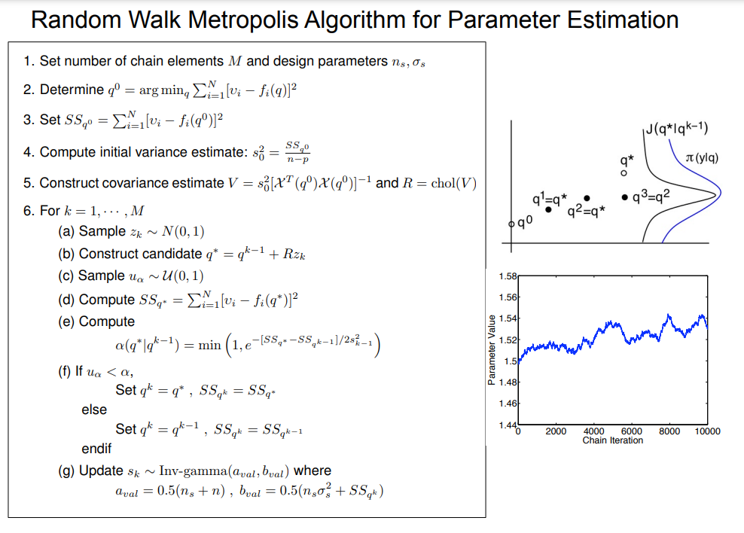
Summary of MH algorithm (from Ralph Smith)
Not in our version, but easily adaptable!

Slide 38
To the MATLAB examples!

Slide 39
Questions or thoughts?

Slide 40
Things we did not discuss
Frequentist methods are still used everywhere
Think any paper that reports confidence intervals, regression, ANOVA, etc.
Frequentist methods also include bootstrapping methods, non-asymptotic methods, etc.
Bayesian methods are expensive but fruitful
If your model is expensive, you can construct an emulator.
Output uncertainty in Bayesian → sample the posterior
What if our errors are correlated? What if our models are wrong?

Slide 41
Thanks for attending!

Slide 42
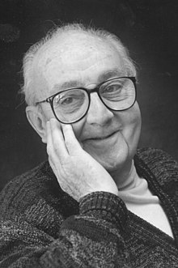
Model Discrepancy
The famous quote we all tend to use…
“All models are wrong, but some are useful.”
Actual quote:
... all models are approximations. Essentially, all models are wrong, but some are useful. However, the approximate nature of the model must always be borne in mind....
How wrong are they?
Are useful are they?
George Box - Statistician
https://en.wikipedia.org/wiki/All_models_are_wrong

Slide 43
Model discrepancy
We typically assume:
$$y^{data}=y\left(t;θ\right)+ε, ε∼𝒩\left(0,σ^{2}\right)$$
In words: our model is perfect, and our inability to fit the model is because the measurements are imperfect
What does $ε∼𝒩\left(0,σ^{2}\right)$ mean?
My measurement errors all have the same uncertainty and are independent/not correlated.

Slide 44
Model discrepancy
What do we actually want to write?
Our model is wrong AND the errors are correlated (e.g., time series/multiple compartments
$$y^{data}=y\left(t;θ\right)+δ\left(t\right)+ε, δ∼GP\left(m\left(t\right),k\left(x,x′\right)\right), ε∼𝒩\left(0,V\right)$$
My model is wrong, so there is model discrepancy.
My measurement errors are correlated.

Slide 45
A toy problem
I
$$γI$$
R
$$βSI$$
S
$$vS$$
V

Slide 46
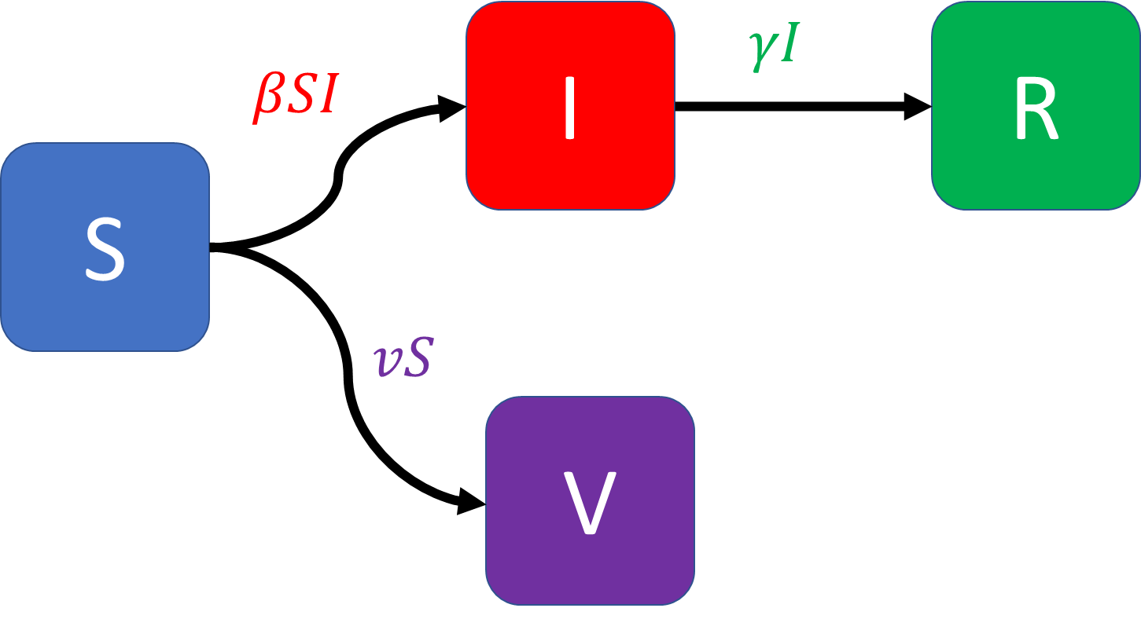
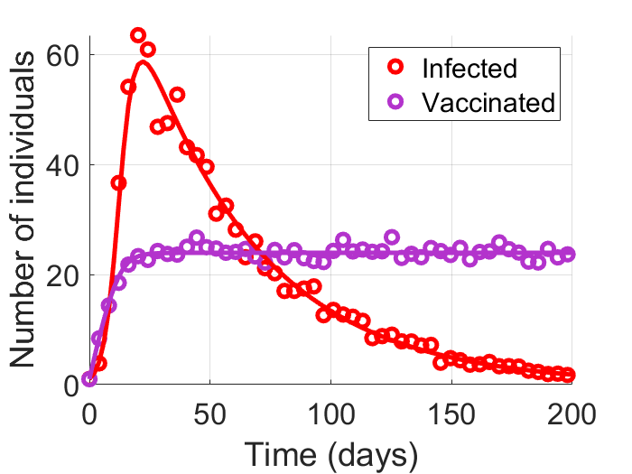
A Toy Problem – Correlated Noise

Slide 47
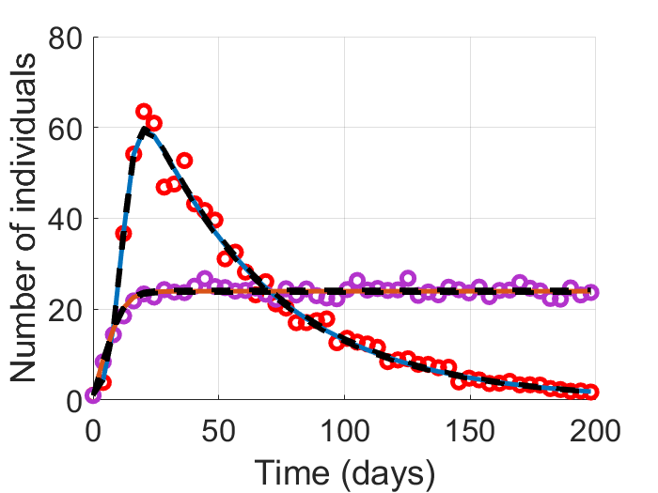
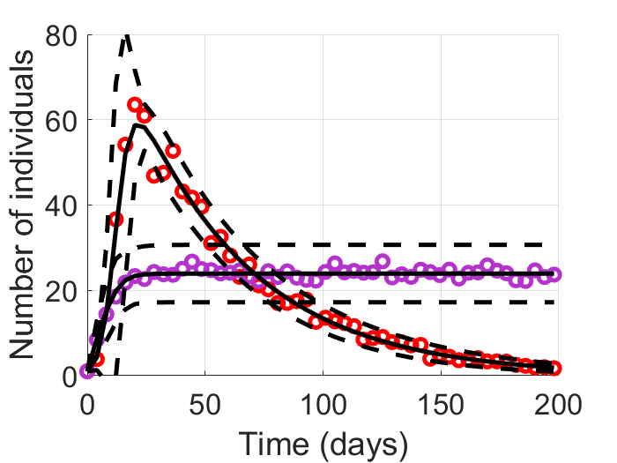
A Toy Problem – Correlated Noise
Correlated errors
Wrong statistical Model
Correct uncertainty estimate

