Slide 1
Collisions & Game State
CS4040 · Unit 3: 2D Game Development

Slide 2
Collisions

Slide 3
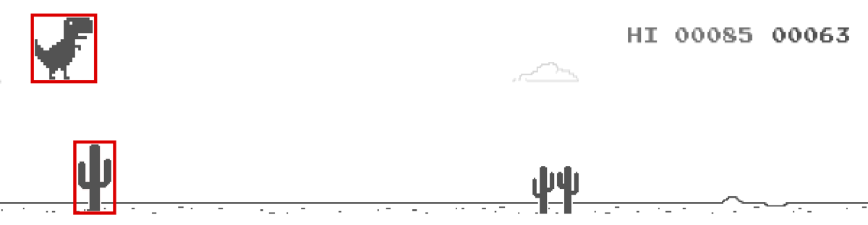
Hitbox
Per Wikipedia, “A hitbox is an invisible shape commonly used in video games for real-time collision detection. It is often a rectangle or cuboid that is attached to and follows a visible object, though circular or spheroidal shapes are also common.”
In Pygame, we have a rectangular hitbox around an Actor’s image.

Slide 4
Detecting Collisions
colliderect(): method called on one Actor to detect if there’s a collision with another Actor.
Returns True if there’s a collision, False otherwise.
Also works between Actors and Rectangles.
unicorn = Actor("unicorn")
monster = Actor("monster")
if unicorn.colliderect(monster):
# game over

Slide 5
Detecting Collisions with Multiple Actors
player = Actor("p1") # create player Actor
bat = Actor("bat") # create bat enemy Actor
coin = Actor("coin") # create coin Actor
...
if player.colliderect(bat): # collision with enemy
player.health -= 1
if player.colliderect(coin): # collision with coin
player.money += 1

Slide 6
Game State

Slide 7
The game Object
game stores information about your game’s state.
Keeps everything in one place.

Slide 8
Instead of lots of globals:
score = 0
level = 1
timer = 0
Use:
game.score = 0
game.level = 1
game.timer = 0

Slide 9
game
game # object that stores information about the game's state
game.state # str: "playing", "won", "lost", "over" or "paused"
game.score # int: starts at 0. Update it in your code.
game.level # int: starts at 1. Update it in your code.
game.timer # float: seconds since game started. Auto-updates.
game.frame_count # int: frames since game started. Auto-updates.

Slide 10
What is Game State
"playing" → normal gameplay
"won" → player won
"lost" → player lost
"over" → game is over (no difference between win/lose)
"paused" → temporarily stopped
Check using:
if game.state == "playing":
player.x += 3
Update using: game.win(), game.lose(), game.over(), etc.

Slide 11
Changing State / Ending a Game
# each one also cancels everything scheduled on the clock
game.win() # sets game.state to "won"
game.lose() # sets game.state to "lost"
game.over() # sets game.state to "over"
game.pause() # sets game.state to "paused"
game.resume() # sets game.state back to "playing"
While paused, game.timer and Sprite animations stop, but update() and the clock keep running.

Slide 12
Restarting a Game
Instead of ending, we can restart a game by adding a number!
game.win(2.5) # like game.win(), then restart after 2.5 seconds
game.lose(3) # like game.lose(), then restart after 3 seconds
game.over(5) # like game.over(), then restart after 5 seconds
Everything listed before still happens right away: changes game.state to "won", "lost" or "over" and clears the clock.
Then, after that many seconds, it restarts the game: resets game (score 0, level 1, timer 0, state "playing") and runs the start() function again.
Note: these do not execute unless game.state is "playing" when they are called. They are skipped otherwise, to prevent multiple restarts from being scheduled when called repeatedly in update().

Slide 13
Heads-Up Display (HUD)
Shows the player info about the current game state.
Common HUD elements: score, health, lives, time, items, etc.
HUD elements are drawn on top of the game, at the end of draw().
def draw():
screen.clear()
# ... draw the actors and scene here, then the HUD on top
screen.draw.text(f"Score: {game.score}", midleft=(20, 20))
screen.draw.text(f"Time: {int(game.timer)}", center=(WIDTH // 2, 20))
screen.draw.text(f"Level: {game.level}", midright=(WIDTH - 20, 20))
if game.state == "lost":
screen.draw.text("Game over!", center=(WIDTH // 2, HEIGHT // 2))
if game.state == "won":
screen.draw.text("You won!", center=(WIDTH // 2, HEIGHT // 2))

Slide 14
Example
Check state in draw().
def start(): # runs at the beginning and again on every restart
player.pos = (200, 200)
enemy.pos = (400, 400)
key.pos = (450, 200) # reach the key to win
def draw():
screen.clear()
key.draw()
if game.state != "lost": # draw player if "playing" or "won"
player.draw()
if game.state != "won": # draw enemy if "playing" or "lost"
enemy.draw()
if game.state == "won":
screen.draw.text("You won!", midtop=(250, 20))
if game.state == "lost":
screen.draw.text("Game over", midtop=(250, 20))

Slide 15
Example (continued)
The first 2 lines prevent the rest of update() from running by returning if game.state is not "playing". Change state and trigger a restart with game.lose().
def update():
if game.state != "playing": # not playing: skip the rest
return
player.x += 1
if player.colliderect(enemy):
game.lose(5) # "lost", then restart after 5 seconds
if player.colliderect(key):
game.win(3) # "won", then restart after 3 seconds

