Slide 1
Pygame Zero Basics
CS4040 · Unit 3: 2D Game Development

Slide 2
Introduction to Pygame Zero
A library that makes it easier to create games by hiding some of the more complex Pygame syntax.
It provides functions to handle graphics, sound, and events like key/mouse input to create 2D games.
For more complex games, developers typically use game engines, like Godot, Unity and Unreal Engine.
Notes:
https://pgzero-plus.readthedocs.io/en/latest/introduction.html

Slide 3
Pygame Zero Setup
Every Pygame Zero program starts with two import lines and ends with pgzrun.go().
# program must start with these two lines
import pgzrun
from pgzero.builtins import *
...
pgzrun.go() # program must always end with this

Slide 4
The Game Loop
When the program runs, Pygame Zero calls start() once. Then draw() and update() are called over and over until the window is closed.
start() → draw() → update() → draw() → update() → …
You cannot change the names of these functions! Pygame Zero looks for these exact names.

Slide 5
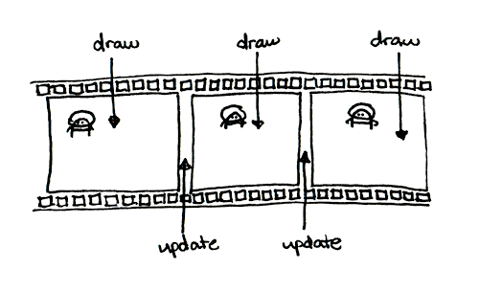
The Game Loop
You can think of it as an infinite flipbook that is updated between frames.
Notes:
https://www.mattlayman.com/blog/2019/teach-kid-code-pygame-zero/

Slide 6
Basic Game Structure
# program must start with these two lines
import pgzrun
from pgzero.builtins import *
# Pygame Constants
WIDTH = 500 # width of game window
HEIGHT = 500 # height of game window
TITLE = "Name of Game" # title in game window
# define global variables
alien = Actor("alien")
# runs once at beginning before draw()/update()
def start():
alien.pos = (200, 200) # sets initial position
# displays the new frame
def draw():
screen.clear() # clears the screen
screen.fill("darkslateblue") # fills background color
alien.draw() # draws the new sprite
# updates game state between drawing of each frame
def update():
pass # pass means do nothing, can't have empty function
pgzrun.go() # program must always end with this
start(): called once when the game starts, before the game loop begins. Set up the game’s starting state here.
update(): called repeatedly (about 60 times per second) to change the game’s state: move characters, check conditions, change variables.
draw(): called repeatedly to draw the current state of the game: backgrounds, shapes and characters.

Slide 7
Screen & Shapes

Slide 8
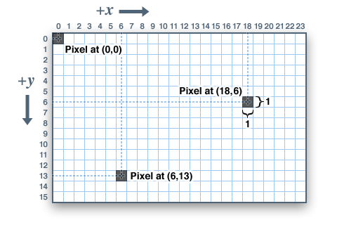
Graphical User Interface (GUI)
A window with visual elements that lets the user interact with the code behind the scenes.
The origin (0, 0) is the top-left corner of the window. x increases to the right and y increases down, so the bottom-right corner is (WIDTH, HEIGHT).
WIDTH: constant that sets the screen width
HEIGHT: constant that sets the screen height

Slide 9
Tuples
A tuple stores several values in parentheses, separated by commas. Positions and colors are tuples. You read one value with square brackets and an index starting at 0, but you cannot change one value: you replace the whole tuple.
new_pos = (300, 400)
new_pos[0] # 300, the x-coordinate
new_pos[1] # 400, the y-coordinate
new_pos[0] = 100 # ERROR! Cannot modify a tuple
new_pos = (100, 400) # correct: assign an entirely new tuple

Slide 10
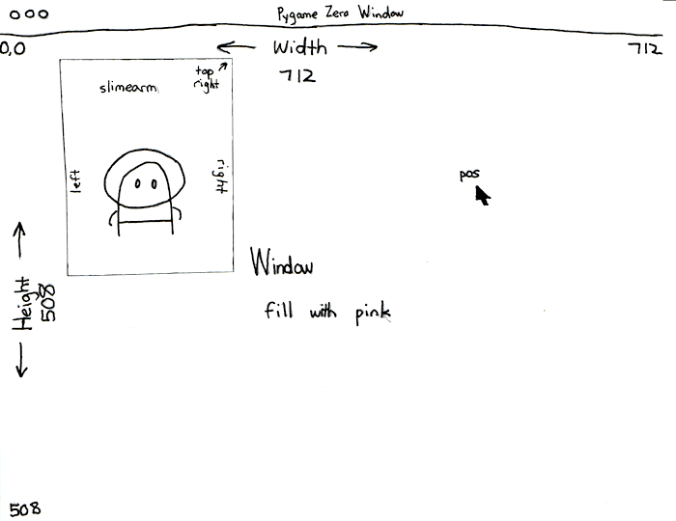
Drawing Order
# Pygame Zero constants
WIDTH = 712
HEIGHT = 508
TITLE = "Demo Game"
def draw():
# runs top to bottom, so draw back to front
screen.clear() # remove the previous frame
screen.fill("darkslateblue") # background first
screen.draw.filled_circle((100, 100), 50, "red")
screen.draw.filled_circle((125, 125), 25, "yellow") # drawn last, so on top

Slide 11
Drawing Rectangles and Lines
# screen.draw.rect((x, y), (width, height), "color")
screen.draw.rect((0, 0), (100, 200), "blue") # outlined rectangle
# screen.draw.filled_rect((x, y), (width, height), "color")
screen.draw.filled_rect((25, 50), (50, 80), "red") # filled rectangle
# screen.draw.line((x1, y1), (x2, y2), "color")
screen.draw.line((0, 0), (100, 100), "purple")

Slide 12
Drawing Circles and Colors
Write a color as | Example | Meaning
a color name string | "darkturquoise" | any name from the Pygame Zero color list
an RGB tuple | (150, 0, 100) | red = 150, green = 0, blue = 100, each from 0 to 255
# screen.draw.circle((x, y), radius, "color")
screen.draw.circle((250, 150), 60, "purple") # outlined circle
# screen.draw.filled_circle((x, y), radius, "color")
screen.draw.filled_circle((120, 120), 40, "red") # filled circle

Slide 13
Drawing Text
Add text with screen.draw.text(). You can also set color, position anchor, font size, background color, word wrap and more (text tutorial).
screen.draw.text("hello", (20, 200)) # top-left corner at (20, 200)
screen.draw.text("hello", (100, 100), fontsize=32)
screen.draw.text("hello", (0, 100), fontsize=32, color="orange")
screen.draw.text("hello world", centery=50, right=300)
screen.draw.text("BARK!", midtop=(400, 0), color="red")

Slide 14
Actor

Slide 15
Objects
In Pygame Zero, many things in our program are objects. An object contains:
Data: information about the object, such as its position and image
Behavior: things the object can do, such as draw()

Slide 16
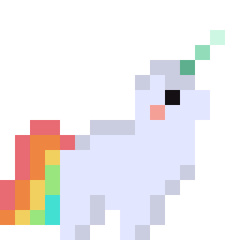
The Actor
An Actor is a graphic you draw in the window, like a sprite in Scratch.
robot = Actor("robot_idle") # image: images/robot_idle.png
robot.pos = (WIDTH // 2, HEIGHT // 2) # center of the robot
def draw():
screen.clear()
robot.draw() # draw the Actor at its current position

Slide 17
Moving and Changing an Actor
Images go in the images folder. Use the name without .png.
def update():
robot.x += 1 # move right 1 pixel every frame (~60 per second)
if robot.image == "robot_idle":
robot.image = "robot_jump"
elif robot.image == "robot_jump":
robot.image = "robot_idle"

Slide 18
Actor Positions
# a point, an (x, y) tuple: get or set
alien.pos = (100, 50) # center
alien.topleft = (10, 10) # top-left corner
alien.midright = (20, 20) # middle of the right edge
alien.midtop # also midbottom, topright, bottomleft...
# one coordinate, an int: get or set
alien.x # center x
alien.y # center y
alien.top # top edge y (smallest y)
alien.bottom # bottom edge y (largest y)
alien.left # left edge x (smallest x)
alien.right # right edge x (largest x)
alien.width # width in pixels (read only)
alien.height # height in pixels (read only)

Slide 19
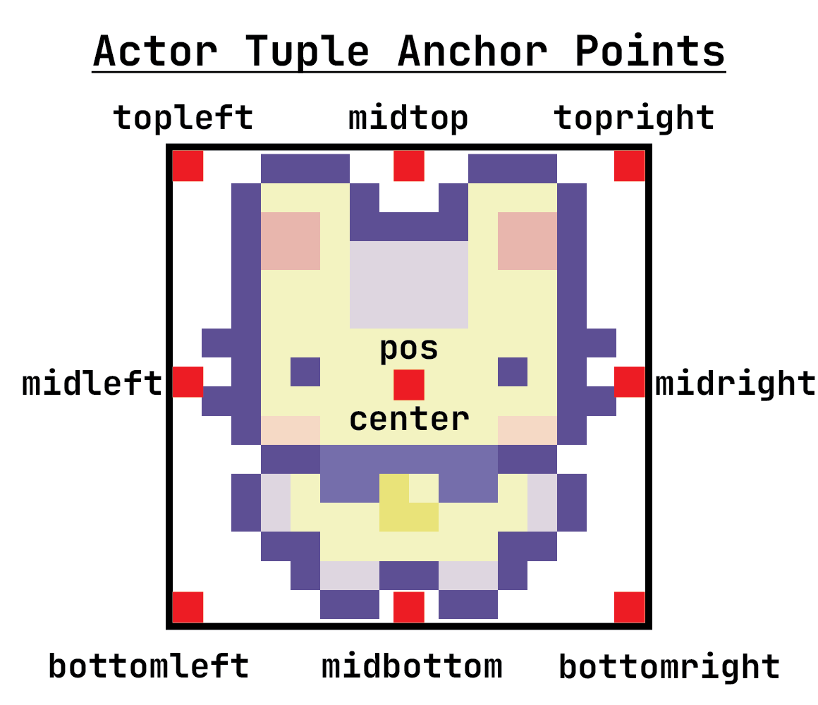

Slide 20
Global Variables

Slide 21
Global Variables
In Pygame Zero, we write almost all our code in functions. How do we keep data across functions, or across many calls to update()?
Global variables!
Define them outside all functions, at the top of the file.
Any function can read them freely.
A function that changes one needs one extra step…

Slide 22
The global Keyword
You do not need global when you are… | You do need global when you are…
only reading the variable | reassigning the variable to a new value
changing something inside it (an Actor’s position, appending to a list) | changing an int, float, bool, str or tuple
The global keyword tells Python that a variable inside a function refers to the global variable defined outside it.

Slide 23
Use global variables sparingly: they make programs harder to understand and debug.

Slide 24
Global Variable Example
alien = Actor("alien_green")
frame = 0 # global variable: how many frames so far
def start():
alien.pos = (0, 250)
def draw():
screen.clear()
alien.draw()
def update():
global frame # we reassign frame, so we need global
frame += 1
if frame % 10 == 0: # every 10 frames
alien.x += 1

Slide 25
Actor Variables

Slide 26
Actor Variables
An alternative to global variables: attach your own variables to an Actor with dot notation. Only use them for values that belong to that Actor.
Built-in: x, y, pos, image…
Your own: anything you create, like velocity_x

Slide 27
Actor Variable Example
alien = Actor("alien_beige")
def start():
alien.pos = (0, 500) # pos is built in
alien.velocity_x = 1 # velocity_x is ours
alien.velocity_y = -1 # velocity_y is ours
def draw():
screen.clear()
alien.draw()
def update():
alien.x += alien.velocity_x
alien.y += alien.velocity_y

