Slide 1
Advanced Pygame Zero
CS4040 · Unit 5: 2D Game Mechanics

Slide 2
Actor Extensions

Slide 3
Actor Extensions
player.angle # gets current angle in degrees
player.angle += 1 # increments angle by 1
player.scale # gets current Actor scaling factor
player.scale = 2.0 # sets the Actor scaling factor
player.flip_v = True # flips the Actor vertically
player.flip_v = False # turns off vertical flip, default
player.flip_h = True # flips the Actor horizontally
player.flip_h = False # turns off horizontal flip, default

Slide 4
Sprite
idle = Sprite("rabbit", frame_width=16, frame_height=16,
row=0, frames=2, fps=3)
Use Sprite to make an animation from a spritesheet in the sprites folder for an Actor.
image_name: sprite sheet filename
frame_width: width of each frame in pixels
frame_height: height of frame in pixels
row (optional): row to start from, counting from 0. Defaults to 0.
frames (optional): number of frames. Defaults to the whole row.
fps (optional): frames per second. Defaults to 10.
transparent_color (optional): color to make see-through. Defaults to none.
loop (optional): False plays once. Defaults to True.

Slide 5
Playing a Sprite
Actors can play Sprites. Give it a Sprite instead of an image name.
walk_left = Sprite("rabbit", frame_width=16, frame_height=16,
row=6, frames=2, fps=10)
walk_right = Sprite("rabbit", frame_width=16, frame_height=16,
row=7, frames=2, fps=10)
# make an Actor that plays a Sprite
rabbit = Actor(idle)
...
rabbit.sprite = walk_right

Slide 6
Controlling Animations
idle = Sprite("fox", 32, 32, row=0)
attack = Sprite("fox", 32, 32, row=3, loop=False) # plays once
fox = Actor(idle)
fox.sprite = attack # same Sprite again: replays only if it has finished
if fox.animation_finished: # True once a loop=False Sprite ends
fox.sprite = idle
fox.frame # current frame number, starting at 0
fox.pause_animation() # freezes on the current frame
fox.resume_animation() # resumes animation on current frame

Slide 7
TileMaps

Slide 8
Tilesheets / Tilesets / Tilemaps
Tilesheet: a .png image file that contains many small images (tiles) arranged in a grid. Each tile is a piece of the world (grass, wall, water, etc.). This is the art asset created by the artist.
Tileset: a .tsx file created in Tiled that defines how to use a tilesheet. It tells Tiled things like tile size, spacing, and any extra data. It references a tilesheet. (Tileset and tilesheet are often used interchangeably.)
Tilemap: a .tmx file created in Tiled that defines the actual level layout. It uses one or more tilesets and organizes tiles into layers (ground, walls, hazards, etc.). This is the level design.
Note: the tilesheet, tileset, and tilemap must all be stored in the maps folder of your project.

Slide 9
Import Tilemap
Use load_tile_map_actors() to import your map made in Tiled into your game based on tile map layers.
tmx_name: path to the TMX file defining the tilemap, created in Tiled.
scale: scaling factor applied to the map for display in Pygame.
map_layers = load_tile_map_actors("L1.tmx", scale=SCALE)
ground = map_layers["ground"] # ground / background scenery to draw
walls = map_layers["walls"] # obstacles for player to collide with
hazards = map_layers["hazards"] # "bad" objects for player collision
hearts = map_layers["hearts"] # "good" objects or collectables

Slide 10
Pygame Constants
You can create your own constants to compute screen size!
# our tile map constants
TILE_SIZE = 18 # length of a tile, in pixels
MAP_WIDTH = 30 # width of the tilemap, in tiles
MAP_HEIGHT = 20 # height of the tilemap, in tiles
SCALE = 2 # global scaling factor
# can use to compute screen dimensions
WIDTH = TILE_SIZE * MAP_WIDTH * SCALE
HEIGHT = TILE_SIZE * MAP_HEIGHT * SCALE

Slide 11
TileMap Collisions

Slide 12
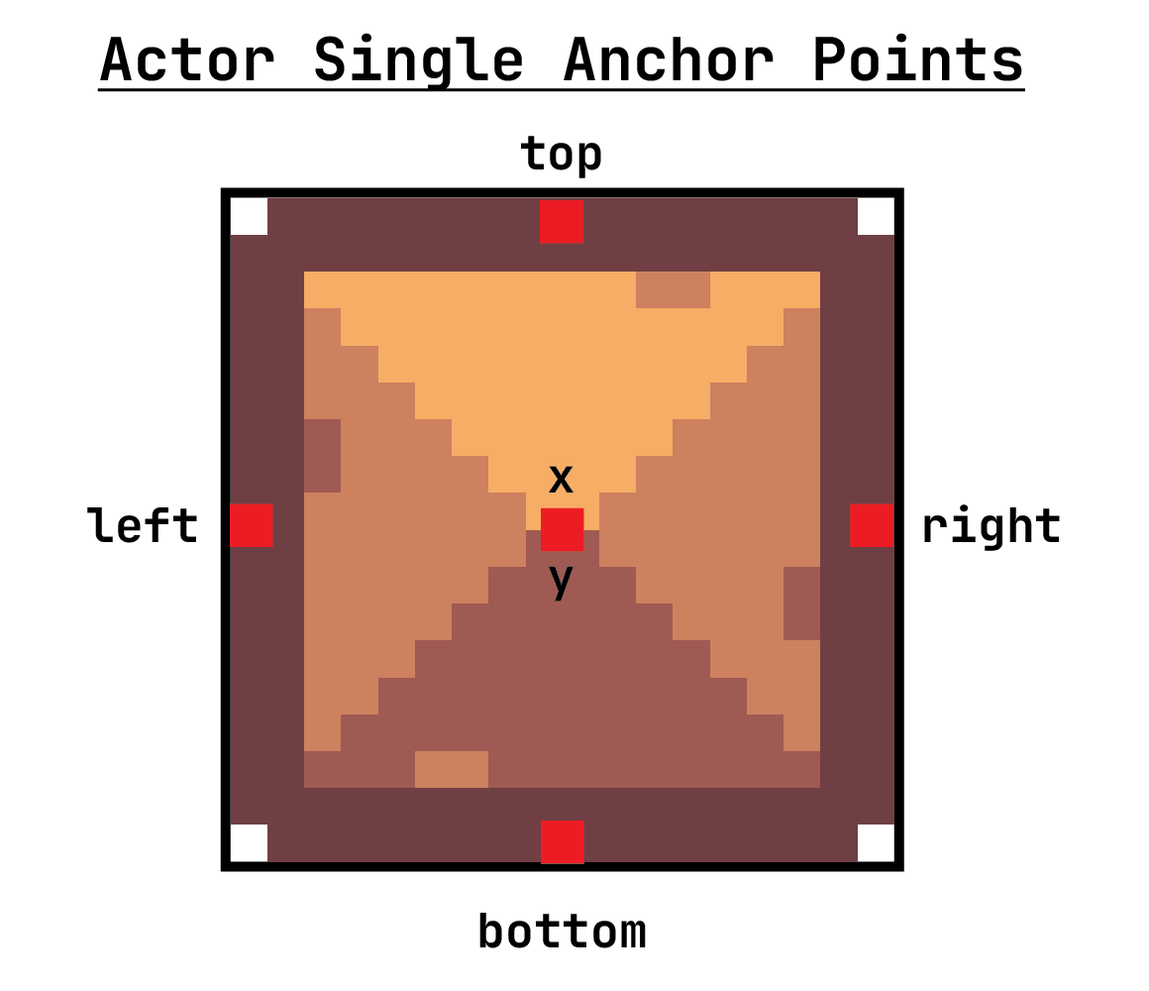
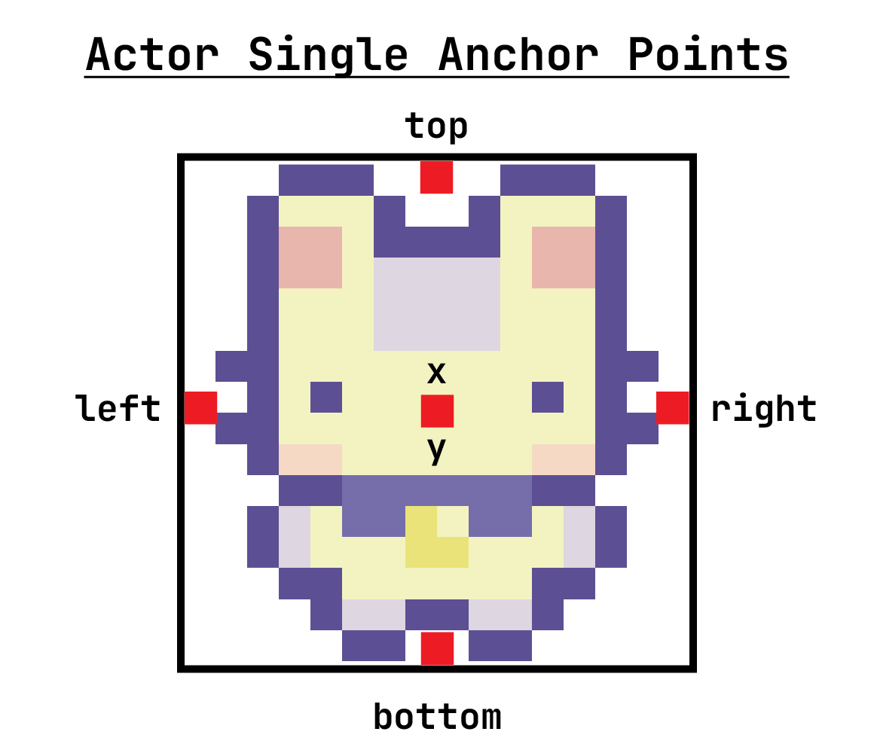
TileMap Collisions

Slide 13
Handling Wall Collisions
# left keyboard button pressed
if keyboard.LEFT:
rabbit.x -= 2 # move to left
rabbit.sprite = walk_left # change to left sprite
# check for collision
collision_index = rabbit.collidelist(walls)
# did collision occur after moving to left?
if collision_index != -1:
# if so, put character's left edge on right edge of wall
rabbit.left = walls[collision_index].right

