Slide 1
Lists & Loops
CS4040 · Unit 4: Iteration, Data, and Design

Slide 2
Creating a List
index | 0 | 1 | 2 | 3 | 4 | 5
value | 2 | 4 | 6 | 8 | 10 | 12
name | nums[0] | nums[1] | nums[2] | nums[3] | nums[4] | nums[5]
Lists: data type used to organize a collection of items.
Items in lists can be ints, strings, Actors, etc.
It is an ordered sequence of individual elements.
Accessible by index.
nums = [2, 4, 6, 8, 10, 12]

Slide 3
List Operations
Definition: creating a list using square brackets [].
Access: getting a value by index.
Update: replacing a value at an index.
len(name_of_list): returns how many items are in the list.
.append(item): adds item to the end of the list.
.remove(item): removes item by value.
.pop(index): removes and returns the item at index. Removes the last item if no index is provided.
.clear(): removes all items.

Slide 4
Example
fruits = ["pear", "fig", "cherry"]
fruits[1] # fig
fruits[0] = "grape" # ["grape", "fig", "cherry"]
len(fruits) # 3
fruits.remove("cherry") # ["grape", "fig"]
fruits.append("apple") # ["grape", "fig", "apple"]
item = fruits.pop() # ["grape", "fig"]
item = fruits.pop(0) # ["fig"]
fruits.clear() # []

Slide 5
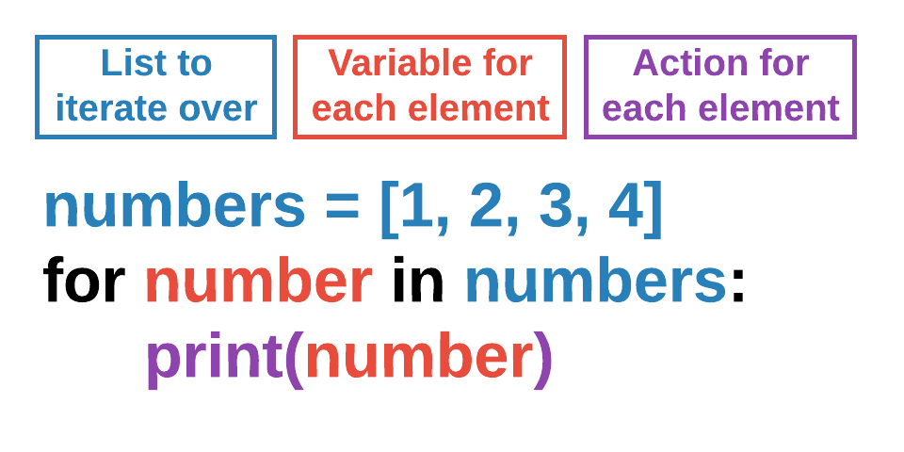
Iterating Over a List
A for loop goes through each item in a list one at a time.
The loop starts at the first item and continues to the end.
The loop iteration variable stores the current item.
The loop runs once for each item in the list.

Slide 6
Pygame Lists

Slide 7
Creating a List of Actors
Define the list as a global.
Figure out where to add new Actors. This example does it based on an interval.
Create a function to create a new Actor and append it to the list.
# globals
enemies = []
# runs once at beginning
def start():
enemies.clear()
clock.schedule_interval(spawn_enemy, 5)
# create spawn callback function
def spawn_enemy():
enemy = Actor("alien")
enemy.pos = (100, 100)
enemy.velocity_x = random.randint(1, 5)
enemy.velocity_y = random.randint(1, 5)
enemies.append(enemy)

Slide 8
Drawing a List of Actors
We use a for loop to iterate/loop over a list of Actors.
List variable names are typically plural (enemies) and our iteration variable names are typically singular (enemy).
The iteration variable grabs a single element from the list at a time, in order.
This shows how to draw all Actors in the list on the screen.
def draw():
screen.clear()
for enemy in enemies: # one Actor at a time, in order
enemy.draw()

Slide 9
Moving a List of Actors
You can use the same style of for loop in update().
See the example below, where we update each individual Actor’s position based on its own velocity.
def update():
for enemy in enemies: # each Actor moves by its own velocity
enemy.x += enemy.velocity_x
enemy.y += enemy.velocity_y

Slide 10
List Collisions

Slide 11
Collisions with a List of Actors
collidelist(): similar to colliderect(), but called on one Actor to detect if there’s a collision with a list of Actors.
Returns the index of the Actor in the list causing the collision (-1 if none).
# check for enemy collision with list
if player.collidelist(enemies) != -1: # -1 means no collision
game.lose() # game over
# check for collectible collision with list
collision_index = player.collidelist(gems) # index of the gem hit
if collision_index != -1:
# collected gem, remove from list
gems.pop(collision_index)
game.score += 1

