Slide 1
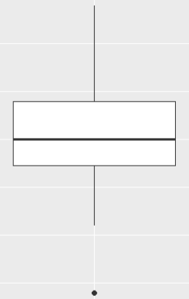
Boxplot
Max
25%
Q3
25%
Q2
25%
Q1
25%
Min
Outlier

Slide 2
Types of Data
Data
Qualitative (Categorical)
Quantitative (Numeric)
Nominal
Ordinal
There is an implied order e.g. low, medium, high
No implied order e.g. colours
Discrete
Fixed width gaps between possible scores e.g. age in years
Continuous
No gaps between possible scores e.g. height

