Slide 1



Challenge: Design a Tool/Product for User Key Management
Dora Factory
Marcelo Santos

Slide 2
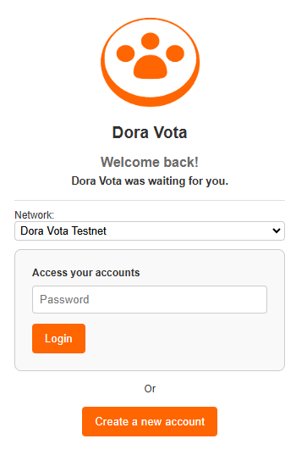
wsl
PowerShell
Node.js API
dorad
wsl dorad keys list

Slide 3
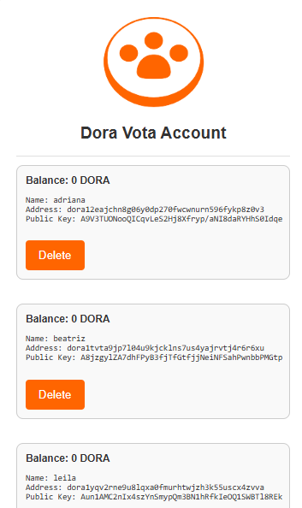
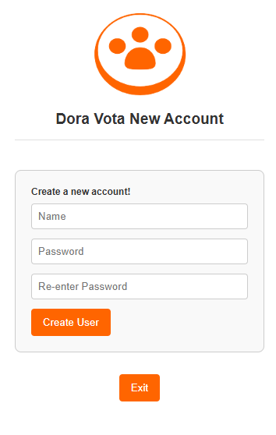
Thank you!

