Slide 1






Slide 2
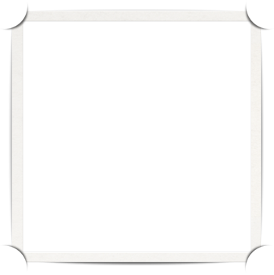

Kendo UI For ASP.NET MVC

Slide 3
What is Kendo UI for MVC?
JavaScript framework with CSS defined for styling and behaviors
Built on jQuery
Web UI widgets
Data visualization widgets
Mobile widgets
Server side wrappers
Notes:
23 UI web widgets , 15 different types of charts

Slide 4
What we’ll cover
JavaScript vs. Server Side Wrappers
Grid paging, grouping , filtering
Grid editing
Custom MVC Editor Templates
Handling Grid events
Using Jquery to modify the grid
Populating Pie Chart

