Slide 1
“Developers don’t have people skills!” It may be a stereotype, but for some, it’s a badge of honor to be the the anti-social, soda-drinking hermit that people are afraid to talk to. Movies, TV shows, and comics make light of it, and so do many of us, but it really is no laughing matter. We strive to the be the absolute best we can be at the technical side of things—we buy books, attend conferences and stay up late hacking on our side projects—but do very little to improve our core skills. Unlike IQ, EQ can actively be developed and improved. In this session, you’ll learn about the components of EQ, why they matter, and some strategies you can use to improve your own EQ!

Slide 2
I have people skills! The Importance of Emotional Intelligence and Your Career!
Michael Eaton
January 2018

Slide 3


Slide 4
QL Terms
Department = Team, Group
Manager, boss = Leader
Borrowers, Debtors, Engineers = Clients
Workers / employees / cogs = Team Members
ISMs = The ideas we live by at Quicken Loans and at every one of our family of companies. They have a lot more to do with who we are than what we do.
Notes:
Department = Team, Group
Manager, boss = Leader
Borrowers, Debtors, Engineers = Clients
Workers / employees / cogs = Team Members
ISMs = The ideas we live by at Quicken Loans and at every one of our family of companies. They have a lot more to do with who we are than what we do.

Slide 5
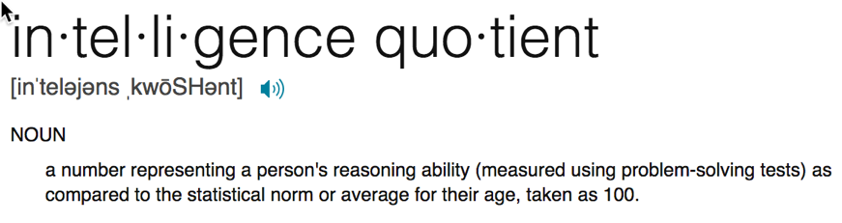

Slide 6
IQ is fixed

Slide 7
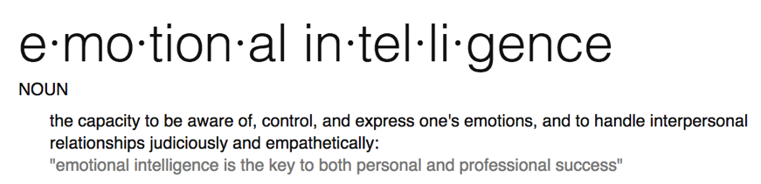
Notes:
Emotional intelligence is your ability to recognize and understand emotions in yourself and others, and your ability to use this awareness to manage your behavior and relationships.

Slide 8
Why do we care?
Notes:
EQ is so critical to success that it accounts for 58 percent of performance in all types of jobs. It’s the single biggest predictor of performance in the workplace and the strongest driver of leadership and personal excellence.

Slide 9
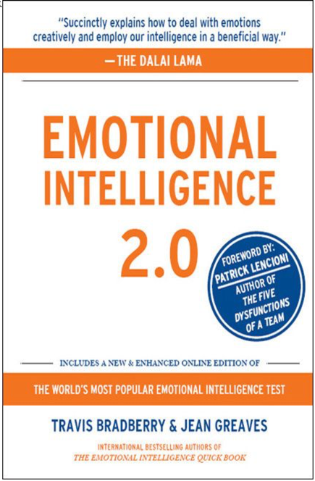

Slide 11
Breakdown

Slide 16
EQ can be learned and improved

Slide 17



Self Awareness
Your ability to accurately perceive your emotions and stay aware of them as they happen.
Notes:
Self Awareness is having a clear perception of your personality, including strengths, weaknesses, thoughts, beliefs, motivation, and emotions. Self Awareness allows you to understand other people, how they perceive you, your attitude and your responses to them in the moment.

Slide 18
Strategies to Improve
Pause, Think, Act
Who and what pushes your buttons?
Journal
Why?
Feedback

Slide 19
Self Management
Your ability to use awareness of your emotions to stay flexible and positively direct your behavior.

Slide 20
Strategies to Improve
Pause, Think, Act / Count to 10
Positive self talk
Sleep
Breath

Slide 21
Social Awareness
Your ability to accurately pick up on emotions in other people and get what is really going on.

Slide 22
Strategies to Improve
Be present
Body language
Listen
Lens (perception matters)
Notes:
Lens = perceptions matter because others’ opinions of you influence you and your life. For example, if people think you are passive in meetings when you simply need time to think before speaking, their perceptions begin to shape what opportunities are offered to you. Soon your boss is passing you over for chairing a committee because you are perceived as passive instead of thoughtful.

Slide 23
Relationship Management
Your ability to use awareness of your emotions and the emotions of others to manage interactions successfully.
Notes:
You use your self-awareness skills to notice your feelings and judge if your needs are being satisfied. You use your self-management skills to express your feelings and act accordingly to benefit the connection. Finally, you use your social awareness skills to better understand the other person’s needs and feelings.

Slide 24
Strategies to Improve
Ask questions
Share
Take feedback well
Acknowledge feelings
Direct and constructive feedback

Slide 25
EQ can be learned and improved

Slide 27
Breakdown

Slide 32
Actions
Determine it’s important
Areas for improvement?
Find a mentor

Slide 33
Questions?

Slide 34
https://about.me/mjeaton

