Slide 1
You're a developer with years of experience creating amazing web or WinForms applications, but you've just been assigned to a *gasp* WPF or Silverlight (or WP7) project! Because you're an expert developer, you're expected to love this new technology and be productive from day 1. You click File | New | WPF (or Silverlight) project and feel completely lost as you open the XAML files. Not only that, but you have to contend with new patterns like MVVM! Trust me, it's not as bad as it appears and XAML is NOT as hard as you think. This hands-on workshop will cover the things you need to know to be successful on your first XAML-based project.
Attendees can expect an all-day dive into the following XAML concepts:
Overview of XAML
Layouts
Controls
Databinding
Styling
Templating
Patterns such as MVVM
And More
There will be a lot to cover in 8 hours and the day will get progressively more advanced as we move through more topics.

Slide 2




















PLATINUM SPONSORS
GOLD SPONSORS
SILVER SPONSORS

Slide 3

An Introduction to XAML using WPF
KCDC
May 2nd – 4th, 2013
Michael Eaton
@mjeaton

Slide 4
@mjeaton

Slide 5


Insiders Program
Born in 2010: Telerik noticed a strong need for community speakers
21 total speakers (as of 2012) (May grow in time)
Independent speakers providing quality sessions
Speaker criteria:
Expertise and talents
Geographical region
Honest enthusiasm for Telerik
Benefits:
Financial support for travel & swag for sessions
Supportive network of Telerik team
Work with product teams and beta test products
Locations: Europe, North America & India
More Info: www.telerik.com/community/insiders/insiders-faq.aspx

Slide 6
Schedule
8:00 – 10:30 | Workshop
10:30 – 10:45 | Break #1
10:45 – 12:30 | Workshop
12:30 – 1:30 | Lunch
1:30 – 3:15 | Workshop
3:15 – 3:30 | Break #2
3:30 – 5:00 | Workshop

Slide 7
This workshop will be
Focused on the here and now, mostly in the context of WPF, but also a little Silverlight and maybe some WP7

Slide 8
This workshop will NOT be
Dealing with Windows 8, other than a discussion on how XAML fits into the Windows 8 development world
Phil Japikse and Jesse Liberty are doing the Windows 8 workshop right now!

Slide 9
You should have
Visual Studio 2012 or Visual Studio 2010 installed and running!

Slide 10
XAML: Why should I care?

Slide 11
WPF: Why should I care?

Slide 12
WPF is…
A component of Microsoft .NET Framework
Used for building desktop applications
It supports
UI
Media
Documents
hardware acceleration
vector graphics
scalability to different form factors
integration with Windows
interactive data visualization
superior content readability

Slide 13
XAML is…
A declarative markup language
Based on XML
Used to initialize structured values and objects
Used extensively in
WPF
Silverlight
Windows Workflow

Slide 14
In WPF (and Silverlight), XAML is…
Used as the UI markup language to define
UI elements
Data binding
Other features
Elements map directly to CLR object instances
Attributes map to properties and events on those objects

Slide 15
Anatomy of a XAML file
<Window | Page | UserControl
xmlns="http://schemas.microsoft.com/winfx/2006/xaml/presentation" xmlns:x="http://schemas.microsoft.com/winfx/2006/xaml"
>
<!– Stuff goes here →
</Window | Page | UserControl>

Slide 16
XAML Tags
Various ways to accomplish the same thing
<Button>This is a button</Button>
<Button Content=“This is a button”></Button>
<Button Content=“This is a button”/>

Slide 17
XAML Tags
For readability, when dealing with long pieces of XAML, place each attribute on a separate line:
<Button
Content="This is a button"
Background="Blue"
Foreground="White"
Height="35"
Width="100"
/>

Slide 18
Did you know?
Anything you can do in XAML, you can do in code
var b = new Button();
b.Content = “hello, world”;
b.Click += clickedEvent;
is the same as
<Button Content=“hello, world” Click=“clickedEvent”/>

Slide 19
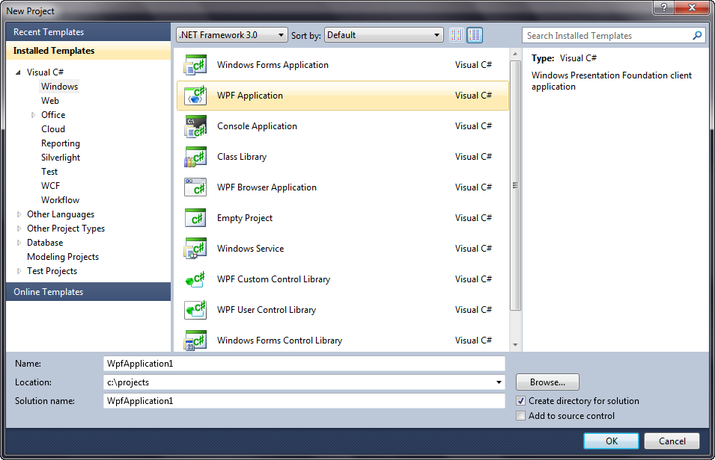
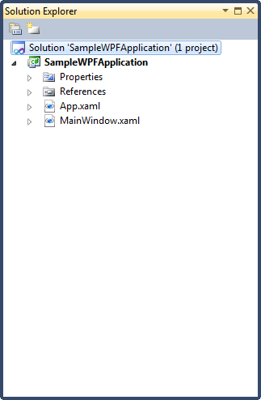
Notes:
Discuss File | New and the parts of a WPF application.

Slide 20
App.xaml
<Application.Resources>
<Style TargetType="Button">
<Setter Property="FontSize"
Value="24" />
<Setter Property="FontFamily"
Value="Comic Sans MS" />
</Style>
</Application.Resources>

Slide 21
App.xaml.cs
public partial class App : Application
{
public App()
{
Startup += App_Startup;
Exit += App_Exit;
InitializeComponent();
}
void App_Exit(object sender, ExitEventArgs e)
{
var ss = ServiceLocator.GetKernel().Get<IScaleServer>();
ss.StopScaleServer();
}
void App_Startup(object sender, StartupEventArgs e)
{
StyleManager.ApplicationTheme = new Windows7Theme();
XmlConfigurator.Configure();
HibernatingRhinos.Profiler.Appender.NHibernate.NHibernateProfiler.Initialize();
}
}

Slide 22

Margins
Outside spacing Left, Top, Right, Bottom
If all margins are the same, you may use the alternate syntax of Margin=“10”
Note: Units are Device Independent
<StackPanel
Orientation="Horizontal"
Grid.Row="3"
Grid.Column="1"
Margin="10,10,10,10"
>
<Button Content="Ok" Margin="0,0,10,0" />
<Button Content="Cancel" />
</StackPanel>

Slide 23

Padding
Inside spacing Left, Top, Right, Bottom
If the padding values are the same, you may use the alternate syntax of Padding=“10”
Note: Units are Device Independent
<Button Content="Button" Padding="25"

Slide 24
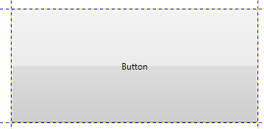
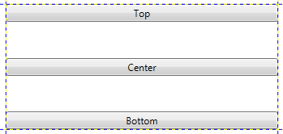
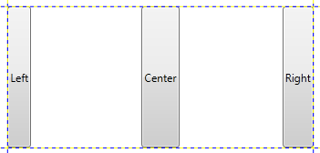
Alignment
HorizontalAlignment and VerticalAlignment
Defaults = “Stretch”
<Button Content="Button" />
<Button Content="Top" VerticalAlignment="Top" /> <Button Content=“Center" VerticalAlignment=“Center" /> <Button Content=“Bottom" VerticalAlignment=“Bottom" />
<Button Content="Left" HorizontalAlignment="Left" />
<Button Content="Center" HorizontalAlignment="Center" />
<Button Content="Right" HorizontalAlignment="Right" />

Slide 25
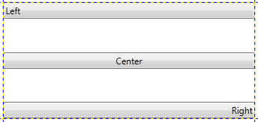
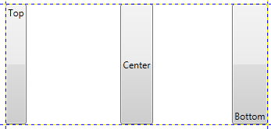
ContentAlignment
HorizontalContentAlignment and VerticalContentAlignment
Applies to Content controls such as buttons
<Button Content="Left" HorizontalContentAlignment="Left" />
<Button Content="Center" HorizontalContentAlignment="Center" />
<Button Content="Right" HorizontalContentAlignment="Right" />
<Button Content="Top" VerticalContentAlignment="Top" />
<Button Content="Center" VerticalContentAlignment="Center" />
<Button Content="Bottom" VerticalContentAlignment="Bottom" />

Slide 26
Control Types
Layout
Content
Grouping
Text
List
Notes:
There are several classes of controls in WPF. Layout controls are for layout, content controls are cool in that a content control can hold any other type of object – example – a button has a content property instead of a text property so you can do crazy stuff like putting videos in buttons. Text controls display text and list controls display lists of objects.

Slide 27
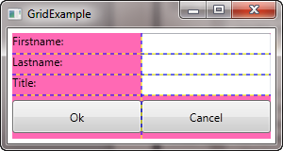
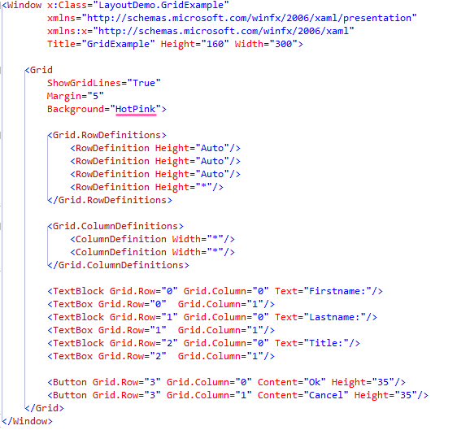
Grid
- Rows and columns
In almost all cases, the Grid should be your primary method of laying out your views.

Slide 28
GridSplitter Demo
Notes:
http://winrtxamltoolkit.codeplex.com/ - WinRT XAML Toolkit

Slide 29
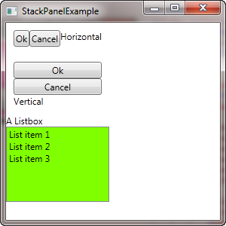
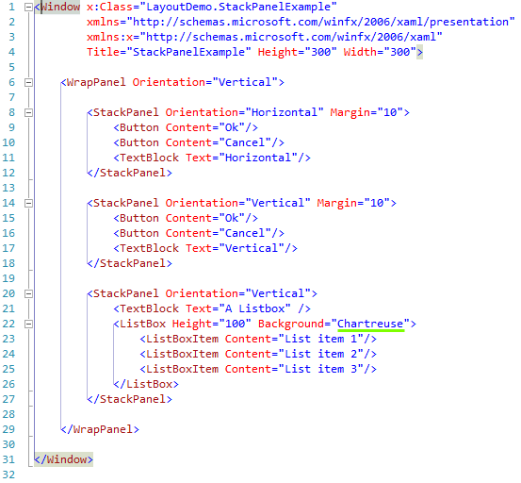
StackPanel
- Vertical or Horizontal orientation

Slide 30
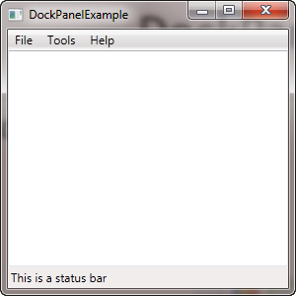
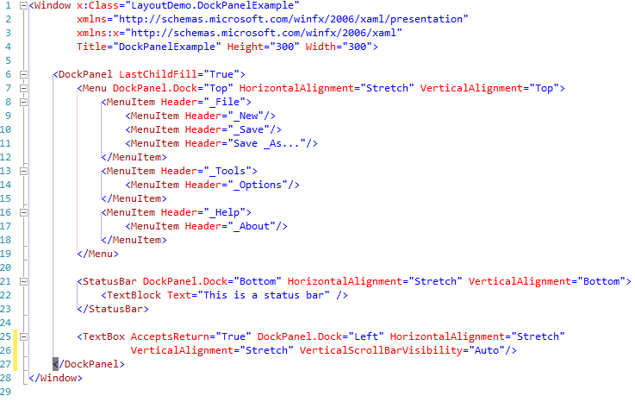
DockPanel
- Left, Top, Right, Bottom

Slide 31
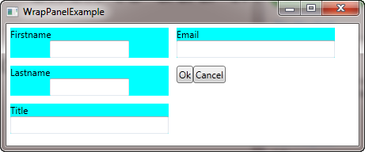
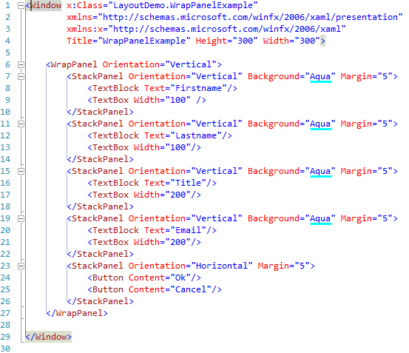
WrapPanel
- Overflow

Slide 32
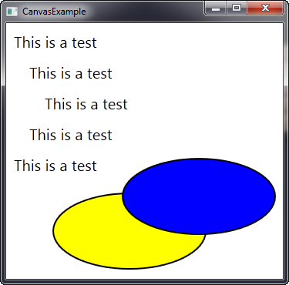
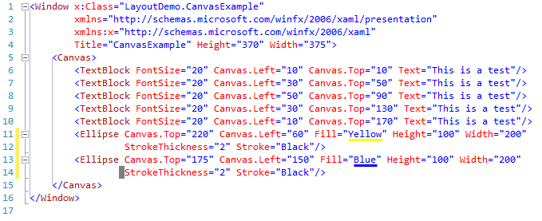
Canvas
- Explicit positioning

Slide 33
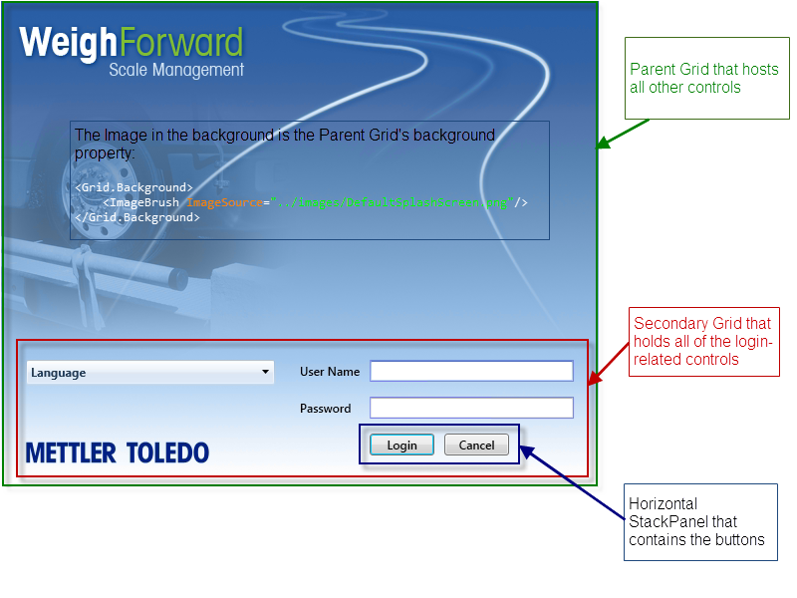
Combining Layouts

Slide 34
Grouping Controls
GroupBox
Expander

Slide 35
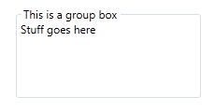
GroupBox
Used when you want to group related items.
<GroupBox Header="This is a group box" Width="200" Height="100">
<TextBlock Text="Stuff goes here"/>
</GroupBox>
Note: The Header is also a Content control!

Slide 36

Expander
Used when you want to group related items, but you
want to allow the user to expand or collapse the
contents.
<Expander Header="Options" IsExpanded="True">
<StackPanel Orientation="Vertical">
<CheckBox Content="Option 1"/>
<CheckBox Content="Option 2"/>
<CheckBox Content="Option 3"/>
</StackPanel>
</Expander>
Note: The Header is also a Content control!

Slide 37
Content Controls
A ContentControl can contain content such as text, images, or panels.
Examples of Content controls include:
Button
CheckBox
RadioButton
ListBoxItem
Menu
Label
Many more…

Slide 38



Button
<Button Content="This is a button" Height="35" Width="150"/>
<Button Height="50" Width="200">
<Image Source="c:\temp\kalamaxoo_web_sml.png"/>
</Button>
<Button Height="36" Width="36“ Click=“Button_Click”>
<Image Source="c:\temp\delete.png"/>
</Button>

Slide 39

CheckBox
<GroupBox Header="Favorite Conference" Padding="5" Width="200" Height="100">
<StackPanel Orientation="Vertical">
<CheckBox>
<Image Source="c:\temp\kalamaxoo_web_sml.png" Height="35"/>
</CheckBox>
<CheckBox>
<Image Source="c:\temp\MADExpoLogo1.png" Height="35"/>
</CheckBox>
</StackPanel>
</GroupBox>

Slide 40

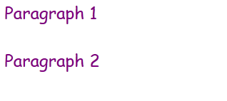
Text Controls
TextBox – Used for entering text.
TextBlock – Used for displaying static text.
RichTextBox – Used for displaying Rich Text
<TextBox Width="200" Height="25" MaxLength="50"/>
<TextBlock Text="This is static text that can’t be changed"/>
<RichTextBox FontFamily="Comic Sans MS" Foreground="Purple" FontSize="24">
<FlowDocument>
<Paragraph>
<Run>Paragraph 1</Run>
</Paragraph>
<Paragraph>
<Run>Paragraph 2</Run>
</Paragraph>
</FlowDocument>
</RichTextBox>

Slide 41

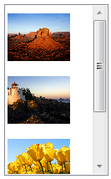
List Controls
ListBox
<ListBox Width="100" Height="75" Margin="0,0,0,25">
<ListBoxItem Content="Item 1"/>
<ListBoxItem Content="Item 2"/>
<ListBoxItem Content="Item 3"/>
<ListBoxItem Content="Item 4"/>
<ListBoxItem Content="Item 5"/>
</ListBox>
<ListBox Width="125" Height="205" Margin="0,0,0,25">
<ListBoxItem>
<Image Source="C:\temp\Desert.jpg" Height="75" Width="75" />
</ListBoxItem>
<ListBoxItem>
<Image Source="C:\temp\lighthouse.jpg" Height="75" Width="75" />
</ListBoxItem>
<ListBoxItem>
<Image Source="C:\temp\Tulips.jpg" Height="75" Width="75" />
</ListBoxItem>
</ListBox>

Slide 42
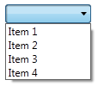

List Controls
ComboBox
<ComboBox Width="100" Margin="0,0,0,25">
<ComboBoxItem Content="Item 1"/>
<ComboBoxItem Content="Item 2"/>
<ComboBoxItem Content="Item 3"/>
<ComboBoxItem Content="Item 4"/>
</ComboBox>
<ComboBox Width="100" Margin="0,0,0,25">
<ComboBoxItem>
<Image Source="C:\temp\Tulips.jpg" Height="75" Width="75"/>
</ComboBoxItem>
<ComboBoxItem>
<Image Source="C:\temp\desert.jpg" Height="75" Width="75"/>
</ComboBoxItem>
</ComboBox>

Slide 43
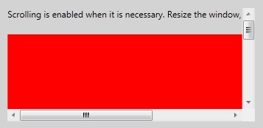
ScrollViewer
Used to define a scrollable area within an application.
<ScrollViewer HorizontalScrollBarVisibility="Auto">
<StackPanel VerticalAlignment="Top" HorizontalAlignment="Left">
<TextBlock TextWrapping="Wrap" Margin="0,0,0,20"> Scrolling is enabled when it is necessary. Resize the window, making it larger and smaller. </TextBlock>
<Rectangle Fill="Red" Width="500" Height="500“/>
</StackPanel>
</ScrollViewer>

Slide 44
Data Binding
Allows us to connect data to an element on the screen
Extremely powerful
Data can come from many different sources
WPF doesn’t care what the source is
Used everywhere
Enables MVVM

Slide 45
Data Binding
DataContext
provides a convenient way to establish a data scope
multiple targets can share the same source
Notes:
Demo

Slide 46
Data Binding
A typical data binding assignment in XAML
<TextBox Text=“{Binding FirstName}”/>
The data source is typically set using the .DataContext property of a parent object.
Typically done via the code-behind unless you’re using MVVM (this will be in a later lesson)
Notes:
This says the Text property of the textbox will display data in the FirstName property of our data source.

Slide 47
INotifyPropertyChanged
Implements a single event
public event PropertyChangedEventHandler PropertyChanged;
Requires a helper method to raise the event. Typical implementation:
public void OnPropertyChanged(string propertyName)
{
if (PropertyChanged != null)
{
PropertyChanged(this, new PropertyChangedEventArgs(propertyName));
}
}
Normally implemented in a base class
Notes:
Used to notify clients, typically binding clients, that a property value has changed

Slide 48
INotifyPropertyChanged
Each property of an object that is bound must raise this event in it’s ‘setter’
private string _FirstName;
public string FirstName
{
get { return _FirstName; }
set
{
_FirstName = value;
OnPropertyChanged("FirstName");
}
}

Slide 49
Collections
ObservableCollection<T>
notification when items are added or removed.
Assign to .ItemsSource of ListBox, ComboBox, DataGrid, etc.
Once you’ve assigned .ItemsSource, you cannot manually add items

Slide 50
Converters
Used when the source data isn’t in the format you want for displaying on the screen
Converts during the binding process
Implements IValueConverter interface
Convert and ConvertBack methods

Slide 51
Common Converters
BooleanToVisibilityConverter
public class BooleanToVisibilityConverter : IValueConverter
{
public object Convert(object value, Type targetType, object parameter, CultureInfo culture)
{
if (targetType != typeof(Visibility))
throw new InvalidOperationException("The target must be visibility");
if((bool)value)
return Visibility.Visible;
return Visibility.Hidden;
}
public object ConvertBack(object value, Type targetType, object parameter, CultureInfo culture)
{
throw new NotSupportedException();
}
}
}

Slide 52
Usage of BooleanToVisibilityConverter
In App.xaml
In a view
<Application x:Class="GlobalVehicle.EntryLevel.Client.App"
xmlns="http://schemas.microsoft.com/winfx/2006/xaml/presentation"
xmlns:x="http://schemas.microsoft.com/winfx/2006/xaml"
xmlns:Converters="clr-namespace:GlobalVehicle.EntryLevel.Client.View.Converters"
xmlns:local="clr-namespace:GlobalVehicle.EntryLevel.Client"
>
<Application.Resources>
<ResourceDictionary>
<BooleanToVisibilityConverter x:Key="VisibilityOfBool" />
</ResourceDictionary>
</Application.Resources>
</Application>
<Button
Content="{x:Static p:OnePassView.SetWeight}"
Visibility="{Binding IsManual, Converter={StaticResource VisibilityOfBool}}"
/>

Slide 53
StringFormat
Can be used to format a string directly in a binding statement
<TextBox Text=“{Binding HireDate, StringFormat={}{0:MM/dd/yyyy}}”/>
<TextBox Text=“{Binding Amount, StringFormat=Amount: {0:C}}”/>

Slide 54
DataBinding Errors
Bindings are *case-sensitive*
If a binding isn’t working, check the output window in Visual Studio.
Look for errors that start with “System.Windows.Data Error: 40 : BindingExpression”

Slide 55
DataBinding Demo

Slide 56
Styles and Templates
Controls the look and feel of an application
Can completely change how a control looks
Notes:
A button doesn’t have to be a gray rectangle
A listbox doesn’t have to contain simple strings
Allows you to easily apply standard colors, fonts, etc.

Slide 57
Styles
Can be applied to any object which derives from FrameworkElement or FrameworkContentElement, both of which expose a public property named Style.
Local / global
Defines the appearance of a control

Slide 58
Styles Demo

Slide 59

Styles
Styles can live in several places
App.xaml
<Application.Resources>
Available globally
<Window|Page|UserControl.Resources/>
Available only within that particular window, page or usercontrol
<Control.Resources>
<Button.Resources>, <Grid.Resources>, etc.
Only available within the context of that particular control
<Style TargetType=“Button”>
<Setter Property=“FontSize” Value=“24”/>
<Setter Property=“FontFamily” Value=“Comic Sans MS”/> <Setter Property="Foreground" Value="Red"/>
</Style>

Slide 60
Data Templates
Defines the visual representation of data

Slide 61
DataTemplate Demo

Slide 62
Control Templates
Determines a controls appearance

Slide 63
ControlTemplate Demo

Slide 64
Resources
http://tinyurl.com/PortToWindowsStore

Slide 65
Contact Info
Email: mjeaton@validussolutions.com
Blog: http://mjeaton.net/blog
Twitter: @mjeaton

