Slide 1







Thanks to our AWESOME sponsors!

Slide 2

XAML: Styles and Templates
Central Ohio Day of .NET
December 8, 2012
Michael Eaton
@mjeaton

Slide 3


Slide 4

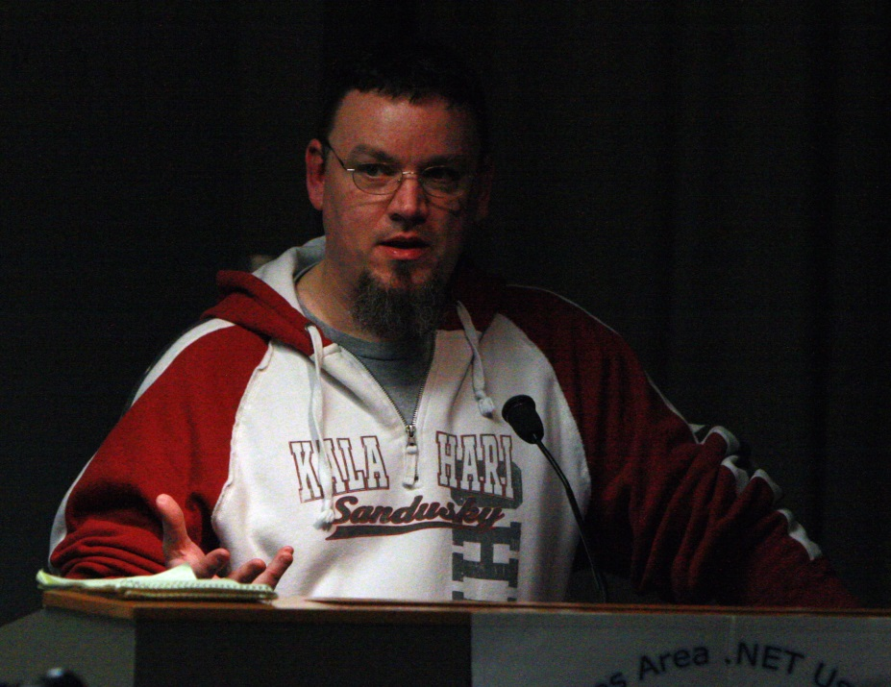
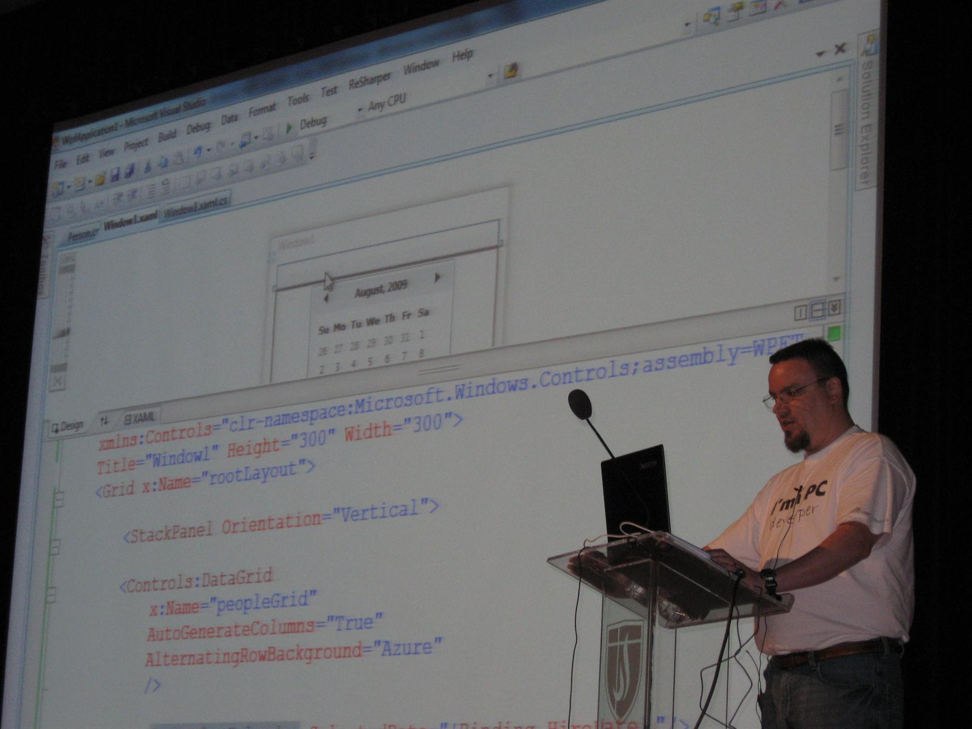
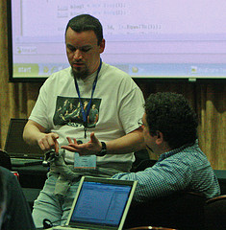

Slide 5


Insiders Program
Born in 2010: Telerik noticed a strong need for community speakers
21 total speakers (as of 2012) (May grow in time)
Independent speakers providing quality sessions
Speaker criteria:
Expertise and talents
Geographical region
Honest enthusiasm for Telerik
Benefits:
Financial support for travel & swag for sessions
Supportive network of Telerik team
Work with product teams and beta test products
Locations: Europe, North America & India
More Info: www.telerik.com/community/insiders/insiders-faq.aspx

Slide 6

"In a time where organizers are censoring speakers and their content, @mjeaton and @kalamazoox is a bastion of freedom. He is a luminary." "@mjeaton @kalamazoox believes in the open exchange of ideas, however uncomfortable, and trusts humans to think, collaborate and create."
"#kalx12 is like an All Star team of speakers. Every single one would have been the best talk at every other conference." "I've discovered @kalamazoox is a hidden gem. Today was like a braver, more profane set of dev-oriented TED talks. Lots of passion and humor."

Slide 7
http://about.me/mjeaton

Slide 8
Styles and Templates
Controls the look and feel of an application
Can completely change how a control looks
Notes:
A button doesn’t have to be a gray rectangle
A listbox doesn’t have to contain simple strings
Allows you to easily apply standard colors, fonts, etc.

Slide 9
Styles
Can be applied to any object which derives from FrameworkElement or FrameworkContentElement, both of which expose a public property named Style.
Local / global
Defines the appearance of a control

Slide 10

Styles
Styles can live in several places
App.xaml
<Application.Resources>
Available globally
<Window|Page|UserControl.Resources/>
Available only within that particular window, page or usercontrol
<Control.Resources>
<Button.Resources>, <Grid.Resources>, etc.
Only available within the context of that particular control
<Style TargetType=“Button”>
<Setter Property=“FontSize” Value=“24”/>
<Setter Property=“FontFamily” Value=“Comic Sans MS”/> <Setter Property="Foreground" Value="Red"/>
</Style>

Slide 11
Styles Demo

Slide 12
Data Templates
Defines the visual representation of data

Slide 13
DataTemplate Demo

Slide 14
Control Templates
Determines a controls appearance

Slide 15
ControlTemplate Demo

Slide 16
Contact Info
Everything you need to know is at
about.me/mjeaton

