Slide 1
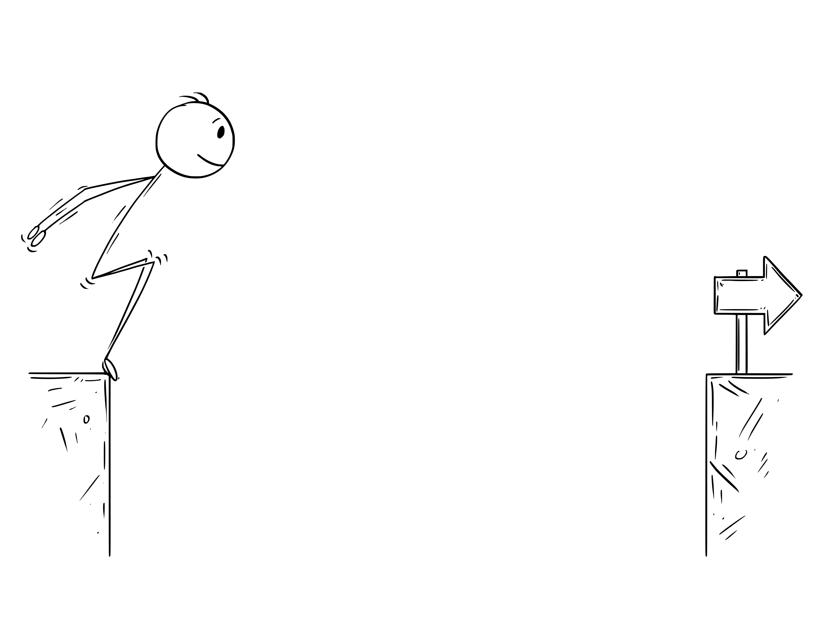
Dev to Leader
One Developer’s Story
Michael Eaton
Principal Consultant @ Improving
Cincy Deliver 2023

Slide 2







Cincy Deliver 2023 Sponsors
Diamond
Platinum
Gold
Silver
Community
Notes:
Before we get started, I want to thank all the fantastic sponsors for helping to make this event possible. I also want to thank Phil and team for putting this event together!

