Slide 1
You’ve spent years working on your technical skills and can write code with the best of them. Then, one day, a leadership position opens up on your team, and you start thinking about it. Should I or shouldn’t I? What if I hate it? What if I love it? What if I’m not that good at it? In this interactive session, we’ll explore “why leadership,” answer some hard questions, and talk about one developer’s path from individual contributor to leader.

Slide 2


Leadership Journey
From Individual Contributor to Leader
Michael Eaton, Principal Consultant, Improving
CincyDeliver July 28, 2023

Slide 3
A story
Notes:
Tell the story about my first day as a leader at QL.
Major points

Slide 4
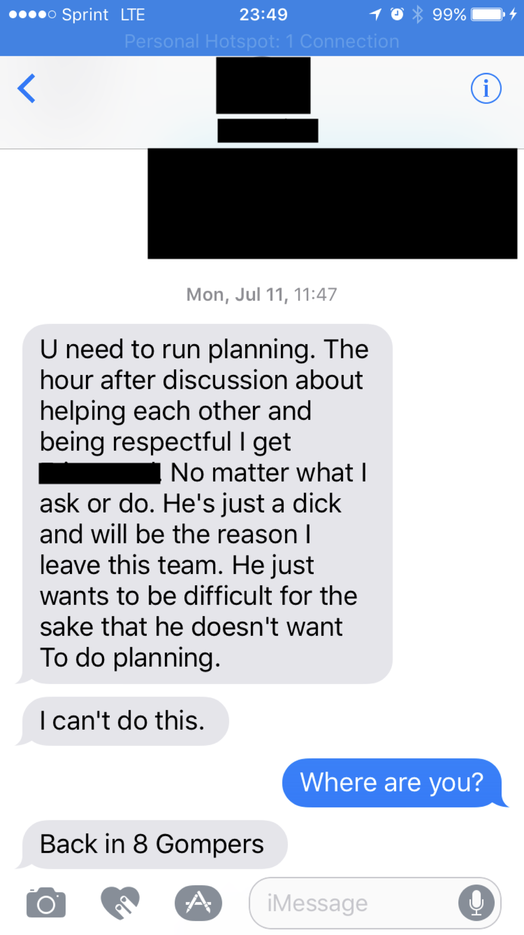
Notes:
U need to run planning. The hour after discussion about helping each other and being respectful I get <redacted>. No matter what I ask or do. He just a dick and will be the reason I leave this team. He just wants to be difficult for the sake that he doesn’t want to do planning.
I can’t do this.

Slide 5
Who am I?
Married for 26 years
Father to 2 adult children
Son/Brother
Caretaker of three cats
Developer with almost 30 years professional experience
Principal Consultant at Improving

Slide 6

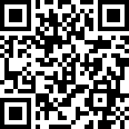
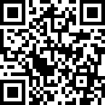
Improving
Improving is a modern digital services company that offers IT consulting, software development, and agile training across the globe. Our innovative solutions have helped thousands of our clients realize their tactical and strategic business objectives, allowing them to achieve great new heights in a competitive and ever-changing market.
Improving’s website https://improving.com
Improving Careers and Open Positions https://improving.com/careers
Improving Training and Upcoming Classes https://improving.com/services/training/

Slide 7
Goals of this session
Tell
you about my journey in moving from an individual contributor role to a people leader (and back again a couple times)
Talk about
my reasons for becoming a leader and for moving between the roles over time
Give
you an idea of the challenges I’ve experienced and how I’ve overcome some of them

Slide 8
A story (continued)

Slide 9
What is a leader?

Slide 10
Questions
How many of you are people leaders?
How many have been people leaders and gone back to being an IC?
How many of you think you will, at some point, become people leaders?

Slide 11
Manager != leader

Slide 12
Leadership (and leadership)
Everyone can be a leader, but not everyone needs to be a people leader
Not every manager is a leader, and not every leader is a manager

Slide 13
My Journey
2000
Tech Lead / Project Director
2007
Tech Lead
2016–2018
Team Leader
2018–2019
Director of Engineering
2019–2020
Back to being an IC
2020–2021
Principal Analyst leading offshore team
2022
Current - Principal Consultant with direct reports
1995-2000
Just a developer
2021
Principal -> Dev Manager

Slide 14
My Journey
2016–2018
Team Leader
2018–2019
Director of Engineering
2019–2020
Back to being an IC
2020–2021
Principal Analyst leading offshore team
2022
Current - Principal Consultant with direct reports
2021
Principal -> Dev Manager

Slide 15
Why leadership?

Slide 16
More questions for the audience

Slide 17
My journey, part 2

Slide 18
Major lessons learned

Slide 19
Key Takeaways
Leadership is challenging and extremely satisfying
Title does not make you a leader / everyone can be a leader
People are hard
Know your why

Slide 20
Questions?

Slide 21
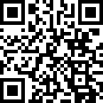
Contact info
Mjeaton everywhere – shortcut: https://samestuffdifferentday.net/about
Work email: michael.eaton@improving.com
Personal email: mjeaton@gmail.com

