Slide 1

Simplify your XAML Applications with Caliburn.Micro
Michael Eaton
Validus Solutions, LLC.
@mjeaton

Slide 2
about.me/mjeaton

Slide 3
Caliburn.Micro

Slide 4
The Code-Behind
The Code-Behind is evil
The Code-Behind is not testable
The Code-Behind is not maintainable

Slide 5
Overview of MVVM Pattern

Slide 6
Overview of Caliburn.Micro
What is it?
History

Slide 7
Other MVVM Frameworks?
MVVM Light
Cinch

Slide 8
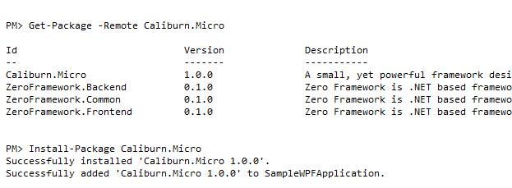
Installing Caliburn.Micro
Using NuGet

Slide 9
Convention Over Configuration

Slide 10
Bootstrapper

Slide 11
Views

Slide 12
ViewModels

Slide 13
Testing

Slide 14
Resources
MVVM on Wikipedia
http://en.wikipedia.org/wiki/Model_View_ViewModel
Rob Eisenburg’s MIX10 MVVM Talk
http://bit.ly/gk4Uft
The Caliburn.Micro Project
http://caliburnmicro.codeplex.com/

Slide 15
about.me/mjeaton

