Slide 1
You're a developer with years of experience creating amazing web or WinForms applications, but you've just been assigned to a *gasp* WPF or Silverlight (or WP7) project! Because you're an expert developer, you're expected to love this new technology and be productive from day 1. You click File | New | WPF (or Silverlight) project and feel completely lost as you open the XAML files. Not only that, but you have to contend with new patterns like MVVM! Trust me, it's not as bad as it appears and XAML is NOT as hard as you think. This hands-on workshop will cover the things you need to know to be successful on your first XAML-based project.
Attendees can expect an all-day dive into the following XAML concepts:
Overview of XAML
Layouts
Controls
Databinding
Styling
Templating
Patterns such as MVVM
And More
There will be a lot to cover in 8 hours and the day will get progressively more advanced as we move through more topics.

Slide 2

XAML: Deep Dive
CodepaLOUsa
April 25th – 27th, 2013
Michael Eaton
@mjeaton

Slide 3


Slide 4


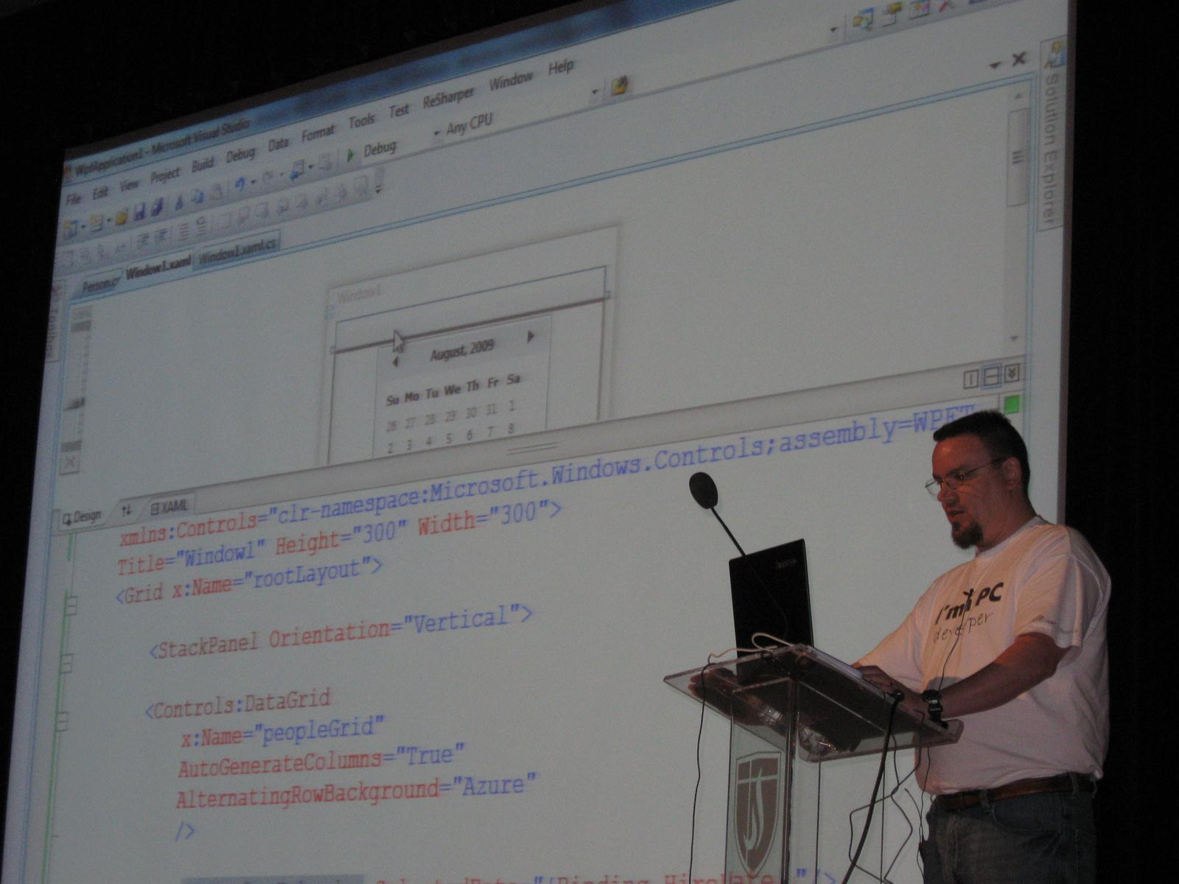
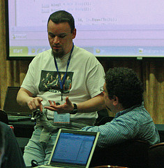

Slide 5


Insiders Program
Born in 2010: Telerik noticed a strong need for community speakers
21 total speakers (as of 2012) (May grow in time)
Independent speakers providing quality sessions
Speaker criteria:
Expertise and talents
Geographical region
Honest enthusiasm for Telerik
Benefits:
Financial support for travel & swag for sessions
Supportive network of Telerik team
Work with product teams and beta test products
Locations: Europe, North America & India
More Info: www.telerik.com/community/insiders/insiders-faq.aspx

Slide 6



Telerik Community Programs
Community Activity
www.telerik.com/community
Insiders Speaker Program
www.telerik.com/community/insiders
MVP Program
www.telerik.com/community/mvp-program

Slide 7





Telerik Online Resources
Earn Points towards your next purchase:
www.telerik.com/telerik-points
facebook.com/telerik
Check out the latest from Telerik blogs: blogs.telerik.com
@telerik
Join the community forums:
www.telerik.com/community/forums

Slide 8
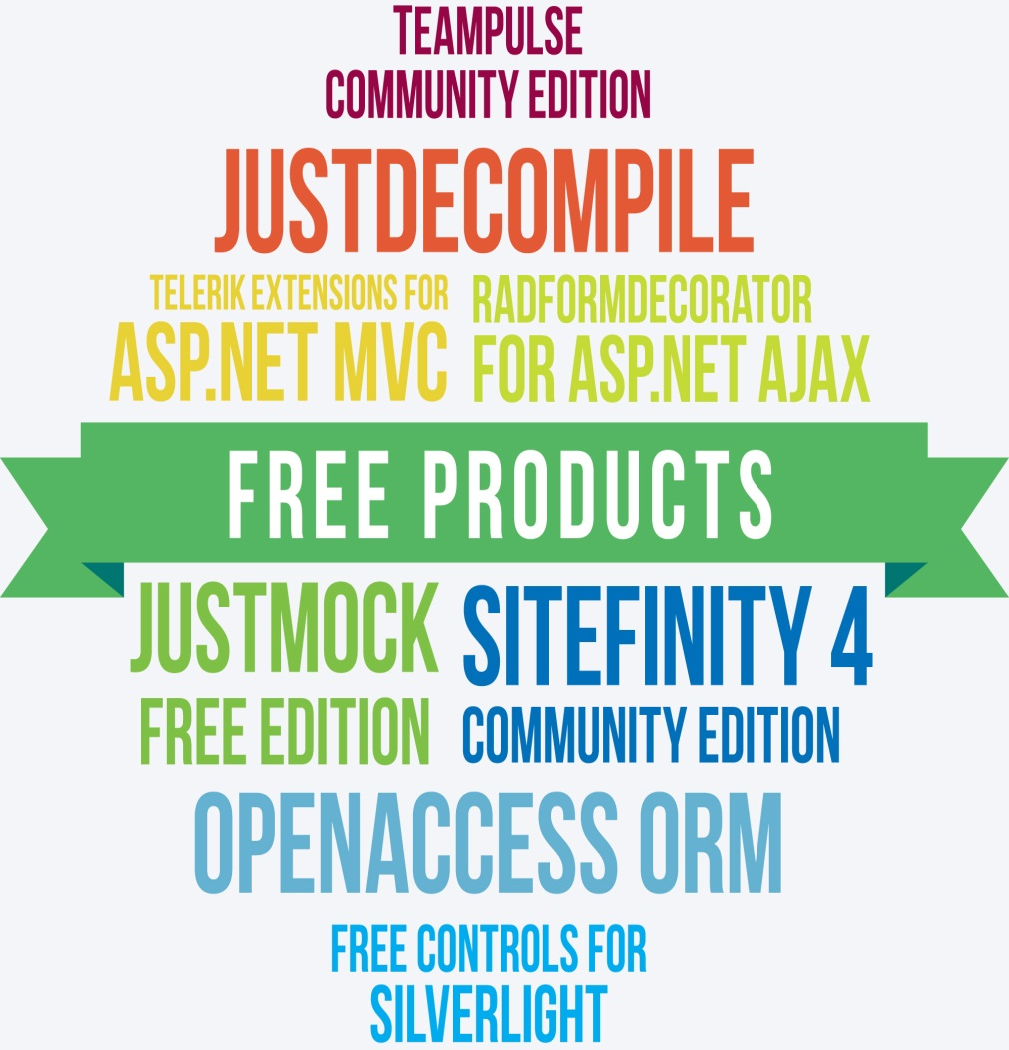
Telerik offers a variety of FREE products!
www.telerik.com/community/free-products

Slide 9

"In a time where organizers are censoring speakers and their content, @mjeaton and @kalamazoox is a bastion of freedom. He is a luminary." "@mjeaton @kalamazoox believes in the open exchange of ideas, however uncomfortable, and trusts humans to think, collaborate and create."
"#kalx12 is like an All Star team of speakers. Every single one would have been the best talk at every other conference." "I've discovered @kalamazoox is a hidden gem. Today was like a braver, more profane set of dev-oriented TED talks. Lots of passion and humor."

Slide 10
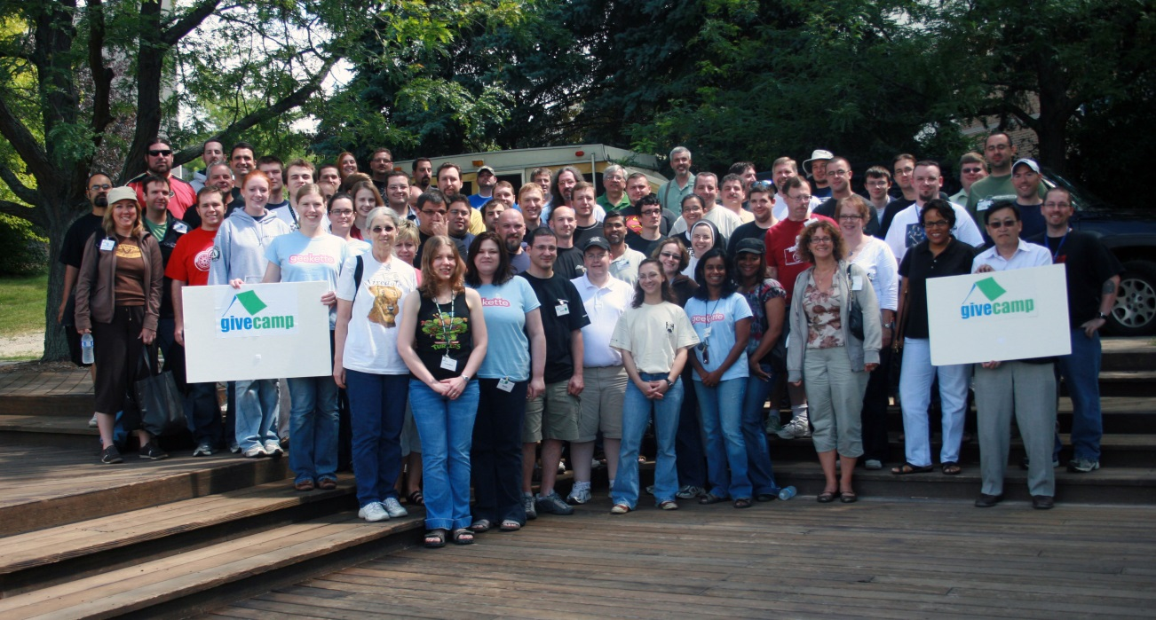



Slide 11
@mjeaton

Slide 12
Schedule
9:00 – 10:30 | Workshop
10:30 – 10:45 | Break #1
10:45 – 12:30 | Workshop
12:30 – 1:30 | Lunch
1:30 – 3:15 | Workshop
3:15 – 3:30 | Break #2
3:30 – 5:00 | Workshop

Slide 13
Agenda
Introduction / logistics
Overview of XAML
Layouts
Controls
Databinding
MVVM
Styling and Templating

Slide 14
This workshop will be
Focused on the here and now, mostly in the context of WPF, but also Silverlight and WP7

Slide 15
This workshop will NOT be
Doing Windows 8, other than a discussion on how XAML fits into the Windows 8 development world
Phil Japikse and Jesse Liberty are doing the Windows 8 workshop right now!

Slide 16
You should have
Visual Studio 2012 or Visual Studio 2010 installed and running!

Slide 17
XAML: Why should I care?

Slide 18
WPF
WPF, a component of Microsoft .NET Framework 4, empowers you to build the next-generation of Windows user experiences. WPF supports UI, media, documents, hardware acceleration, vector graphics, scalability to different form factors, integration with Windows, interactive data visualization, and superior content readability.
Notes:
Silverlight is a free plug-in powered by the .NET framework that is compatible across multiple browsers, devices and operating systems to bring a new level of interactivity wherever the Web works. With support for advanced data integration, multithreading, HD video using IIS Smooth Streaming, and built in content protection, Silverlight enables online and offline applications for a broad range of business and consumer scenarios.

Slide 19
Silverlight
Silverlight is a free plug-in powered by the .NET framework that is compatible across multiple browsers, devices and operating systems to bring a new level of interactivity wherever the Web works. With support for advanced data integration, multithreading, HD video using IIS Smooth Streaming, and built in content protection, Silverlight enables online and offline applications for a broad range of business and consumer scenarios.

Slide 20
Windows Phone 7

Slide 21
Windows 8 Metro Apps
XAML + C#/C++/VB.NET + WinRT

Slide 22
XAML is…
A declarative markup language
Based on XML
Used to initialize structured values and objects
Used extensively in
WPF
Silverlight
Windows Workflow
Windows 8

Slide 23
Tools for writing XAML
Visual Studio
Expression Blend
XAMLPad
Free. Ships with the .NET Framework
#Develop
KaXAML

Slide 24
In WPF (and Silverlight), XAML is…
Used as the UI markup language to define
UI elements
Data binding
Other features
Elements map directly to CLR object instances
Attributes map to properties and events on those objects

Slide 25
Anatomy of a XAML file
<Window | Page | UserControl
xmlns="http://schemas.microsoft.com/winfx/2006/xaml/presentation" xmlns:x="http://schemas.microsoft.com/winfx/2006/xaml"
>
<!– Stuff goes here →
</Window | Page | UserControl>

Slide 26
XAML Tags
<Button>This is a button</Button>
<Button Content=“This is a button”></Button>
<Button Content=“This is a button”/>

Slide 27
XAML Tags
For readability, when dealing with long pieces of XAML, place each attribute on a separate line:
<Button
Content="This is a button"
Background="Blue"
Foreground="White"
Height="35"
Width="100"
/>

Slide 29
Did you know?
Anything you can do in XAML, you can do in code
var b = new Button();
b.Content = “hello, world”;
b.Click += clickedEvent;
is the same as
<Button Content=“hello, world” Click=“clickedEvent”/>

Slide 30
Layouts
Goals
Learn the methods for laying out your apps

Slide 31
Controls
Content
Text
List

Slide 32
Databinding
Notes:
Binding
Targets
- property on a framework object such as Text on a TextBox
{Binding} is a markup extension
- causes a Binding object to be created
- Path, Xpath, Source, Mode
- Mode = OneWay, TwoWay, OneWayToSource (don’t read the source, but update it with whatever the user types in), OneTime (don’t expect source to change)
DataContext
DataTemplates

Slide 33
MVVM

Slide 34
Styles and Control Templates
Notes:
Lookless controls
ControlTemplates
TemplateBinding
Triggers
ContentControl
ItemsControl

Slide 35
Data Templates

Slide 36
Contact Info
Email: mjeaton@validussolutions.com
Blog: http://mjeaton.net/blog
Twitter: @mjeaton
LinkedIn: http://www.linkedin.com/in/mjeaton

